Slide 1
Online Electricity Bill Payment (OEBP)

Slide 2
Problem Statement
In the ancient times, people used to pay their Electricity Bills by going at the Electricity Bill Payment Centre and then standing in the long queues for long hours and wasting their valuable time. Hence, now the System has changed completely according to the change in the modern technology and then the Online Electricity Billing came.
The project is about instant Online Electricity Bill Payment via Wallet payment system.

Slide 3
Paying electricity bills online usually requires you to physically go to an outlet and stand in long queues to clear the payment. Well not anymore! OEBP is your one-stop destination for all of your bill payment requirements, with no extra charges.
OEBP provides you with a trusted online wallet that can make your online electricity bill payments as easy as you want them to be.
So, gone are the days where standing in crowded queues at bill outlets to clear your electricity bill was the only way out of such situations, as OEBP enables you to pay bills securely in the comfort of your home!

Slide 4
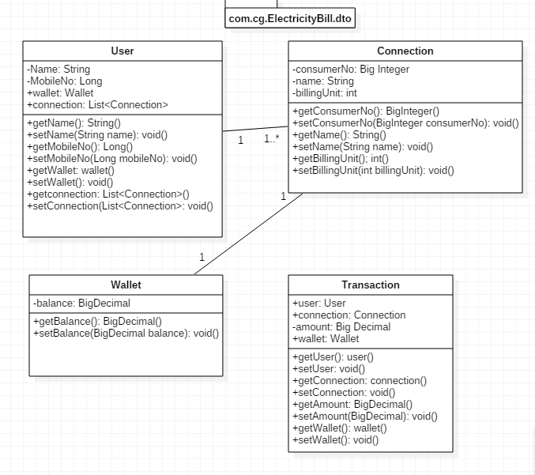
PoJo Classes

Slide 5
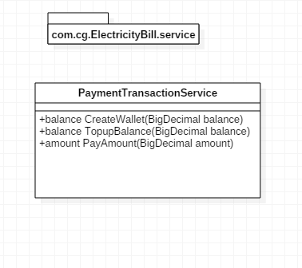
Service Classes

Slide 6
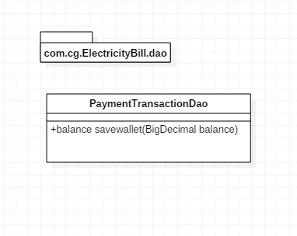
Repository

Slide 7
Thank You…

