Slide 1



UrbanClap Expert Services, Anytime, Anywhere
Tariq Shaikh – A28
Muhammed Pehlari – A46
Faiz Saiyed – A55
Jawwad Shaikh – A60

Slide 2

Introduction
UrbanClap connects customers with service professionals.
Offers services like beauty, cleaning, and repairs.
Redefining home services with tech and trust.
2

Slide 3
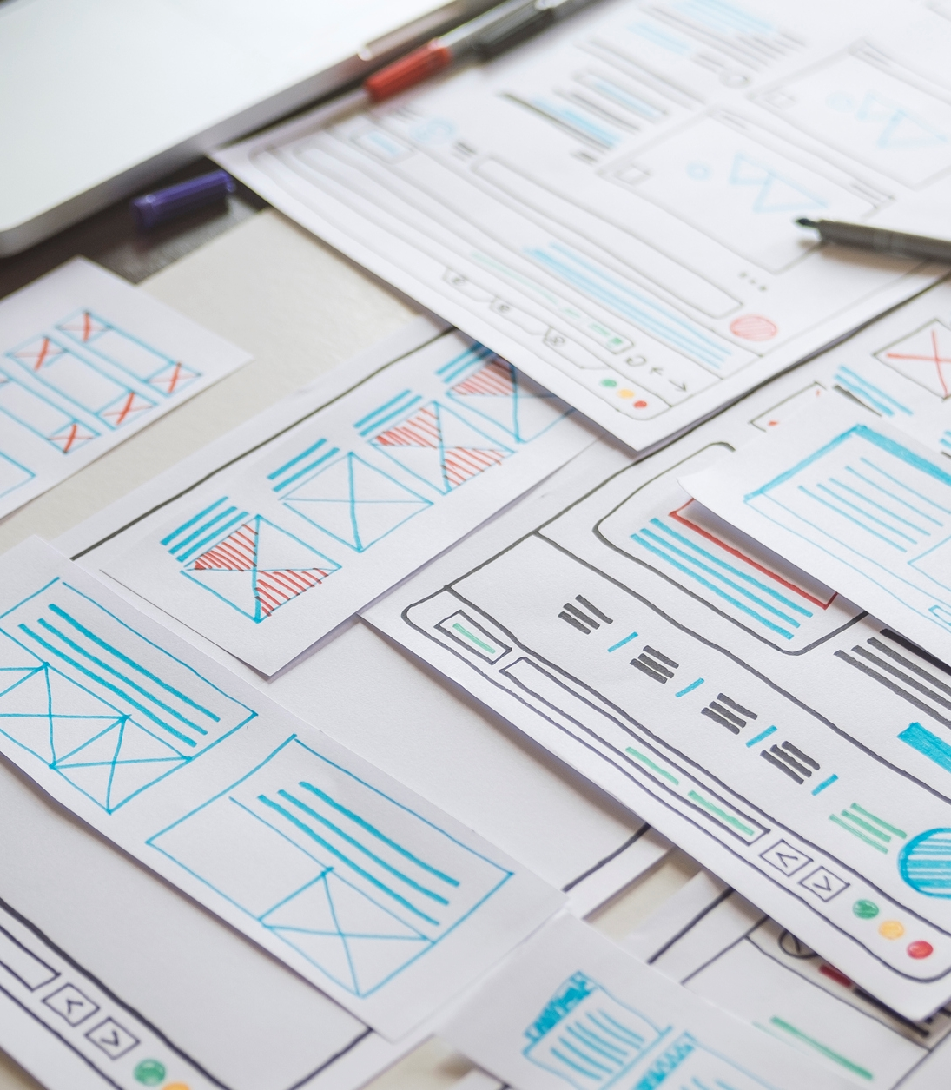
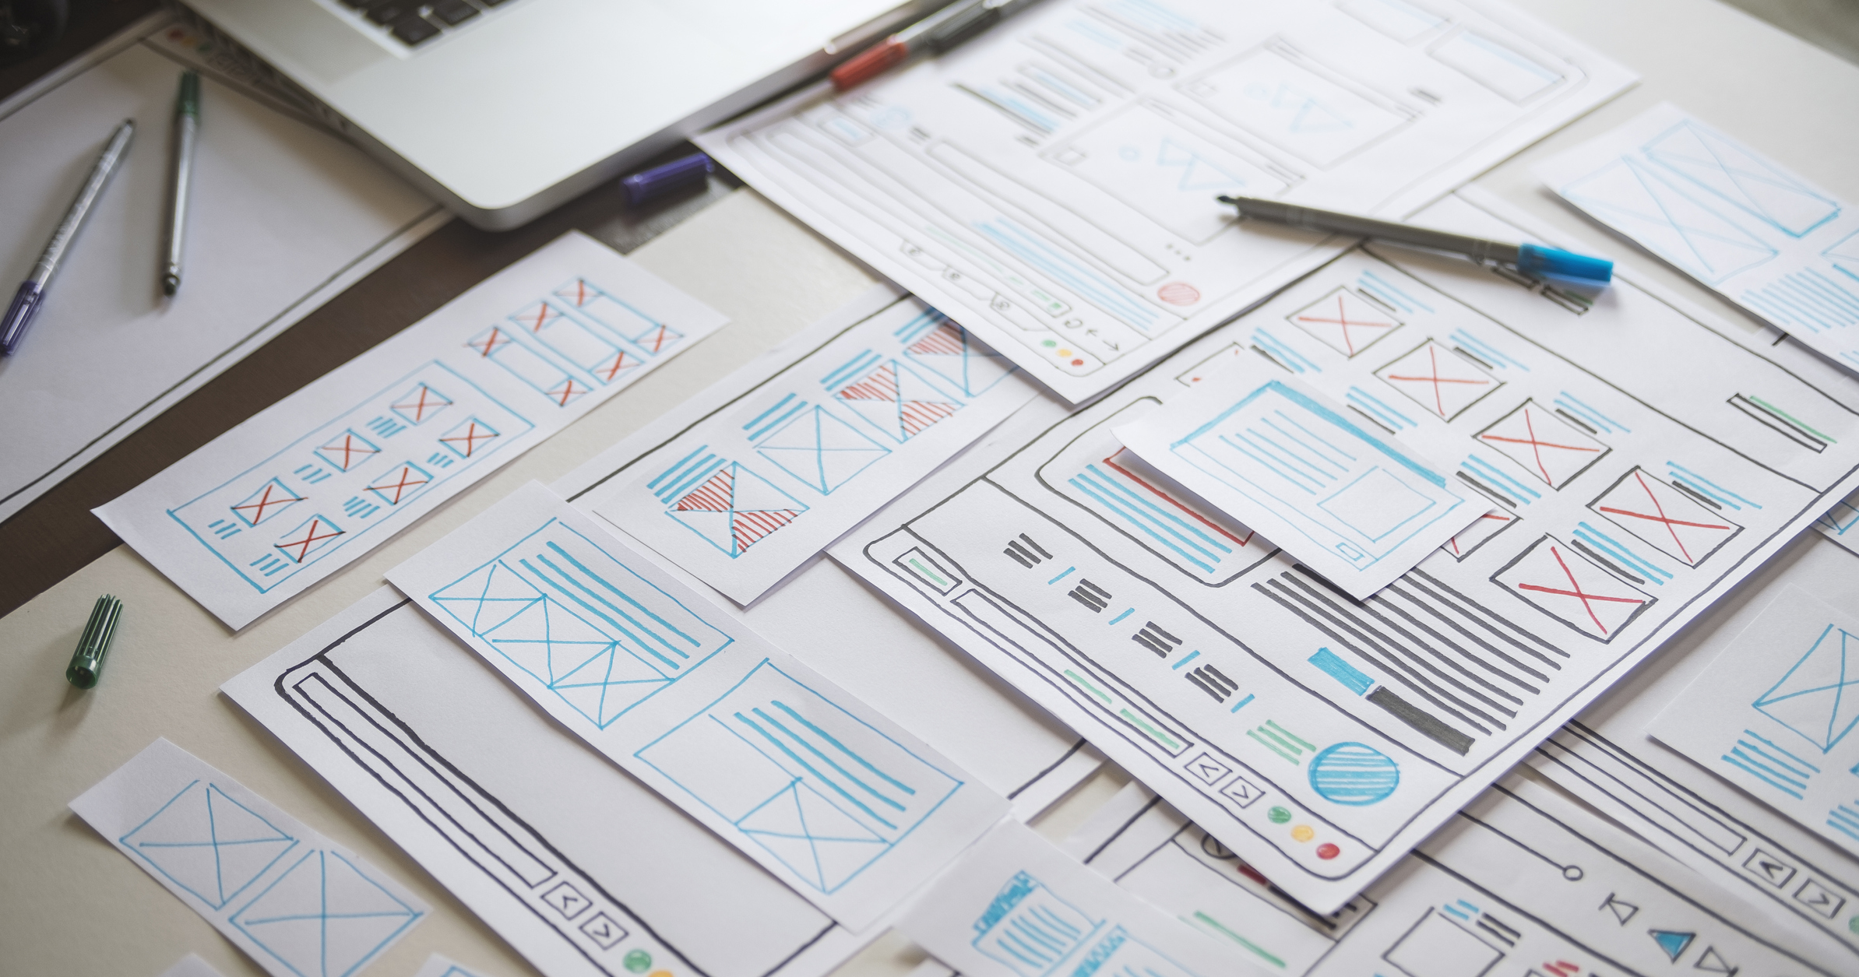
Existing system is partly manual.
Problems: No feedback, no service history, no provider verification.
Rising demand for reliable home services.
Project Background
UrbanClap - Expert Services, Anytime, Anywhere

Slide 4
Project Objectives
- Verify providers for safety.
- Enable feedback & ratings.
- Track service history.
- Build platform reputation.
4

Slide 5
In Scope:
- Service provider verification
- Booking, feedback, history tracking
- Admin, customer, and provider interfaces
Out of Scope:
- International expansion
- Physical service logistics
Project Scope
UrbanClap - Expert Services, Anytime, Anywhere

Slide 6
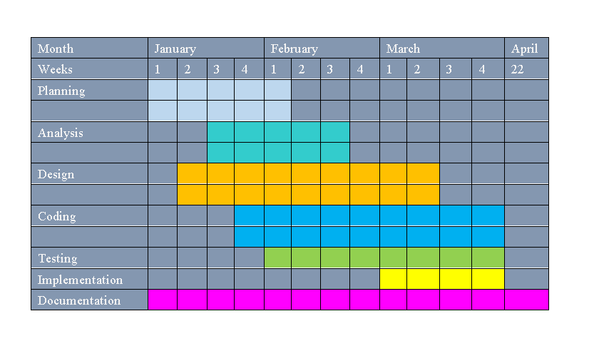
Project Timeline
6

Slide 7

Project Deliverables
- Service booking website
- Admin dashboard
- Verified provider profiles
- Feedback & history system
- Complete documentation
7
UrbanClap - Expert Services, Anytime, Anywhere

Slide 8
Project Methodology
Agile with sprints
Tools: Django, Tailwind CSS, Flowbite
Daily stand-ups, sprint reviews
Docs via Word, Excel, SmartSheet
8
UrbanClap - Expert Services, Anytime, Anywhere

Slide 9

Project Team
Tariq Shaikh: Frontend & UI
Muhammed Pehlari: Documentation & Data
Faiz Saiyed: Documentation & Tables, Diagrams
Jawwad Shaikh: Backend & UI
9
UrbanClap - Expert Services, Anytime, Anywhere

Slide 10
Project Risks & Mitigation
Internet dependence: Consider offline fallback
Non-tech users: Intuitive UI
Scalability: Cloud infrastructure
Third-party failures: Redundancies
10
UrbanClap - Expert Services, Anytime, Anywhere

Slide 11
Project Status
Core website: Complete
Admin & user interfaces: Done
Provider portal: In Progress
Remaining: Testing & enhancements
11
UrbanClap - Expert Services, Anytime, Anywhere

Slide 12
Next Steps
Complete modules by Apr 10
Final testing & deployment
Post-launch monitoring
Mobile app development
12
UrbanClap - Expert Services, Anytime, Anywhere

Slide 13
Conclusion
UrbanClap improves trust, transparency, and tech.
Solves existing issues with feedback and verification.
Agile development ensured effective delivery.
13
UrbanClap - Expert Services, Anytime, Anywhere

Slide 14


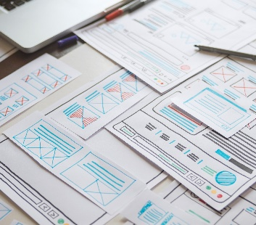

Thank you
Tariq Shaikh
Muhammed Pehlari
Faiz Saiyed
Jawwad Shaikh

