Slide 1
Dynamic Fare Calculation - Mohd Rayyan Shaikh

Slide 2

What is ?
- Deutschline is a web application specifically designed to calculate dynamic fare for passengers between stations.
- Based on various factors such as date, timing, ticket class and seat demand, Deutschline provides passengers with fare prices.
- With collection of fare rules followed, it makes sure that the fare which is calculated is precise and fair.
- Deutschline, simplifies booking of tickets to ease the journey of passenger.

Slide 3
How it is Modelled?

Slide 4

Backend Python & Flask
Frontend HTML, CSS & JS
To develop the user interface and interactivity for journey searches and booking interactions.
Database MongoDB & Neo4j
To develop the backend logic of the system, handling HTTP requests, processing data, and generating responses.
MongoDB handling bookings data and Neo4j storing information about stations and train connections.

Slide 5
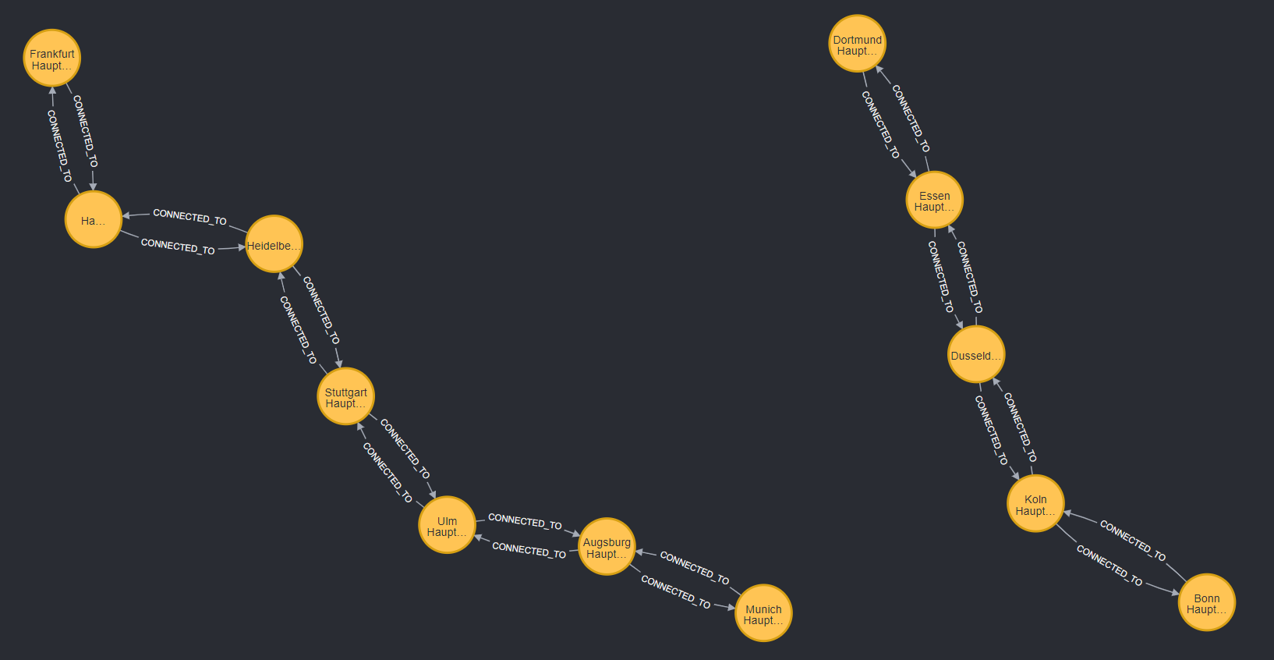
Neo4j Routes:

Slide 6
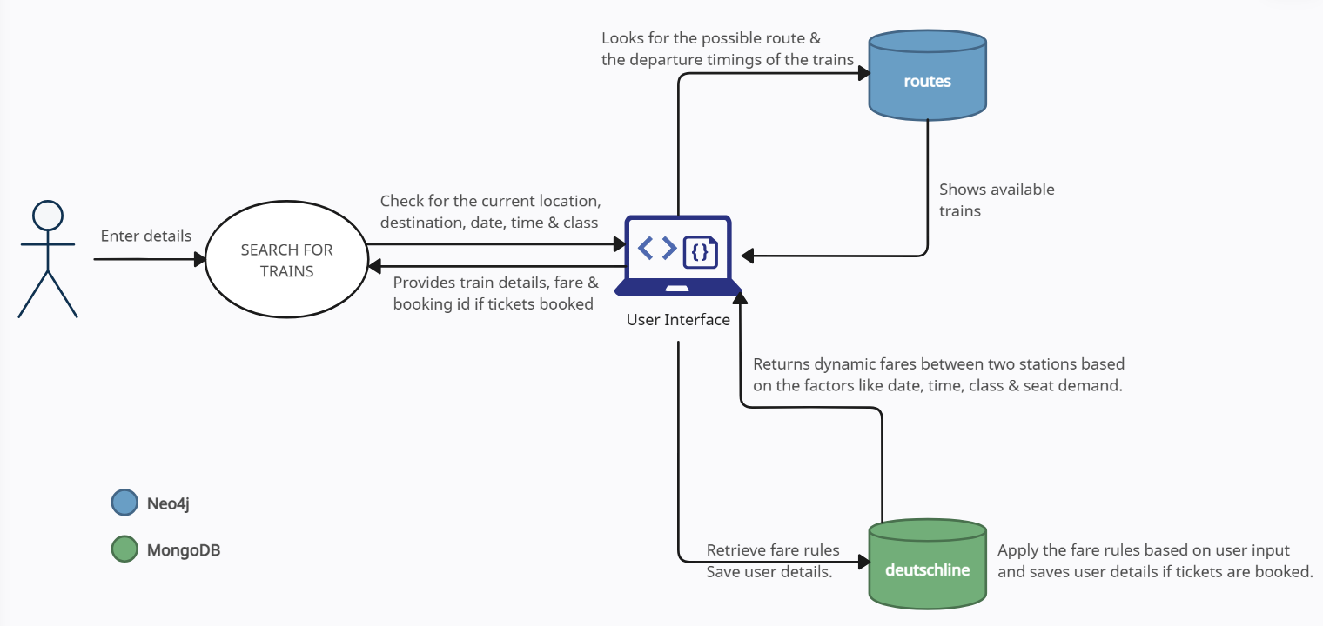
Data Flow:

Slide 7
Thanks for your attention. Danke für Ihre Aufmerksamkeit.

