Slide 1
Prediction challenge 1
By Sahal Shaikh

Slide 2
What does the model do?
It predicts the grades based on professor Moody’s grading pattern.
The training data contains the StudentID, Scores, Asks_Questions, Leaves Early, and Participation.
The model gets trained by training and learn the grading pattern of professor Moody, and predict the grades of testing file.

Slide 3
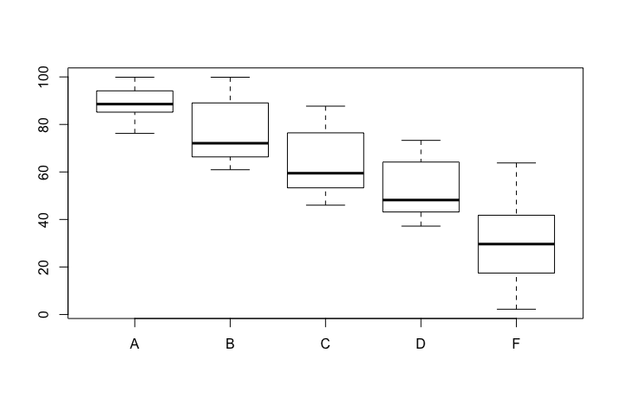
Approach
Plot the graph of score and grades
Took the subset of overlapping areas
Determined which condition satisfies what grade
Figured out rules based of those conditions

Slide 4
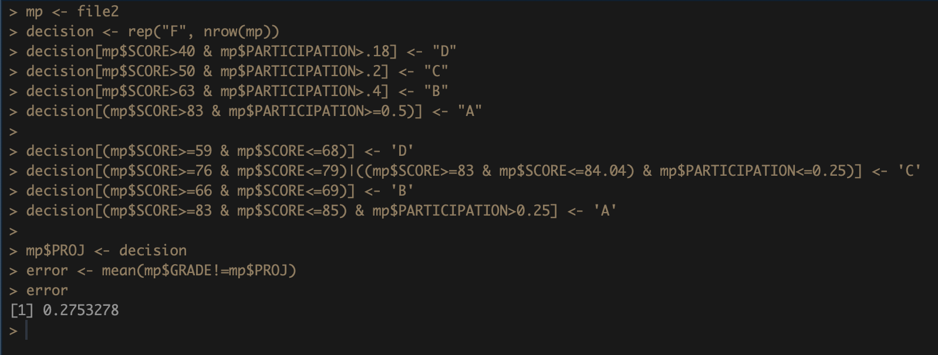
Rules and error

