Slide 1
Prediction challenge 2
BY SAHAL SHAIKH

Slide 2
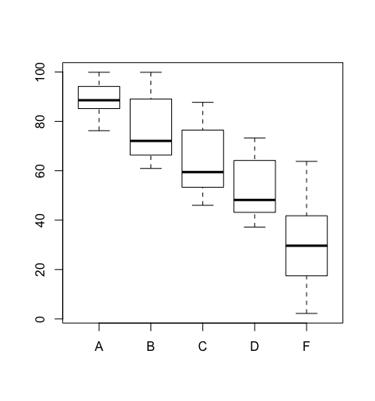
PURPOSE
Create a best prediction model
Use the best model to predict grades based on professor Moody’s grading system from the training dataset.
Used ” rpart ” library to create a model.
Used “ rpart.plot “ library to create a decision tree.

Slide 3
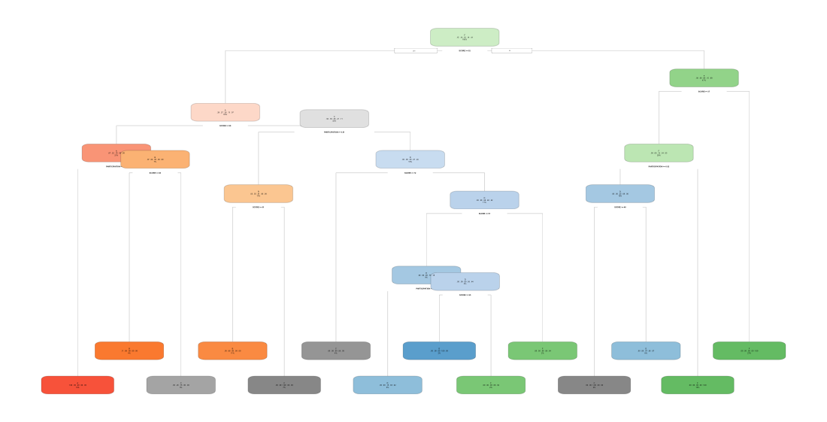
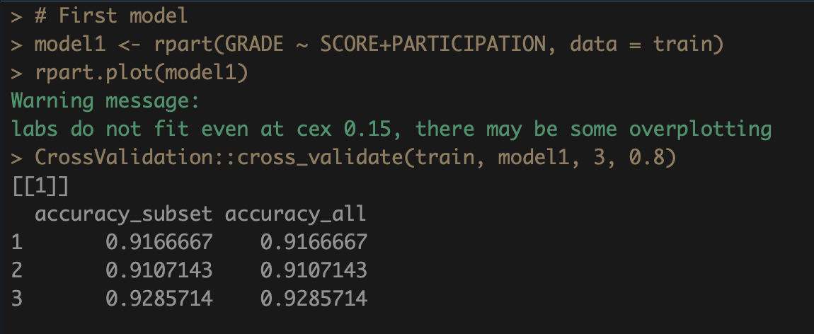
Model and cross-validation
This model uses score and participation attribute to make a prediction model.
Very good accuracy.

Slide 4
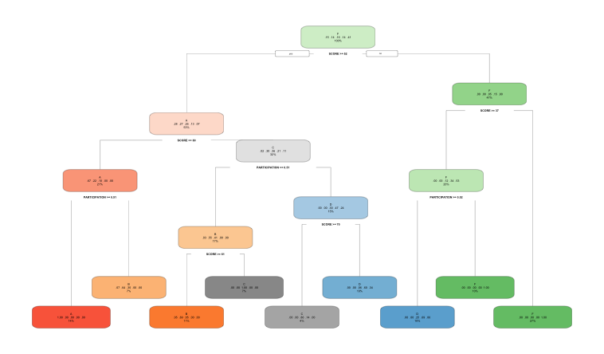
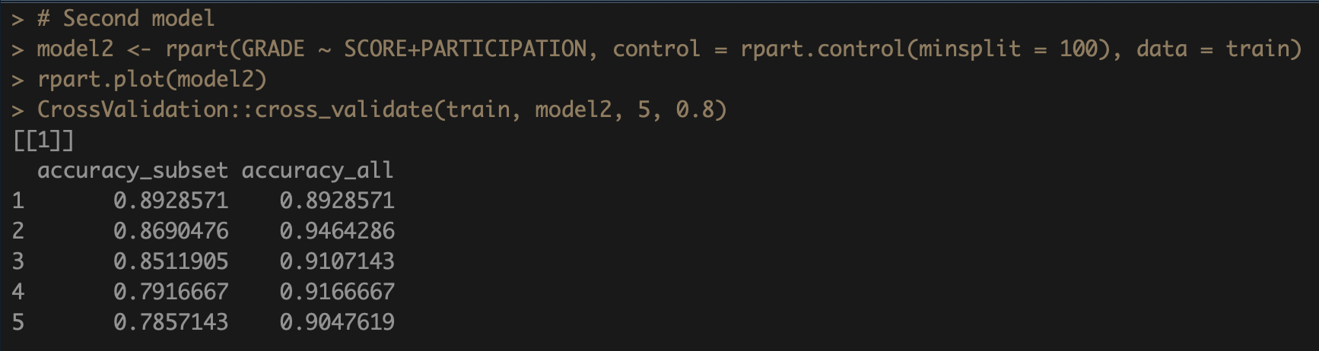
Model and cross-validation
This model uses the score and participation with minsplit of 100.
Accuracy is getting little bit off compering to previous model.

Slide 5
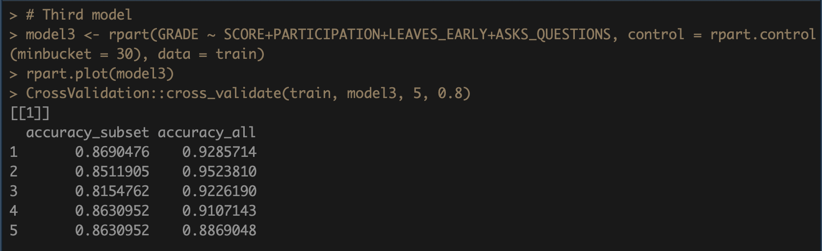
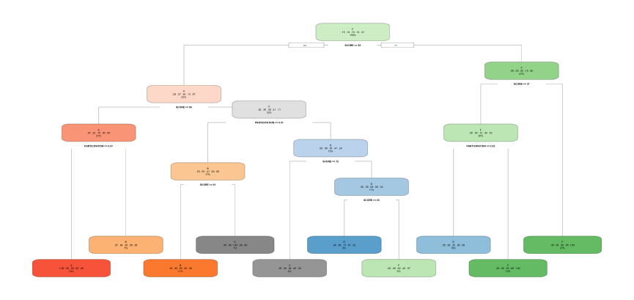
Model and cross validation
This model uses all attributes with the minbucket of 30.
Accuracy is decreasing comparing to previous models.

Slide 6
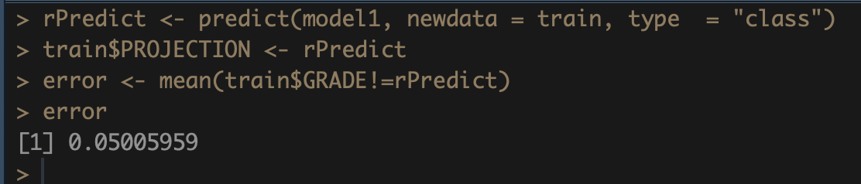
Best model and error
As we can conclude that model1 is is the best.
According to the cross-validation, we found that model1 is the most accurate than other models.
By predicting with this model, we get an error of 5%
Which means it is 95% accurate on the training dataset.

