Slide 1
Prediction challenge 4
By Sahal Shaikh

Slide 2
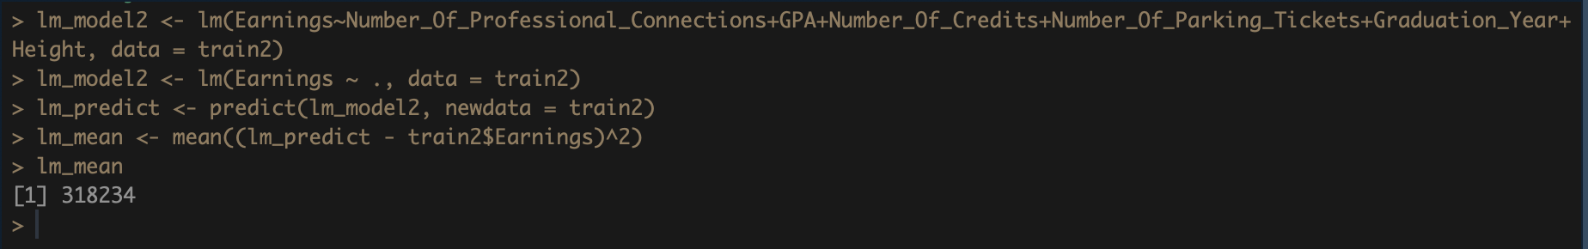
Model – Regression
This model has MSE of 318234
High !

Slide 3
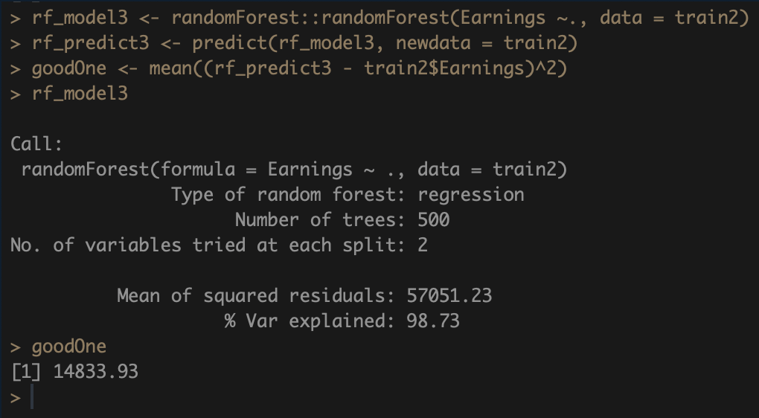
Model – random forest (default)
Mean Squared Error of this model is 14833.93
Better than last one!

Slide 4
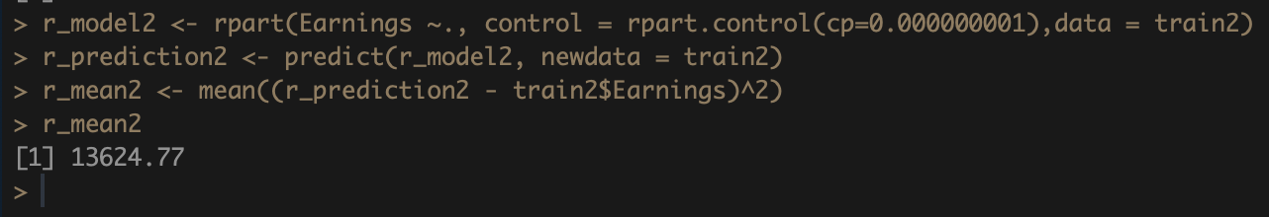
Model - rpart
rPart model gives an error of 13624.77
This is also the good one!

Slide 5
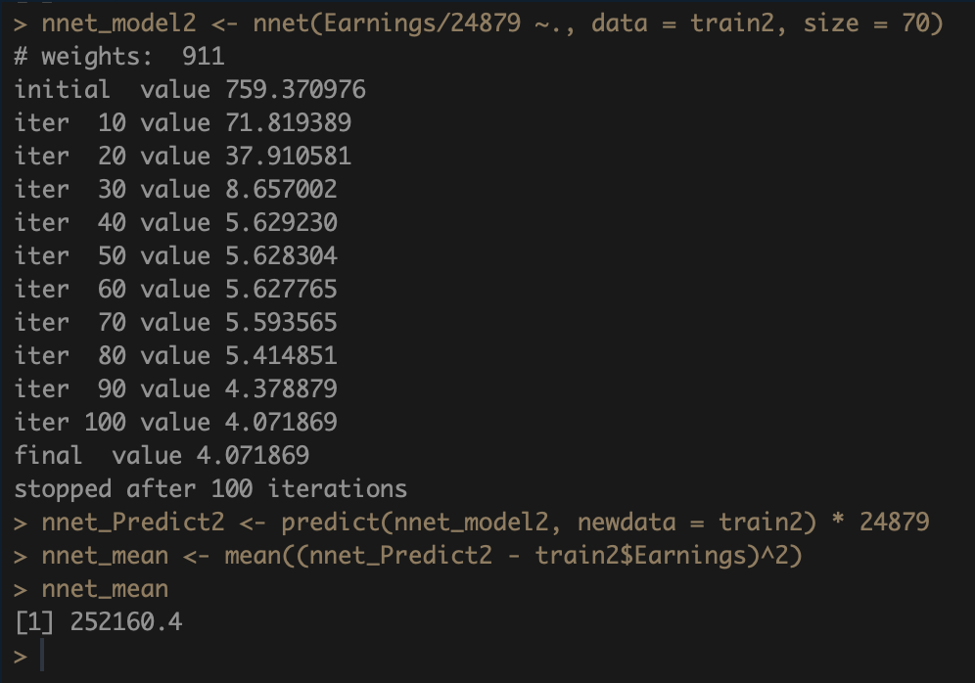
Model – Neural networks
This model gives the MSE of 252160.4
Not good as previous two!

Slide 6
decision
We can conclude that Regression Model and Neural Networks Model has higher Mean Squared Error than Random Forest Model and rPart Model.
It gives the basic idea that which model we can use to get more lower Mean Squared Error.
Try adding more parameters and making new attributes.

Slide 7
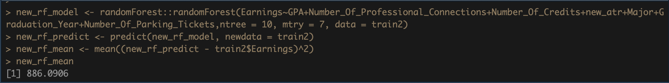
Final model
Made a new attribute
Added a new parameters to the model such as ntree and mtry
Mean Squared Error is 886.0906
A Lot better than previous models.

Slide 8
Thank you

