Slide 1
Prediction challenge 5
By Sahal Shaikh

Slide 2
Data
The data contains four attributes
Duration
Activity
Revenue
Source
Predict Revenue based on Duration, Activity, and Source

Slide 3
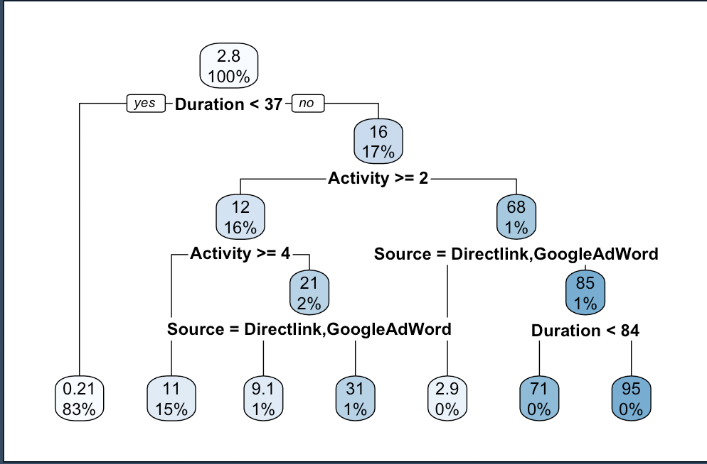
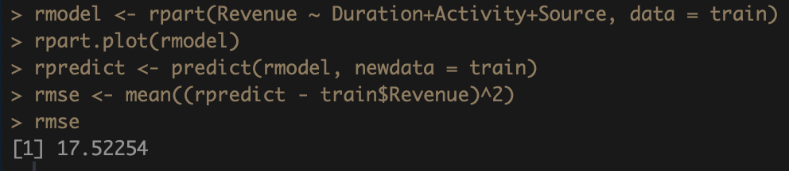
Model 1:-- rpart
By plotting this model gives the basic idea which attributes are important through the decision tree.
This model gives the Mean Square Error of 17.52

Slide 4
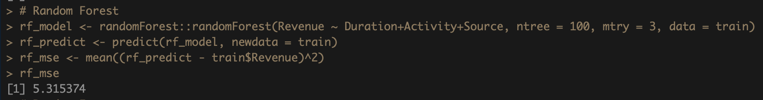
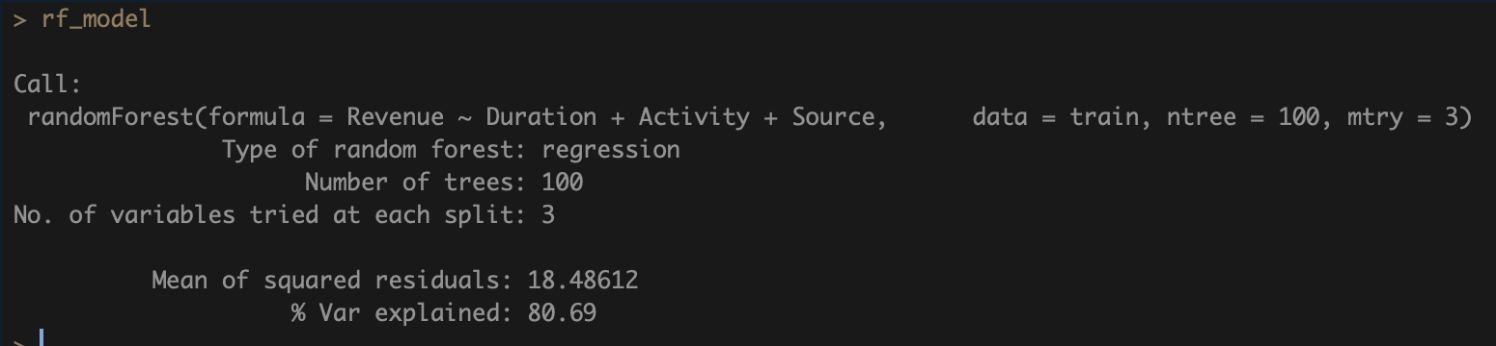
Model 2 :- Random forest
This model uses two new parameters (ntree & mtry)
It gives the Mean Square Error of 5.31

Slide 5
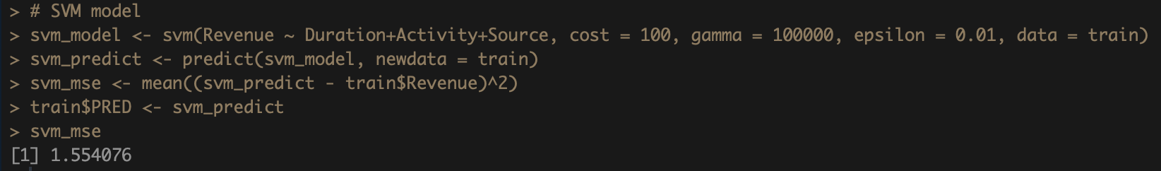
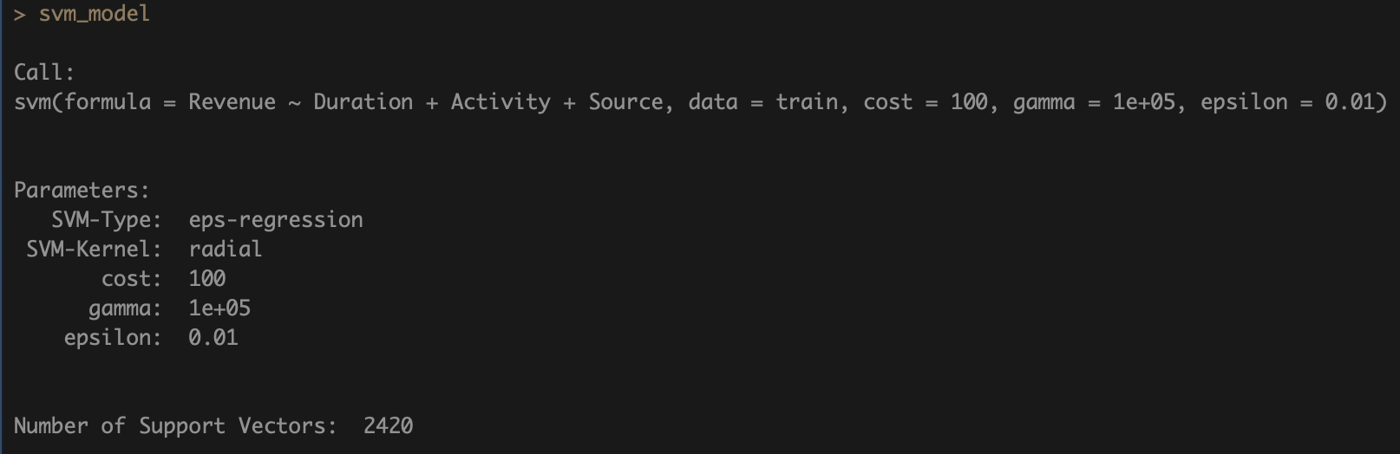
Model 3 :- svm
This model uses new parameters (cost, gamma, and epsilon)
It gives the Mean Square Error of 1.55

Slide 6
Conclusion
As we can see that out of three models, SVM_MODEL is the best one with the lowest Mean Squared Error on train data.
I have made two submissions on kaggle.
SVM model gave me high error on Kaggle, so I made another submition with RANDOM FOREST MODEL
Which gave me way lower MSE on Kaggle (test data)

Slide 7
Thank you!

