Slide 1
SQL Sales Data Cleaning Project
Objective: To clean and standardize raw sales data for accurate analysis and reporting.
Tools Used: SQL
Dataset: Raw sales dataset containing inconsistent formats, missing values, and data quality issues.
Key Tasks Performed:
Removed extra spaces and special characters
Handled missing (NULL) values
Standardized date and status formats
Cleaned currency values and converted to numeric
Validated data for accuracy

Slide 2
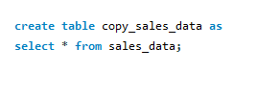
Question 1 :
How to create a backup copy of the original dataset before performing data cleaning?
Created a backup table to keep original data safe before starting data cleaning.

Slide 3
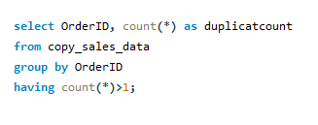

Question 2 :
Are there any duplicate Order IDs in the dataset?
There are no duplicate Order ID in given dataset.

Slide 4
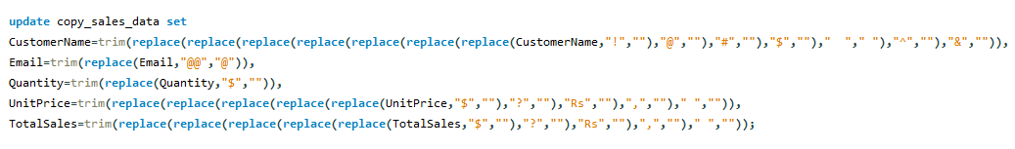
Question 3 :
How to remove “Extra spaces” and “special characters” from Data?

Slide 5
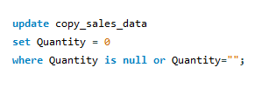
Question 4 :
How to handle missing values in Quantity column?

Slide 6
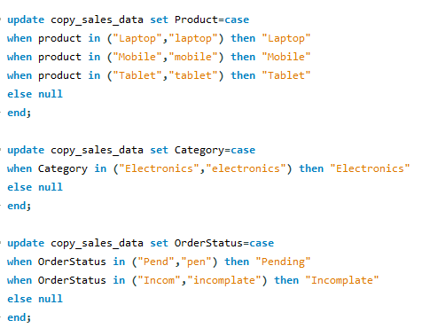


Question 5 :
How to standardize inconsistent Order Status, Category, Product values?
Before
After

Slide 7
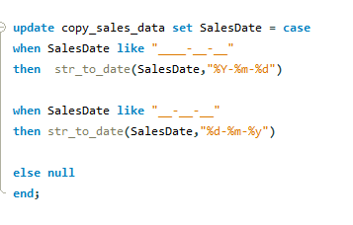


Question 6 :
How to standardize “Sales Date” into proper date format?
Before
After

Slide 8
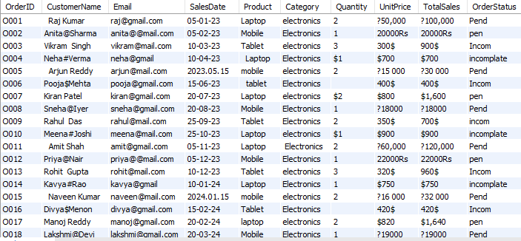
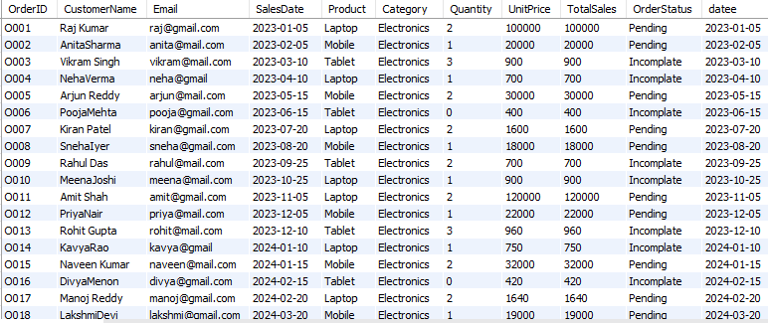
Before vs After Data Cleaning
Before Cleaning
After Cleaning
Note: Data cleaning improved consistency, removed errors, and standardized formats for accurate analysis.

Slide 9
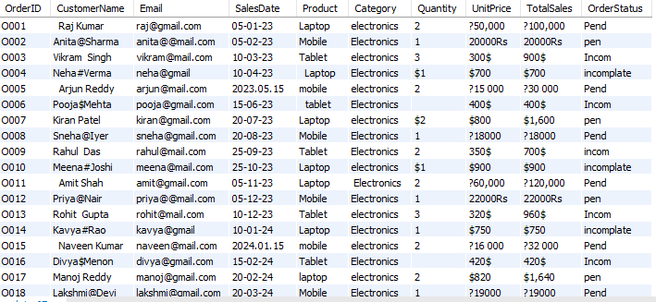
Before data Cleaning

Slide 10
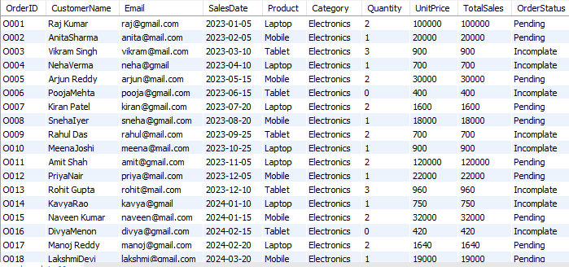
After Data Cleaning

