Slide 1

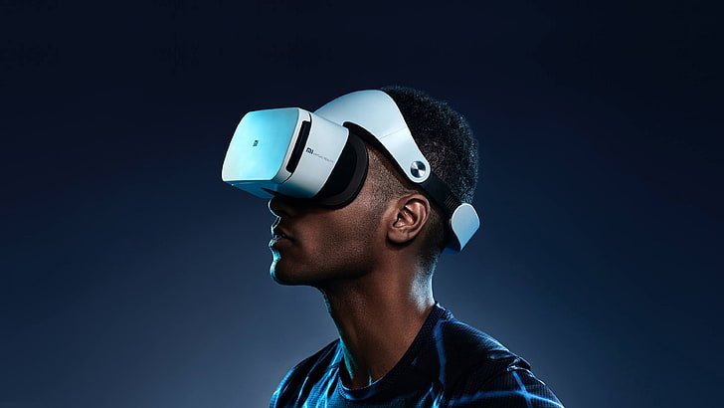
VR TOURISM
START
SHAIKH ZAITH R
SULTHAN NIFAN S

Slide 2

VR TOURISM
INTRODUCTION
A virtual tour is a simulation of an location, usually composed of a 3D rendered models. It may also use other multimedia elements such as sound effects, music, narration, text and floor map. It is distinguished from the use of live television to affect tele-tourism.
NEXT

Slide 3
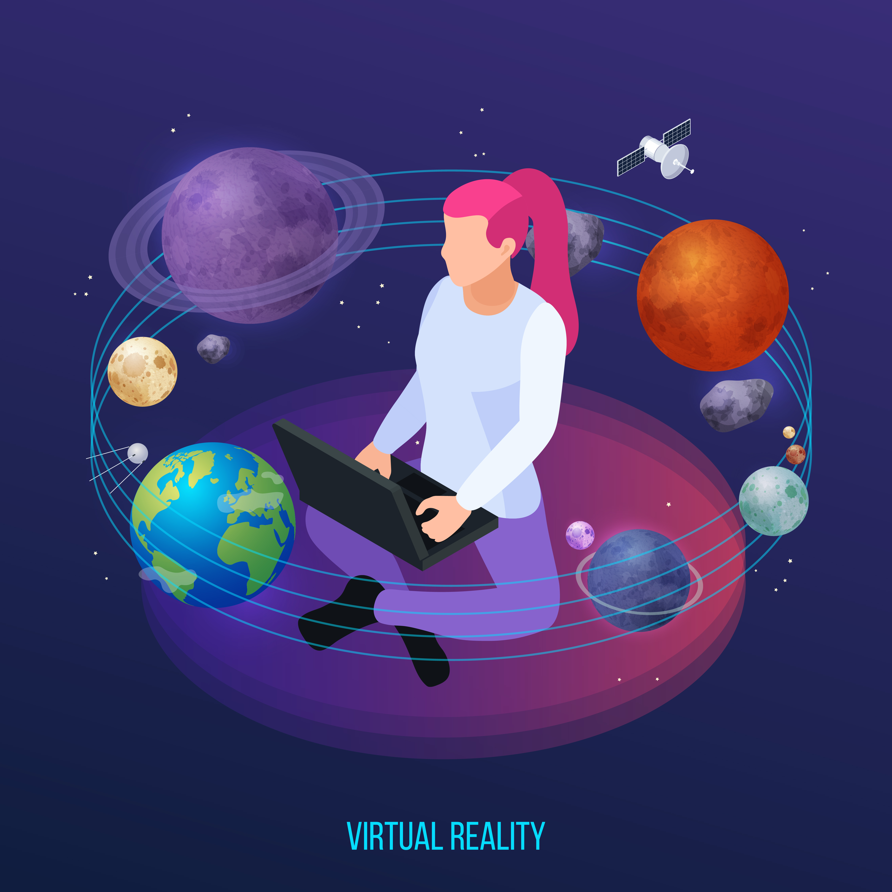
VR TOURISM
ABSTRACT
Our project on VR tourism of wonders aims to provide an immersive and interactive experience of visiting historical sites using cutting-edge technologies. By leveraging virtual reality, users can explore and learn about wonders from around the world, including their architecture, culture, and significance. The project will allow users to experience these sites in a way that is not possible through traditional tourism, with the added benefit of being able to interact with and learn from the environment. This project will be an innovative and engaging tool for both educational and recreational purposes, giving users a unique glimpse into the wonders of the world.
NEXT

Slide 4




VR TOURISM
TECH STACK
UNITY
BLENDER
NEXT
MIXAMO
SKETCHFAB

Slide 5
VR TOURISM
OUR MISSION
The Great Pyramid of Giza
Hanging Gardens of Babylon
Colossus of Rhodes
Light House of Alexandria
The Temple Of Artemis
Statue of Zeus
Museum at Halicarnassus
NEXT

Slide 6
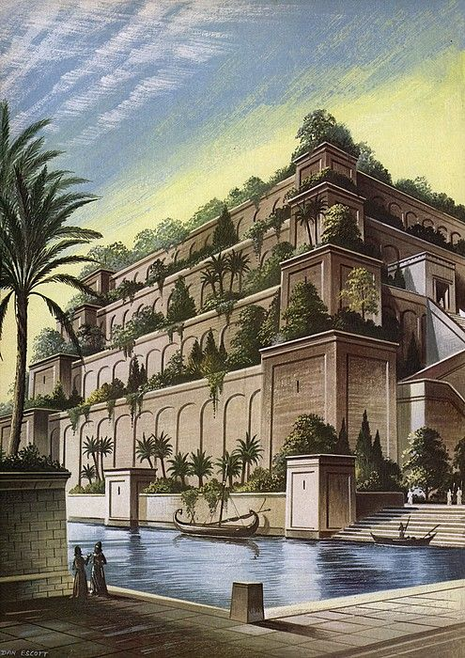
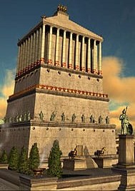
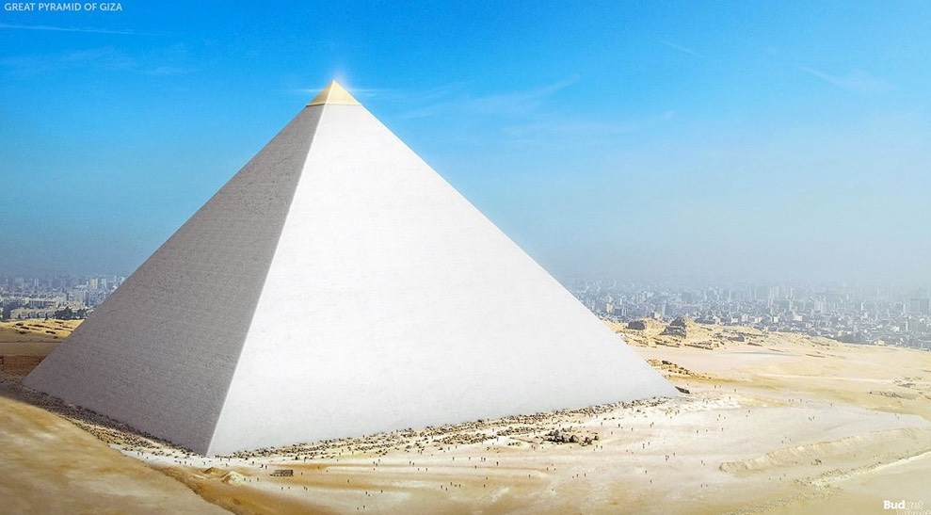
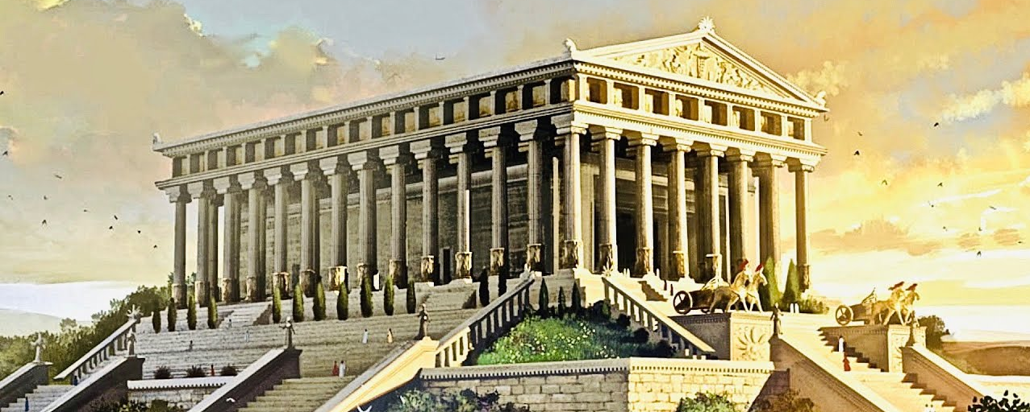
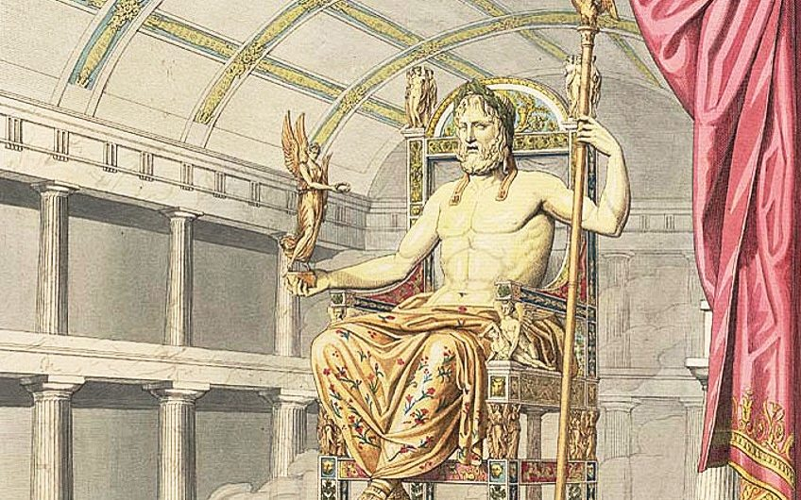
VR TOURISM
PROJECT GALLERY
NEXT

Slide 7
THANK
YOU
GAME OVER

