Slide 1

The title goes here
Click here to add text
Add description
Name

Slide 2
JAKEER :- 25MVCSMRO699
SAIKIRAN :- 25MVCSMR0664
RAKESH :- 25MVCSMR0701
NANDU :- 25MVCSMR0671
TOPIC :--- SKILL DEPENDENCY GRAPH

Slide 3


Slide 4
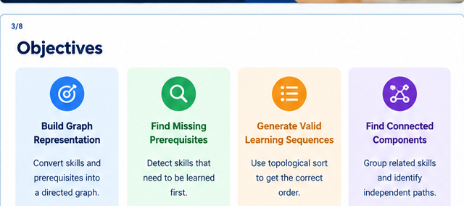

Slide 5


Slide 6
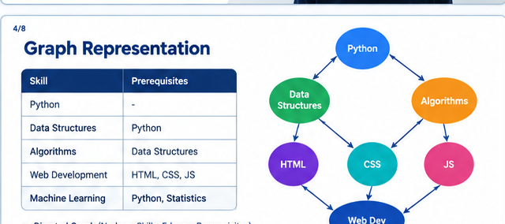

Slide 7
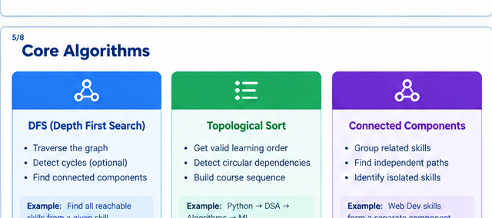

Slide 8
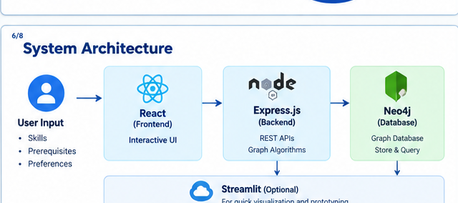

Slide 9
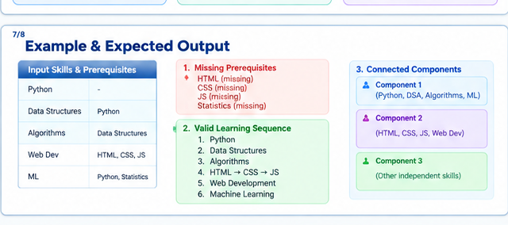

Slide 10


Slide 11


