Slide 1
PIP4004: UNIVERSITY PROJECT Review-1 Presentation
PRICE COMPARISION OF GeM PRODUCTS WITH OTHER
E-MARKETPLACES
Batch Number: CEI -17
Under the Supervision of,
Dr. Debasmita Mishra
Assistant Professor
School of Computer Science and Engineering
Presidency University
 | MANVITHA REDDY I
 | SHAIK MAHABOOB
 | ABHINAY REDDY J
Roll Number | Student Name
20211CEI0024 20211CEI0142 20211CEI0151
Name of the Program: COMPUTER ENGINEERING SPL.(AI&ML)
Name of the HOD: DR.GOPAL KRISHNA SHYAM
Name of the Program Project Coordinator: DR.SUDHA P
Name of the School Project Coordinators: Dr. Sampath A K / Dr. Abdul Khadar A / Mr. Md Ziaur Rahman

Slide 2
Content
Introduction
literature Survey
Existing Methods and Drawbacks
Proposed Method
Architecture Diagram
Modules
Software Details
Timeline of the Project (Gantt Chart)
References
Analysis of Problem Statement

Slide 3
Introduction
The Price Comparison of GeM Products with Other E-Marketplaces is a research-based study aimed at analyzing price variations of products available on GeM and other online platforms.
This project analyzes and compares the pricing of products listed on the Government e-Marketplace (GeM) with those available on other e-commerce platforms.
By systematically collecting and evaluating data, the study examines pricing trends, cost variations, and key factors influencing price differences across various marketplaces.

Slide 4
Literature Survey
Title | Authors | Publication Year | Main Findings
Evaluating Government E-Marketplaces: A Comparative Analysis | Sharma et al. | 2018 | Examined GeM’s pricing structures in comparison to commercial platforms, highlighting transparency and cost-effectiveness while discussing pricing variations.
Price Variability in Online Marketplaces: A Case Study of GeM and Private E-Commerce Platforms | Patel et al. | 2019 | Analyzed price fluctuations in government and private online marketplaces. Found that GeM offers cost advantages due to procurement policies, bulk purchasing, and supplier competition.
Competitive Pricing Strategies in Public Procurement Portals | Kumar & Singh | 2020 | Explored pricing strategies in GeM and private e-marketplaces, considering subsidies, tax exemptions, and vendor participation. Highlighted the role of government regulations in ensuring fair pricing.

Slide 5
Literature Survey
Title | Authors | Publication Year | Main Findings
Cost Efficiency of Government E-Marketplaces Compared to Commercial Platforms | Rao et al. | 2021 | Investigated the cost-effectiveness of GeM compared to private e-commerce sites. Found that GeM’s standardized pricing and lower procurement costs benefit government buyers.
Role of Vendor Competition in Online Price Dynamics | Mehta et al. | 2017 | Studied the impact of vendor competition on price variations. Concluded that GeM’s regulated competition reduces price disparities compared to private platforms with dynamic pricing.
Bulk Procurement and Its Impact on Price Reduction in E-Marketplaces | Bose & Jain | 2019 | Highlighted how bulk procurement on GeM leads to lower prices compared to retail purchases, emphasizing economies of scale and government contracts.

Slide 6
Literature Survey
Title | Authors | Publication Year | Main Findings
Price Discrepancies in Digital Marketplaces: An Analytical Review | Ramesh et al. | 2020 | Analyzed price inconsistencies between GeM and private platforms. Discussed product availability, vendor credibility, and transaction fees as contributing factors.
Digital Procurement and Cost Optimization in E-Marketplaces | Chatterjee et al. | 2018 | Compared GeM with private platforms, finding that GeM’s controlled vendor ecosystem stabilizes pricing, while private platforms use fluctuating discounts and promotions.
Government E-Procurement Systems: A Study on Cost-Effectiveness | Nair & Gupta | 2021 | Examined the cost benefits of GeM, showing that it provides structured pricing, reducing procurement delays and ensuring lower costs for government agencies.

Slide 7
Literature Survey
Title | Authors | Publication Year | Main Findings
Comparative Analysis of Pricing Trends in Government and Private E-Marketplaces | Verma et al. | 2019 | Analyzed pricing trends across GeM and private platforms, assessing differences in procurement strategies and cost structures.

Slide 8
Existing Methods and Drawbacks
Manual Price Comparison
Method: Buyers manually compare product prices on GeM and other e-marketplaces by visiting multiple websites, checking listings, and recording prices for analysis.
Drawbacks:
Time-Consuming: Manually comparing prices across different platforms takes significant effort, leading to delays in procurement.
Data Inconsistencies: The Prices fluctuate frequently, making it challenging to maintain up-to-date comparisons.
Human Error: Manual tracking can result in misinterpretation of discounts, taxes, and shipping costs, leading to inaccurate conclusions.
Lack of Standardization: Product descriptions and specifications may vary between platforms, making direct price comparisons difficult.
Automated Web Scraping for Price Comparison
Method: Automated web scraping tools or price comparison software collect price data from multiple e-marketplaces, including GeM, for real-time analysis.
Drawbacks:
Legal and Compliance Issues: Some platforms restrict automated data extraction, making web scraping legally questionable.
Data Accuracy Concerns: Variations in product names, specifications, or discount structures can lead to misleading comparisons.
Limited Coverage: Some platforms may not include GeM or specific government procurement rates

Slide 9
Proposed Method
The proposed method focuses on an automated price comparison system for GeM and other e-marketplaces.
Key Features:
No Additional Hardware Required: Uses web-based tools and APIs for price extraction, eliminating the need for specialized equipment.
Real-time monitoring: Continuously monitors price fluctuations across platforms, ensuring up-to-date comparisons.
Remote access: Users can access price comparisons from any location via a web or mobile interface.
Scalability: Supports multiple product categories and vendors, making it adaptable for various procurement needs.

Slide 10
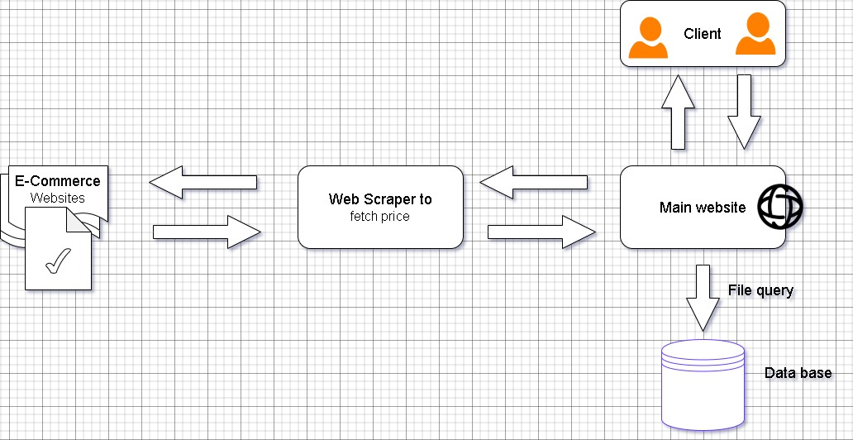
Architecture Diagram
Fig.1: The image (Fig.2) illustrates a data flow diagram for a price-fetching web scraper system. The process begins with a web scraper extracting pricing data from various e-commerce websites. This data is then sent to the main website, which interacts with a database for storing and retrieving information. Clients access the main website to query and retrieve price-related data, enabling real-time price comparisons and updates.

Slide 11
Modules
Data Collection: Gathers price details from GeM and other e-marketplaces through web scraping, APIs, or manual entry.
Product Matching and Categorization: Identifies and categorizes similar products across different platforms for accurate comparison.
Price Analysis and Comparison: Analyzes pricing trends, discounts, and variations between GeM and other marketplaces.
Data Logging and Management:: Stores historical price data for trend analysis and procurement decisions.
Alerts and Notifications: Sends real-time alerts for price drops, bulk discounts, or cost-effective alternatives.
User Interface: Ensures real-time updates and secure storage for seamless data access.
Cloud Integration and Synchronization: Manages vehicle records and system settings.
Security and Authentication: Implements user authentication and data encryption to ensure secure access.

Slide 12
Software Details
Made With : Flutter
Database : Firebase
IDE : Visual Studio Code

Slide 13
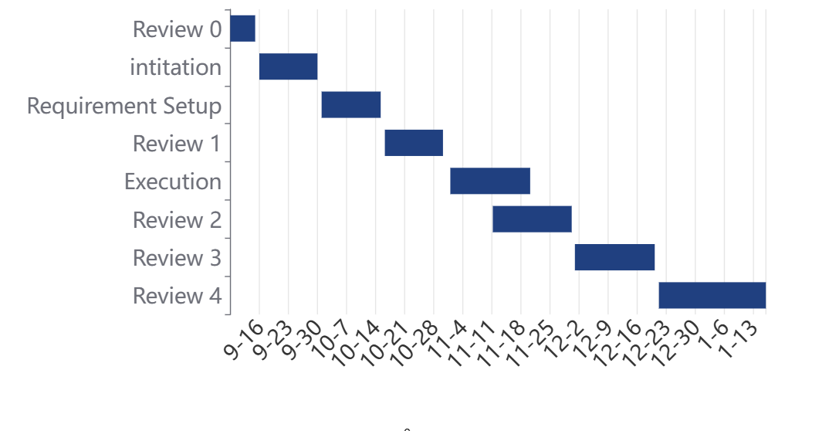
Timeline of the Project (Gantt Chart)
Fig.2: The image (Fig.2) illustrates a Gantt chart representing the timeline of various project phases, including initiation, requirement setup, execution, and multiple review stages. The horizontal bars indicate the duration of each phase, with the x-axis showing the dates and the y-axis listing key project milestones.

Slide 14
References
[1] W. Qi, N. Li, J. Wang and X. Luo, "Pricing of Product Line Along With Its Value-Added Services With Consideration of Effects of Reference Price," in IEEE Transactions on Computational Social Systems, vol. 12, no. 1, pp. 447-462, Feb. 2025, doi: 10.1109/TCSS.2024.3479271.
[2] Jianxia Chen and Ri Huang, "A price comparison system based on Lucene," 2013 8th International Conference on Computer Science & Education, Colombo, Sri Lanka, 2013, pp. 117-120, doi: 10.1109/ICCSE.2013.6553894.
[3] N. Singh, A. Rana and A. Chaudhary, "Price Comparison Using Web Scraping and Machine Learning," 2023 International Conference on Computer Science and Emerging Technologies (CSET), Bangalore, India, 2023, pp. 1-5, doi: 10.1109/CSET58993.2023.10346784.

Slide 15
References (contd...)
[4] P. Nagaraj, V. Muneeswaran, A. V. S. R. Pavan Naidu, N. Shanmukh, P. V. Kumar and G. S. Satyanarayana, "Automated E-Commerce Price Comparison Website using PHP, XAMPP, MongoDB, Django, and Web Scrapping," 2023 International Conference on Computer Communication and Informatics (ICCCI), Coimbatore, India, 2023, pp. 1-6, doi: 10.1109/ICCCI56745.2023.10128573.

Slide 16
Analysis of Problem Statement
Technology Stack Components:
Frameworks: React.js ,Angular
Languages: HTML ,CSS , JavaScript ,Python
Web Scraping &APIs :Selenium ,GeM API ,Scrapy
Data Storage :MYSQL
Data Analytics & Visualization: Pandas ,Matplotlib ,Seaborn ,PowerBI

Slide 17
Analysis of Problem Statement (contd…)
Software and Hardware Requirements:
Processor : i5
RAM : 8GB
Storage : SSD 256GB+

Slide 18
Analysis of Problem Statement (contd…)
Technology Stack Components:
Frameworks: React.js ,Angular
Languages: HTML ,CSS , JavaScript ,Python
Web Scraping &APIs :Selenium ,GeM API ,Scrapy
Data Storage :MYSQL
Data Analytics & Visualization: Pandas ,Matplotlib ,Seaborn ,PowerBI
Software and Hardware Requirements:
Processor : i5
RAM : 8GB
Storage : SSD 256GB+

Slide 19
Problem Statement Number: PSCS41
Organization: Ministry of Commerce and Industries
Category (Hardware / Software / Both) : Software
Problem Description:
The problem at hand involves developing a cost or price comparison solution specifically tailored for comparing the prices of products available on GeM (Government e-Marketplace) with other e-marketplaces or e-commerce platforms.
Difficulty Level: Simple

Slide 20


