Slide 1
PIP4004: UNIVERSITY PROJECT Review-0 Presentation
PRICE COMPARISION OF GeM PRODUCTS WITH OTHER
E-MARKETPLACES
Batch Number: CEI -17
Under the Supervision of,
Dr. Debasmita Mishra
Assistant Professor
School of Computer Science and Engineering
Presidency University
 | MANVITHA REDDY I
 | SHAIK MAHABOOB
 | ABHINAY REDDY J
Roll Number | Student Name
20211CEI0024 20211CEI0142 20211CEI0151
Name of the Program: COMPUTER ENGINEERING SPL.(AI&ML)
Name of the HOD: DR.GOPAL KRISHNA SHYAM
Name of the Program Project Coordinator: DR.SUDHA P
Name of the School Project Coordinators: Dr. Sampath A K / Dr. Abdul Khadar A / Mr. Md Ziaur Rahman

Slide 2
Content
Problem Statement
Github Link
Analysis of Problem Statement
Timeline of the Project
References

Slide 3
Problem Statement Number: PSCS_77
Organization: Ministry of Commerce and Industries
Category (Hardware / Software / Both) : Software
Problem Description: The problem at hand involves developing a cost or price comparison solution specifically tailored for comparing the prices of products available on GeM (Government e-Marketplace) with other e-marketplaces or e-commerce platforms. GeM is a dedicated online platform in India that facilitates the procurement of goods and services by various government departments, organizations, and public sector undertakings. Comparing the prices of products listed on GeM with those on other platforms is crucial for ensuring fair and competitive pricing. The cost or price comparison solution aims to provide users with a convenient way to compare the prices of products available on GeM with other popular e-marketplaces or e-commerce platforms. By leveraging data scraping techniques, APIs, and data analytics, the solution will gather and analyze pricing information from multiple sources, allowing users to make informed decisions based on the best available options.
Difficulty Level: Simple

Slide 4
Github Link
Github Link
https://github.com/shaikjr/GeM-Product-Price-Comparison

Slide 5
Analysis of Problem Statement
Technology Stack Components:
Frameworks: React.js ,Angular
Languages: HTML ,CSS , JavaScript ,Python
Web Scraping &APIs :Selenium ,GeM API ,Scrapy
Data Storage :MYSQL
Data Analytics & Visualization: Pandas ,Matplotlib ,Seaborn ,PowerBI

Slide 6
Analysis of Problem Statement (contd...)
Software and Hardware Requirements:
Processor : i5
RAM : 8GB
Storage : SSD 256GB+

Slide 7
Analysis of Problem Statement (contd...)
The GeM price comparison solution addresses a critical need for transparency and cost efficiency in government procurement. The main challenges involve data access, dynamic pricing, and fair product comparisons, which can be mitigated through efficient scraping, API integration, and machine learning analytics.

Slide 8
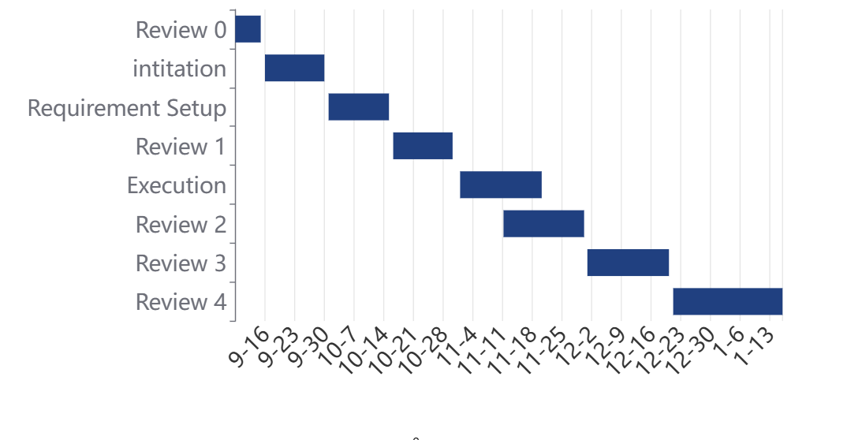
Timeline of the Project (Gantt Chart)

Slide 9
References (IEEE Paper format)
[1] W. Qi, N. Li, J. Wang and X. Luo, "Pricing of Product Line Along With Its Value-Added Services With Consideration of Effects of Reference Price," in IEEE Transactions on Computational Social Systems, vol. 12, no. 1, pp. 447-462, Feb. 2025, doi: 10.1109/TCSS.2024.3479271.
[2] Jianxia Chen and Ri Huang, "A price comparison system based on Lucene," 2013 8th International Conference on Computer Science & Education, Colombo, Sri Lanka, 2013, pp. 117-120, doi: 10.1109/ICCSE.2013.6553894.
[3] N. Singh, A. Rana and A. Chaudhary, "Price Comparison Using Web Scraping and Machine Learning," 2023 International Conference on Computer Science and Emerging Technologies (CSET), Bangalore, India, 2023, pp. 1-5, doi: 10.1109/CSET58993.2023.10346784.

Slide 10
References (IEEE Paper format) contd..
[4] P. Nagaraj, V. Muneeswaran, A. V. S. R. Pavan Naidu, N. Shanmukh, P. V. Kumar and G. S. Satyanarayana, "Automated E-Commerce Price Comparison Website using PHP, XAMPP, MongoDB, Django, and Web Scrapping," 2023 International Conference on Computer Communication and Informatics (ICCCI), Coimbatore, India, 2023, pp. 1-6, doi: 10.1109/ICCCI56745.2023.10128573.

Slide 11


