Slide 1
Database Systems
25MC408-DATABASE SYSTEMS
I MCA II Semester
2025-26 II SEMESTER
Slide 1- <number>

Slide 2
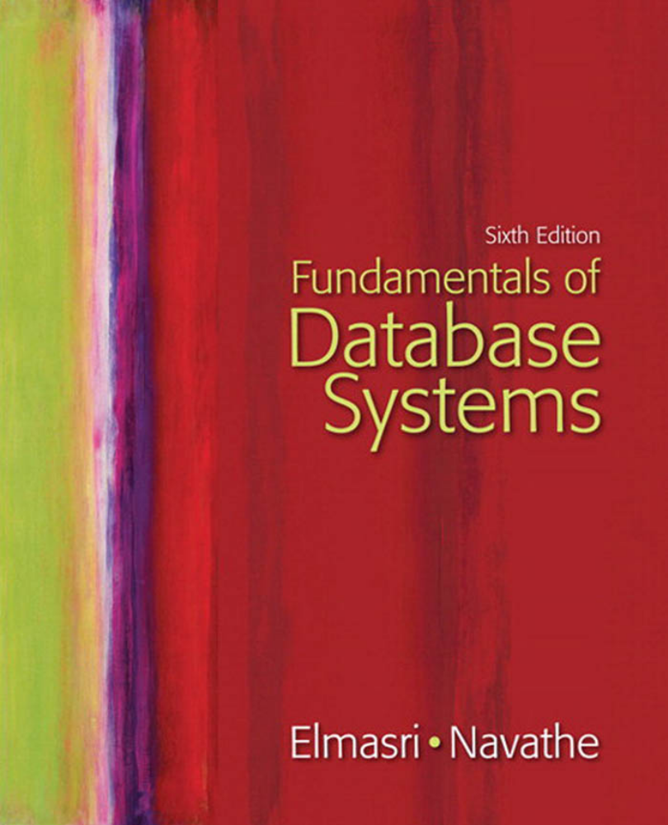
Text book
Slide 1- <number>

Slide 3
Syllabus
MODULE-1
UNIT-1 18L+0T+12P=30 Hours
DATABASES AND DATABASE USERS: Introduction, Characteristics of the database approach; Actors on the scene, Advantages of using the DBMS approach.
DATABASE SYSTEM CONCEPTS AND ARCHITECTURE: Data models, Schemas, and instances, Three-Schema architecture and data Independence, Database languages and interfaces, the database system environment, Centralized and Client-Server architectures for DBMS.
CONCEPTUAL DATA MODELING AND DATABASE DESIGN: Entity types, Entity sets, Attributes, and keys, Relationship types, Relationship Sets, Roles, and structural constraints, Weak entity types, Relationship types of degree higher than two.
Slide 1- <number>

Slide 4
Syllabus
UNIT-2
THE RELATIONAL DATA MODEL AND RELATIONAL DATABASE CONSTRAINTS: Relational model concepts, Relational model constraints and Relational database schemas.
BASIC SQL: SQL data definition and data types, specifying constraints in SQL, Basic retrieval queries in SQL.
MORE SQL: COMPLEX QUERIES, TRIGGERS, VIEWS: More complex SQL retrieval queries, Views (virtual tables) in SQL, Introduction to PL/SQL Procedures, Functions Specifying constraints as assertions and actions as triggers.
Slide 1- <number>

Slide 5
Basic Definitions
Database:
  A collection of related data.
Data:
  Known facts that can be recorded and have an implicit meaning.
  Consider the names, telephone numbers and addresses of the people you know.
  This data recorded in an indexed address book or stored on a hard drive.
  A database can be any size and complexity
        Library – author wise, title,
        Large commercial database
        60 million active users
        Millions of books, CDs, Videos, DVDs, games, electronics, apparel and other.
        42 tera bytes – (10¹² bytes) and stored in hundreds of computers (servers). Millions of visitors.
Slide 1- <number>

Slide 6
Basic Definitions
Database Management System (DBMS) is a computerized system that enables users to create and maintain database.
  DBMS: A general-purpose software package/ system that facilitates the processes of defining, constructing, manipulating and sharing data bases among various users and applications.
Database System:
  The DBMS software together with the data itself. Sometimes, the applications are also included.
Slide 1- <number>

Slide 7
Basic Definitions
  Defining – Specifying data types, structures and constraints of the data to be stored. The database definition or descriptive information is also stored – Meta data
  Constructing – The process of storing on some storage medium
  Manipulating – querying, insert, delete, update and generating reports.
  Sharing – Allows multiple users and programs to access the database simultaneously.
Slide 1- <number>

Slide 8
Typical DBMS Functionality
Define a particular database in terms of its data types, structures, and constraints
Construct or Load the initial database contents on a secondary storage medium
Manipulating the database:
  Retrieval: Querying, generating reports
  Modification: Insertions, deletions and updates to its content
  Accessing the database through Web applications
Processing and Sharing by a set of concurrent users and application programs – yet, keeping all data valid and consistent
Slide 1- <number>

Slide 9
Typical DBMS Functionality
Other features:
  Protection or Security measures to prevent unauthorized access
  “Active” processing to take internal actions on data
  Presentation and Visualization of data
  Maintaining the database and associated programs over the lifetime of the database application
    Called database, software, and system maintenance
Slide 1- <number>

Slide 10

Simplified database system environment
Slide 1- <number>

Slide 11
Example of a Database
(with a Conceptual Data Model)
Mini-world for the example:
  Part of a UNIVERSITY environment.
Some mini-world entities:
  STUDENTs
  COURSEs
  SECTIONs (of COURSEs)
  (academic) DEPARTMENTs
  INSTRUCTORs
Slide 1- <number>

Slide 12
Example of a Database
(with a Conceptual Data Model)
Some mini-world relationships:
  SECTIONs are of specific COURSEs
  STUDENTs take SECTIONs
  COURSEs have prerequisite COURSEs
  INSTRUCTORs teach SECTIONs
  COURSEs are offered by DEPARTMENTs
  STUDENTs major in DEPARTMENTs
Note: The above entities and relationships are typically expressed in a conceptual data model, such as the ENTITY-RELATIONSHIP data model (see Chapters 3, 4)
Slide 1- <number>

Slide 13
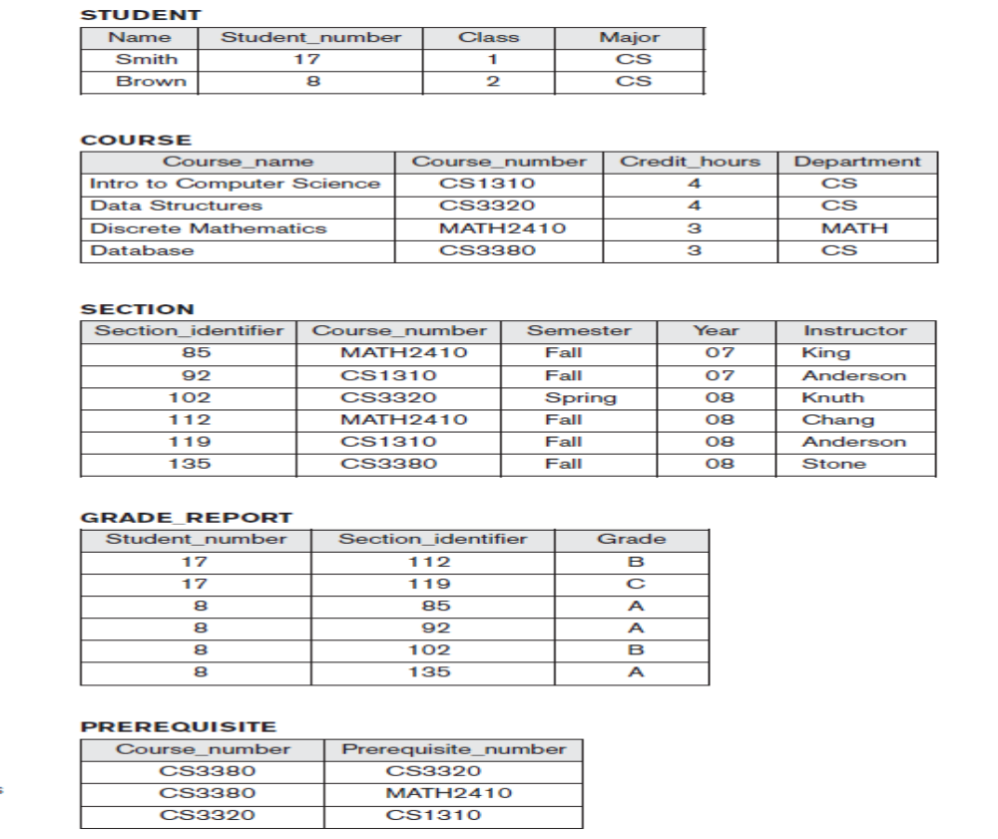
Example of a simple database
Slide 1- <number>

Slide 14
Main Characteristics of the Database Approach
Self-describing nature of a database system:
  A DBMS catalog stores the description of a particular database (e.g. data structures, types, and constraints)
  The description is called meta-data.
  This allows the DBMS software to work with different database applications.
Insulation between programs and data:
  Called program-data independence.
  Allows changing data structures and storage organization without having to change the DBMS access programs.
Slide 1- <number>

Slide 15

Example of a simplified database catalog
Slide 1- <number>

Slide 16
Main Characteristics of the Database Approach (continued)
Data Abstraction:
  A data model is used to hide storage details and present the users with a conceptual view of the database.
  Programs refer to the data model constructs rather than data storage details
Support of multiple views of the data:
  Each user may see a different view of the database, which describes only the data of interest to that user.
Slide 1- <number>

Slide 17
Main Characteristics of the Database Approach (continued)
Sharing of data and multi-user transaction processing:
  Allowing a set of concurrent users to retrieve from and to update the database.
  Concurrency control within the DBMS guarantees that each transaction is correctly executed or aborted
  Recovery subsystem ensures each completed transaction has its effect permanently recorded in the database
  OLTP (Online Transaction Processing) is a major part of database applications. This allows hundreds of concurrent transactions to execute per second.
Slide 1- <number>

Slide 18
Database Users
Users may be divided into
  Those who actually use and control the database content, and those who design, develop and maintain database applications (called “Actors on the Scene”), and
  Those who design and develop the DBMS software and related tools, and the computer systems operators (called “Workers Behind the Scene”).
Slide 1- <number>

Slide 19
Database Users (Actors on the scene)
  Database administrators:
    Responsible for authorizing access to the database, for coordinating and monitoring its use, acquiring software and hardware resources, controlling its use and monitoring efficiency of operations.
    Accountable for problems such as security breaches and poor response time.
  Database Designers:
    Responsible to define the content, the structure, the constraints, and functions or transactions against the database. They must communicate with the end-users and understand their needs.
Slide 1- <number>

Slide 20
Categories of End-users
Actors on the scene (continued)
  End-users: They use the data for queries, reports and some of them update the database content. End-users can be categorized into:
    Casual: access database occasionally when needed
    Naïve or Parametric: they make up a large section of the end-user population.
      They use previously well-defined functions in the form of “canned transactions” against the database.
      Examples are bank-tellers or reservation clerks who do this activity for an entire shift of operations.
Slide 1- <number>

Slide 21
Categories of End-users (continued)
    Sophisticated:
      These include business analysts, scientists, engineers, others thoroughly familiar with the system capabilities.
      Many use tools in the form of software packages that work closely with the stored database.
    Stand-alone:
      Mostly maintain personal databases using ready-to-use packaged applications.
      An example is a tax program user that creates its own internal database.
      Another example is a user that maintains an address book
Slide 1- <number>

Slide 22
Actors on the scene
Slie 1- <number>
System Analysts and Application Programmers
(Software Engineers)
System analysts determine the requirements of end users, especially naive and parametric end users, and develop specifications for standard canned transactions that meet these requirements.
Application programmers implement these specifications as programs; then they test, debug, document, and maintain these canned transactions.

Slide 23
Workers behind the Scene
DBMS system designers and implementers design and implement the DBMS modules and interfaces as a software package.
Tool developers design and implement tools
Operators and maintenance personnel (system administration personnel) are responsible for the actual running and maintenance of the hardware and software environment for the database system.

Slide 24
Advantages of Using the Database Approach
Controlling redundancy - in data storage and in development and maintenance efforts.
  Sharing of data among multiple users.
  need to perform a single logical update
  storage space is wasted
  Files that represent the same data may become inconsistent.
Restricting unauthorized access.
Providing persistent storage for program Objects
  In Object-oriented DBMSs
Providing Storage Structures for efficient Query Processing
Slide 1- <number>

Slide 25
Advantages of Using the Database Approach (continued)
Providing backup and recovery
Providing multiple user interfaces
Representing complex relationships among data.
Enforcing integrity constraints.
Permitting Inferencing and Actions Using Rules
Slide 1- <number>

Slide 26
Additional Implications of Using the Database Approach
Potential for enforcing standards:
  This is very crucial for the success of database applications in large organizations. Standards refer to data item names, display formats, screens, report structures, meta-data (description of data), Web page layouts, etc.
Reduced application development time:
  Incremental time to add each new application is reduced.
Slide 1- <number>

Slide 27
Additional Implications of Using the Database Approach (continued)
Flexibility to change data structures:
  Database structure may evolve as new requirements are defined.
Availability of current information:
  Extremely important for on-line transaction systems such as airline, hotel, car reservations.
Economies of scale:
  Wasteful overlap of resources and personnel can be avoided by consolidating data and applications across departments.
Slide 1- <number>

Slide 28
Historical Development of Database Technology
Early Database Applications:
  The Hierarchical and Network Models were introduced in mid 1960s and dominated during the seventies.
  A bulk of the worldwide database processing still occurs using these models, particularly, the hierarchical model.
Relational Model based Systems:
  Relational model was originally introduced in 1970, was heavily researched and experimented within IBM Research and several universities.
  Relational DBMS Products emerged in the early 1980s.
Slide 1- <number>

Slide 29
Historical Development of Database Technology (continued)
Object-oriented and emerging applications:
  Object-Oriented Database Management Systems (OODBMSs) were introduced in late 1980s and early 1990s to cater to the need of complex data processing in CAD and other applications.
    Their use has not taken off much.
  Many relational DBMSs have incorporated object database concepts, leading to a new category called object-relational DBMSs (ORDBMSs)
  Extended relational systems add further capabilities (e.g. for multimedia data, XML, and other data types)
Slide 1- <number>

Slide 30
Historical Development of Database Technology (continued)
Data on the Web and E-commerce Applications:
  Web contains data in HTML (Hypertext markup language) with links among pages.
  This has given rise to a new set of applications and E-commerce is using new standards like XML (eXtended Markup Language). (see Ch. 27).
  Script programming languages such as PHP and JavaScript allow generation of dynamic Web pages that are partially generated from a database (see Ch. 26).
    Also allow database updates through Web pages
Slide 1- <number>

Slide 31
Extending Database Capabilities
New functionality is being added to DBMSs in the following areas:
  Scientific Applications
  XML (eXtensible Markup Language)
  Image Storage and Management
  Audio and Video Data Management
  Data Warehousing and Data Mining
  Spatial Data Management
  Time Series and Historical Data Management
The above gives rise to new research and development in incorporating new data types, complex data structures, new operations and storage and indexing schemes in database systems.
Slide 1- <number>

Slide 32
When not to use a DBMS
Main inhibitors (costs) of using a DBMS:
  High initial investment and possible need for additional hardware.
  Overhead for providing generality, security, concurrency control, recovery, and integrity functions.
When a DBMS may be unnecessary:
  If the database and applications are simple, well defined, and not expected to change.
  If there are stringent real-time requirements that may not be met because of DBMS overhead.
  If access to data by multiple users is not required.
Slide 1- <number>

Slide 33
When not to use a DBMS
When no DBMS may suffice:
  If the database system is not able to handle the complexity of data because of modeling limitations
  If the database users need special operations not supported by the DBMS.
Slide 1- <number>

Slide 34
Summary
Types of Databases and Database Applications
Basic Definitions
Typical DBMS Functionality
Example of a Database (UNIVERSITY)
Main Characteristics of the Database Approach
Database Users
Advantages of Using the Database Approach
When Not to Use Databases
Slide 1- <number>

Slide 35
Chapter 2
Database System Concepts and Architecture

Slide 36
Outline
Data Models and Their Categories
History of Data Models
Schemas, Instances, and States
Three-Schema Architecture
Data Independence
DBMS Languages and Interfaces
Database System Utilities and Tools
Centralized and Client-Server Architectures
Classification of DBMSs
Slide 2- <number>

Slide 37
Data Models
Data Model:
  A collection of concepts to describe the structure of a database, the operations for manipulating these structures, and certain constraints that the database should obey.
Data Model Structure and Constraints:
  Constructs are used to define the database structure
  Constructs typically include elements (and their data types) as well as groups of elements (e.g. entity, record, table), and relationships among such groups
  Constraints specify some restrictions on valid data; these constraints must be enforced at all times
Slide 2- <number>

Slide 38
Categories of Data Models
Conceptual (high-level, semantic) data models:
  Provide concepts that are close to the way many users perceive data.
    (Also called entity-based or object-based data models.)
Physical (low-level, internal) data models:
  Provide concepts that describe details of how data is stored in the computer. These are usually specified in an ad-hoc manner through DBMS design and administration manuals
Implementation (representational) data models:
  Provide concepts that fall between the above two, used by many commercial DBMS implementations (e.g. relational data models used in many commercial systems).
Slide 2- <number>

Slide 39
Schemas versus Instances
Database Schema:
  The description of a database.
  Includes descriptions of the database structure, data types, and the constraints on the database.
Schema Diagram:
  An illustrative display of (most aspects of) a database schema.
Schema Construct:
  A component of the schema or an object within the schema, e.g., STUDENT, COURSE.
Slide 2- <number>

Slide 40
Schemas versus Instances
Database State:
  The actual data stored in a database at a particular moment in time. This includes the collection of all the data in the database.
  Also called database instance (or occurrence or snapshot).
    The term instance is also applied to individual database components, e.g. record instance, table instance, entity instance
Slide 2- <number>

Slide 41
Database Schema vs. Database State (continued)
Distinction
  The database schema changes very infrequently.
  The database state changes every time the database is updated.
Schema is also called intension.
State is also called extension.
Slide 2- <number>

Slide 42

Example of a Database Schema
Slide 2- <number>

Slide 43

Example of a database state
Slide 2- <number>

Slide 44
Three-Schema Architecture
Proposed to support DBMS characteristics of:
  Program-data independence.
  Support of multiple views of the data.
Not explicitly used in commercial DBMS products, but has been useful in explaining database system organization
Slide 2- <number>

Slide 45
Three-Schema Architecture
Defines DBMS schemas at three levels:
  Internal schema at the internal level to describe physical storage structures and access paths (e.g indexes).
    Typically uses a physical data model.
  Conceptual schema at the conceptual level to describe the structure and constraints for the whole database for a community of users.
    Uses a conceptual or an implementation data model.
  External schemas at the external level to describe the various user views.
    Usually uses the same data model as the conceptual schema.
Slide 2- <number>

Slide 46

The three-schema architecture
Slide 2- <number>

Slide 47
Three-Schema Architecture
Mappings among schema levels are needed to transform requests and data.
  Programs refer to an external schema, and are mapped by the DBMS to the internal schema for execution.
  Data extracted from the internal DBMS level is reformatted to match the user’s external view (e.g. formatting the results of an SQL query for display in a Web page)
Slide 2- <number>

Slide 48
Data Independence
Logical Data Independence:
  The capacity to change the conceptual schema without having to change the external schemas and their associated application programs.
Physical Data Independence:
  The capacity to change the internal schema without having to change the conceptual schema.
  For example, the internal schema may be changed when certain file structures are reorganized or new indexes are created to improve database performance
Slide 2- <number>

Slide 49
Data Independence (continued)
When a schema at a lower level is changed, only the mappings between this schema and higher-level schemas need to be changed in a DBMS that fully supports data independence.
The higher-level schemas themselves are unchanged.
  Hence, the application programs need not be changed since they refer to the external schemas.
Slide 2- <number>

Slide 50
DBMS Languages
Data Definition Language (DDL)
Data Manipulation Language (DML)
  High-Level or Non-procedural Languages: These include the relational language SQL
    May be used in a standalone way or may be embedded in a programming language
  Low Level or Procedural Languages:
    These must be embedded in a programming language
Slide 2- <number>

Slide 51
DBMS Languages
Data Definition Language (DDL):
  Used by the DBA and database designers to specify the conceptual schema of a database.
  In many DBMSs, the DDL is also used to define internal and external schemas (views).
  In some DBMSs, separate storage definition language (SDL) and view definition language (VDL) are used to define internal and external schemas.
    SDL is typically realized via DBMS commands provided to the DBA and database designers
Slide 2- <number>

Slide 52
DBMS Languages
Data Manipulation Language (DML):
  Used to specify database retrievals and updates
  DML commands (data sublanguage) can be embedded in a general-purpose programming language (host language), such as COBOL, C, C++, or Java.
    A library of functions can also be provided to access the DBMS from a programming language
  Alternatively, stand-alone DML commands can be applied directly (called a query language).
Slide 2- <number>

Slide 53
Types of DML
High Level or Non-procedural Language:
  For example, the SQL relational language
  Are “set”-oriented and specify what data to retrieve rather than how to retrieve it.
  Also called declarative languages.
Low Level or Procedural Language:
  Retrieve data one record-at-a-time;
  Constructs such as looping are needed to retrieve multiple records, along with positioning pointers.
Slide 2- <number>

Slide 54
DBMS Interfaces
Stand-alone query language interfaces
  Example: Entering SQL queries at the DBMS interactive SQL interface (e.g. SQL*Plus in ORACLE)
Programmer interfaces for embedding DML in programming languages
User-friendly interfaces
  Menu-based, forms-based, graphics-based, etc.
Slide 2- <number>

Slide 55
DBMS Interfaces
Menu-based interfaces
Forms-Based interfaces
Graphical user interfaces
Natural language interfaces
Speech input and output
Interfaces for parametric users
Interfaces for the DBA
Slide 2- <number>

Slide 56
DBMS Programming Language Interfaces
Programmer interfaces for embedding DML in a programming languages:
  Embedded Approach: e.g embedded SQL (for C, C++, etc.), SQLJ (for Java)
  Procedure Call Approach: e.g. JDBC for Java, ODBC for other programming languages
  Database Programming Language Approach: e.g. ORACLE has PL/SQL, a programming language based on SQL; language incorporates SQL and its data types as integral components
Slide 2- <number>

Slide 57
Database System Utilities
To perform certain functions such as:
  Loading data stored in files into a database. Includes data conversion tools.
  Backing up the database periodically on tape.
  Reorganizing database file structures.
  Report generation utilities.
  Performance monitoring utilities.
  Other functions, such as sorting, user monitoring, data compression, etc.
Slide 2- <number>

Slide 58

Typical DBMS Component Modules
Slide 2- <number>

Slide 59
Centralized and
Client-Server DBMS Architectures
Centralized DBMS:
  Combines everything into single system including- DBMS software, hardware, application programs, and user interface processing software.
  User can still connect through a remote terminal – however, all processing is done at centralized site.
Slide 2- <number>

Slide 60

A Physical Centralized Architecture
Slide 2- <number>

Slide 61
Basic 2-tier Client-Server Architectures
Specialized Servers with Specialized functions
  Print server
  File server
  DBMS server
  Web server
  Email server
Clients can access the specialized servers as needed
Slide 2- <number>

Slide 62

Logical two-tier client server architecture
Slide 2- <number>

Slide 63
Clients
Provide appropriate interfaces through a client software module to access and utilize the various server resources.
Clients may be diskless machines or PCs or Workstations with disks with only the client software installed.
Connected to the servers via some form of a network.
  (LAN: local area network, wireless network, etc.)
Slide 2- <number>

Slide 64
DBMS Server
Provides database query and transaction services to the clients
Relational DBMS servers are often called SQL servers, query servers, or transaction servers
Applications running on clients utilize an Application Program Interface (API) to access server databases via standard interface such as:
  ODBC: Open Database Connectivity standard
  JDBC: for Java programming access
Client and server must install appropriate client module and server module software for ODBC or JDBC
See Chapter 9
Slide 2- <number>

Slide 65
Two Tier Client-Server Architecture
A client program may connect to several DBMSs, sometimes called the data sources.
In general, data sources can be files or other non-DBMS software that manages data.
Other variations of clients are possible: e.g., in some object DBMSs, more functionality is transferred to clients including data dictionary functions, optimization and recovery across multiple servers, etc.
Slide 2- <number>

Slide 66
Three Tier Client-Server Architecture
Common for Web applications
Intermediate Layer called Application Server or Web Server:
  Stores the web connectivity software and the business logic part of the application used to access the corresponding data from the database server
  Acts like a conduit for sending partially processed data between the database server and the client.
Three-tier Architecture Can Enhance Security:
  Database server only accessible via middle tier
  Clients cannot directly access database server
Slide 2- <number>

Slide 67

Three-tier client-server architecture
Slide 2- <number>

Slide 68
Classification of DBMSs
Based on the data model used
  Traditional: Relational, Network, Hierarchical.
  Emerging: Object-oriented, Object-relational.
Other classifications
  Single-user (typically used with personal computers)
  vs. multi-user (most DBMSs).
  Centralized (uses a single computer with one database)
  vs. distributed (uses multiple computers, multiple databases)
Slide 2- <number>

Slide 69
Variations of Distributed DBMSs (DDBMSs)
Homogeneous DDBMS
Heterogeneous DDBMS
Federated or Multidatabase Systems
Distributed Database Systems have now come to be known as client-server based database systems because:
  They do not support a totally distributed environment, but rather a set of database servers supporting a set of clients.
Slide 2- <number>

Slide 70
Cost considerations for DBMSs
Cost Range: from free open-source systems to configurations costing millions of dollars
Examples of free relational DBMSs: MySQL, PostgreSQL, others
Commercial DBMS offer additional specialized modules, e.g. time-series module, spatial data module, document module, XML module
  These offer additional specialized functionality when purchased separately
  Sometimes called cartridges (e.g., in Oracle) or blades
Different licensing options: site license, maximum number of concurrent users (seat license), single user, etc.
Slide 2- <number>

Slide 71
History of Data Models
Network Model
Hierarchical Model
Relational Model
Object-oriented Data Models
Object-Relational Models
Slide 2- <number>

Slide 72
History of Data Models
Network Model:
  The first network DBMS was implemented by Honeywell in 1964-65 (IDS System).
  Adopted heavily due to the support by CODASYL (Conference on Data Systems Languages) (CODASYL - DBTG report of 1971).
  Later implemented in a large variety of systems - IDMS (Cullinet - now Computer Associates), DMS 1100 (Unisys), IMAGE (H.P. (Hewlett-Packard)), VAX -DBMS (Digital Equipment Corp., next COMPAQ, now H.P.).
Slide 2- <number>

Slide 73
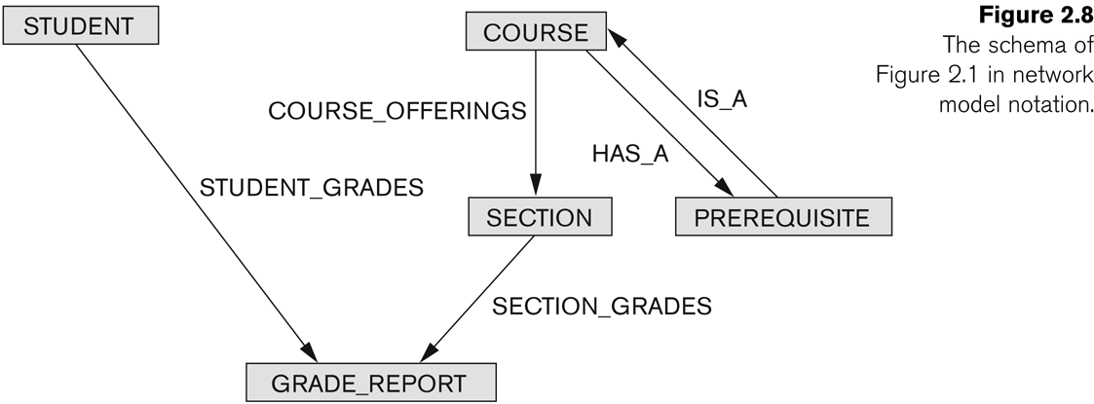
Example of Network Model Schema
Slide 2- <number>

Slide 74
Network Model
Advantages:
  Network Model is able to model complex relationships and represents semantics of add/delete on the relationships.
  Can handle most situations for modeling using record types and relationship types.
  Language is navigational; uses constructs like FIND, FIND member, FIND owner, FIND NEXT within set, GET, etc.
    Programmers can do optimal navigation through the database.
Slide 2- <number>

Slide 75
Network Model
Disadvantages:
  Navigational and procedural nature of processing
  Database contains a complex array of pointers that thread through a set of records.
    Little scope for automated “query optimization”
Slide 2- <number>

Slide 76
History of Data Models
Hierarchical Data Model:
  Initially implemented in a joint effort by IBM and North American Rockwell around 1965. Resulted in the IMS family of systems.
  IBM’s IMS product had (and still has) a very large customer base worldwide
  Hierarchical model was formalized based on the IMS system
  Other systems based on this model: System 2k (SAS inc.)
Slide 2- <number>

Slide 77
Hierarchical Model
Advantages:
  Simple to construct and operate
  Corresponds to a number of natural hierarchically organized domains, e.g., organization (“org”) chart
  Language is simple:
    Uses constructs like GET, GET UNIQUE, GET NEXT, GET NEXT WITHIN PARENT, etc.
Disadvantages:
  Navigational and procedural nature of processing
  Database is visualized as a linear arrangement of records
  Little scope for "query optimization"
Slide 2- <number>

Slide 78
History of Data Models
Relational Model:
  Proposed in 1970 by E.F. Codd (IBM), first commercial system in 1981-82.
  Now in several commercial products (e.g. DB2, ORACLE, MS SQL Server, SYBASE, INFORMIX).
  Several free open source implementations, e.g. MySQL, PostgreSQL
  Currently most dominant for developing database applications.
  SQL relational standards: SQL-89 (SQL1), SQL-92 (SQL2), SQL-99, SQL3, …
  Chapters 5 through 11 describe this model in detail
Slide 2- <number>

Slide 79
History of Data Models
Object-oriented Data Models:
  Several models have been proposed for implementing in a database system.
  One set comprises models of persistent O-O Programming Languages such as C++ (e.g., in OBJECTSTORE or VERSANT), and Smalltalk (e.g., in GEMSTONE).
  Additionally, systems like O2, ORION (at MCC - then ITASCA), IRIS (at H.P.- used in Open OODB).
  Object Database Standard: ODMG-93, ODMG-version 2.0, ODMG-version 3.0.
  Chapters 20 and 21 describe this model.
Slide 2- <number>

Slide 80
History of Data Models
Object-Relational Models:
  Most Recent Trend. Started with Informix Universal Server.
  Relational systems incorporate concepts from object databases leading to object-relational.
  Exemplified in the latest versions of Oracle-10i, DB2, and SQL Server and other DBMSs.
  Standards included in SQL-99 and expected to be enhanced in future SQL standards.
  Chapter 22 describes this model.
Slide 2- <number>

Slide 81
Summary
Data Models and Their Categories
History of Data Models
Schemas, Instances, and States
Three-Schema Architecture
Data Independence
DBMS Languages and Interfaces
Database System Utilities and Tools
Centralized and Client-Server Architectures
Classification of DBMSs
Slide 2- <number>

