Slide 1
UNIT - II
The Relational Data Model and Relational Database Constraints
Copyright © 2007 Ramez Elmasri and Shamkant B. Navathe

Slide 2
Chapter Outline
Relational Model Concepts
Relational Model Constraints and Relational Database Schemas
Update Operations and Dealing with Constraint Violations
Slide 5- <number>

Slide 3
Relational Model Concepts
A Relation is a mathematical concept based on the ideas of sets
The model was first proposed by Dr. E.F. Codd of IBM Research in 1970 in the following paper:
  "A Relational Model for Large Shared Data Banks," Communications of the ACM, June 1970
The above paper caused a major revolution in the field of database management and earned Dr. Codd the coveted ACM Turing Award
Slide 5- <number>

Slide 4
Informal Definitions
Informally, a relation looks like a table of values.
A relation typically contains a set of rows.
The data elements in each row represent certain facts that correspond to a real-world entity or relationship
  In the formal model, rows are called tuples
Each column has a column header that gives an indication of the meaning of the data items in that column
  In the formal model, the column header is called an attribute name (or just attribute)
Slide 5- <number>

Slide 5

Example of a Relation
Slide 5- <number>

Slide 6
Informal Definitions
Key of a Relation:
  Each row has a value of a data item (or set of items) that uniquely identifies that row in the table
    Called the key
  In the STUDENT table, SSN is the key
  Sometimes row-ids or sequential numbers are assigned as keys to identify the rows in a table
    Called artificial key or surrogate key
Slide 5- <number>

Slide 7
Formal Definitions - Schema
The Schema (or description) of a Relation:
A Relation schema R, denoted by R(A1, A2, .....An), is made up of a relation name R and a list of attributes A1, A2, ..., An. Each attribute Ai has some domain D and is represented by dom(Ai).
The Degree of a relation is the number off attributes n of its relation schema.
Example:
CUSTOMER (Cust-id, Cust-name, Address, Phone#)
  CUSTOMER is the relation name
  Defined over the four attributes: Cust-id, Cust-name, Address, Phone#
Each attribute has a domain or a set of valid values.
  For example, the domain of Cust-id is 6 digit numbers.
Slide 5- <number>

Slide 8
Formal Definitions - Tuple
A tuple is an ordered set of values (enclosed in angled brackets ‘< … >’)
Each value is derived from an appropriate domain.
A row in the CUSTOMER relation is a 4-tuple and would consist of four values, for example:
  <632895, "John Smith", "101 Main St. Atlanta, GA 30332", "(404) 894-2000">
  This is called a 4-tuple as it has 4 values
  A tuple (row) in the CUSTOMER relation.
A relation is a set of such tuples (rows)
Slide 5- <number>

Slide 9
Formal Definitions - Summary
  A relation (or relation state) r of the relation schema R(A1, A2, ..., An), also denoted by r(R), is a set of n-tuples r = {t1, t2, ..., tm}. Each n-tuple t is an ordered list of n values t =<v1, v2, ..., vn>, where each value vi, 1 ≤ i ≤ n, is an element of dom (Ai) or is a special NULL value.
Slide 5- <number>

Slide 10
Definition Summary
Informal Terms |  | Formal Terms
Table |  | Relation
Column Header |  | Attribute
All possible Column Values |  | Domain
Row |  | Tuple
Table Definition |  | Schema of a Relation
Populated Table |  | State of the Relation
Slide 5- <number>

Slide 11
Example – A relation STUDENT
Slide 5- <number>

Slide 12
Characteristics Of Relations
Ordering of tuples in a relation r(R):
  The tuples are not considered to be ordered, even though they appear to be in the tabular form.
Ordering of attributes in a relation schema R (and of values within each tuple):
  We will consider the attributes in R(A1, A2, ..., An) and the values in t=<v1, v2, ..., vn> to be ordered .
    (However, a more general alternative definition of relation does not require this ordering).
Slide 5- <number>

Slide 13

Same state as previous Figure (but with different order of tuples)
Slide 5- <number>

Slide 14
Characteristics Of Relations
Values in a tuple:
  All values are considered atomic (indivisible).
  Each value in a tuple must be from the domain of the attribute for that column
    If tuple t = <v1, v2, …, vn> is a tuple (row) in the relation state r of R(A1, A2, …, An)
    Then each vi must be a value from dom(Ai)
  A special null value is used to represent values that are unknown or inapplicable to certain tuples.
Slide 5- <number>

Slide 15
Characteristics Of Relations
Notation:
  We refer to component values of a tuple t by:
    t[Ai] or t.Ai
    This is the value vi of attribute Ai for tuple t
  Similarly, t[Au, Av, ..., Aw] refers to the subtuple of t containing the values of attributes Au, Av, ..., Aw, respectively in t
Slide 5- <number>

Slide 16
Relational Integrity Constraints
Constraints are conditions that must hold on all valid relation states.
There are three main types of constraints in the relational model:
  Key constraints
  Entity integrity constraints
  Referential integrity constraints
Another implicit constraint is the domain constraint
  Every value in a tuple must be from the domain of its attribute (or it could be null, if allowed for that attribute)
Slide 5- <number>

Slide 17
Key Constraints
Superkey of R:
  Is a set of attributes SK of R with the following condition:
    No two tuples in any valid relation state r(R) will have the same value for SK
    That is, for any distinct tuples t1 and t2 in r(R), t1[SK] ≠ t2[SK]
    This condition must hold in any valid state r(R)
Key of R:
  A "minimal" superkey
  That is, a key is a superkey K such that removal of any attribute from K results in a set of attributes that is not a superkey (does not possess the superkey uniqueness property)
Slide 5- <number>

Slide 18
Key Constraints (continued)
Example: Consider the CAR relation schema:
  CAR(State, Reg#, SerialNo, Make, Model, Year)
  CAR has two keys:
    Key1 = {State, Reg#}
    Key2 = {SerialNo}
  Both are also superkeys of CAR
  {SerialNo, Make} is a superkey but not a key.
In general:
  Any key is a superkey (but not vice versa)
  Any set of attributes that includes a key is a superkey
  A minimal superkey is also a key
Slide 5- <number>

Slide 19
Key Constraints (continued)
If a relation has several candidate keys, one is chosen arbitrarily to be the primary key.
  The primary key attributes are underlined.
Example: Consider the CAR relation schema:
  CAR(State, Reg#, SerialNo, Make, Model, Year)
  We chose SerialNo as the primary key
The primary key value is used to uniquely identify each tuple in a relation
  Provides the tuple identity
Also used to reference the tuple from another tuple
  General rule: Choose as primary key the smallest of the candidate keys (in terms of size)
  Not always applicable – choice is sometimes subjective
Slide 5- <number>

Slide 20

CAR table with two candidate keys – LicenseNumber chosen as Primary Key
Slide 5- <number>

Slide 21
Relational Database Schema
Relational Database Schema:
  A set S of relation schemas that belong to the same database.
  S is the name of the whole database schema
  S = {R1, R2, ..., Rn}
  R1, R2, …, Rn are the names of the individual relation schemas within the database S
Following slide shows a COMPANY database schema with 6 relation schemas
Slide 5- <number>

Slide 22

COMPANY Database Schema
Slide 5- <number>

Slide 23
Entity Integrity
Entity Integrity:
  The primary key attributes PK of each relation schema R in S cannot have null values in any tuple of r(R).
    This is because primary key values are used to identify the individual tuples.
    t[PK] ≠ null for any tuple t in r(R)
    If PK has several attributes, null is not allowed in any of these attributes
  Note: Other attributes of R may be constrained to disallow null values, even though they are not members of the primary key.
Slide 5- <number>

Slide 24
Referential Integrity
A constraint involving two relations
  The previous constraints involve a single relation.
Used to specify a relationship among tuples in two relations:
  The referencing relation and the referenced relation.
Slide 5- <number>

Slide 25
Referential Integrity
Tuples in the referencing relation R1 have attributes FK (called foreign key attributes) that reference the primary key attributes PK of the referenced relation R2.
  A tuple t1 in R1 is said to reference a tuple t2 in R2 if t1[FK] = t2[PK].
A referential integrity constraint can be displayed in a relational database schema as a directed arc from R1.FK to R2.
Slide 5- <number>

Slide 26
Referential Integrity (or foreign key)
Constraint
Statement of the constraint
  The value in the foreign key column (or columns) FK of the the referencing relation R1 can be either:
    (1) a value of an existing primary key value of a corresponding primary key PK in the referenced relation R2, or
    (2) a null.
In case (2), the FK in R1 should not be a part of its own primary key.
Slide 5- <number>

Slide 27
Create table vdept (deptno integer primary key, dname varchar2(15), loc varchar2(15));
insert into vdept values (&deptno,'&dname','&loc')
SELECT * FROM VDEPT
Create table vemp (empnonumber(5) Primary key, ename varchar2(10), job varchar2(10),mgr number(5), hiredate date, sal number(5), comm number(4), deptno number(2) references vdept(deptno));
Slide 5- <number>

Slide 28
DEPTNO | DNAME | LOC
10 | ACCOUNTING | NEWYORK
20 | RESEARCH | DALLAS
30 | SALES | CHICAGO
40 | OPERATIONS | BOSTAN
EMPNO | ENAME | JOB | MGR | HIREDATE | SAL | COMM | DEPTNO
7369 | SMITH | CLERK | 7902 | 17-DEC-80 | 800 |  | 20
7499 | ALLEN | SALES | 7698 | 20-FEB-81 | 1600 | 300 | 30
7521 | WARD | SALES | 7698 | 22-FEB-81 | 1250 | 500 | 30
7566 | JONES | MANAGER | 7839 | 02-APR-81 | 2975 |  | 20
7654 | MARTIN | SALES | 7698 | 28-SEP-81 | 1250 | 1400 | 30
7698 | BLAKE | MANAGER | 7839 | 01-MAY-81 | 2850 |  | 30
7782 | CLARK | MANAGER | 7839 | 09-JUN-81 | 2450 |  | 10
7788 | SCOTT | ANALYST | 7566 | 09-DEC-82 | 3000 |  | 20
7839 | KING | PRESIDENT |  | 17-NOV-81 | 5000 |  | 10
7844 | TURNER | SALES | 7698 | 08-SEP-81 | 1500 | 0 | 30
7876 | ADAMS | CLERK | 7788 | 12-JAN-83 | 1100 |  | 20
7900 | JAMES | CLERK | 7698 | 03-DEC-81 | 950 |  | 30
7902 | FORD | ANALYST | 7566 | 03-DEC-81 | 3000 |  | 20
7934 | MILLER | CLERK | 7782 | 23-JAN-82 | 1300 |  | 10
Slide 5- <number>

Slide 29
Displaying a relational database schema and its constraints
Each relation schema can be displayed as a row of attribute names
The name of the relation is written above the attribute names
The primary key attribute (or attributes) will be underlined
A foreign key (referential integrity) constraints is displayed as a directed arc (arrow) from the foreign key attributes to the referenced table
  Can also point the the primary key of the referenced relation for clarity
Next slide shows the COMPANY relational schema diagram
Slide 5- <number>

Slide 30

Referential Integrity Constraints for COMPANY database
Slide 5- <number>

Slide 31
Other Types of Constraints
Semantic Integrity Constraints:
  based on application semantics and cannot be expressed by the model per se
  Example: “the max. no. of hours per employee for all projects he or she works on is 56 hrs per week”
A constraint specification language may have to be used to express these
SQL-99 allows triggers and ASSERTIONS to express for some of these
Slide 5- <number>

Slide 32
Populated database state
Each relation will have many tuples in its current relation state
The relational database state is a union of all the individual relation states
Whenever the database is changed, a new state arises
Basic operations for changing the database:
  INSERT a new tuple in a relation
  DELETE an existing tuple from a relation
  MODIFY an attribute of an existing tuple
Next slide shows an example state for the COMPANY database
Slide 5- <number>

Slide 33

Populated database state for COMPANY
Slide 5- <number>

Slide 34
Update Operations on Relations
INSERT a tuple.
DELETE a tuple.
MODIFY a tuple.
Integrity constraints should not be violated by the update operations.
Several update operations may have to be grouped together.
Updates may propagate to cause other updates automatically. This may be necessary to maintain integrity constraints.
Slide 5- <number>

Slide 35
Update Operations on Relations
In case of integrity violation, several actions can be taken:
  Cancel the operation that causes the violation (RESTRICT or REJECT option)
  Perform the operation but inform the user of the violation
  Trigger additional updates so the violation is corrected (CASCADE option, SET NULL option)
  Execute a user-specified error-correction routine
Slide 5- <number>

Slide 36
Possible violations for each operation
INSERT may violate any of the constraints:
  Domain constraint:
    if one of the attribute values provided for the new tuple is not of the specified attribute domain
  Key constraint:
    if the value of a key attribute in the new tuple already exists in another tuple in the relation
  Referential integrity:
    if a foreign key value in the new tuple references a primary key value that does not exist in the referenced relation
  Entity integrity:
    if the primary key value is null in the new tuple
Slide 5- <number>

Slide 37
Possible violations for each operation
DELETE may violate only referential integrity:
  If the primary key value of the tuple being deleted is referenced from other tuples in the database
    Can be remedied by several actions: RESTRICT, CASCADE, SET NULL (see Chapter 8 for more details)
      RESTRICT option: reject the deletion
      CASCADE option: propagate the new primary key value into the foreign keys of the referencing tuples
      SET NULL option: set the foreign keys of the referencing tuples to NULL
  One of the above options must be specified during database design for each foreign key constraint
Slide 5- <number>

Slide 38
Possible violations for each operation
UPDATE may violate domain constraint and NOT NULL constraint on an attribute being modified
Any of the other constraints may also be violated, depending on the attribute being updated:
  Updating the primary key (PK):
    Similar to a DELETE followed by an INSERT
    Need to specify similar options to DELETE
  Updating a foreign key (FK):
    May violate referential integrity
  Updating an ordinary attribute (neither PK nor FK):
    Can only violate domain constraints
Slide 5- <number>

Slide 39
Summary
Presented Relational Model Concepts
  Definitions
  Characteristics of relations
Discussed Relational Model Constraints and Relational Database Schemas
  Domain constraints’
  Key constraints
  Entity integrity
  Referential integrity
Described the Relational Update Operations and Dealing with Constraint Violations
Slide 5- <number>

Slide 40
In-Class Exercise
(Taken from Exercise 5.15)
Consider the following relations for a database that keeps track of student enrollment in courses and the books adopted for each course:
STUDENT(SSN, Name, Major, Bdate)
COURSE(Course#, Cname, Dept)
ENROLL(SSN, Course#, Quarter, Grade)
BOOK_ADOPTION(Course#, Quarter, Book_ISBN)
TEXT(Book_ISBN, Book_Title, Publisher, Author)
Draw a relational schema diagram specifying the foreign keys for this schema.
Slide 5- <number>

Slide 41
Chapter Outline
ER-to-Relational Mapping Algorithm
  Step 1: Mapping of Regular Entity Types
  Step 2: Mapping of Weak Entity Types
  Step 3: Mapping of Binary 1:1 Relation Types
  Step 4: Mapping of Binary 1:N Relationship Types.
  Step 5: Mapping of Binary M:N Relationship Types.
  Step 6: Mapping of Multivalued attributes.
  Step 7: Mapping of N-ary Relationship Types.
Mapping EER Model Constructs to Relations
  Step 8: Options for Mapping Specialization or Generalization.
  Step 9: Mapping of Union Types (Categories).
Slide 7- <number>

Slide 42
ER-to-Relational Mapping Algorithm
Step 1: Mapping of Regular Entity Types.
  For each regular (strong) entity type E in the ER schema, create a relation R that includes all the simple attributes of E.
  Choose one of the key attributes of E as the primary key for R.
  If the chosen key of E is composite, the set of simple attributes that form it will together form the primary key of R.
Example: We create the relations EMPLOYEE, DEPARTMENT, and PROJECT in the relational schema corresponding to the regular entities in the ER diagram.
  SSN, DNUMBER, and PNUMBER are the primary keys for the relations EMPLOYEE, DEPARTMENT, and PROJECT as shown.
Slide 7- <number>

Slide 43

FIGURE 7.1
The ER conceptual schema diagram for the COMPANY database.
Slide 7- <number>

Slide 44
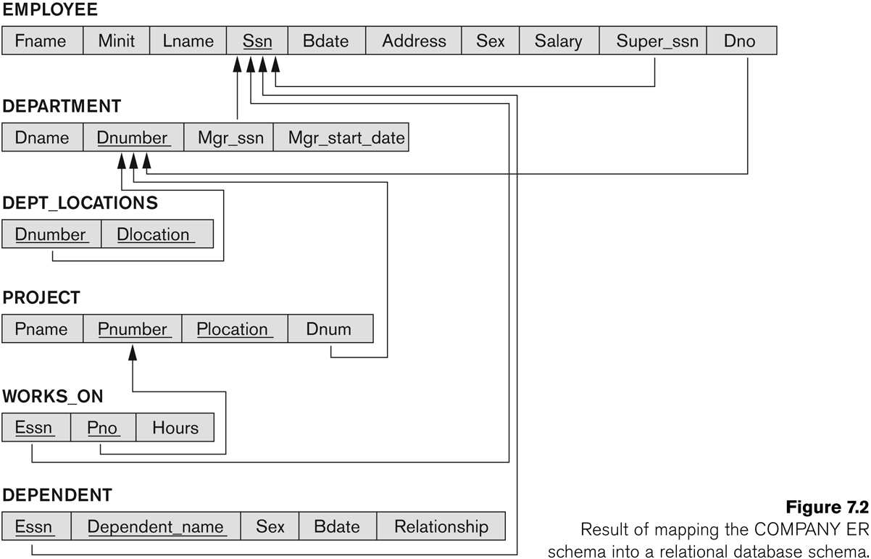
FIGURE 7.2
Result of mapping the COMPANY ER schema into a relational schema.
Slide 7- <number>

Slide 45
ER-to-Relational Mapping Algorithm (contd.)
Step 2: Mapping of Weak Entity Types
  For each weak entity type W in the ER schema with owner entity type E, create a relation R & include all simple attributes (or simple components of composite attributes) of W as attributes of R.
  Also, include as foreign key attributes of R the primary key attribute(s) of the relation(s) that correspond to the owner entity type(s).
  The primary key of R is the combination of the primary key(s) of the owner(s) and the partial key of the weak entity type W, if any.
Example: Create the relation DEPENDENT in this step to correspond to the weak entity type DEPENDENT.
  Include the primary key SSN of the EMPLOYEE relation as a foreign key attribute of DEPENDENT (renamed to ESSN).
  The primary key of the DEPENDENT relation is the combination {ESSN, DEPENDENT_NAME} because DEPENDENT_NAME is the partial key of DEPENDENT.
Slide 7- <number>

Slide 46
ER-to-Relational Mapping Algorithm (contd.)
Step 3: Mapping of Binary 1:1 Relation Types
  For each binary 1:1 relationship type R in the ER schema, identify the relations S and T that correspond to the entity types participating in R.
There are three possible approaches:
  Foreign Key approach: Choose one of the relations-say S-and include a foreign key in S the primary key of T. It is better to choose an entity type with total participation in R in the role of S.
    Example: 1:1 relation MANAGES is mapped by choosing the participating entity type DEPARTMENT to serve in the role of S, because its participation in the MANAGES relationship type is total.
  Merged relation option: An alternate mapping of a 1:1 relationship type is possible by merging the two entity types and the relationship into a single relation. This may be appropriate when both participations are total.
  Cross-reference or relationship relation option: The third alternative is to set up a third relation R for the purpose of cross-referencing the primary keys of the two relations S and T representing the entity types.
Slide 7- <number>

Slide 47
ER-to-Relational Mapping Algorithm (contd.)
Step 4: Mapping of Binary 1:N Relationship Types.
  For each regular binary 1:N relationship type R, identify the relation S that represent the participating entity type at the N-side of the relationship type.
  Include as foreign key in S the primary key of the relation T that represents the other entity type participating in R.
  Include any simple attributes of the 1:N relation type as attributes of S.
Example: 1:N relationship types WORKS_FOR, CONTROLS, and SUPERVISION in the figure.
  For WORKS_FOR we include the primary key DNUMBER of the DEPARTMENT relation as foreign key in the EMPLOYEE relation and call it DNO.
Slide 7- <number>

Slide 48
ER-to-Relational Mapping Algorithm (contd.)
Step 5: Mapping of Binary M:N Relationship Types.
  For each regular binary M:N relationship type R, create a new relation S to represent R.
  Include as foreign key attributes in S the primary keys of the relations that represent the participating entity types; their combination will form the primary key of S.
  Also include any simple attributes of the M:N relationship type (or simple components of composite attributes) as attributes of S.
Example: The M:N relationship type WORKS_ON from the ER diagram is mapped by creating a relation WORKS_ON in the relational database schema.
  The primary keys of the PROJECT and EMPLOYEE relations are included as foreign keys in WORKS_ON and renamed PNO and ESSN, respectively.
  Attribute HOURS in WORKS_ON represents the HOURS attribute of the relation type. The primary key of the WORKS_ON relation is the combination of the foreign key attributes {ESSN, PNO}.
Slide 7- <number>

Slide 49
ER-to-Relational Mapping Algorithm (contd.)
Step 6: Mapping of Multivalued attributes.
  For each multivalued attribute A, create a new relation R.
  This relation R will include an attribute corresponding to A, plus the primary key attribute K-as a foreign key in R-of the relation that represents the entity type of relationship type that has A as an attribute.
  The primary key of R is the combination of A and K. If the multivalued attribute is composite, we include its simple components.
Example: The relation DEPT_LOCATIONS is created.
  The attribute DLOCATION represents the multivalued attribute LOCATIONS of DEPARTMENT, while DNUMBER-as foreign key-represents the primary key of the DEPARTMENT relation.
  The primary key of R is the combination of {DNUMBER, DLOCATION}.
Slide 7- <number>

Slide 50
ER-to-Relational Mapping Algorithm (contd.)
Step 7: Mapping of N-ary Relationship Types.
  For each n-ary relationship type R, where n>2, create a new relationship S to represent R.
  Include as foreign key attributes in S the primary keys of the relations that represent the participating entity types.
  Also include any simple attributes of the n-ary relationship type (or simple components of composite attributes) as attributes of S.
Example: The relationship type SUPPY in the ER on the next slide.
  This can be mapped to the relation SUPPLY shown in the relational schema, whose primary key is the combination of the three foreign keys {SNAME, PARTNO, PROJNAME}
Slide 7- <number>

Slide 51

FIGURE 4.11
Ternary relationship types. (a) The SUPPLY relationship.
Slide 7- <number>

Slide 52

FIGURE 7.3
Mapping the n-ary relationship type SUPPLY from Figure 4.11a.
Slide 7- <number>

Slide 53
Summary of Mapping constructs and constraints
Table 7.1 Correspondence between ER and Relational Models
ER Model Relational Model
Entity type “Entity” relation
1:1 or 1:N relationship type Foreign key (or “relationship” relation)
M:N relationship type “Relationship” relation and two foreign keys
n-ary relationship type “Relationship” relation and n foreign keys
Simple attribute Attribute
Composite attribute Set of simple component attributes
Multivalued attribute Relation and foreign key
Value set Domain
Key attribute Primary (or secondary) key
Slide 7- <number>

Slide 54
Mapping EER Model Constructs to Relations
Step8: Options for Mapping Specialization or Generalization.
  Convert each specialization with m subclasses {S1, S2,….,Sm} and generalized superclass C, where the attributes of C are {k,a1,…an} and k is the (primary) key, into relational schemas using one of the four following options:
    Option 8A: Multiple relations-Superclass and subclasses
    Option 8B: Multiple relations-Subclass relations only
    Option 8C: Single relation with one type attribute
    Option 8D: Single relation with multiple type attributes
Slide 7- <number>

Slide 55
Mapping EER Model Constructs to Relations
Option 8A: Multiple relations-Superclass and subclasses
  Create a relation L for C with attributes Attrs(L) = {k,a1,…an} and PK(L) = k. Create a relation Li for each subclass Si, 1 < i < m, with the attributesAttrs(Li) = {k} U {attributes of Si} and PK(Li)=k. This option works for any specialization (total or partial, disjoint of over-lapping).
Option 8B: Multiple relations-Subclass relations only
  Create a relation Li for each subclass Si, 1 < i < m, with the attributes Attr(Li) = {attributes of Si} U {k,a1…,an} and PK(Li) = k. This option only works for a specialization whose subclasses are total (every entity in the superclass must belong to (at least) one of the subclasses).
Slide 7- <number>

Slide 56

FIGURE 4.4
EER diagram notation for an attribute-defined specialization on JobType.
Slide 7- <number>

Slide 57

FIGURE 7.4
Options for mapping specialization or generalization.
(a) Mapping the EER schema in Figure 4.4 using option 8A.
Slide 7- <number>

Slide 58
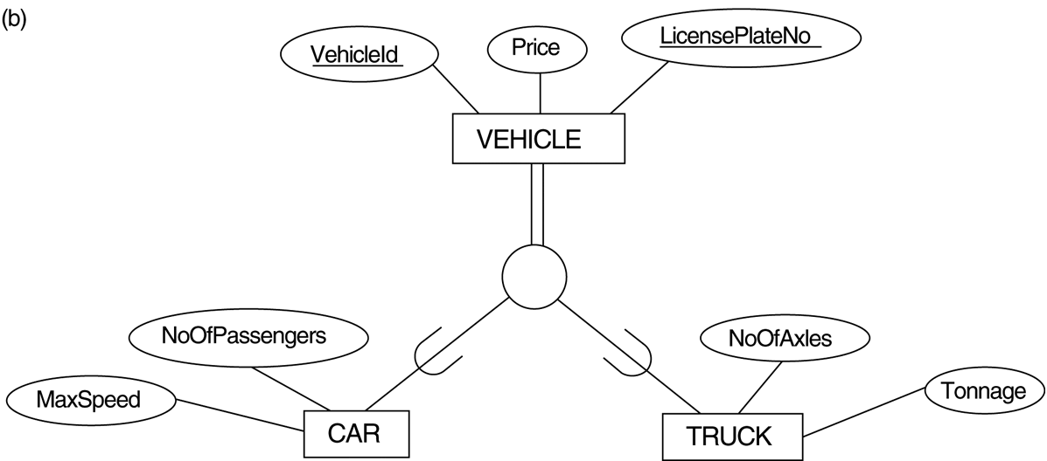
FIGURE 4.3
Generalization. (b) Generalizing CAR and TRUCK into the superclass VEHICLE.
Slide 7- <number>

Slide 59

FIGURE 7.4
Options for mapping specialization or generalization.
(b) Mapping the EER schema in Figure 4.3b using option 8B.
Slide 7- <number>

Slide 60
Mapping EER Model Constructs to Relations (contd.)
Option 8C: Single relation with one type attribute
  Create a single relation L with attributes Attrs(L) = {k,a₁,…a_{n}} U {attributes of S₁} U…U {attributes of S_{m}} U {t} and PK(L) = k. The attribute t is called a type (or discriminating) attribute that indicates the subclass to which each tuple belongs
Option 8D: Single relation with multiple type attributes
  Create a single relation schema L with attributes Attrs(L) = {k,a₁,…a_{n}} U {attributes of S₁} U…U {attributes of S_{m}} U {t₁, t₂,…,t_{m}} and PK(L) = k. Each t_{i}, 1 < I < m, is a Boolean type attribute indicating whether a tuple belongs to the subclass S_{i}.
Slide 7- <number>

Slide 61
FIGURE 4.4
EER diagram notation for an attribute-defined specialization on JobType.
Slide 7- <number>

Slide 62
FIGURE 7.4
Options for mapping specialization or generalization.
(c) Mapping the EER schema in Figure 4.4 using option 8C.
Slide 7- <number>

Slide 63

FIGURE 4.5
EER diagram notation for an overlapping (non-disjoint) specialization.
Slide 7- <number>

Slide 64
FIGURE 7.4
Options for mapping specialization or generalization. (d) Mapping Figure 4.5 using option 8D with Boolean type fields Mflag and Pflag.
Slide 7- <number>

Slide 65
Mapping EER Model Constructs to Relations (contd.)
Mapping of Shared Subclasses (Multiple Inheritance)
  A shared subclass, such as STUDENT_ASSISTANT, is a subclass of several classes, indicating multiple inheritance. These classes must all have the same key attribute; otherwise, the shared subclass would be modeled as a category.
  We can apply any of the options discussed in Step 8 to a shared subclass, subject to the restriction discussed in Step 8 of the mapping algorithm. Below both 8C and 8D are used for the shared class STUDENT_ASSISTANT.
Slide 7- <number>

Slide 66
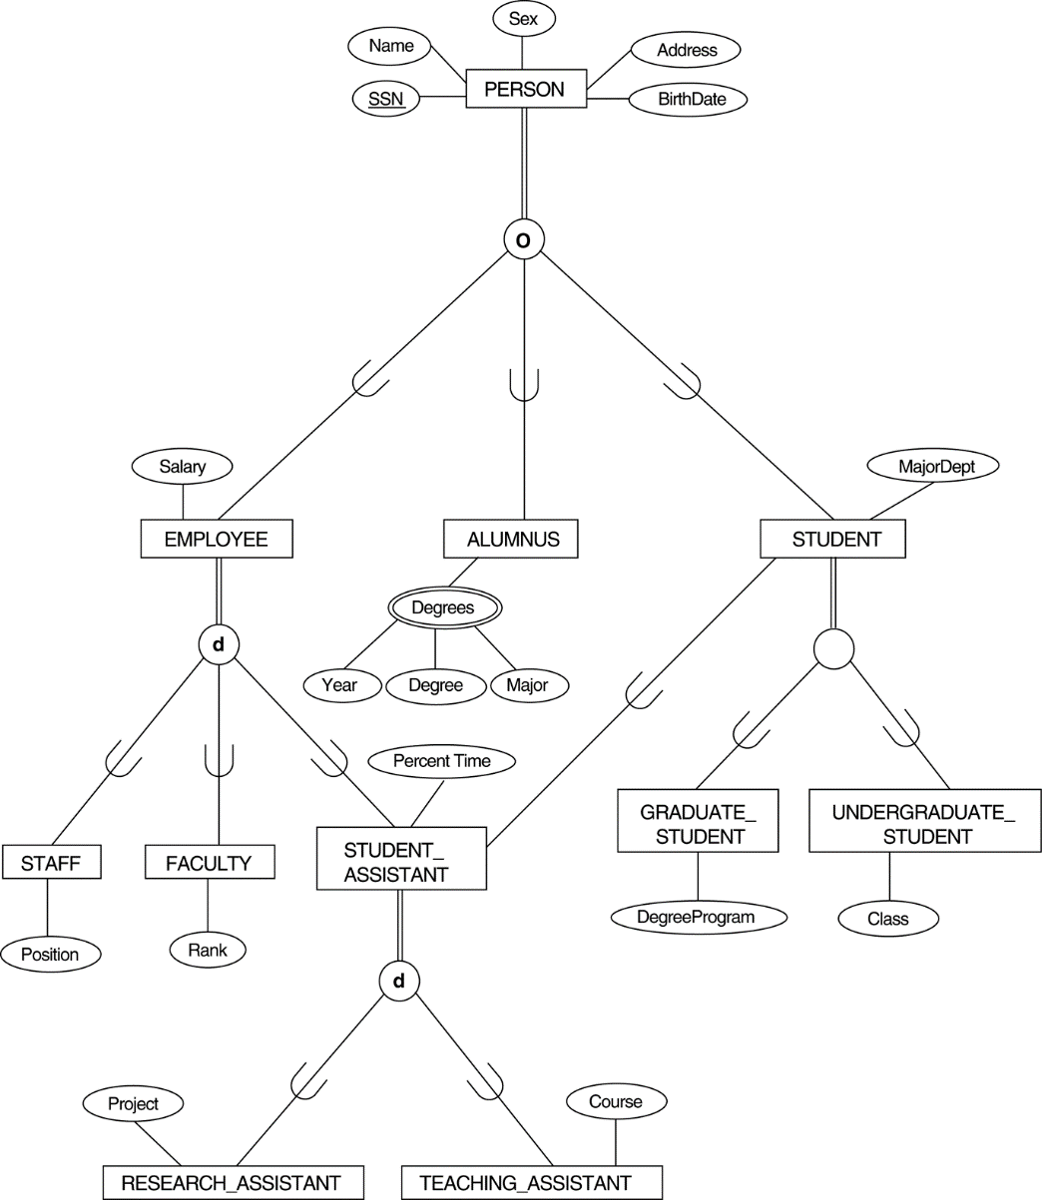
FIGURE 4.7
A specialization lattice with multiple inheritance for a UNIVERSITY database.
Slide 7- <number>

Slide 67
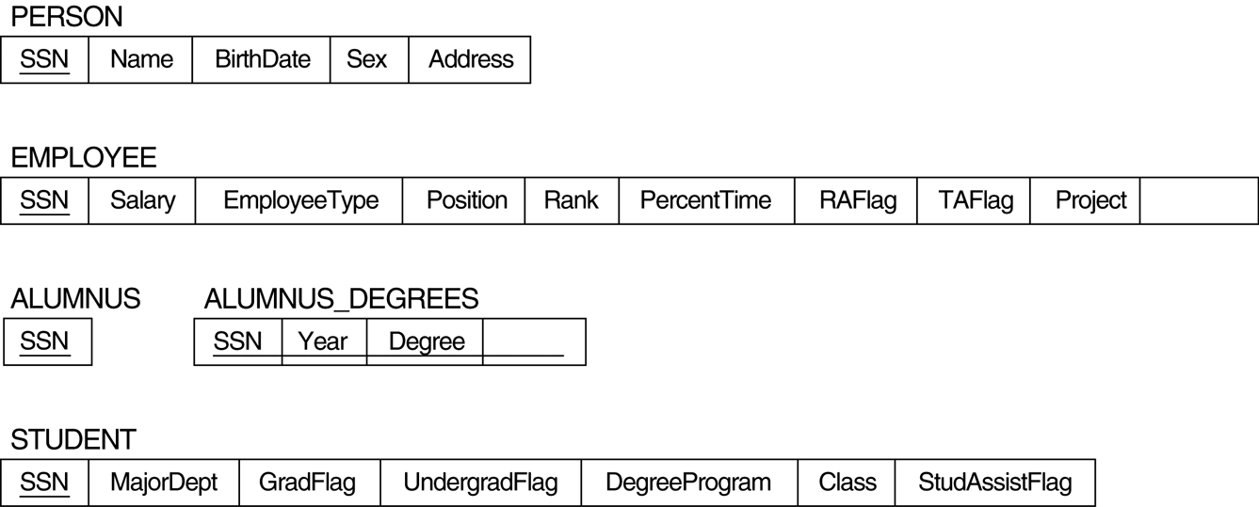
FIGURE 7.5
Mapping the EER specialization lattice in Figure 4.6 using multiple options.
Slide 7- <number>

Slide 68
Mapping EER Model Constructs to Relations (contd.)
Step 9: Mapping of Union Types (Categories).
  For mapping a category whose defining superclass have different keys, it is customary to specify a new key attribute, called a surrogate key, when creating a relation to correspond to the category.
  In the example below we can create a relation OWNER to correspond to the OWNER category and include any attributes of the category in this relation. The primary key of the OWNER relation is the surrogate key, which we called OwnerId.
Slide 7- <number>

Slide 69

FIGURE 4.8
Two categories (union types): OWNER and REGISTERED_VEHICLE.
Slide 7- <number>

Slide 70
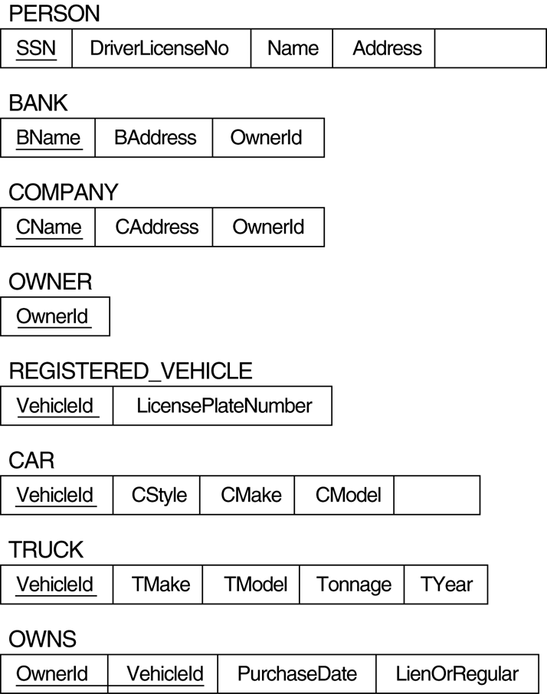
FIGURE 7.6
Mapping the EER categories (union types) in Figure 4.7 to relations.
Slide 7- <number>

Slide 71

Mapping Exercise
Exercise 7.4.
FIGURE 7.7
An ER schema for a SHIP_TRACKING database.
Slide 7- <number>

Slide 72
Chapter Summary
ER-to-Relational Mapping Algorithm
  Step 1: Mapping of Regular Entity Types
  Step 2: Mapping of Weak Entity Types
  Step 3: Mapping of Binary 1:1 Relation Types
  Step 4: Mapping of Binary 1:N Relationship Types.
  Step 5: Mapping of Binary M:N Relationship Types.
  Step 6: Mapping of Multivalued attributes.
  Step 7: Mapping of N-ary Relationship Types.
Mapping EER Model Constructs to Relations
  Step 8: Options for Mapping Specialization or Generalization.
  Step 9: Mapping of Union Types (Categories).
Slide 7- <number>

