Slide 1
Module 2 Unit 2
Introduction to Transaction Processing Concepts and Theory

Slide 2
Chapter Outline
1 Introduction to Transaction Processing
2 Transaction and System Concepts
3 Desirable Properties of Transactions
4 Characterizing Schedules based on Recoverability
5 Characterizing Schedules based on Serializability

Slide 3
Introduction to Transaction Processing
Single-User System:
  At most one user at a time can use the system.
Multiuser System:
  Many users can access the system concurrently.
Concurrency
  Interleaved processing:
    Concurrent execution of processes is interleaved in a single CPU
  Parallel processing:
    Processes are concurrently executed in multiple CPUs.

Slide 4
Introduction to Transaction Processing (2)
A Transaction:
  Logical unit of database processing that includes one or more access operations (read -retrieval, write - insert or update, delete).
A transaction (set of operations) may be stand-alone specified in a high level language like SQL submitted interactively, or may be embedded within a program.
Transaction boundaries:
  Begin and End transaction.
An application program may contain several transactions separated by the Begin and End transaction boundaries.

Slide 5
Introduction to Transaction Processing
A database is a collection of named data items
Granularity of data - a field, a record , or a whole disk block
Basic operations are read and write
  read_item(X): Reads a database item named X into a program variable. To simplify our notation, we assume that the program variable is also named X.
  write_item(X): Writes the value of program variable X into the database item named X.

Slide 6
Introduction to Transaction Processing
READ AND WRITE OPERATIONS:
read_item(X) command includes the following steps:
  Find the address of the disk block that contains item X.
  Copy that disk block into a buffer in main memory (if that disk block is not already in some main memory buffer).
  Copy item X from the buffer to the program variable named X.
write_item(X) command includes the following steps:
  Find the address of the disk block that contains item X.
  Copy that disk block into a buffer in main memory (if that disk block is not already in some main memory buffer).
  Copy item X from the program variable named X into its correct location in the buffer.
  Store the updated block from the buffer back to disk (either immediately or at some later point in time).

Slide 7

Two sample transactions
FIGURE 17.2 Two sample transactions:
  (a) Transaction T1
  (b) Transaction T2

Slide 8
Why Concurrency Control is needed?
Concurrency control is the process of managing multiple users access and modifications in data simultaneously in shared or multi-user database systems.
The Lost Update Problem
  This occurs when two transactions that access the same database items have their operations interleaved in a way that makes the value of some database item incorrect.
The Temporary Update (or Dirty Read) Problem
  This occurs when one transaction updates a database item and then the transaction fails for some reason The updated item is accessed by another transaction before it is changed back to its original value.
The Incorrect Summary Problem
  If one transaction is calculating an aggregate summary function on a number of records while other transactions are updating some of these records, the aggregate function may calculate some values before they are updated and others after they are updated.

Slide 9
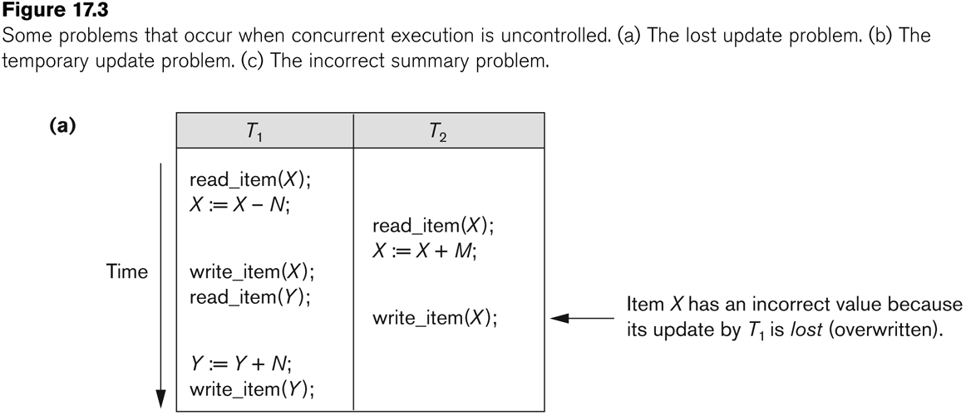
The lost update problem.

Slide 10
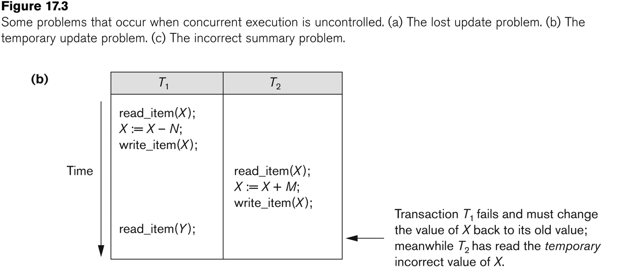
The temporary update problem.

Slide 11
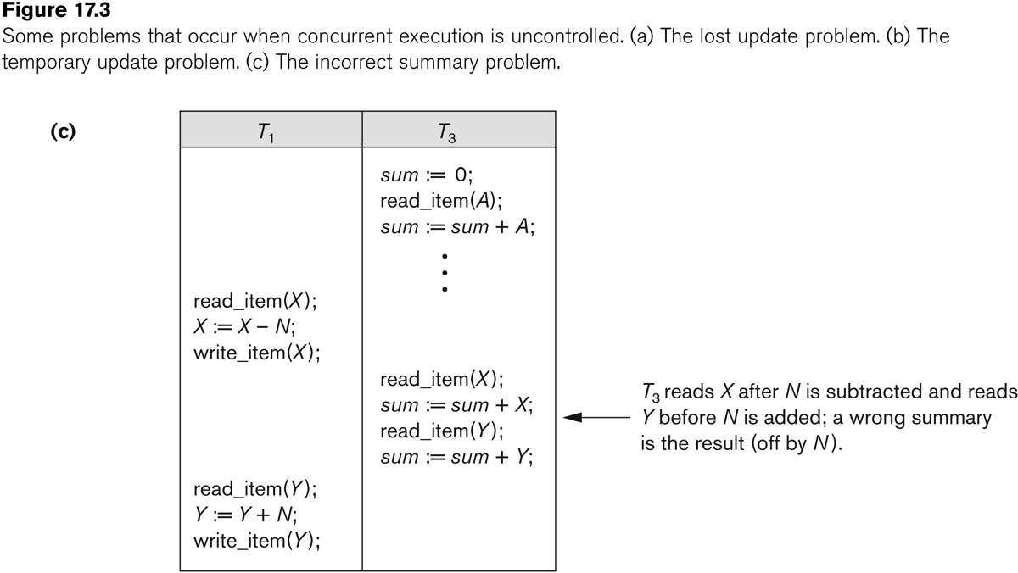
The incorrect summary problem.

Slide 12
Why recovery is needed?
Why recovery is needed:
(What causes a Transaction to fail)
  1. A computer failure (system crash):
    A hardware or software error occurs in the computer system during transaction execution. If the hardware crashes, the contents of the computer’s internal memory may be lost.
  2. A transaction or system error:
    Some operation in the transaction may cause it to fail, such as integer overflow or division by zero. Transaction failure may also occur because of erroneous parameter values or because of a logical programming error. In addition, the user may interrupt the transaction during its execution.

Slide 13
Why recovery is needed (Contd.):
(What causes a Transaction to fail)
  3. Local errors or exception conditions detected by the transaction:
    Certain conditions necessitate cancellation of the transaction. For example, data for the transaction may not be found. A condition, such as insufficient account balance in a banking database, may cause a transaction, such as a fund withdrawal from that account, to be canceled.
    A programmed abort in the transaction causes it to fail.
  4. Concurrency control enforcement:
    The concurrency control method may decide to abort the transaction, to be restarted later, because it violates serializability or because several transactions are in a state of deadlock (see Chapter 18).

Slide 14
Why recovery is needed (contd.):
(What causes a Transaction to fail)
  5. Disk failure:
    Some disk blocks may lose their data because of a read or write malfunction or because of a disk read/write head crash. This may happen during a read or a write operation of the transaction.
  6. Physical problems and catastrophes:
    This refers to an endless list of problems that includes power or air-conditioning failure, fire, theft, sabotage, overwriting disks or tapes by mistake, and mounting of a wrong tape by the operator.

Slide 15
2 Transaction and System Concepts (1)
A transaction is an atomic unit of work that is either completed in its entirety or not done at all.
  For recovery purposes, the system needs to keep track of when the transaction starts, terminates, and commits or aborts.
Transaction states:
  Active state
  Partially committed state
  Committed state
  Failed state
  Terminated State

Slide 16
Transaction and System Concepts (2)
Recovery manager keeps track of the following operations:
  begin_transaction: This marks the beginning of transaction execution.
  read or write: These specify read or write operations on the database items that are executed as part of a transaction.
  end_transaction: This specifies that read and write transaction operations have ended and marks the end limit of transaction execution.
    At this point it may be necessary to check whether the changes introduced by the transaction can be permanently applied to the database or whether the transaction has to be aborted because it violates concurrency control or for some other reason.

Slide 17
Transaction and System Concepts (3)
Recovery manager keeps track of the following operations (cont):
  commit_transaction: This signals a successful end of the transaction so that any changes (updates) executed by the transaction can be safely committed to the database and will not be undone.
  rollback (or abort): This signals that the transaction has ended unsuccessfully, so that any changes or effects that the transaction may have applied to the database must be undone.

Slide 18
Transaction and System Concepts (4)
Recovery techniques use the following operators:
  undo: Similar to rollback except that it applies to a single operation rather than to a whole transaction.
  redo: This specifies that certain transaction operations must be redone to ensure that all the operations of a committed transaction have been applied successfully to the database.

Slide 19
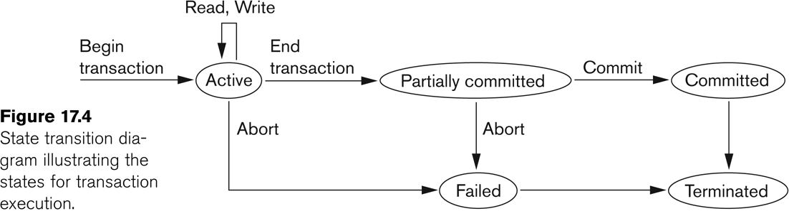
State transition diagram illustrating the states for transaction execution

Slide 20
3 Desirable Properties of Transactions (1)
ACID properties:
Atomicity: A transaction is an atomic unit of processing; it is either performed in its entirety or not performed at all.
Consistency preservation: A correct execution of the transaction must take the database from one consistent state to another.
Isolation: A transaction should not make its updates visible to other transactions until it is committed; this property, when enforced strictly, solves the temporary update problem and makes cascading rollbacks of transactions unnecessary (see Chapter 21).
Durability or permanency: Once a transaction changes the database and the changes are committed, these changes must never be lost because of subsequent failure.

Slide 21
5 Characterizing Schedules based on Serializability (1)
Serial schedule:
  A schedule S is serial if, for every transaction T participating in the schedule, all the operations of T are executed consecutively in the schedule.
    Otherwise, the schedule is called nonserial schedule.
Serializable schedule:
  A schedule S is serializable if it is equivalent to some serial schedule of the same n transactions.

Slide 22
Characterizing Schedules based on Serializability (2)
Result equivalent:
  Two schedules are called result equivalent if they produce the same final state of the database.
Conflict equivalent:
  Two schedules are said to be conflict equivalent if the order of any two conflicting operations is the same in both schedules.
Conflict serializable:
  A schedule S is said to be conflict serializable if it is conflict equivalent to some serial schedule S’.

Slide 23
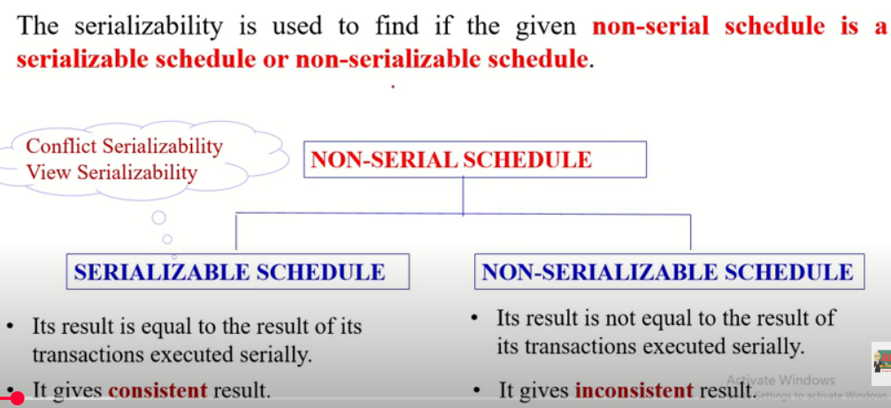
Serializability

Slide 24
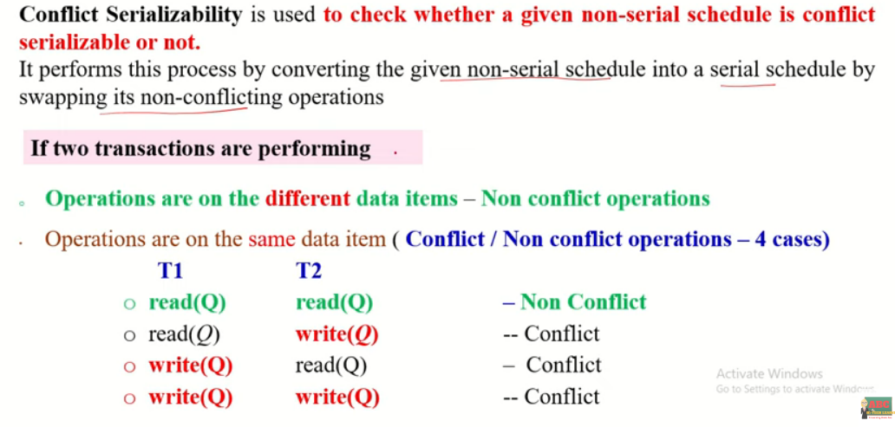
Conflict Serializability

Slide 25
Conflict Serializability
Given non serial schedule S1
T1 | T2
READ (A)
 | READ (A)
 | READ (B)
 | WRITE (B)
READ (B)
WRITE (A)
T1 | T2
 | READ (A)
READ (A)
 | READ (B)
 | WRITE (B)
READ (B)
WRITE (A)
Since S1 is converted to S2 successfully by swapping its non-conflicting operations.
S1 is conflict serializable schedule i.e it will not violate the consistency of the database, if executed.
Serial schedule s2
T1 | T2
 | READ (A)
 | READ (B)
READ (A)
 | WRITE (B)
READ (B)
WRITE (A)
T1 | T2
 | READ (A)
 | READ (B)
 | WRITE (B)
READ (A)
READ (B)
WRITE (A)

Slide 26
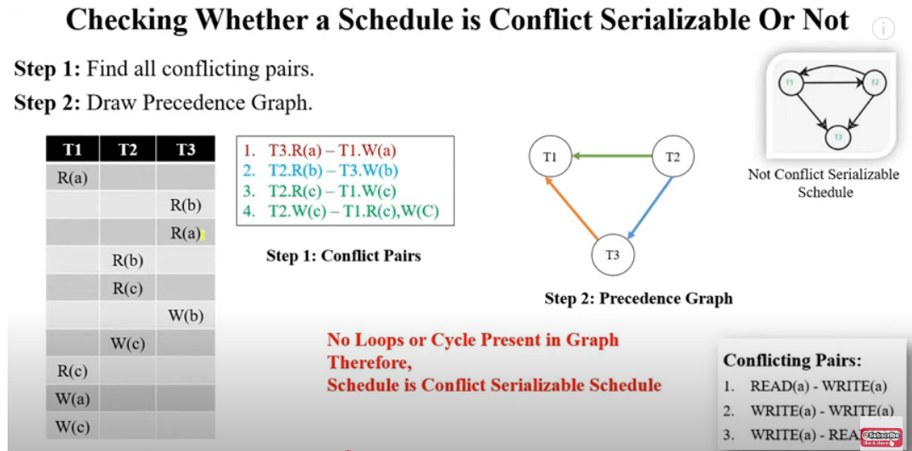
Conflict Serializability

Slide 27
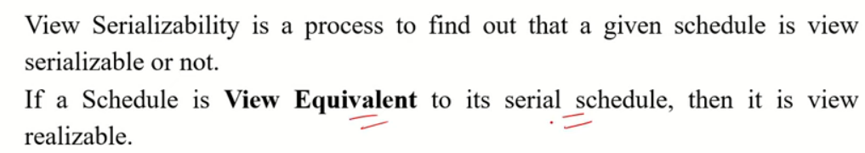
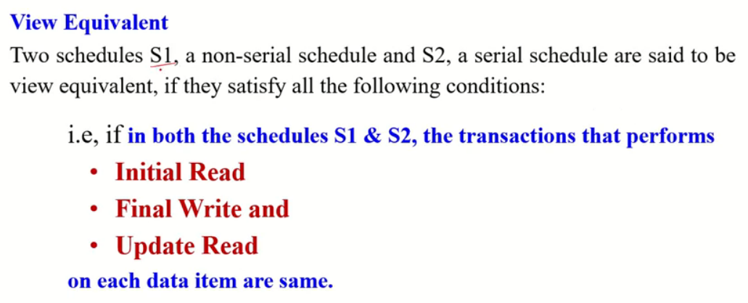
View serilizability

Slide 28
View serilizability

Slide 29
View serilizability
S1
T1 | T2
READ (A)
WRITE (A)
 | READ (A)
 | WRITE (A)
READ (B)
WRITE (B)
 | READ (B)
 | WRITE (B)
S2
T1 | T2
READ (A)
WRITE (A)
READ (B)
WRITE (B)
 | READ (A)
 | WRITE (A)
 | READ (B)
 | WRITE (B)
Initial Read(A): T1
Update Read(A): T2
Final Write(A): T2
Initial Read(B): T1
Update Read(B): T2
Final Write(B): T2
Initial Read(A): T1
Update Read(A): T2
Final Write(A): T2
Initial Read(B): T1
Update Read(B): T2
Final Write(B): T2
S1=S2 The given schedule is view serializable

Slide 30
View serilizability
S1
T1 | T2
READ (Q)
 | WRITE (Q)
WRITE (Q)
S2
T1 | T2
READ (Q)
WRITE (Q)
 | WRITE (Q)
Initial Read(Q): T1
Update Read(Q): NIL
Final Write(Q): T1
Initial Read(Q): T1
Update Read(Q): NIL
Final Write(Q): T2

Slide 31
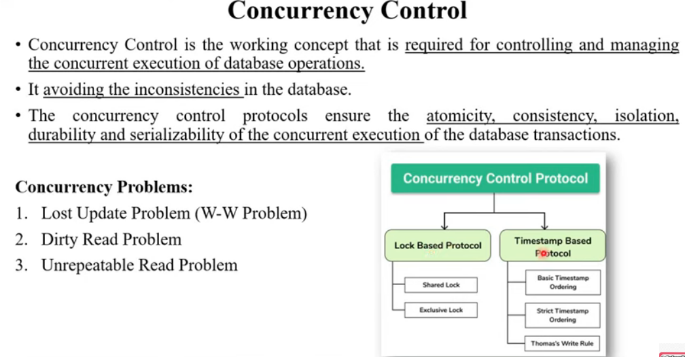

Slide 32
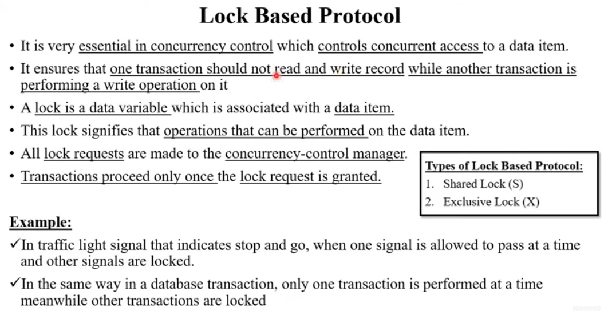

Slide 33
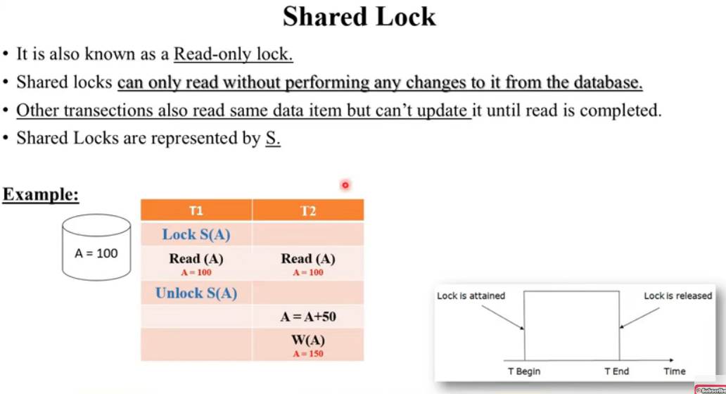

Slide 34
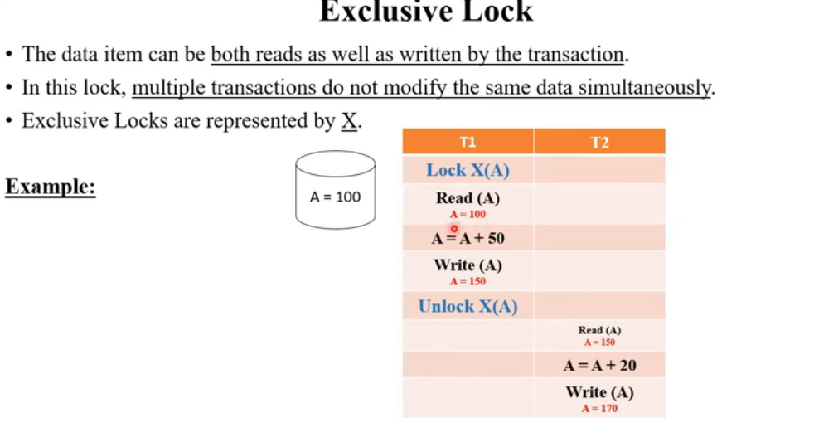

Slide 35
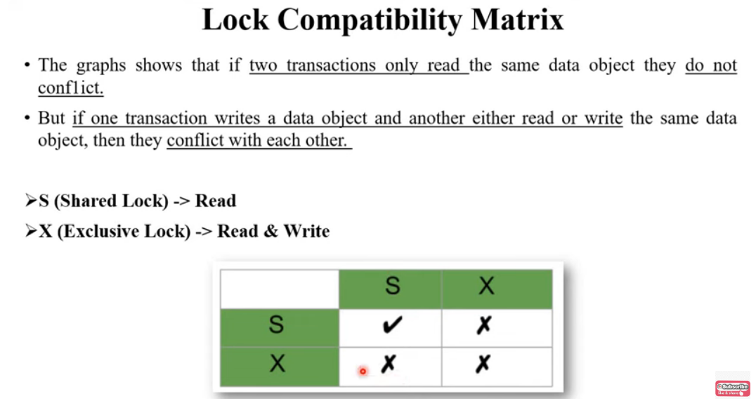

Slide 36
Characterizing Schedules based on Serializability (3)
Being serializable is not the same as being serial
Being serializable implies that the schedule is a correct schedule.
  It will leave the database in a consistent state.
  The interleaving is appropriate and will result in a state as if the transactions were serially executed, yet will achieve efficiency due to concurrent execution.

Slide 37
Characterizing Schedules based on Serializability (4)
Serializability is hard to check.
  Interleaving of operations occurs in an operating system through some scheduler
  Difficult to determine beforehand how the operations in a schedule will be interleaved.

Slide 38
Characterizing Schedules based on Serializability (5)
Practical approach:
Come up with methods (protocols) to ensure serializability.
It’s not possible to determine when a schedule begins and when it ends.
  Hence, we reduce the problem of checking the whole schedule to checking only a committed project of the schedule (i.e. operations from only the committed transactions.)
Current approach used in most DBMSs:
  Use of locks with two phase locking

Slide 39
Characterizing Schedules based on Serializability (6)
View equivalence:
  A less restrictive definition of equivalence of schedules
View serializability:
  Definition of serializability based on view equivalence.
  A schedule is view serializable if it is view equivalent to a serial schedule.

Slide 40
Characterizing Schedules based on Serializability (7)
Two schedules are said to be view equivalent if the following three conditions hold:
  The same set of transactions participates in S and S’, and S and S’ include the same operations of those transactions.
  For any operation Ri(X) of Ti in S, if the value of X read by the operation has been written by an operation Wj(X) of Tj (or if it is the original value of X before the schedule started), the same condition must hold for the value of X read by operation Ri(X) of Ti in S’.
  If the operation Wk(Y) of Tk is the last operation to write item Y in S, then Wk(Y) of Tk must also be the last operation to write item Y in S’.

Slide 41
Characterizing Schedules based on Serializability (8)
The premise behind view equivalence:
  As long as each read operation of a transaction reads the result of the same write operation in both schedules, the write operations of each transaction must produce the same results.
  “The view”: the read operations are said to see the same view in both schedules.

Slide 42
Characterizing Schedules based on Serializability (9)
Relationship between view and conflict equivalence:
  The two are same under constrained write assumption which assumes that if T writes X, it is constrained by the value of X it read; i.e., new X = f(old X)
  Conflict serializability is stricter than view serializability. With unconstrained write (or blind write), a schedule that is view serializable is not necessarily conflict serializable.
  Any conflict serializable schedule is also view serializable, but not vice versa.

Slide 43
Characterizing Schedules based on Serializability (10)
Relationship between view and conflict equivalence (cont):
  Consider the following schedule of three transactions
    T1: r1(X), w1(X); T2: w2(X); and T3: w3(X):
  Schedule Sa: r1(X); w2(X); w1(X); w3(X); c1; c2; c3;
In Sa, the operations w2(X) and w3(X) are blind writes, since T1 and T3 do not read the value of X.
  Sa is view serializable, since it is view equivalent to the serial schedule T1, T2, T3.
  However, Sa is not conflict serializable, since it is not conflict equivalent to any serial schedule.

Slide 44
Characterizing Schedules based on Serializability (11)
Testing for conflict serializability: Algorithm 17.1:
  Looks at only read_Item (X) and write_Item (X) operations
  Constructs a precedence graph (serialization graph) - a graph with directed edges
  An edge is created from Ti to Tj if one of the operations in Ti appears before a conflicting operation in Tj
  The schedule is serializable if and only if the precedence graph has no cycles.

Slide 45
Database Concurrency Control
1 Purpose of Concurrency Control
  To enforce Isolation (through mutual exclusion) among conflicting transactions.
  To preserve database consistency through consistency preserving execution of transactions.
  To resolve read-write and write-write conflicts.
Example:
  In concurrent execution environment if T1 conflicts with T2 over a data item A, then the existing concurrency control decides if T1 or T2 should get the A and if the other transaction is rolled-back or waits.

Slide 46
Database Concurrency Control
Two-Phase Locking Techniques
  Locking is an operation which secures
    (a) permission to Read
    (b) permission to Write a data item for a transaction.
  Example:
    Lock (X). Data item X is locked in behalf of the requesting transaction.
  Unlocking is an operation which removes these permissions from the data item.
  Example:
    Unlock (X): Data item X is made available to all other transactions.
  Lock and Unlock are Atomic operations.

Slide 47
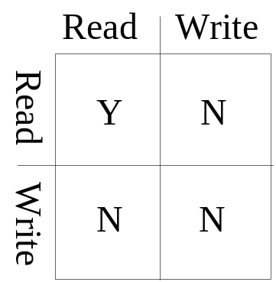
Database Concurrency Control
Two-Phase Locking Techniques: Essential components
  Two locks modes:
    (a) shared (read) (b) exclusive (write).
  Shared mode: shared lock (X)
    More than one transaction can apply share lock on X for reading its value but no write lock can be applied on X by any other transaction.
  Exclusive mode: Write lock (X)
    Only one write lock on X can exist at any time and no shared lock can be applied by any other transaction on X.
  Conflict matrix

Slide 48
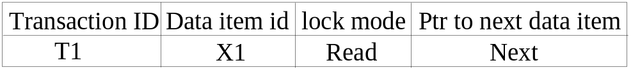
Database Concurrency Control
Two-Phase Locking Techniques: Essential components
  Lock Manager:
    Managing locks on data items.
  Lock table:
    Lock manager uses it to store the identify of transaction locking a data item, the data item, lock mode and pointer to the next data item locked. One simple way to implement a lock table is through linked list.

Slide 49
Database Concurrency Control
Two-Phase Locking Techniques: Essential components
  Database requires that all transactions should be well-formed. A transaction is well-formed if:
    It must lock the data item before it reads or writes to it.
    It must not lock an already locked data items and it must not try to unlock a free data item.

Slide 50
Database Concurrency Control
Two-Phase Locking Techniques: Essential components
  The following code performs the lock operation:
  B: if LOCK (X) = 0 (*item is unlocked*)
  then LOCK (X) ← 1 (*lock the item*)
  else begin
  wait (until lock (X) = 0) and
  the lock manager wakes up the transaction);
  goto B
  end;

Slide 51
Database Concurrency Control
Two-Phase Locking Techniques: Essential components
  The following code performs the unlock operation:
  LOCK (X) ← 0 (*unlock the item*)
  if any transactions are waiting then
  wake up one of the waiting the transactions;

Slide 52
Database Concurrency Control
Two-Phase Locking Techniques: Essential components
  The following code performs the read operation:
B: if LOCK (X) = “unlocked” then
  begin LOCK (X) ← “read-locked”;
  no_of_reads (X) ← 1;
  end
  else if LOCK (X) ← “read-locked” then
  no_of_reads (X) ← no_of_reads (X) +1
  else begin wait (until LOCK (X) = “unlocked” and
  the lock manager wakes up the transaction);
  go to B
  end;

Slide 53
Database Concurrency Control
Two-Phase Locking Techniques: Essential components
  The following code performs the write lock operation:
B: if LOCK (X) = “unlocked” then
  begin LOCK (X) ← “read-locked”;
  no_of_reads (X) ← 1;
  end
  else if LOCK (X) ← “read-locked” then
  no_of_reads (X) ← no_of_reads (X) +1
  else begin wait (until LOCK (X) = “unlocked” and
  the lock manager wakes up the transaction);
  go to B
  end;

Slide 54
Database Concurrency Control
Two-Phase Locking Techniques: Essential components
  The following code performs the unlock operation:
if LOCK (X) = “write-locked” then
  begin LOCK (X) ← “unlocked”;
  wakes up one of the transactions, if any
  end
  else if LOCK (X) ← “read-locked” then
  begin
  no_of_reads (X) ← no_of_reads (X) -1
  if no_of_reads (X) = 0 then
  begin
  LOCK (X) = “unlocked”;
  wake up one of the transactions, if any
  end
  end;

Slide 55
Database Concurrency Control
Two-Phase Locking Techniques: Essential components
Lock conversion
  Lock upgrade: existing read lock to write lock
if Ti has a read-lock (X) and Tj has no read-lock (X) (i ≠ j) then
  convert read-lock (X) to write-lock (X)
  else
  force Ti to wait until Tj unlocks X
  Lock downgrade: existing write lock to read lock
  Ti has a write-lock (X) (*no transaction can have any lock on X*)
  convert write-lock (X) to read-lock (X)

Slide 56
Database Concurrency Control
Two-Phase Locking Techniques: The algorithm
Two Phases:
  (a) Locking (Growing)
  (b) Unlocking (Shrinking).
Locking (Growing) Phase:
  A transaction applies locks (read or write) on desired data items one at a time.
Unlocking (Shrinking) Phase:
  A transaction unlocks its locked data items one at a time.
Requirement:
  For a transaction these two phases must be mutually exclusively, that is, during locking phase unlocking phase must not start and during unlocking phase locking phase must not begin.

Slide 57
Database Concurrency Control
Two-Phase Locking Techniques: The algorithm
T1 T2 Result
read_lock (Y); read_lock (X); Initial values: X=20; Y=30
read_item (Y); read_item (X); Result of serial execution
unlock (Y); unlock (X); T1 followed by T2
write_lock (X); Write_lock (Y); X=50, Y=80.
read_item (X); read_item (Y); Result of serial execution
X:=X+Y; Y:=X+Y; T2 followed by T1
write_item (X); write_item (Y); X=70, Y=50
unlock (X); unlock (Y);

Slide 58
Database Concurrency Control
Two-Phase Locking Techniques: The algorithm
T1 T2 Result
read_lock (Y); X=50; Y=50
read_item (Y); Nonserializable because it.
unlock (Y); violated two-phase policy.
read_lock (X);
read_item (X);
unlock (X);
write_lock (Y);
read_item (Y);
Y:=X+Y;
write_item (Y);
unlock (Y);
write_lock (X);
read_item (X);
X:=X+Y;
write_item (X);
unlock (X);
Time

Slide 59
Database Concurrency Control
Two-Phase Locking Techniques: The algorithm
T’1 T’2
read_lock (Y); read_lock (X); T1 and T2 follow two-phase
read_item (Y); read_item (X); policy but they are subject to
write_lock (X); Write_lock (Y); deadlock, which must be
unlock (Y); unlock (X); dealt with.
read_item (X); read_item (Y);
X:=X+Y; Y:=X+Y;
write_item (X); write_item (Y);
unlock (X); unlock (Y);

Slide 60
Database Concurrency Control
Two-Phase Locking Techniques: The algorithm
Two-phase policy generates two locking algorithms
  (a) Basic
  (b) Conservative
Conservative:
  Prevents deadlock by locking all desired data items before transaction begins execution.
Basic:
  Transaction locks data items incrementally. This may cause deadlock which is dealt with.
Strict:
  A more stricter version of Basic algorithm where unlocking is performed after a transaction terminates (commits or aborts and rolled-back). This is the most commonly used two-phase locking algorithm.

Slide 61
Database Concurrency Control
Dealing with Deadlock and Starvation
  Deadlock
T’1 T’2
read_lock (Y); T1 and T2 did follow two-phase
read_item (Y); policy but they are deadlock
read_lock (X);
read_item (Y);
write_lock (X);
(waits for X) write_lock (Y);
(waits for Y)
  Deadlock (T’1 and T’2)

Slide 62
Database Concurrency Control
Dealing with Deadlock and Starvation
Deadlock prevention
  A transaction locks all data items it refers to before it begins execution.
  This way of locking prevents deadlock since a transaction never waits for a data item.
  The conservative two-phase locking uses this approach.

Slide 63
Database Concurrency Control
Dealing with Deadlock and Starvation
Deadlock detection and resolution
  In this approach, deadlocks are allowed to happen. The scheduler maintains a wait-for-graph for detecting cycle. If a cycle exists, then one transaction involved in the cycle is selected (victim) and rolled-back.
  A wait-for-graph is created using the lock table. As soon as a transaction is blocked, it is added to the graph. When a chain like: Ti waits for Tj waits for Tk waits for Ti or Tj occurs, then this creates a cycle. One of the transaction o

Slide 64
Database Concurrency Control
Dealing with Deadlock and Starvation
Deadlock avoidance
  There are many variations of two-phase locking algorithm.
  Some avoid deadlock by not letting the cycle to complete.
  That is as soon as the algorithm discovers that blocking a transaction is likely to create a cycle, it rolls back the transaction.
  Wound-Wait and Wait-Die algorithms use timestamps to avoid deadlocks by rolling-back victim.

Slide 65
Database Concurrency Control
Dealing with Deadlock and Starvation
Starvation
  Starvation occurs when a particular transaction consistently waits or restarted and never gets a chance to proceed further.
  In a deadlock resolution it is possible that the same transaction may consistently be selected as victim and rolled-back.
  This limitation is inherent in all priority based scheduling mechanisms.
  In Wound-Wait scheme a younger transaction may always be wounded (aborted) by a long running older transaction which may create starvation.

Slide 66
Database Concurrency Control
Timestamp based concurrency control algorithm
Timestamp
  A monotonically increasing variable (integer) indicating the age of an operation or a transaction. A larger timestamp value indicates a more recent event or operation.
  Timestamp based algorithm uses timestamp to serialize the execution of concurrent transactions.

Slide 67
Database Concurrency Control
Timestamp based concurrency control algorithm
Basic Timestamp Ordering
  1. Transaction T issues a write_item(X) operation:
    If read_TS(X) > TS(T) or if write_TS(X) > TS(T), then an younger transaction has already read the data item so abort and roll-back T and reject the operation.
    If the condition in part (a) does not exist, then execute write_item(X) of T and set write_TS(X) to TS(T).
  2. Transaction T issues a read_item(X) operation:
    If write_TS(X) > TS(T), then an younger transaction has already written to the data item so abort and roll-back T and reject the operation.
    If write_TS(X) ≤ TS(T), then execute read_item(X) of T and set read_TS(X) to the larger of TS(T) and the current read_TS(X).

Slide 68
Database Concurrency Control
Timestamp based concurrency control algorithm
Strict Timestamp Ordering
  1. Transaction T issues a write_item(X) operation:
    If TS(T) > read_TS(X), then delay T until the transaction T’ that wrote or read X has terminated (committed or aborted).
  2. Transaction T issues a read_item(X) operation:
    If TS(T) > write_TS(X), then delay T until the transaction T’ that wrote or read X has terminated (committed or aborted).

Slide 69
Database Concurrency Control
Timestamp based concurrency control algorithm
Thomas’s Write Rule
  If read_TS(X) > TS(T) then abort and roll-back T and reject the operation.
  If write_TS(X) > TS(T), then just ignore the write operation and continue execution. This is because the most recent writes counts in case of two consecutive writes.
  If the conditions given in 1 and 2 above do not occur, then execute write_item(X) of T and set write_TS(X) to TS(T).

Slide 70
Database Concurrency Control
Multiversion concurrency control techniques
  This approach maintains a number of versions of a data item and allocates the right version to a read operation of a transaction. Thus unlike other mechanisms a read operation in this mechanism is never rejected.
  Side effect:
    Significantly more storage (RAM and disk) is required to maintain multiple versions. To check unlimited growth of versions, a garbage collection is run when some criteria is satisfied.

Slide 71
Database Concurrency Control
Multiversion technique based on timestamp ordering
  This approach maintains a number of versions of a data item and allocates the right version to a read operation of a transaction.
    Thus unlike other mechanisms a read operation in this mechanism is never rejected.
  Side effects: Significantly more storage (RAM and disk) is required to maintain multiple versions. To check unlimited growth of versions, a garbage collection is run when some criteria is satisfied.

Slide 72
Database Concurrency Control
Multiversion technique based on timestamp ordering
  Assume X1, X2, …, Xn are the version of a data item X created by a write operation of transactions. With each Xi a read_TS (read timestamp) and a write_TS (write timestamp) are associated.
  read_TS(Xi): The read timestamp of Xi is the largest of all the timestamps of transactions that have successfully read version Xi.
  write_TS(Xi): The write timestamp of Xi that wrote the value of version Xi.
  A new version of Xi is created only by a write operation.

Slide 73
Database Concurrency Control
Multiversion technique based on timestamp ordering
  To ensure serializability, the following two rules are used.
  If transaction T issues write_item (X) and version i of X has the highest write_TS(Xi) of all versions of X that is also less than or equal to TS(T), and read _TS(Xi) > TS(T), then abort and roll-back T; otherwise create a new version Xi and read_TS(X) = write_TS(Xj) = TS(T).
  If transaction T issues read_item (X), find the version i of X that has the highest write_TS(Xi) of all versions of X that is also less than or equal to TS(T), then return the value of Xi to T, and set the value of read _TS(Xi) to the largest of TS(T) and the current read_TS(Xi).

Slide 74
Database Concurrency Control
Multiversion technique based on timestamp ordering
  To ensure serializability, the following two rules are used.
    If transaction T issues write_item (X) and version i of X has the highest write_TS(Xi) of all versions of X that is also less than or equal to TS(T), and read _TS(Xi) > TS(T), then abort and roll-back T; otherwise create a new version Xi and read_TS(X) = write_TS(Xj) = TS(T).
    If transaction T issues read_item (X), find the version i of X that has the highest write_TS(Xi) of all versions of X that is also less than or equal to TS(T), then return the value of Xi to T, and set the value of read _TS(Xi) to the largest of TS(T) and the current read_TS(Xi).
  Rule 2 guarantees that a read will never be rejected.

Slide 75
Database Concurrency Control
Multiversion Two-Phase Locking Using Certify Locks
Concept
  Allow a transaction T’ to read a data item X while it is write locked by a conflicting transaction T.
  This is accomplished by maintaining two versions of each data item X where one version must always have been written by some committed transaction. This means a write operation always creates a new version of X.

Slide 76
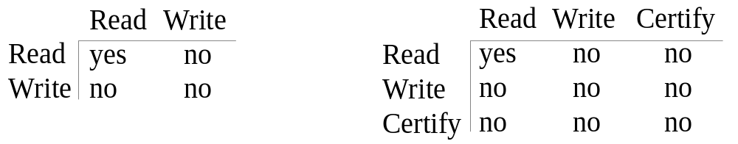
Database Concurrency Control
Multiversion Two-Phase Locking Using Certify Locks
Steps
  X is the committed version of a data item.
  T creates a second version X’ after obtaining a write lock on X.
  Other transactions continue to read X.
  T is ready to commit so it obtains a certify lock on X’.
  The committed version X becomes X’.
  T releases its certify lock on X’, which is X now.
Compatibility tables for
read/write locking scheme read/write/certify locking scheme

Slide 77
Database Concurrency Control
Multiversion Two-Phase Locking Using Certify Locks
Note:
  In multiversion 2PL read and write operations from conflicting transactions can be processed concurrently.
  This improves concurrency but it may delay transaction commit because of obtaining certify locks on all its writes. It avoids cascading abort but like strict two phase locking scheme conflicting transactions may get deadlocked.

Slide 78
Database Concurrency Control
Validation (Optimistic) Concurrency Control Schemes
In this technique only at the time of commit serializability is checked and transactions are aborted in case of non-serializable schedules.
Three phases:
  Read phase
  Validation phase
  Write phase
1. Read phase:
  A transaction can read values of committed data items. However, updates are applied only to local copies (versions) of the data items (in database cache).

Slide 79
Database Concurrency Control
Validation (Optimistic) Concurrency Control Schemes
2. Validation phase: Serializability is checked before transactions write their updates to the database.
  This phase for Ti checks that, for each transaction Tj that is either committed or is in its validation phase, one of the following conditions holds:
    Tj completes its write phase before Ti starts its read phase.
    Ti starts its write phase after Tj completes its write phase, and the read_set of Ti has no items in common with the write_set of Tj
    Both the read_set and write_set of Ti have no items in common with the write_set of Tj, and Tj completes its read phase.
    When validating Ti, the first condition is checked first for each transaction Tj, since (1) is the simplest condition to check. If (1) is false then (2) is checked and if (2) is false then (3 ) is checked. If none of these conditions holds, the validation fails and Ti is aborted.

Slide 80
Database Concurrency Control
Validation (Optimistic) Concurrency Control Schemes
3. Write phase: On a successful validation transactions’ updates are applied to the database; otherwise, transactions are restarted.

Slide 81
Database Concurrency Control
Granularity of data items and Multiple Granularity Locking
A lockable unit of data defines its granularity. Granularity can be coarse (entire database) or it can be fine (a tuple or an attribute of a relation).
Data item granularity significantly affects concurrency control performance. Thus, the degree of concurrency is low for coarse granularity and high for fine granularity.
Example of data item granularity:
  A field of a database record (an attribute of a tuple)
  A database record (a tuple or a relation)
  A disk block
  An entire file
  The entire database

Slide 82
DBS MODULE 2 UNIT 3

Slide 83
Introduction
NOSQL
  Not only SQL
  SQL systems offer many features (not everyone will use) and restrictive
Most NOSQL systems are distributed databases or distributed storage systems
  Focus on semi-structured data storage, high performance, availability, data replication, and scalability

Slide 84
Introduction (cont’d.)
NOSQL systems focus on storage of “big data”
Typical applications that use NOSQL
  Social media
  Web links
  User profiles
  Marketing and sales
  Posts and tweets
  Road maps and spatial data
  Email

Slide 85
Introduction to NOSQL Systems
BigTable
  Google’s proprietary NOSQL system
  Column-based or wide column store
DynamoDB (Amazon)
  Key-value data store
Cassandra (Facebook)
  Uses concepts from both key-value store and column-based systems

Slide 86
Introduction to NOSQL Systems (cont’d.)
MongoDB and CouchDB
  Document stores
Neo4J and GraphBase
  Graph-based NOSQL systems
OrientDB
  Combines several concepts
Database systems classified on the object model
  Or native XML model

Slide 87
Introduction to NOSQL Systems (cont’d.)
NOSQL characteristics related to distributed databases and distributed systems
  Scalability
  Availability, replication, and eventual consistency
  Replication models
    Master-slave
    Master-master
  Sharding of files
  High performance data access

Slide 88
Introduction to NOSQL Systems (cont’d.)
NOSQL characteristics related to data models and query languages
  Schema not required
  Less powerful query languages
  Versioning

Slide 89
Introduction to NOSQL Systems (cont’d.)
Categories of NOSQL systems
  Document-based NOSQL systems
  NOSQL key-value stores
  Column-based or wide column NOSQL systems
  Graph-based NOSQL systems
  Hybrid NOSQL systems
  Object databases
  XML databases

Slide 90
24.2 The CAP Theorem
Various levels of consistency among replicated data items
  Enforcing serializabilty the strongest form of consistency
    High overhead – can reduce read/write operation performance
CAP theorem
  Consistency, availability, and partition tolerance
  Not possible to guarantee all three simultaneously
    In distributed system with data replication

Slide 91
The CAP Theorem (cont’d.)
Designer can choose two of three to guarantee
  Weaker consistency level is often acceptable in NOSQL distributed data store
  Guaranteeing availability and partition tolerance more important
  Eventual consistency often adopted

Slide 92
24.3 Document-Based NOSQL Systems and MongoDB
Document stores
  Collections of similar documents
Individual documents resemble complex objects or XML documents
  Documents are self-describing
  Can have different data elements
Documents can be specified in various formats
  XML
  JSON

Slide 93
MongoDB Data Model
Documents stored in binary JSON (BSON) format
Individual documents stored in a collection
Example command
  First parameter specifies name of the collection
  Collection options include limits on size and number of documents
Each document in collection has unique ObjectID field called _id

Slide 94
MongoDB Data Model (cont’d.)
A collection does not have a schema
  Structure of the data fields in documents chosen based on how documents will be accessed
  User can choose normalized or denormalized design
Document creation using insert operation
Document deletion using remove operation

Slide 95
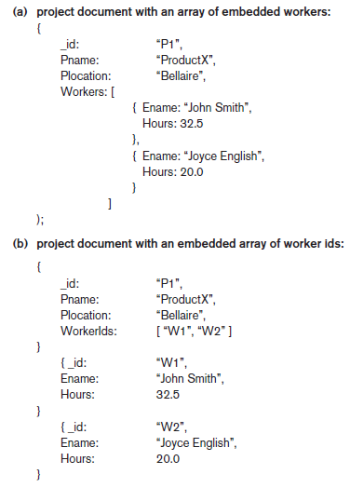
Figure 24.1 (continues)
Example of simple documents in MongoDB (a) Denormalized document design with embedded subdocuments (b) Embedded array of document references

Slide 96
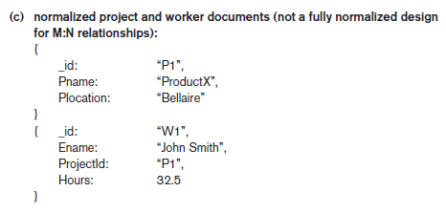
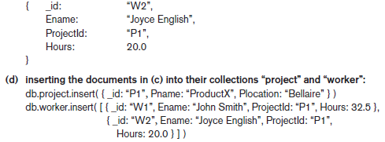
Figure 24.1 (cont’d.) Example of simple documents in MongoDB (c) Normalized documents (d) Inserting the documents in Figure 24.1(c) into their collections

Slide 97
MongoDB Distributed Systems Characteristics
Two-phase commit method
  Used to ensure atomicity and consistency of multidocument transactions
Replication in MongoDB
  Concept of replica set to create multiple copies on different nodes
  Variation of master-slave approach
  Primary copy, secondary copy, and arbiter
    Arbiter participates in elections to select new primary if needed

Slide 98
MongoDB Distributed Systems Characteristics (cont’d.)
Replication in MongoDB (cont’d.)
  All write operations applied to the primary copy and propagated to the secondaries
  User can choose read preference
    Read requests can be processed at any replica
Sharding in MongoDB
  Horizontal partitioning divides the documents into disjoint partitions (shards)
  Allows adding more nodes as needed
  Shards stored on different nodes to achieve load balancing

Slide 99
MongoDB Distributed Systems Characteristics (cont’d.)
Sharding in MongoDB (cont’d.)
  Partitioning field (shard key) must exist in every document in the collection
    Must have an index
  Range partitioning
    Creates chunks by specifying a range of key values
    Works best with range queries
  Hash partitioning
    Partitioning based on the hash values of each shard key

Slide 100
24.4 NOSQL Key-Value Stores
Key-value stores focus on high performance, availability, and scalability
  Can store structured, unstructured, or semi-structured data
Key: unique identifier associated with a data item
  Used for fast retrieval
Value: the data item itself
  Can be string or array of bytes
  Application interprets the structure
No query language

Slide 101
DynamoDB Overview
DynamoDB part of Amazon’s Web Services/SDK platforms
  Proprietary
Table holds a collection of self-describing items
Item consists of attribute-value pairs
  Attribute values can be single or multi-valued
Primary key used to locate items within a table
  Can be single attribute or pair of attributes

Slide 102
Voldemort Key-Value Distributed Data Store
Voldemort: open source key-value system similar to DynamoDB
Voldemort features
  Simple basic operations (get, put, and delete)
  High-level formatted data values
  Consistent hashing for distributing (key, value) pairs
  Consistency and versioning
    Concurrent writes allowed
    Each write associated with a vector clock

Slide 103
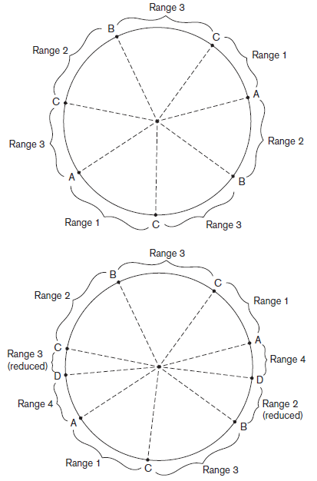
Figure 24.2 Example of consistent hashing (a) Ring having three nodes A, B, and C, with C having greater capacity. The h(K) values that map to the circle points in range 1 have their (k, v) items stored in node A, range 2 in node B, range 3 in node C (b) Adding a node D to the ring. Items in range 4 are moved to the node D from node B (range 2 is reduced) and node C (range 3 is reduced)

Slide 104
Examples of Other Key-Value Stores
Oracle key-value store
  Oracle NOSQL Database
Redis key-value cache and store
  Caches data in main memory to improve performance
  Offers master-slave replication and high availability
  Offers persistence by backing up cache to disk
Apache Cassandra
  Offers features from several NOSQL categories
  Used by Facebook and others

Slide 105
24.5 Column-Based or Wide Column
NOSQL Systems
BigTable: Google’s distributed storage system for big data
  Used in Gmail
  Uses Google File System for data storage and distribution
Apache Hbase a similar, open source system
  Uses Hadoop Distributed File System (HDFS) for data storage
  Can also use Amazon’s Simple Storage System (S3)

Slide 106
Hbase Data Model and Versioning
Data organization concepts
  Namespaces
  Tables
  Column families
  Column qualifiers
  Columns
  Rows
  Data cells
Data is self-describing

Slide 107
Hbase Data Model and Versioning (cont’d.)
HBase stores multiple versions of data items
  Timestamp associated with each version
Each row in a table has a unique row key
Table associated with one or more column families
Column qualifiers can be dynamically specified as new table rows are created and inserted
Namespace is collection of tables
Cell holds a basic data item

Slide 108
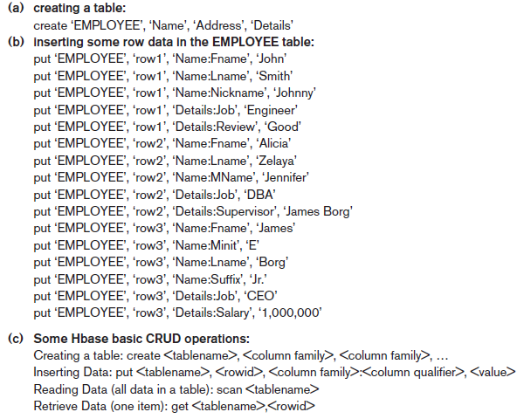
Figure 24.3 Examples in Hbase (a) Creating a table called EMPLOYEE with three column families: Name, Address, and Details (b) Inserting some in the EMPLOYEE table; different rows can have different self-describing column qualifiers (Fname, Lname, Nickname, Mname, Minit, Suffix, … for column family Name; Job, Review, Supervisor, Salary for column family Details). (c) Some CRUD operations of Hbase

Slide 109
Hbase Crud Operations
Provides only low-level CRUD (create, read, update, delete) operations
Application programs implement more complex operations
Create
  Creates a new table and specifies one or more column families associated with the table
Put
  Inserts new data or new versions of existing data items

Slide 110
Hbase Crud Operations (cont’d.)
Get
  Retrieves data associated with a single row
Scan
  Retrieves all the rows

Slide 111
Hbase Storage and Distributed System Concepts
Each Hbase table divided into several regions
  Each region holds a range of the row keys in the table
  Row keys must be lexicographically ordered
  Each region has several stores
    Column families are assigned to stores
Regions assigned to region servers for storage
  Master server responsible for monitoring the region servers
Hbase uses Apache Zookeeper and HDFS

