Slide 1
MODULE 2 – UNIT - 1
Basics of Functional Dependencies and Normalization for Relational Databases

Slide 2
Chapter Outline
1 Informal Design Guidelines for Relational Databases
  1.1 Semantics of the Relation Attributes
  1.2 Redundant Information in Tuples and Update Anomalies
  1.3 Null Values in Tuples
  1.4 Spurious Tuples
2 Functional Dependencies (FDs)
  2.1 Definition of Functional Dependency

Slide 3
Chapter Outline
3 Normal Forms Based on Primary Keys
  3.1 Normalization of Relations
  3.2 Practical Use of Normal Forms
  3.3 Definitions of Keys and Attributes Participating in Keys
  3.4 First Normal Form
  3.5 Second Normal Form
  3.6 Third Normal Form
4 General Normal Form Definitions for 2NF and 3NF (For Multiple Candidate Keys)
5 BCNF (Boyce-Codd Normal Form)
Slide 14- <number>

Slide 4
Chapter Outline
6 Multivalued Dependency and Fourth Normal Form
7 Join Dependencies and Fifth Normal Form
Slide 14- <number>

Slide 5
1.2 Redundant Information in Tuples and Update Anomalies
Information is stored redundantly
  Wastes storage
  Causes problems with update anomalies
    Insertion anomalies
    Deletion anomalies
    Modification anomalies
Slide 14- <number>

Slide 6
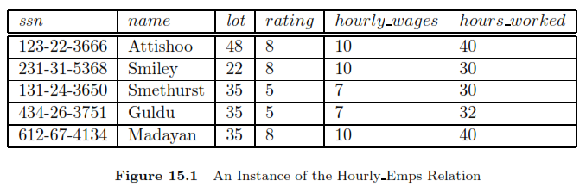
1.2 Redundant Information in Tuples and Update Anomalies
Some information is stored multiple times. For example, the rating value 8 corresponds to the hourly wage 10 and the association repeated three times. Wasting space, inconsistency
Slide 14- <number>

Slide 7
1.2 Redundant Information in Tuples and Update Anomalies
Update anomaly: The hourly-wages in the first tuple could be updated without making a similar change in the second tuple, which is an example of an update anomaly.
Slide 14- <number>

Slide 8
1.2 Redundant Information in Tuples and Update Anomalies
Insertion anomaly: we cannot insert a tuple for an employee unless we know the hourly wage for the employee’s rating value, which is an example of an insertion anomaly.
Slide 14- <number>

Slide 9
1.2 Redundant Information in Tuples and Update Anomalies
Deletion anomaly: if we delete all tuples with a given rating value, we lose the association between that rating value and its hourly-wage value.
Slide 14- <number>

Slide 10
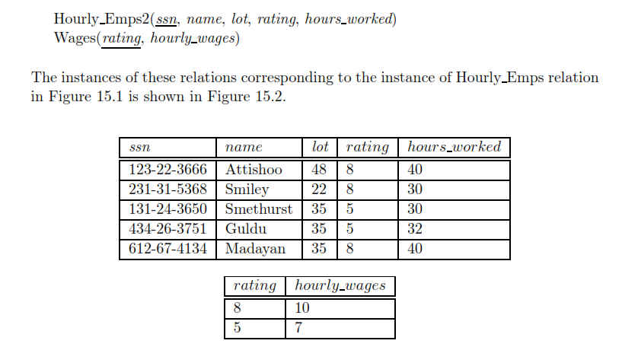
1.2 Redundant Information in Tuples and Update Anomalies
Slide 14- <number>

Slide 11
Guideline for Redundant Information in Tuples and Update Anomalies
GUIDELINE 2:
  Design a schema that does not suffer from the insertion, deletion and update anomalies.
  If there are any anomalies present, then note them so that applications can be made to take them into account.
Slide 14- <number>

Slide 12
1.3 Null Values in Tuples
GUIDELINE 3:
  Relations should be designed such that their tuples will have as few NULL values as possible
  Attributes that are NULL frequently could be placed in separate relations (with the primary key)
Reasons for nulls:
  Attribute not applicable or invalid
  Attribute value unknown (may exist)
  Value known to exist, but unavailable
Slide 14- <number>

Slide 13
1.4 Generation of Spurious Tuples – avoid at any cost
Bad designs for a relational database may result in erroneous results for certain JOIN operations
The "lossless join" property is used to guarantee meaningful results for join operations
GUIDELINE 4:
  The relations should be designed to satisfy the lossless join condition.
  No spurious tuples should be generated by doing a natural-join of any relations.
Slide 14- <number>

Slide 14
Spurious Tuples (2)
There are two important properties of decompositions:
  Non-additive or losslessness of the corresponding join
  Preservation of the functional dependencies.
Note that:
  Property (a) is extremely important and cannot be sacrificed.
  Property (b) is less stringent and may be sacrificed. (See Chapter 15).
Slide 14- <number>

Slide 15
2. Functional Dependencies
Functional dependencies (FDs)
  Are used to specify formal measures of the "goodness" of relational designs
  And keys are used to define normal forms for relations
  Are constraints that are derived from the meaning and interrelationships of the data attributes
A set of attributes X functionally determines a set of attributes Y if the value of X determines a unique value for Y
Slide 14- <number>

Slide 16
2.1 Defining Functional Dependencies
X  Y holds if whenever two tuples have the same value for X, they must have the same value for Y
  For any two tuples t1 and t2 in any relation instance r(R): If t1[X]=t2[X], then t1[Y]=t2[Y]
X  Y in R specifies a constraint on all relation instances r(R)
Written as X  Y; can be displayed graphically on a relation schema as in Figures. ( denoted by the arrow: ).
FDs are derived from the real-world constraints on the attributes
Slide 14- <number>

Slide 17
Examples of FD constraints (1)
Social security number determines employee name
  SSN  ENAME
Project number determines project name and location
  PNUMBER  {PNAME, PLOCATION}
Employee ssn and project number determines the hours per week that the employee works on the project
  {SSN, PNUMBER}  HOURS
Slide 14- <number>

Slide 18
Examples of FD constraints (2)
An FD is a property of the attributes in the schema R
The constraint must hold on every relation instance r(R)
If K is a key of R, then K functionally determines all attributes in R
  (since we never have two distinct tuples with t1[K]=t2[K])
Slide 14- <number>

Slide 19
Defining FDs from instances
Note that in order to define the FDs, we need to understand the meaning of the attributes involved and the relationship between them.
An FD is a property of the attributes in the schema R
Given the instance (population) of a relation, all we can conclude is that an FD may exist between certain attributes.
What we can definitely conclude is – that certain FDs do not exist because there are tuples that show a violation of those dependencies.
Slide 14- <number>

Slide 20
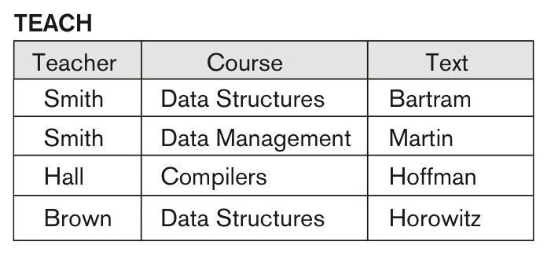
Figure 14.7 Ruling Out FDs
Note that given the state of the TEACH relation, we can say that the FD: Text → Course may exist. However, the FDs Teacher → Course, Teacher → Text and
Couse → Text are ruled out.
Slide 14- <number>

Slide 21
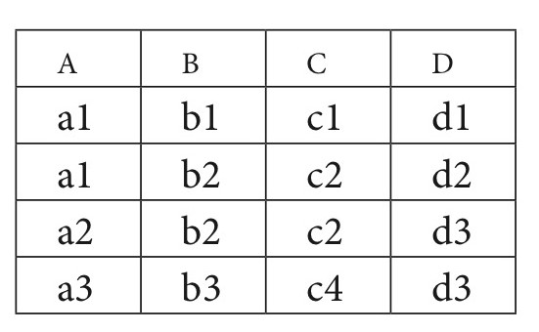
Figure 14.8 What FDs may exist?
A relation R(A, B, C, D) with its extension.
Which FDs may exist in this relation?
Slide 14- <number>

Slide 22
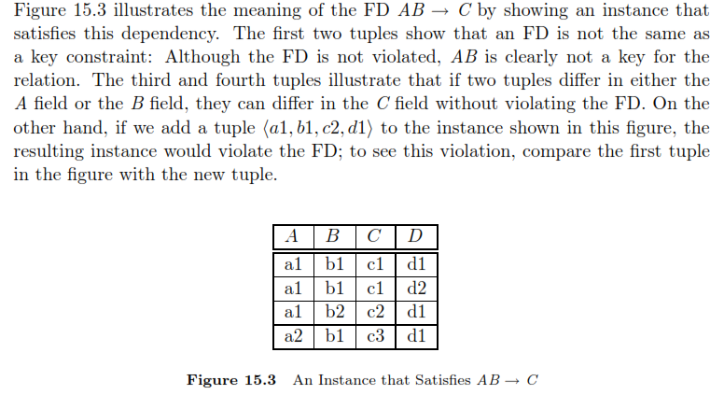
Figure 14.8 What FDs may exist?
Slide 14- <number>

Slide 23
3 Normal Forms Based on Primary Keys
3.1 Normalization of Relations
3.2 Practical Use of Normal Forms
3.3 Definitions of Keys and Attributes Participating in Keys
3.4 First Normal Form
3.5 Second Normal Form
3.6 Third Normal Form
Slide 14- <number>

Slide 24
3.1 Normalization of Relations (1)
Normalization:
  The process of decomposing unsatisfactory "bad" relations by breaking up their attributes into smaller relations
Normal form:
  Condition using keys and FDs of a relation to certify whether a relation schema is in a particular normal form
Slide 14- <number>

Slide 25
Normalization of Relations (2)
2NF, 3NF, BCNF
  based on keys and FDs of a relation schema
4NF
  based on keys, multi-valued dependencies : MVDs;
5NF
  based on keys, join dependencies : JDs
Additional properties may be needed to ensure a good relational design (lossless join, dependency preservation; see Chapter 15)
Slide 14- <number>

Slide 26
3.2 Practical Use of Normal Forms
Normalization is carried out in practice so that the resulting designs are of high quality and meet the desirable properties
The practical utility of these normal forms becomes questionable when the constraints on which they are based are hard to understand or to detect
The database designers need not normalize to the highest possible normal form
  (usually up to 3NF and BCNF. 4NF rarely used in practice.)
Denormalization:
  The process of storing the join of higher normal form relations as a base relation—which is in a lower normal form
Slide 14- <number>

Slide 27
3.3 Definitions of Keys and Attributes Participating in Keys (1)
A superkey of a relation schema R = {A1, A2, ...., An} is a set of attributes S subset-of R with the property that no two tuples t1 and t2 in any legal relation state r of R will have t1[S] = t2[S]
A key K is a superkey with the additional property that removal of any attribute from K will cause K not to be a superkey any more.
Slide 14- <number>

Slide 28
Definitions of Keys and Attributes Participating in Keys (2)
If a relation schema has more than one key, each is called a candidate key.
  One of the candidate keys is arbitrarily designated to be the primary key, and the others are called secondary keys.
A Prime attribute must be a member of some candidate key
A Nonprime attribute is not a prime attribute—that is, it is not a member of any candidate key.
Slide 14- <number>

Slide 29
Normalization
The process of decomposing the relations with anomalies to produce smaller and good relations is called Normalization.
The normalization process, as first proposed by Codd, takes a relation schema through a series of tests to certify whether it satisfies a certain normal form.
Advantages of Normalization:
Less storage space
Reduces data redundancy in a database
It eliminates serious manipulation anomalies.
Flexible structure
Slide 14- <number>

Slide 30
3.4 First Normal Form
Def: A relation is said to be in 1NF if it contains no multivalued attributes.
It states that the domain of an attribute must include only atomic values and that the value of any attribute in a tuple must be a single value from the domain of that attribute.
Consider the DEPARTMENT relation schema:
Slide 14- <number>

Slide 31
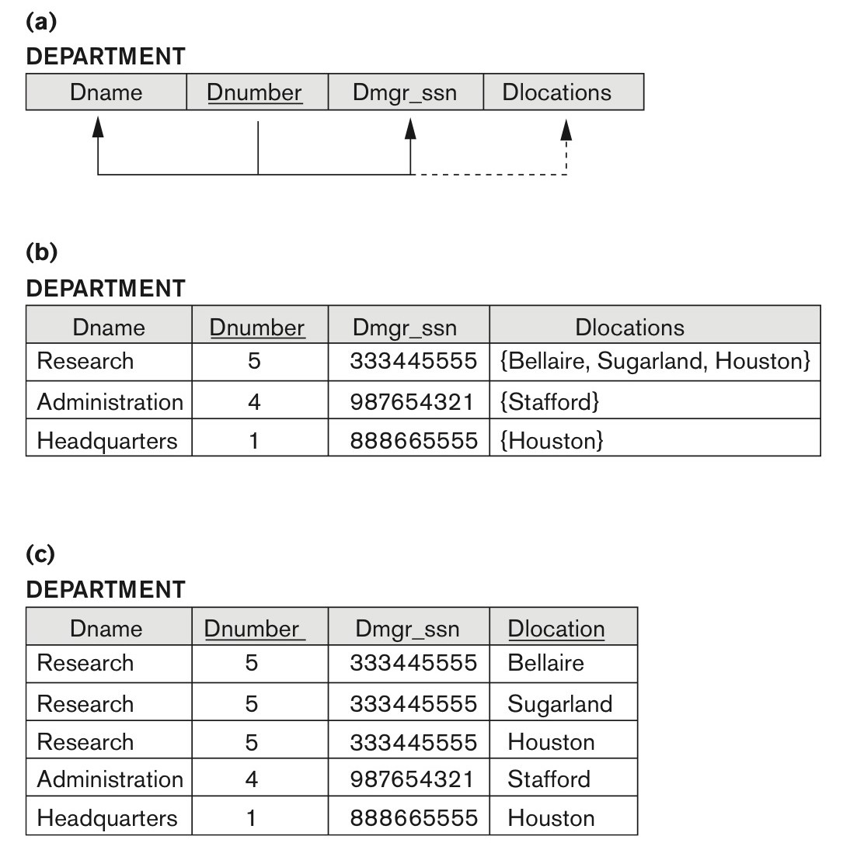
Figure 14.9 Normalization into 1NF
Figure 14.9
Normalization into 1NF. (a) A relation schema that is not in 1NF. (b) Sample state of relation DEPARTMENT. (c) 1NF version of the same relation with redundancy.
Slide 14- <number>

Slide 32
3.4 First Normal Form
This relation is not in 1NF because Dlocations is not an atomic attribute, in fact, it does not even qualify as a relation
There are three main techniques to achieve first normal form for such a relation:
Remove the attribute Dlocations that violates 1NF and place it in a separate relation DEPT_LOCATIONS along with the primary key Dnumber of DEPARTMENT.
The primary key of this relation is the combination {Dnumber, Dlocation},
This decomposes the non-1NF relation into two 1NF relations.
Slide 14- <number>

Slide 33
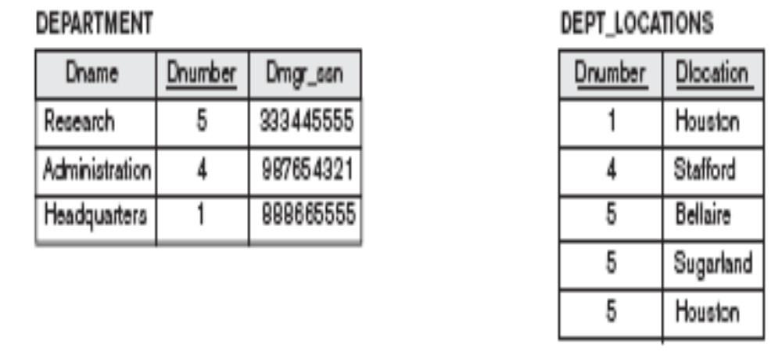
3.4 First Normal Form
Slide 14- <number>

Slide 34
3.4 First Normal Form
Expand the key so that there will be a separate tuple in the original DEPARTMENT relation for each location of a DEPARTMENT, In this case, the primary key becomes the combination {Dnumber, Dlocation}. This solution has the disadvantage of introducing redundancy in the relation.
Replace the Dlocations attribute by three atomic attributes: Dlocation1, Dlocation2, and Dlocation3.
This solution has the disadvantage of introducing NULL values.
Of the three solutions above, the first is generally considered best because it does not suffer from redundancy
Slide 14- <number>

Slide 35

Figure 14.10 Normalizing nested relations into 1NF
Figure 14.10
Normalizing nested relations into 1NF. (a) Schema of the EMP_PROJ relation with a nested relation attribute PROJS. (b) Sample extension of the EMP_PROJ relation showing nested relations within each tuple. (c) Decomposition of EMP_PROJ into relations EMP_PROJ1 and EMP_PROJ2 by propagating the primary key.
Slide 14- <number>

Slide 36
Second Normal Form
Def: A relation schema R is in 2NF if every nonprime attribute A in R is fully functionally dependent on the primary key of R.
Full Functional Dependency: A functional dependency X →Y is a full functional dependency if removal of any attribute A from X means that the dependency does not hold any more; that is, for any attribute A ε X, (X – {A}) does not functionally determine Y.
Partial Functional Dependency: A functional dependency X→Y is a partial dependency if some attribute A ε X can be removed from X and the dependency still holds; that is, for some A εX, (X – {A}) →Y.
Slide 14- <number>

Slide 37
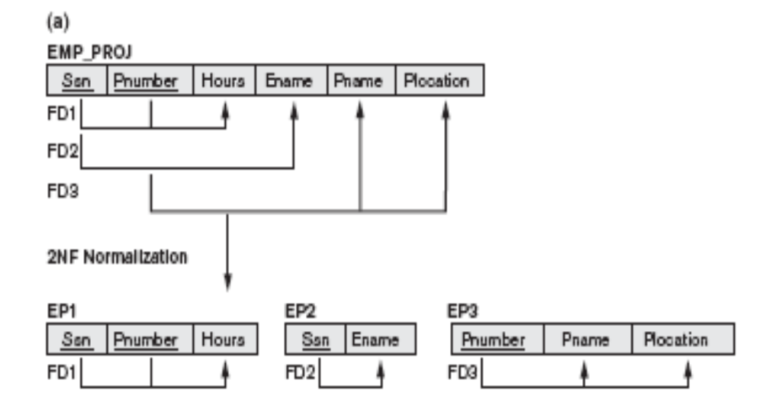
3.5 Second Normal Form (1)
Slide 14- <number>

Slide 38
Second Normal Form (2)
A relation schema R is in second normal form (2NF) if every non-prime attribute A in R is fully functionally dependent on the primary key
R can be decomposed into 2NF relations via the process of 2NF normalization or “second normalization”
Slide 14- <number>

Slide 39
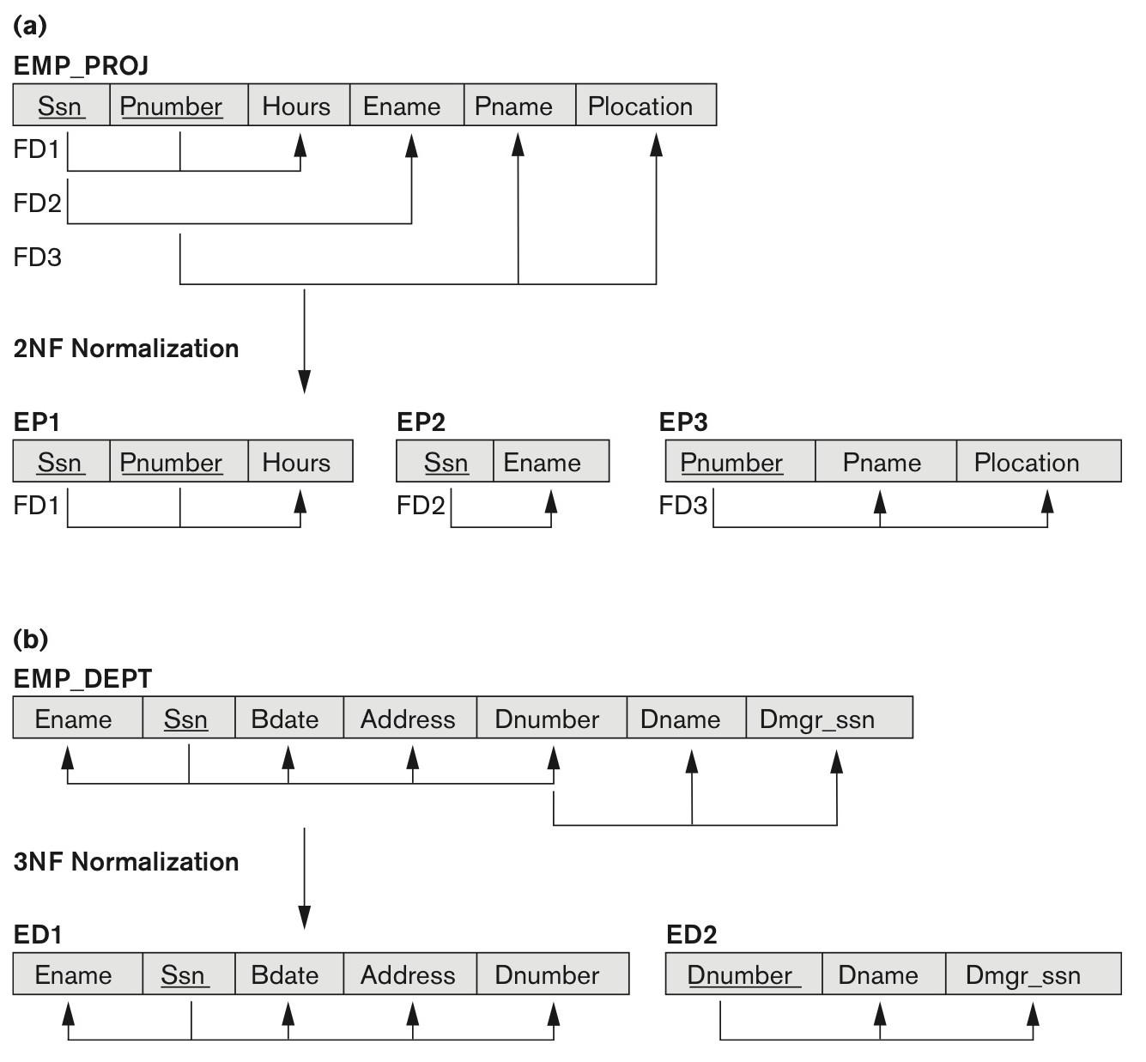
Figure 14.11 Normalizing into 2NF and 3NF
Figure 14.11
Normalizing into 2NF and 3NF. (a) Normalizing EMP_PROJ into 2NF relations. (b) Normalizing EMP_DEPT into 3NF relations.
Slide 14- <number>

Slide 40
Figure 14.11 Normalizing into 2NF and 3NF
Third normal form (3NF) is based on the concept of transitive dependency. A functional dependency X→Y in a relation schema R is a transitive dependency if there exists a set of attributes Z in R that is neither a candidate key nor a subset of any key of R, and both X→Z and Z→Y hold
Definition. A relation schema R is in third normal form (3NF) if, whenever a nontrivial functional dependency X→A holds in R, either (a) X is a superkey of R, or (b) A is a prime attribute of R.
Slide 14- <number>

Slide 41
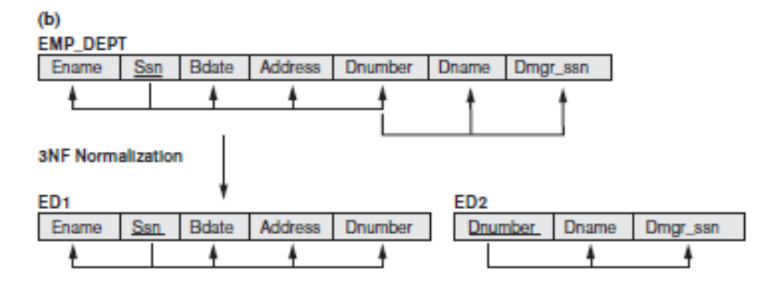
3NF
The dependency Ssn → Dmgr_ssn is transitive through Dnumber in EMP_DEPT because both the dependencies Ssn → Dnumber and Dnumber → Dmgr_ssn hold and Dnumber is neither a key itself nor a subset of the key of EMP_DEPT. The dependency of Dmgr_ssn on Dnumber is undesirable in EMP_DEPT since Dnumber is not a key of EMP_DEPT. EMP_DEPT by decomposing it into the two 3NF relation schemas ED1 and ED2
Slide 14- <number>

Slide 42
Figure 14.11 Normalizing into 2NF and 3NF
Closure of a Set of FDs: The set of all FDs implied by a given set F of FDs is called the closure of F, denoted as F+. The closure F+ can be calculated by using the following Armstrong’s Axioms rules.
Inference Rules:
Let X, Y, and Z be the sets of attributes over a relation schema R:
IR1: Reflexive Rule : If X is a super set of Y, then X→Y.
IR2: Augmentation Rule : If X→Y, then XZ→YZ for any Z.
IR3: Transitive Rule : If X→Y and Y→Z, then X→Z.
IR4: Decomposition Rule : If X→YZ, then X→Y and X→Z.
IR5: Union or additive Rule : If X→Y and X→Z, then X→YZ.
IR6: Pseudo Transitive Rule : if X→Y, WY→Z, then WX→Z
Slide 14- <number>

Slide 43
BCNF
Boyce-Codd normal form (BCNF) was proposed as a simpler form of 3NF, but it was found to be stricter than 3NF. That is, every relation in BCNF is also in 3NF; however, a relation in 3NF is not necessarily in BCNF.
Definition. A relation schema R is in BCNF if whenever a nontrivial functional dependency X→A holds in R, then X is a superkey of R.
Slide 14- <number>

Slide 44
BCNF
SID | Major | Advisor | Maj_GPA
123 | Physics | Hawking | 4.0
123 | Music | Mahler | 3.3
456 | Literature | Michener | 3.2
789 | Music | Bach | 3.7
678 | Physics | Hawking | 3.5
Slide 14- <number>

Slide 45
BCNF
The functional Dependencies are: fd1:
{SID, MAJOR} → {ADVISOR, MAJ_GPA}
FD2: {Advisor} → {Major}
The above relation is in 3NF, but not in BCNF.
This relation can be converted to relations in BCNF
using a simple two-step process.
Relations are Sid, Advisor Maj_gpa and another table is Advisor, Major
FD1: {SID, MAJOR} → {MAJ_GPA}
FD2: {Advisor} → {Major}:
Slide 14- <number>

Slide 46
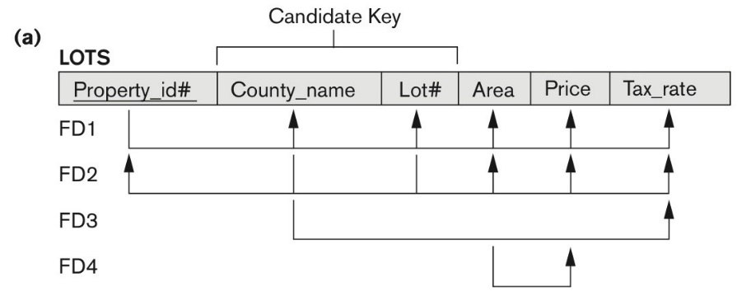
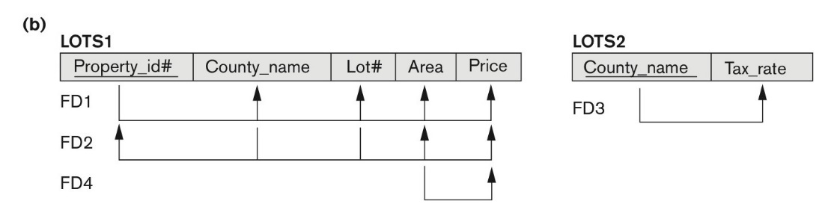
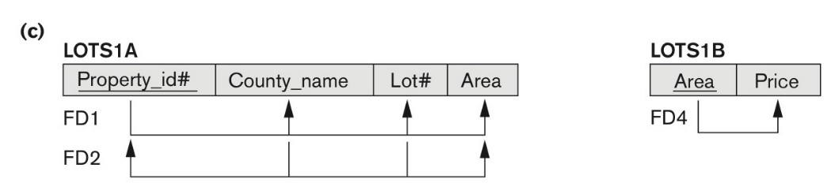
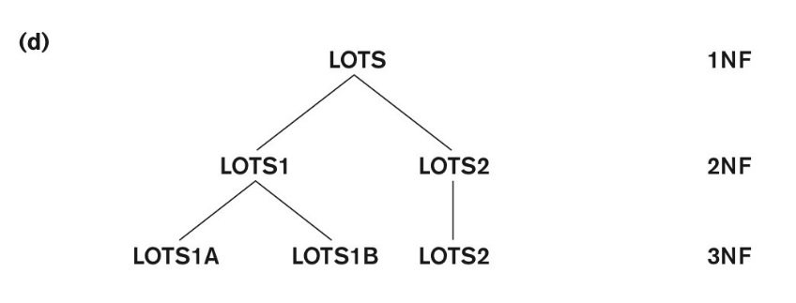
Figure 14.12 Normalization into 2NF and 3NF
Figure 14.12 Normalization into 2NF and 3NF. (a) The LOTS relation with its functional dependencies FD1 through FD4.
(b) Decomposing into the 2NF relations LOTS1 and LOTS2. (c) Decomposing LOTS1 into the 3NF relations LOTS1A and LOTS1B. (d) Progressive normalization of LOTS into a 3NF design.
Slide 14- <number>

Slide 47
Figure 14.12 Normalization into 2NF and 3NF
A decomposition of a relation schema R consists of replacing the relation schema by two (or more) relation schemas that each contain a subset of the attributes of R and together include all attributes in R. Intuitively, we want to store the information in any given instance of R by storing projections of the instance.
Two desirable properties of Decomposition:
Lossless (Non-additive) Join Property.
Dependency Preservation Property.
Slide 14- <number>

Slide 48
Properties of Decomposition
Lossless-Join Decomposition
Let R be a relation schema and let F be a set of FDs over R. A decomposition of R into two schemas with attribute sets X and Y is said to be a lossless-join decomposition with respect to F if for every instance r of R that satisfies the dependencies in F,
π_{X}(r) ⋈ π_{Y} (r) = r.
Slide 14- <number>

Slide 49
Properties of Decomposition
Dependency Preservation Decomposition:
Let R be a relation schema that is decomposed into two schemas with attribute sets X and Y, and let F be a set of FDs over R. The projection of F on X is the set of FDs in the closure F+ (not just F !) that involve only attributes in X.
We will denote the projection of F on attributes X as F_{X}. Note that a dependency U → V in F+ is in FX only if all the attributes in U and V are in X.
The decomposition of relation schema R with FDs F into schemas with attribute sets X and Y is dependency-preserving if (F_{X} U F_{Y} )⁺ = F⁺. That is, if we take the dependencies in F_{X} and F_{Y} and compute the closure of their union, we get back all dependencies in the closure of F.
Slide 14- <number>

Slide 50
5. BCNF (Boyce-Codd Normal Form)
A relation schema R is in Boyce-Codd Normal Form (BCNF) if whenever an FD X → A holds in R, then X is a superkey of R
Each normal form is strictly stronger than the previous one
  Every 2NF relation is in 1NF
  Every 3NF relation is in 2NF
  Every BCNF relation is in 3NF
There exist relations that are in 3NF but not in BCNF
Hence BCNF is considered a stronger form of 3NF
The goal is to have each relation in BCNF (or 3NF)
Slide 14- <number>

Slide 51
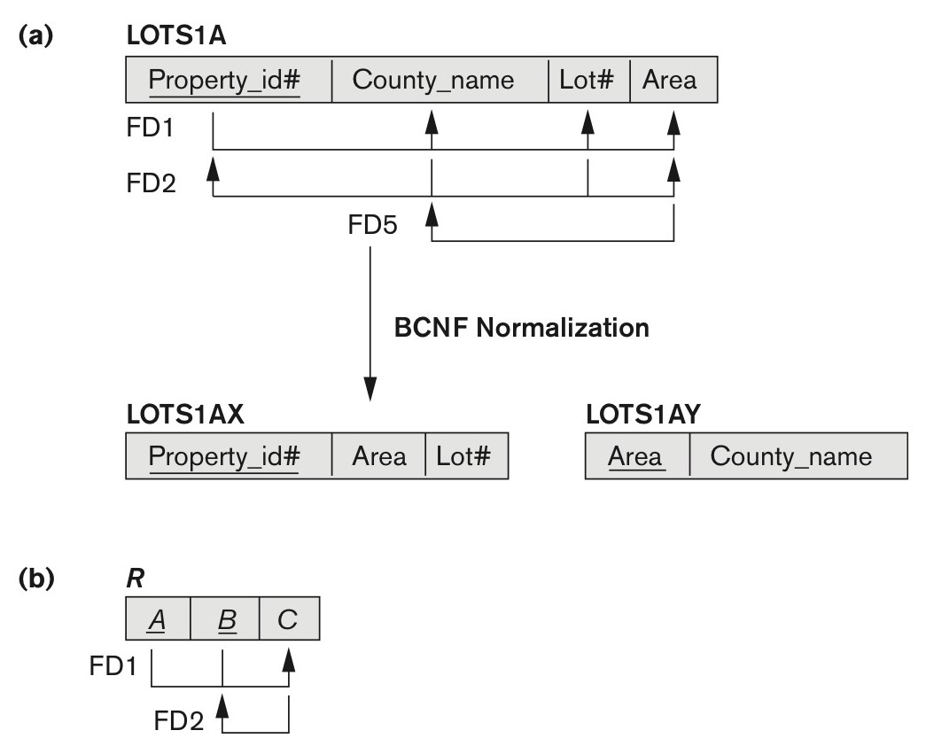
Figure 14.13 Boyce-Codd normal form
Figure 14.13
Boyce-Codd normal form. (a) BCNF normalization of LOTS1A with the functional dependency FD2 being lost in the decomposition. (b) A schematic relation with FDs; it is in 3NF, but not in BCNF due to the f.d. C → B.
Slide 14- <number>

Slide 52

Figure 14.14 A relation TEACH that is in 3NF but not in BCNF
Figure 14.14
A relation TEACH that is in 3NF but not BCNF.
Slide 14- <number>

Slide 53
Achieving the BCNF by Decomposition (1)
Two FDs exist in the relation TEACH:
  fd1: { student, course} -> instructor
  fd2: instructor -> course
{student, course} is a candidate key for this relation and that the dependencies shown follow the pattern in Figure 14.13 (b).
  So this relation is in 3NF but not in BCNF
A relation NOT in BCNF should be decomposed so as to meet this property, while possibly forgoing the preservation of all functional dependencies in the decomposed relations.
  (See Algorithm 15.3)
Slide 14- <number>

Slide 54
Achieving the BCNF by Decomposition (2)
Three possible decompositions for relation TEACH
  D1: {student, instructor} and {student, course}
  D2: {course, instructor } and {course, student}
  D3: {instructor, course } and {instructor, student} ✓
All three decompositions will lose fd1.
  We have to settle for sacrificing the functional dependency preservation. But we cannot sacrifice the non-additivity property after decomposition.
Out of the above three, only the 3rd decomposition will not generate spurious tuples after join.(and hence has the non-additivity property).
A test to determine whether a binary decomposition (decomposition into two relations) is non-additive (lossless) is discussed under Property NJB on the next slide. We then show how the third decomposition above meets the property.
Slide 14- <number>

Slide 55
General Procedure for achieving BCNF when a relation fails BCNF
Here we make use the algorithm from Chapter 15 (Algorithm 15.5):
Let R be the relation not in BCNF, let X be a subset-of R, and let X → A be the FD that causes a violation of BCNF. Then R may be decomposed into two relations:
(i) R –A and (ii) X υ A.
If either R –A or X υ A. is not in BCNF, repeat the process.
Note that the f.d. that violated BCNF in TEACH was Instructor →Course. Hence its BCNF decomposition would be :
(TEACH – COURSE) and (Instructor υ Course), which gives
the relations: (Instructor, Student) and (Instructor, Course) that we obtained before in decomposition D3.
Slide 14-55

Slide 56
5. Multivalued Dependencies and Fourth Normal Form (1)
Definition:
A multivalued dependency (MVD) X —>> Y specified on relation schema R, where X and Y are both subsets of R, specifies the following constraint on any relation state r of R: If two tuples t₁ and t₂ exist in r such that t₁[X] = t₂[X], then two tuples t₃ and t₄ should also exist in r with the following properties, where we use Z to denote (R 2 (X υ Y)):
  t₃[X] = t₄[X] = t₁[X] = t₂[X].
  t₃[Y] = t₁[Y] and t₄[Y] = t₂[Y].
  t₃[Z] = t₂[Z] and t₄[Z] = t₁[Z].
An MVD X —>> Y in R is called a trivial MVD if (a) Y is a subset of X, or (b) X υ Y = R.
Slide 14-56

Slide 57
Multivalued Dependencies and Fourth Normal Form (3)
Definition:
A relation schema R is in 4NF with respect to a set of dependencies F (that includes functional dependencies and multivalued dependencies) if, for every nontrivial multivalued dependency X —>> Y in F⁺, X is a superkey for R.
  Note: F⁺ is the (complete) set of all dependencies (functional or multivalued) that will hold in every relation state r of R that satisfies F. It is also called the closure of F.
Slide 14-57

Slide 58

Fourth normal forms.
Suppose that we have a relation with attributes course, teacher, and book, which we denote as CTB. The meaning of a tuple is that teacher T can teach course C, and book B is a recommended text for the course. There are no FDs; the key is CTB. However, the recommended texts for a course are independent of the instructor.
Slide 14- <number>

Slide 59
Fourth normal forms.
The relation schema CTB is in BCNF; thus we would not consider decomposing it further if we looked only at the FDs that hold over CTB.
There is redundancy. The fact that Green can teach Physics101 is recorded once per recommended text for the course. Similarly, the fact that Optics is a text for Physics101 is recorded once per potential teacher.
The redundancy can be eliminated by decomposing CTB into CT and CB.
Those two relations are in 4NF.
Slide 14- <number>

Slide 60
6. Join Dependencies and Fifth Normal Form (1)
Definition:
A join dependency (JD), denoted by JD(R₁, R₂, ..., R_{n}), specified on relation schema R, specifies a constraint on the states r of R.
  The constraint states that every legal state r of R should have a non-additive join decomposition into R₁, R₂, ..., R_{n}; that is, for every such r we have
  * (π_{R1}(r), π_{R2}(r), ..., π_{Rn}(r)) = r
Note: an MVD is a special case of a JD where n = 2.
A join dependency JD(R₁, R₂, ..., R_{n}), specified on relation schema R, is a trivial JD if one of the relation schemas R_{i} in JD(R₁, R₂, ..., R_{n}) is equal to R.
Slide 14- <number>

Slide 61
Join Dependencies and Fifth Normal Form (2)
Definition:
A relation schema R is in fifth normal form (5NF) (or Project-Join Normal Form (PJNF)) with respect to a set F of functional, multivalued, and join dependencies if,
  for every nontrivial join dependency JD(R₁, R₂, ..., R_{n}) in F⁺ (that is, implied by F),
    every R_{i} is a superkey of R.
Discovering join dependencies in practical databases with hundreds of relations is next to impossible. Therefore, 5NF is rarely used in practice.
Slide 14- <number>

Slide 62
Chapter Summary
Informal Design Guidelines for Relational Databases
Functional Dependencies (FDs)
Normal Forms (1NF, 2NF, 3NF)Based on Primary Keys
General Normal Form Definitions of 2NF and 3NF (For Multiple Keys)
BCNF (Boyce-Codd Normal Form)
Fourth and Fifth Normal Forms
Slide 14- <number>

