Slide 1

SQL
STRUCTRED QUERY LANGUAGE
Presented By
Shaik khalida

Slide 2
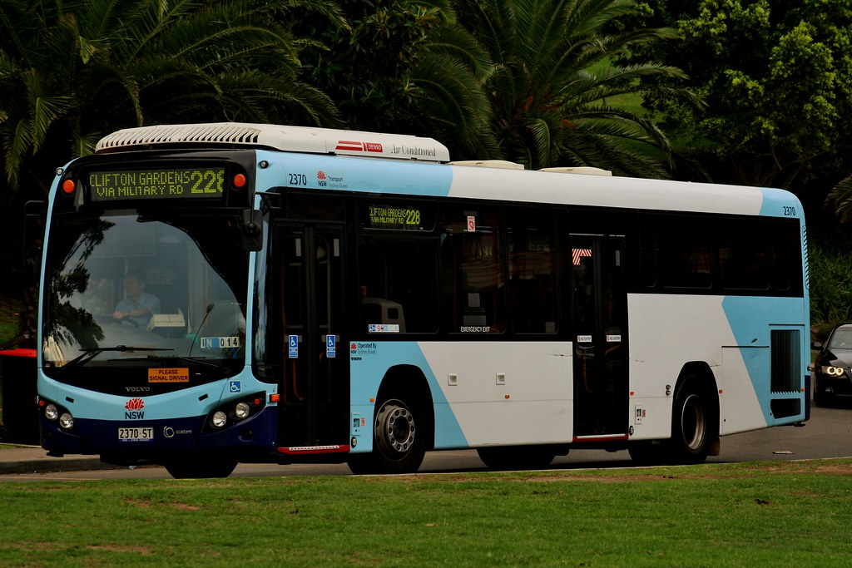
Bus management system
Project Title:

Slide 3
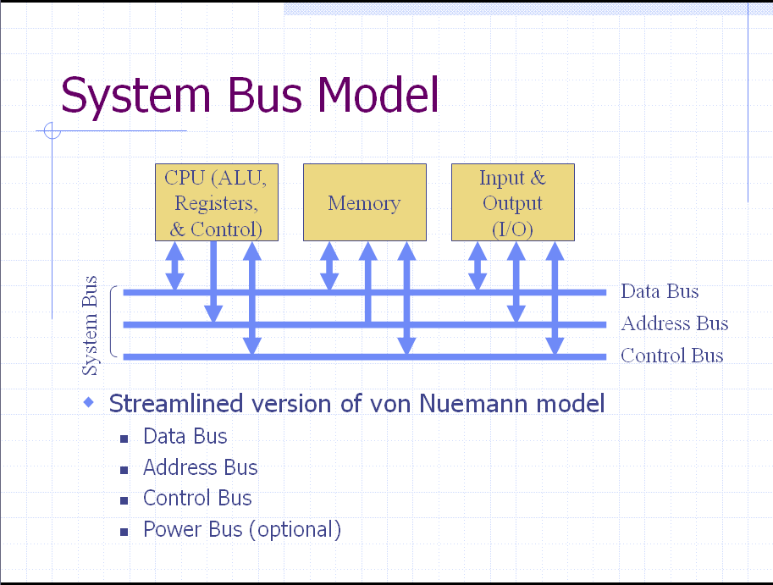
Introduction to Bus Management System :
The Bus Management System is an advanced software solution designed to streamline and automate the operations involved in managing bus services. From route planning to passenger bookings and payment processing, the system offers a comprehensive platform for bus operators to efficiently manage their services and enhance the overall passenger experience.

Slide 4
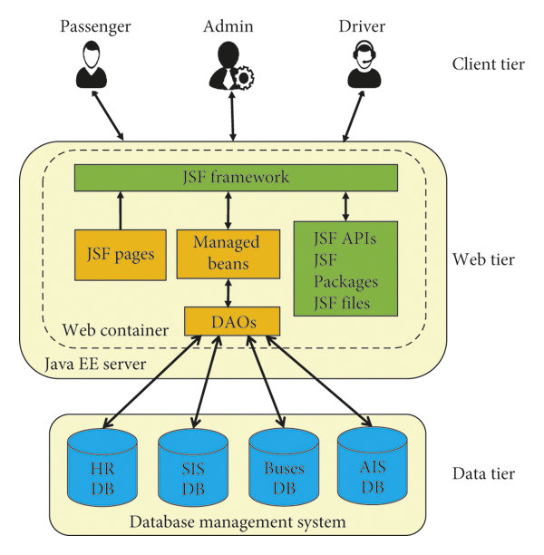
Purpose of the System :
The primary purpose of the Bus Management System is to optimize the management of bus services by providing a centralized platform that automates various tasks. These tasks include route management, schedule planning, booking management, passenger tracking, payment processing, and reporting.

Slide 5
Key Functionalities:
Route Management: The system allows administrators to create, update, and manage bus routes. This includes defining starting points, destinations, stops along the route, and the frequency of services.
Schedule Management: Bus schedules can be efficiently managed, including setting departure and arrival times, assigning buses to specific schedules, and adjusting schedules as needed.
Booking Management: Passengers can easily book seats on buses, view available seats, make payments securely, receive booking confirmations, and manage their bookings.
Passenger Management: The system keeps track of passenger information, such as registration details, booking history, preferences, and provides personalized services to passengers.
Bus Management: Information about buses, including details, seating capacity, maintenance schedules, and assignments to routes and schedules, is managed effectively.
Payment Management: Secure payment processing for bookings, generating payment receipts, managing payment records, and ensuring a smooth payment experience for passengers.

Slide 6
System Architecture Overview::
Client Tier
Web Browser
Mobile App
Desktop App
User Interfaces
(Passenger, Admin, Bus Operator)
Application Tier
Web Server
Application Server
APIs
Business Logic
Processing
Booking
Payment
Data Tier
Database Server
(MySQL DBMS) Database
(Tables: Passengers Bookings Routes Schedules Buses Payments

Slide 7
Entities Relationship Diagram:
Bus
Passengers
Route
Drivers
Bookings
Payments

Slide 8
Connection Between Multiple Tables
Booking :
booking_id Int(Primary Key)
passenger_id Int(Foreign Key)
route_id Int(Foreign Key )
bus_id Int(Foreign Key)
booking_date(DateTime)
departure_time(DateTime)
fare(Decimal(8, 2)
Bus :
bus_id Int (Primary Key)
bus_number(Varchar(20))
capacity(Int)
type(Varchar(50))
Status ENUM
Passenger :
passenger_id Int(Primary Key)
Full_name(Varchar(50))
email(Varchar(100))
Contact_number(Varchar(20))
Routes :
route_id Int(Primary Key)
origin(Varchar(100))
destination(Varchar(100))
distance(Decimal(8, 2))
Payments :
payment_id Int(Primary Key)
booking_id Int(Foreign Key referencing Route)
amount(Decimal(8, 2))
payment_date(DateTime)
Payment_method(Varchar(50))
Drivers :
Driver_id Int(Primary Key)
Full_name(Varchar(100))
License_number(Varchar(100))
Contact_number(Varchar(20))

Slide 9
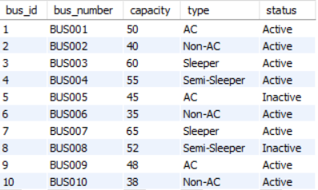
Bus Table:
Manage information about buses, including bus details, seating capacity, and availability.
Track bus assignments to routes and schedules, monitor bus status, and manage maintenance schedules.
Monitor and update available seats on buses based on bookings and cancellations.

Slide 10
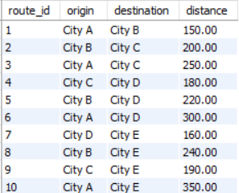
Routes Table:
Administer routes by creating, updating, and deleting routes for bus services.
Define starting points, destinations, stops along the route, and the frequency of services.
Manage route information such as route names, starting points, destinations, and distances.

Slide 11
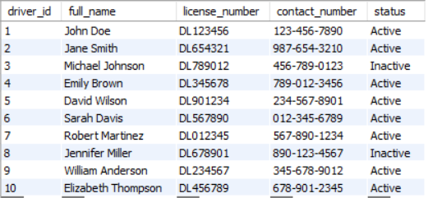
Drivers Table:
Bus drivers must possess a clean driving record and frequently may be required to pass a background check. They also must meet physical, hearing and vision requirements. In addition, bus drivers often need a high school diploma or the equivalent.

Slide 12
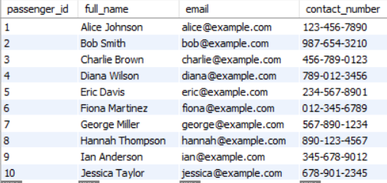
Passengers Table:
Allow passengers to register, create accounts, and log in to the system.
Manage passenger information, including personal details, contact information, and booking history.
Provide personalized services to passengers, such as storing preferences and providing customized recommendations.

Slide 13
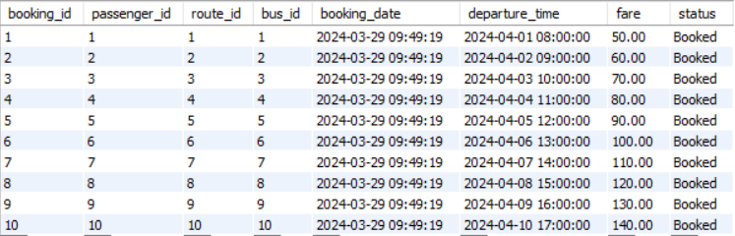
Bookings Table:
Allow passengers to search for available buses based on route, date, and time.
Enable passengers to book seats on buses, select seat preferences, and make payments securely.
Provide booking confirmations with booking details, including seat numbers, departure time, and arrival time.

Slide 14
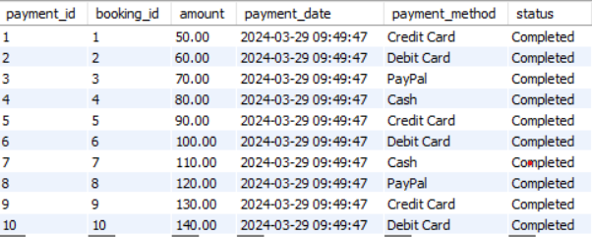
Payments Table:
Process payments securely for bookings made by passengers.
Accept various payment methods such as credit/debit cards, online banking, and digital wallets.
Generate payment receipts, manage payment records, and handle refunds or cancellations.

Slide 15
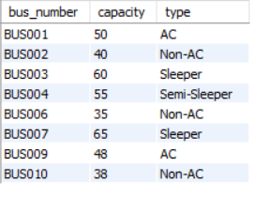
1.Write a Query to get the list of active buses along with their capacity and type.
SELECT bus_number, capacity, type
FROM Buses
WHERE status = 'Active';

Slide 16
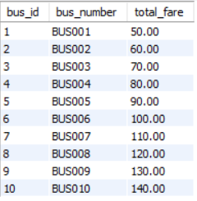
2.Write a Query to calculate the total fare collected for each bus.
SELECT b.bus_id, bu.bus_number, SUM(b.fare) AS total_fare
FROM Bookings b
INNER JOIN Buses bu ON b.bus_id = bu.bus_id
GROUP BY b.bus_id, bu.bus_number;
3.Write a Query to get the list of active buses along with their capacity and type.
SELECT bus_number, capacity, type
FROM Buses
WHERE status = 'Active';

Slide 17
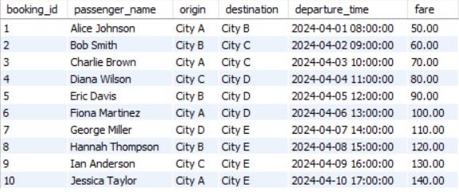
4.Write a Query to retrieve information about bookings along with related passenger and route details.
SELECT b.booking_id, p.full_name AS passenger_name, r.origin, r.destination, b.departure_time, b.fare
FROM Bookings b
INNER JOIN Passengers p ON b.passenger_id = p.passenger_id
INNER JOIN Routes r ON b.route_id = r.route_id;

Slide 18
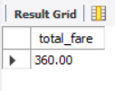
5.Write a Query to get the total fare collected for a specific route.
CREATE PROCEDURE GetTotalFareForRoute(IN route_name VARCHAR(100))
BEGIN
SELECT SUM(b.fare) AS total_fare
FROM Bookings b
INNER JOIN Routes r ON b.route_id = r.route_id
WHERE r.origin = route_name OR r.destination = route_name;
END
Usage : CALL GetTotalFareForRoute('City A’);

Slide 19
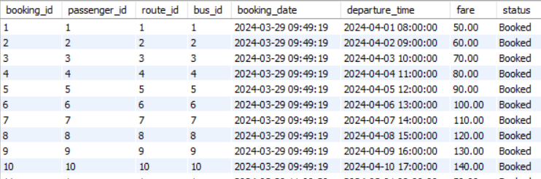
6.Write a Query to updates the status of a booking to 'Completed' or 'Cancelled' based on the departure time when a new booking is inserted or an existing booking is updated.
DELIMITER //
CREATE TRIGGER UpdateBookingStatusOnDeparture
BEFORE INSERT ON Bookings
FOR EACH ROW
BEGIN
IF NEW.departure_time <= NOW() THEN
SET NEW.status = 'Completed';
ELSE
SET NEW.status = 'Booked';
END IF;
END//
DELIMITER ;
select * from Bookings;

Slide 20
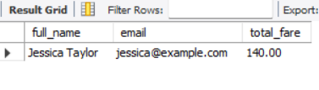
7.Write a Query to find the passenger with the highest total fare spent.
SELECT full_name, email, (
SELECT SUM(fare)
FROM Bookings
WHERE passenger_id = p.passenger_id
) AS total_fare
FROM Passengers p
ORDER BY total_fare DESC
LIMIT 1;

Slide 21
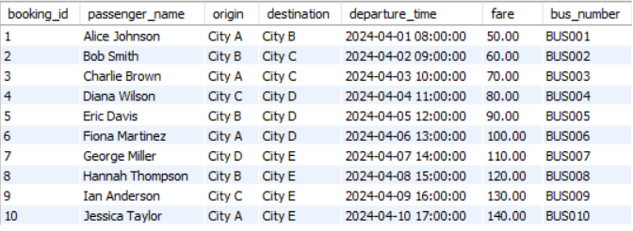
8.Write a Query to retrieve booking details along with passenger and bus information for bookings with status 'Booked’.
SELECT b.booking_id, p.full_name AS passenger_name, r.origin, r.destination, b.departure_time, b.fare, bu.bus_number
FROM Bookings b
INNER JOIN Passengers p ON b.passenger_id = p.passenger_id
INNER JOIN Routes r ON b.route_id = r.route_id
INNER JOIN Buses bu ON b.bus_id = bu.bus_id
WHERE b.status = 'Booked';

Slide 22
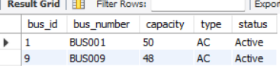
9.Write a Query to retrieves information about active buses based on a specified bus type.
CREATE PROCEDURE GetActiveBusesByType(IN bus_type VARCHAR(50))
BEGIN
SELECT *
FROM Buses
WHERE status = 'Active' AND type = bus_type;
END
Usage: CALL GetActiveBusesByType('AC');

Slide 23
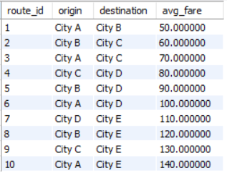
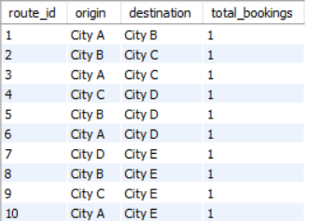
10.Write a Query to calculates the average fare per route.
SELECT r.route_id, r.origin, r.destination, AVG(b.fare) AS avg_fare
FROM Routes r
INNER JOIN Bookings b ON r.route_id = b.route_id
GROUP BY r.route_id, r.origin, r.destination;
11.Write a Query to count the number of bookings made for each route.
SELECT r.route_id, r.origin, r.destination, COUNT(*) AS total_bookings
FROM Bookings b
INNER JOIN Routes r ON b.route_id = r.route_id
GROUP BY r.route_id, r.origin, r.destination;

Slide 24

12.Write a Query to counts the number of bookings made by a specific passenger.
CREATE PROCEDURE CountBookingsByPassenger(IN passenger_id INT)
BEGIN
SELECT COUNT(*) AS total_bookings
FROM Bookings
WHERE passenger_id = passenger_id;
END//
Usage: CALL CountBookingsByPassenger(1);

Slide 25
13.Write a Query to updates the status of a bus to 'Inactive' when all bookings for that bus are cancelled.
DELIMITER //
CREATE TRIGGER UpdateBusStatusOnBooking
AFTER UPDATE ON Bookings
FOR EACH ROW
BEGIN
DECLARE total_cancelled INT;
DECLARE total_bookings INT;
SELECT COUNT(*) INTO total_cancelled
FROM Bookings
WHERE bus_id = NEW.bus_id AND status = 'Cancelled';
SELECT COUNT(*) INTO total_bookings
FROM Bookings
WHERE bus_id = NEW.bus_id;
IF total_cancelled = total_bookings THEN
UPDATE Buses
SET status = 'Inactive'
WHERE bus_id = NEW.bus_id;
END IF;
END//
DELIMITER ;

Slide 26
14.Write a Query to prevents bookings that exceed the capacity of a bus from being inserted.
DELIMITER //
CREATE TRIGGER CheckBookingCapacity
BEFORE INSERT ON Bookings
FOR EACH ROW
BEGIN
DECLARE current_capacity INT;
SELECT capacity INTO current_capacity
FROM Buses
WHERE bus_id = NEW.bus_id;
IF current_capacity <= 0 THEN
SIGNAL SQLSTATE '45000'
SET MESSAGE_TEXT = 'Booking capacity exceeded for this bus';
END IF;
END//
DELIMITER ;

Slide 27
Thank You!

