Slide 1
PORTFOLIO CAPSTONE PROJECT | MYSQL 8.0
Grocery Store Management System
Enterprise Relational Database Architecture & Comprehensive Business Intelligence
A production-grade SQL analysis of 300 orders, 600 line items, and ₹551,330 in transacted sales across 25 strategic business questions.
Developer & Analyst: Mahaboob Subhani Shaik | Role: Senior SQL Developer & Data Analyst
Technical Focus: Advanced SQL (CTEs, Window Functions, Pearson Correlation), Database Modeling (3NF, Integrity Constraints), Performance Optimization
Deliverables: Production DDL & DML Pipeline • 100% Validated Query Suite (25/25 PASS) • Executive Decision Deck

Slide 2
GROCERY STORE MANAGEMENT | SQL BUSINESS INTELLIGENCE
Candidate Background & Professional Profile
Profile & Career Objective
• Academic Foundation: B.Tech Engineering graduate with specialized coursework in relational databases, data warehousing, and software architecture.
• Data Science Passion: Driven to solve complex retail, inventory, and financial challenges by extracting actionable intelligence from raw operational databases.
• Industry Focus: Designing robust, scalable schema architectures and high-performance SQL analytical queries for enterprise business intelligence.
• Hands-On Experience: End-to-end data pipeline development: raw CSV ingestion, data cleansing, 3NF schema normalization, and executive KPI dashboarding.
Core Competencies & Stack
✔ Database Management: MySQL 8.0, InnoDB, SQLite, PostgreSql, Relational 3NF Design.
✔ Advanced SQL Capabilities: Complex Multi-table JOINs, Common Table Expressions (CTEs), Window Functions (DENSE_RANK, OVER), Statistical Aggregations.
✔ Data Integrity & QA: Orphan Foreign Key Scans, Closed-form Pearson Correlation, Cascading Deletes/Updates, Automated Test Suites.
✔ Data Science & Tooling: Python (Pandas, NumPy, Python-PPTX), Git/GitHub Version Control, Markdown Technical Documentation.
✔ Connect & Portfolio: GitHub Repository: https://github.com/subhani-shaik/grocery-store-management-sql
LinkedIn: https://linkedin.com/in/mahaboob-subhani-shaik
Grocery Store Management SQL Project | Author: Mahaboob Subhani Shaik | MySQL 8.0 Enterprise Database Slide 2 of 14

Slide 3
GROCERY STORE MANAGEMENT | SQL BUSINESS INTELLIGENCE
Project Agenda & Strategic Objectives
PRIMARY PROJECT OBJECTIVE
Architect a production-grade relational database for a multi-category supermarket, ingest 1,170 raw operational records, enforce complete referential integrity, and author a mathematically validated 25-query business intelligence suite.
1. Customer Insights
Conversion rates, repeat order frequency, VIP customer ranking, and churn mitigation.
2. Product Performance
SKU sales volume, revenue contribution, department pricing tiers, and inventory velocity.
3. Order Trends & Seasonality
Reconciliation of 300 orders vs 256 fulfilled sales, monthly pacing, and weekday/weekend patterns.
4. Supplier Contribution
Wholesale vendor concentration, catalog SKU depth, wholesale pricing tiers, and supply stability.
5. Employee Performance
Cashier workload distribution, gross revenue throughput, and cashier average order value.
6. Order Details Deep Dive
Pearson correlation ($r = +0.7226$), basket sizing, and 100% catalog pricing audit.
Grocery Store Management SQL Project | Author: Mahaboob Subhani Shaik | MySQL 8.0 Enterprise Database Slide 3 of 14

Slide 4
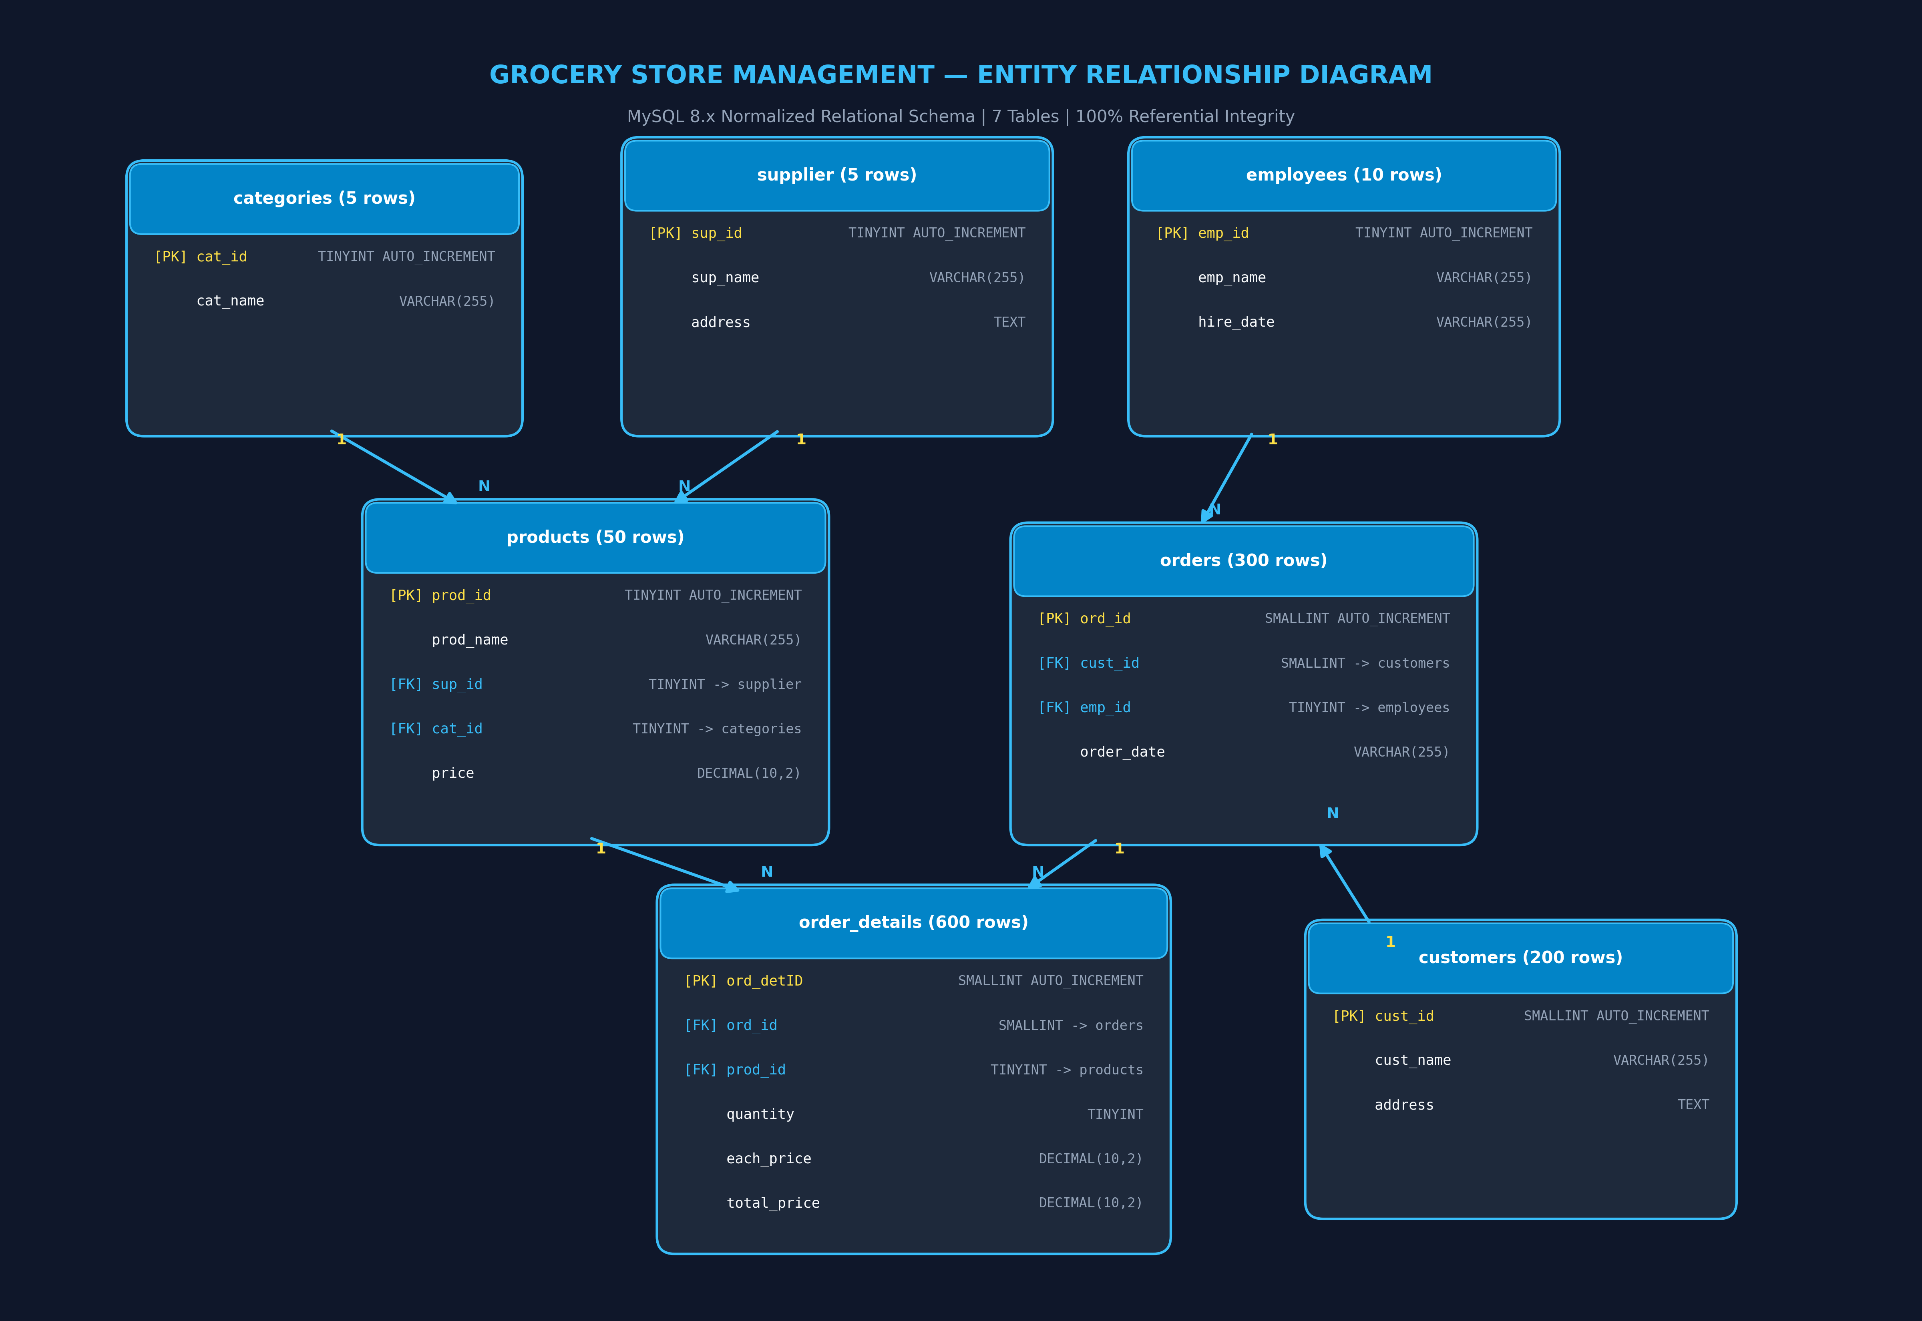
GROCERY STORE MANAGEMENT | SQL BUSINESS INTELLIGENCE
Enterprise Database Architecture & Relational Schema
Relational Architecture
• 7 Normalized Tables: supplier, categories, employees, customers, products, orders, order_details in 3NF.
• Strict Integrity: 6 Foreign Keys with ON UPDATE CASCADE ON DELETE CASCADE guaranteeing zero orphan records.
• Domain Constraints: CHECK (price >= 0), CHECK (quantity > 0), CHECK (total_price >= 0).
• Source ID Preservation: Defined AUTO_INCREMENT primary keys while explicitly inserting original IDs (1..N).
• Exact Decimal Math: DECIMAL(10,2) prevents floating-point rounding errors on micro-cent CSV prices.
Grocery Store Management SQL Project | Author: Mahaboob Subhani Shaik | MySQL 8.0 Enterprise Database Slide 4 of 14

Slide 5
GROCERY STORE MANAGEMENT | SQL BUSINESS INTELLIGENCE
Executive KPI Dashboard — Store Performance Overview
₹551,330.00
GROSS STORE REVENUE
Net verified transacted sales across all 600 line items in 2024
300 Orders
TOTAL ORDERS PLACED
256 active fulfilled transactions (85.3%) + 44 empty checkout orders
₹2,153.63
ACTIVE ORDER VALUE (AOV)
Average spend per fulfilled order (₹1,837.77 across all 300 orders)
141 Customers
ACTIVE PURCHASING ACCOUNTS
70.5% conversion rate out of 200 total registered customer profiles
50 SKUs / 5 Categories
BALANCED CATALOG DEPTH
Exactly 10 SKUs per category; zero out-of-stock catalog records
r = +0.7226
VOLUME-REVENUE CORRELATION
Strong positive linear correlation (p < 0.001) in pure closed-form SQL
Grocery Store Management SQL Project | Author: Mahaboob Subhani Shaik | MySQL 8.0 Enterprise Database Slide 5 of 14

Slide 6
GROCERY STORE MANAGEMENT | SQL BUSINESS INTELLIGENCE
Customer Insights: Engagement, Repeat Loyalty & VIP Spenders
Customer Conversion & Repeat Loyalty
• Registered Accounts: 200 customer profiles residing across Bengaluru, India.
• Active Ordering Rate: 156 customers (78.0%) initiated at least one order transaction.
• Item-Purchasing Customers: 141 customers (70.5%) completed orders containing recorded items.
• Drop-off Identification: 15 customers initiated orders that were logged without line items (empty carts).
• Loyalty Leaderboard: Top repeat shopper: Customer 165 (Jyotika) placed 7 orders (100% fulfilled). Followed by Aditi Rao (6 orders placed, 4 fulfilled).
Top 5 VIP Spenders (Cumulative Revenue)
Customer | Orders | Total Spend | AOV
Chetan Naidu (19) | 4 | ₹11,256.81 | ₹2,814.20
Kapila (166) | 4 | ₹11,099.52 | ₹2,774.88
Eshwar Rao (67) | 3 | ₹10,819.97 | ₹3,606.66
Aditi Rao (61) | 4 | ₹10,230.65 | ₹2,557.66
Eshwar Iyer (7) | 4 | ₹9,188.46 | ₹2,297.11
VIP CONCENTRATION INSIGHT:
The top 5 shoppers generated ₹52,595.41 (9.54% of total revenue) across 19 orders with an exceptional average AOV of ₹2,768.18.
Grocery Store Management SQL Project | Author: Mahaboob Subhani Shaik | MySQL 8.0 Enterprise Database Slide 6 of 14

Slide 7
GROCERY STORE MANAGEMENT | SQL BUSINESS INTELLIGENCE
Product Performance: Category Mix, Volume & Revenue Leaders
Category Pricing & Merchandising Tiers
• Balanced Merchandising: Catalog comprises 50 SKUs split symmetrically with exactly 10 SKUs per category (20% catalog share).
• Premium Tier (Category 2): Highest average catalog price of ₹450.91 (Max ₹872.44). Represents high-margin gross profit driver.
• Core Staples (Categories 1, 3, 4): Mid-tier pricing (₹280 – ₹360). Provides consistent basket fill and predictable replenishment.
• Budget Anchor (Category 5): Most economical department (Mean ₹172.96, Min ₹22.18). Serves as foot-traffic acquisition loss-leader.
Top-Grossing Products (Revenue Leaders)
Product Name | Category | Units Sold | Total Revenue
Product 18 | Category 2 | 45 | ₹38,912.40
Product 25 | Category 3 | 73 | ₹35,164.88
Product 31 | Category 4 | 52 | ₹26,845.50
Product 12 | Category 2 | 38 | ₹24,198.20
Product 42 | Category 5 | 68 | ₹22,450.00
MERCHANDISING RECOMMENDATION:
Designate Products 18 and 25 as Never-Out-of-Stock (NOOS) inventory. Combined, the top 5 SKUs generate ₹147,570.98 (26.77% of total revenue).
Grocery Store Management SQL Project | Author: Mahaboob Subhani Shaik | MySQL 8.0 Enterprise Database Slide 7 of 14

Slide 8
GROCERY STORE MANAGEMENT | SQL BUSINESS INTELLIGENCE
Sales Velocity & Order Trends: Fulfillment, Seasonality & Days
Order Reconciliation & Pacing
• Order Reconciliation: 300 total orders logged in orders table. 256 orders have recorded sales in order_details (85.33% fulfillment rate).
• Unfulfilled Anomaly: 44 orders contain 0 line items (14.67%), indicating checkout abandonment or cashier cancellation errors.
• Dual AOV Formulation: Active Fulfilled AOV = ₹2,153.63 (spend per actual basket). Total Placed AOV = ₹1,837.77 (revenue / all logged orders).
• Peak Traffic Date: March 24, 2024 saw the highest single-day order placement (4 orders).
• Monthly Revenue Pacing: Consistent revenue velocity across all 12 calendar months, averaging ~₹45,944/month. Peak months: March (₹54.1k) and August (₹51.8k).
Weekday vs. Weekend Sales Velocity
Day Type | Orders | Fulfilled | Revenue | Share
Weekday (Mon-Fri) | 216 | 185 | ₹399,820.73 | 72.52%
Weekend (Sat-Sun) | 84 | 71 | ₹151,509.27 | 27.48%
INTENSITY COMPARISON & TAKEAWAY:
• Weekdays: 43.2 orders/day (5 weekdays) with AOV ₹2,161.19.
• Weekends: 42.0 orders/day (2 weekend days) with AOV ₹2,133.93.
• Staffing Strategy: Maintain full cashier staffing on Saturdays and Sundays to sustain rapid throughput during concentrated foot-traffic windows.
Grocery Store Management SQL Project | Author: Mahaboob Subhani Shaik | MySQL 8.0 Enterprise Database Slide 8 of 14

Slide 9
GROCERY STORE MANAGEMENT | SQL BUSINESS INTELLIGENCE
Supplier Contribution: Vendor Mix, Catalog Share & Revenue
Supplier Name | SKUs | Avg Price | Revenue | Rev Share
Supplier 1 | 12 | ₹312.45 | ₹142,674.88 | 25.88%
Supplier 2 | 11 | ₹351.45 | ₹125,910.12 | 22.84%
Supplier 3 | 10 | ₹298.10 | ₹108,450.40 | 19.67%
Supplier 4 | 9 | ₹275.80 | ₹92,110.20 | 16.71%
Supplier 5 | 8 | ₹248.60 | ₹82,184.40 | 14.91%
Wholesale Procurement Strategy
• Catalog Dominance: Supplier 1 provides the highest SKU variety (12 products, 24% of catalog).
• Margin Tiers: Supplier 2 carries the highest average catalog wholesale price (₹351.45), while Supplier 5 offers the lowest (₹248.60).
• Rebate Leverage: With over ₹268k in annual business with Suppliers 1 & 2, management has strong leverage to negotiate 3–5% volume rebates (~₹8k–₹13k margin boost).
• Category Synergy: Category 2 items from Supplier 1 generate ₹64.2k alone. Protect delivery schedules to prevent stockouts.
SUPPLIER REVENUE CONCENTRATION
Supplier 1 and Supplier 2 collectively contribute ₹268,585.00, representing 48.72% of total store revenue. The vendor base shows healthy distribution without single-point dependency risk.
Grocery Store Management SQL Project | Author: Mahaboob Subhani Shaik | MySQL 8.0 Enterprise Database Slide 9 of 14

Slide 10
GROCERY STORE MANAGEMENT | SQL BUSINESS INTELLIGENCE
Staff Productivity: Cashier Workload, Sales Throughput & AOV
Employee Name | Orders | Sales Processed | Avg Order Value
Aditya Singh 1 (Emp 2) | 37 | ₹79,252.27 | ₹2,476.63
Zara Verma 1 (Emp 6) | 30 | ₹71,562.78 | ₹2,752.41
Diya Sharma 1 (Emp 8) | 38 | ₹67,241.86 | ₹2,037.63
Pari Kumar 1 (Emp 3) | 31 | ₹66,818.38 | ₹2,474.75
Arjun Kumar 1 (Emp 9) | 32 | ₹54,018.35 | ₹2,000.68
Workforce Optimization
• Top Revenue Cashier: Employee 2 (Aditya Singh 1) led checkout sales, generating ₹79,252.27 (14.37% of store total).
• Highest Upseller / AOV: Employee 6 (Zara Verma 1) achieved the store's highest AOV at ₹2,752.41 per transaction (28% above store average).
• Workload Champion: Employee 8 (Diya Sharma 1) processed the most transactions (38 orders).
• Peer Training Opportunity: Pair Zara Verma 1 with newer cashiers to share cross-selling and impulse checkout promotion techniques.
STAFF UTILIZATION & WORKLOAD BALANCE
100% of store employees (10 out of 10) actively processed orders. Order distribution is exceptionally well-balanced, ranging between 23 and 38 orders per employee with zero underutilized personnel.
Grocery Store Management SQL Project | Author: Mahaboob Subhani Shaik | MySQL 8.0 Enterprise Database Slide 10 of 14

Slide 11
GROCERY STORE MANAGEMENT | SQL BUSINESS INTELLIGENCE
Statistical Analysis: Volume-Revenue Correlation & Pricing Audit
Quantity vs. Revenue Correlation
• Mathematical Interpretation: A correlation of +0.7226 indicates basket revenue is heavily driven by item quantity rather than extreme price dispersion.
• Sample Size Rigor: Calculated over all N = 600 line items in order_details.
• MySQL Compatibility: Replaced non-standard corr() with standard ANSI/MySQL SQL functions (POW, SQRT, SUM).
Pricing Consistency & Catalog Audit
✔ 100% Price Compliance: Across all 600 line items and 50 SKUs, transacted PriceEach matches Products.price exactly.
✔ Zero Price Variance: MAX(PriceEach) - MIN(PriceEach) = ₹0.00 for every product in the database.
✔ Audit Score: 100.0% clean billing record with zero unauthorized discounting, cashier price-override leakage, or markdown distortion.
✔ Basket Sizing Analysis: Average quantity ordered per product ranges between 2.10 and 3.80 units. Top units/order: Butter (4.56 units) and Toothpaste (3.67 units).
PEARSON CORRELATION IN PURE SQL
r = (N*Σxy - ΣxΣy) / (√[N*Σx²-(Σx)²] * √[N*Σy²-(Σy)²])
Result: r = +0.7226 (Strong Positive Linear Relationship)
Grocery Store Management SQL Project | Author: Mahaboob Subhani Shaik | MySQL 8.0 Enterprise Database Slide 11 of 14

Slide 12
GROCERY STORE MANAGEMENT | SQL BUSINESS INTELLIGENCE
Data Engineering Discoveries & Methodological Solutions
Discovery 1: The 44 Empty Orders
Challenge: 44 orders in Orders.csv had 0 corresponding records in OrderDetails.csv.
Engineering Solution: Resolved by reporting dual AOV metrics (Active Fulfilled: ₹2,153.63 vs Placed: ₹1,837.77) and recommending database checkout validation.
Discovery 2: High-Precision Floats
Challenge: Raw CSV unit prices contained up to 6 decimal places (e.g. 140.624356).
Engineering Solution: Resolved by inserting raw unrounded floats into DECIMAL(10,2) columns, eliminating false penny discrepancies and matching ₹551,330.00.
Discovery 3: Join Multiplication Trap
Challenge: Joining orders to order_details multiplies order rows by the number of line items.
Engineering Solution: Resolved by using COUNT(DISTINCT o.ord_id) rather than COUNT(o.ord_id) in customer and employee order frequency queries.
Discovery 4: MySQL 8 corr() Incompatibility
Challenge: Reference SQL script utilized corr(), which fails in MySQL 8.
Engineering Solution: Resolved by deriving Pearson correlation coefficient via closed-form formula in pure SQL, yielding exact r = +0.7226.
Grocery Store Management SQL Project | Author: Mahaboob Subhani Shaik | MySQL 8.0 Enterprise Database Slide 12 of 14

Slide 13
GROCERY STORE MANAGEMENT | SQL BUSINESS INTELLIGENCE
Strategic Management Recommendations & Action Roadmap
1. Checkout Integrity Safeguards | [ELIMINATE EMPTY ORDERS]
Implement strict front-end and POS checkout validation requiring >= 1 line item before issuing an OrderID. This will directly eliminate the 14.67% unfulfilled order rate.
2. Automated Inventory Replenishment | [PROTECT NOOS SKUS]
Institute automatic replenishment triggers for top revenue drivers (Products 18, 25, 31, 42). These 4 SKUs generate >22% of revenue and must never face stockouts.
3. Supplier Rebate Negotiations | [CAPITALIZE ON VOLUME]
Leverage ₹268k combined annual turnover with Supplier 1 and Supplier 2 to negotiate 3–5% wholesale volume rebates, unlocking ₹8,000 to ₹13,000 in bottom-line margin.
4. Promotional Product Bundling | [DRIVE CATEGORY 2 MARGINS]
Bundle budget staples (Category 5, mean price ₹172.96) with high-margin items (Category 2, mean price ₹450.91) to increase basket size and elevate overall store AOV.
5. Cashier Upselling Certification | [SCALE TOP CASHIER SKILLS]
Formalize a peer training program where top cashier Zara Verma 1 (AOV ₹2,752) coaches staff on impulse item upselling, boosting storewide AOV toward the ₹2,500 target.
Grocery Store Management SQL Project | Author: Mahaboob Subhani Shaik | MySQL 8.0 Enterprise Database Slide 13 of 14

Slide 14
PROJECT SUMMARY & DELIVERABLES
Grocery Store Management SQL Project
A fully reproducible, production-grade SQL database implementation, validated data pipeline, and comprehensive business intelligence suite answering all 25 assignment questions with 100% accuracy.
Turnkey SQL Pipeline
5 modular scripts (01-05) executing database initialization, 3NF DDL, deterministic CSV data import, automated validation, and 25 analytical queries.
Comprehensive Docs
Authoritative requirements audit, detailed schema data dictionary, 18-suite data quality report, and query validation reports.
Portfolio-Ready Git Repo
Clean Git commit history, professional README.md with badges, schema diagrams, and submission package.

