Slide 1
Client-Server Architecture & Role of HTTP

Slide 2

Client

Slide 3
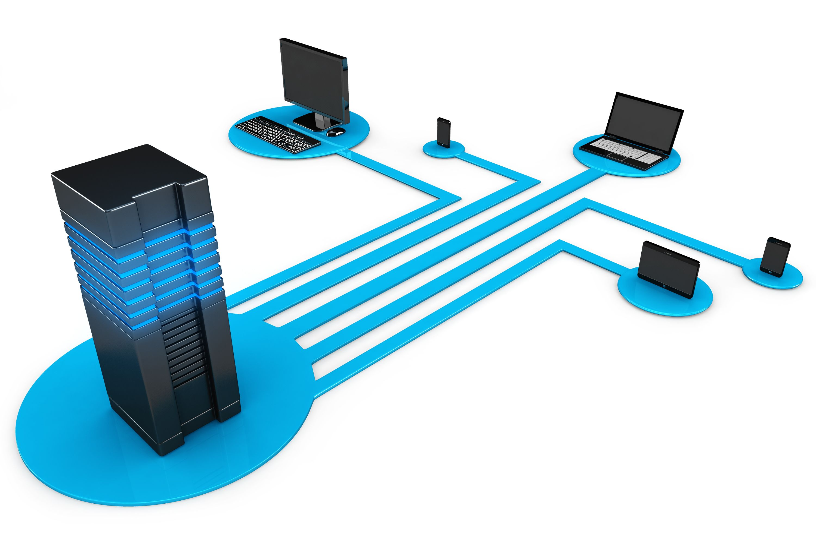
Server

Slide 4
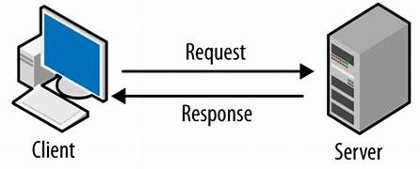
Client-Server Interaction

Slide 5
Example in Application
User Registration: Client sends HTTP POST request; server processes and responds.
User Login: Client sends HTTP POST request; server verifies and responds with a token.
Fetching User Details: Client sends HTTP GET request; server retrieves and responds with data.
Application Status: Client sends HTTP GET request; server retrieves and responds with status.

