Slide 1
Netradyne Hackathon · Prototype Phase
RouteShield
Score a planned fleet route for risk before dispatch — with an honest confidence interval, an explanation a dispatcher can argue with, and safer alternatives on an explicit risk-vs-time trade-off.
Safer Roads for India · Fleet Route Risk Intelligence · MIT licensed
Notes:
RouteShield turns road risk into something a dispatcher can see and act on at the moment the route is assigned. Everything in this deck is measured by code in the repository and reproducible with one command.

Slide 2
Dispatchers choose routes blind to risk
Distance and ETA are visible. The things that actually hurt are not.
Unlit stretches
Ghat curves
Junction history
No street lighting on rural and peri-urban links
Gradient and curvature on hill sections
Clusters of harsh braking and near-misses
Night fatigue
Monsoon and fog
Sparse history
22:00–05:00, the largest behavioural factor in Indian fleet crashes
Seasonal conditions that change risk week to week
Most roads have almost no fleet data at all
None of it is on the dispatcher’s screen when the decision is made.
Notes:
The information exists — in telematics, in OSM, in weather feeds. It just never reaches the one person who can act on it, at the one moment it matters.

Slide 3
The obvious fix does not work
Build a heat map of historical incidents. Here is what it actually ranks.
0.459
Worse than a coin flip
A count measures how BUSY a road is, not how RISKY.
The Outer Ring Road tops the map because everything drives on it.
And roads nobody has driven yet report “zero risk” rather than “unknown”.
AUC — raw historical event counts, ranking the roads that are truly highest-risk
RouteShield ranks the same roads at 0.961 AUC
Measured against ground truth on a strict temporal holdout — fit on 9 months, scored on the next 4.
Notes:
This is the single most important slide. Everyone builds the heat map. It ranks traffic volume, not risk, and it is silent exactly where you have no data.

Slide 4
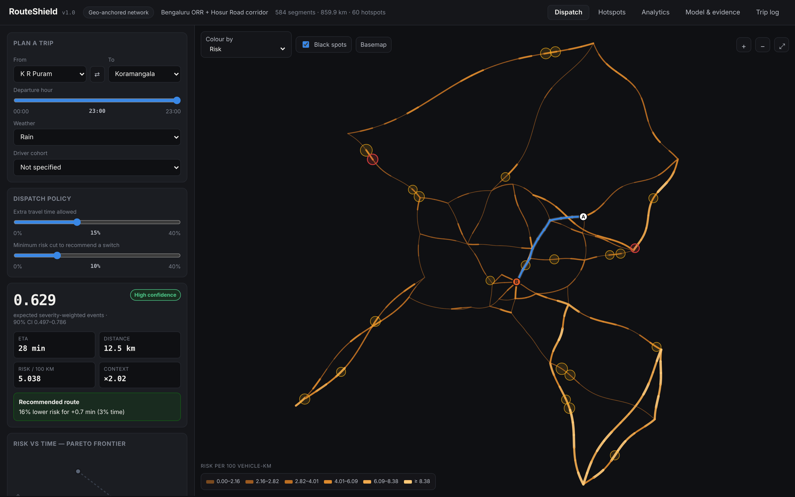
The dispatcher console
Risk before dispatch
Expected severity-weighted events, with a 90% interval
Confidence badge
Says plainly when the data is too thin to trust
Pareto alternatives
Every genuinely different route, time against risk
Why this score
Exact factor contributions, worst segments, black spots
Notes:
Live demo runs entirely in the browser — the model, the routing and the Monte Carlo interval are all client-side. No backend needed to try it.

Slide 5
How it works
1
Ingest
2
Map-match
3
Model
Telematics events, OpenStreetMap geometry and tags, weather, elevation
Snap GPS to the right road — and refuse to guess when it is ambiguous
Frequency × severity, Gamma-Poisson posterior with calibrated uncertainty
4
Score
5
Choose
6
Learn
Route risk = lookup + sum, adjusted for hour, weather and cohort
Pareto frontier of alternatives, with a dispatch policy you control
Log the decision, join to outcomes, report trends and overrides
Notes:
Everything expensive happens in a nightly batch. Request time is a table lookup and a sum, which is why scoring a route costs under a millisecond.

Slide 6
Three modelling decisions that made the difference
Frequency × severity
Counting severity-weighted events in one Poisson rate conflates two processes. One accident carries 10× a harsh brake, the count becomes wildly overdispersed, the fitted prior collapses — and the model degenerates into the baseline it should beat.
A prior from road structure
Poisson gradient boosting on curvature, junctions, lighting, gradient, speed, lanes. A road with no history inherits the risk of structurally similar roads, instead of reporting zero. Shrinkage strength is learned, not hand-tuned.
Uncertainty about the prior itself
Textbook empirical Bayes treats the fitted prior mean as exact. It is not. Measured 90% coverage of the plain version: 0.69 — a tight interval around a wrong centre. Folding in the prior’s own out-of-fold error lifts coverage to 89.04%.
Notes:
We found each of these by measuring, not by design. The uncertainty correction in particular: our first version was confidently wrong on sparse roads.

Slide 7
A bug we found by measuring, not by looking
Near a junction, two roads are almost equidistant. Forcing a match there is how a quiet side road inherits a trunk road’s events.
4.6%
0.5%
13%
of events landed on the WRONG road when every match is forced
after adding an 18 m ambiguity gate
of events dropped — the price paid
Why it mattered more than it looks
Misattributed events made a handful of low-traffic roads look like the worst in the city — and the risk model faithfully learned it.
Measured effect on the product: the benefit of re-routing went from −0.2% (no benefit at all) to +22.4% once matching was fixed.
A Bayesian model cannot repair data attributed to the wrong road. Correlation with the true rate rose from 0.20 to 0.87.
Notes:
This is the slide we are proudest of. It is not a feature — it is evidence that we validated the thing rather than trusting it.

Slide 8
Does the score predict incidents?
Strict temporal holdout: fit on 9 months, score the next 4. Every metric against a baseline.
And the rest of it
Sparse roads — rank vs truth
0.789
0.476
Severe-event ranking (AUC)
0.933
0.928
90% interval coverage
89.0%
target 90%
Posterior predictive coverage
91.8%
target 90%
Calibration error
0.085
mean |log obs/exp|
Reproduce all of it: python -m routeshield.cli demo
35 automated tests, ~13 s. Full pipeline and evaluation, ~5 s.
Notes:
Ranking against ground truth is the fair test — the observed-rate label is itself a noisy draw, and a noisy baseline can track that noise.

Slide 9
Risk versus time, made explicit
Counterfactual replay: routes are chosen with the model’s predictions but scored against ground truth withheld from training, so the system cannot grade its own homework.
11.6%
−22.4%
+1.0%
of trips have a materially safer alternative inside a +15% time budget
true risk when the recommendation is taken
fleet-wide travel time — averaged over every trip, not only the switches
Notes:
The dispatcher sets the policy — how many extra minutes are acceptable, and how big a risk cut justifies a switch. The system shows the frontier, not a verdict.

Slide 10
What is real, and what is not
No public Indian fleet-telematics dataset exists. We say so everywhere it matters, including inside the product.
Real
Not real
Bengaluru junction coordinates — ORR, Hosur Rd, NH44/48/75/275/648
OpenStreetMap ingestion against the live Overpass API, unit-tested
Open-Meteo weather feed with an offline climatology fallback
MoRTH severity mix and night-crash share shaping the priors
Every metric, computed by code in the repository
Telematics events — synthetic, clearly labelled, seeded from real structure
Inter-junction geometry — interpolated; one command swaps in true OSM ways
Fleet exposure — drawn heavy-tailed to mimic real lane concentration
Therefore: every number validates the pipeline, not real-world accuracy
Real accuracy needs a fleet data-sharing agreement — that is what Phase 1 is for
Notes:
We would rather be trusted than impressive. A judge who asks "is this real?" should find the answer before they have to ask.

Slide 11
From prototype to a fleet that depends on it
Phase 1
Phase 2
Phase 3
Shadow
Advisory
Scale
6 weeks, one corridor
weeks 7–16
multi-region
Scores computed and logged, nothing shown
Weekly: predicted vs observed on routes actually driven
Exit: coverage 85–95%, match accuracy > 98%
Dispatchers see score, interval, reasons, alternatives
Overrides require a reason code and are logged
Exit: adoption > 40%, no SLA regression
Nightly retraining, drift and calibration monitoring
Cohort reports to the safety team
Segment risk published as vector tiles
Privacy by construction: vehicle IDs hashed at ingest · reports at cohort level only · driver identity never in a report · routes advisory with logged overrides
Notes:
Shadow mode is non-negotiable. It is where the synthetic numbers in this deck get replaced by real ones.

Slide 12
Impact hypothesis
Stated as a target to be tested in Phase 1, not as a result we are claiming.
If dispatchers take safer alternatives inside a bounded time penalty, risk-weighted exposure on high-risk corridors falls by at least 20% for under 10% extra travel time.
Why it is plausible
What would falsify it
Held-out replay already shows −22.4% true risk for +7.5% time
The policy is tunable: the operator sets the budget, not the model
Adoption below 40% — dispatchers do not believe the score
Interval coverage outside 85–95% on real data — the badge is not honest
No measurable change in incidents on the pilot corridor
Notes:
Naming what would falsify the hypothesis is how we keep ourselves honest once there is real data.

Slide 13
RouteShield
Open source, MIT. Runs end to end in about five seconds, with no API keys and no GPU.
0.961
0.79
89%
35
AUC ranking the
truly riskiest roads
rank correlation where
history is thinnest
90% interval coverage
— the badge is honest
automated tests
pinning the behaviour
Try it, read it, break it
Live demo shaikmdarifcse23-byte.github.io/routeshield
Source github.com/shaikmdarifcse23-byte/routeshield
Run it pip install -r requirements.txt && python -m routeshield.cli demo
Notes:
The demo runs the full model client-side. Nothing to install to see it work.

