Slide 1
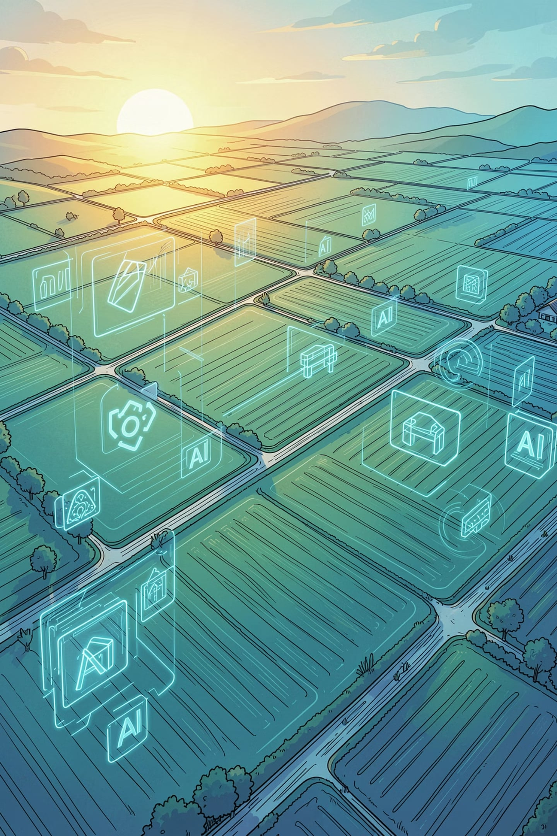
OptiCrop – Smart Crop Recommendation System
OptiCrop combines machine learning with agronomy to recommend optimal crops for a given field. The system ingests soil nutrients and environmental parameters, analyzes them with a trained model, and returns ranked crop suggestions plus actionable parameter-level guidance.
Problem
Objective
Farmers often choose crops by tradition rather than data, risking low yields due to variable soil and climate.
Predict the most suitable crops using a Random Forest model on soil (N,P,K,pH) and environmental inputs (temp, humidity, rainfall).
Impact
Improve yields, reduce risk, and support sustainable, data-driven farming decisions.

Slide 2

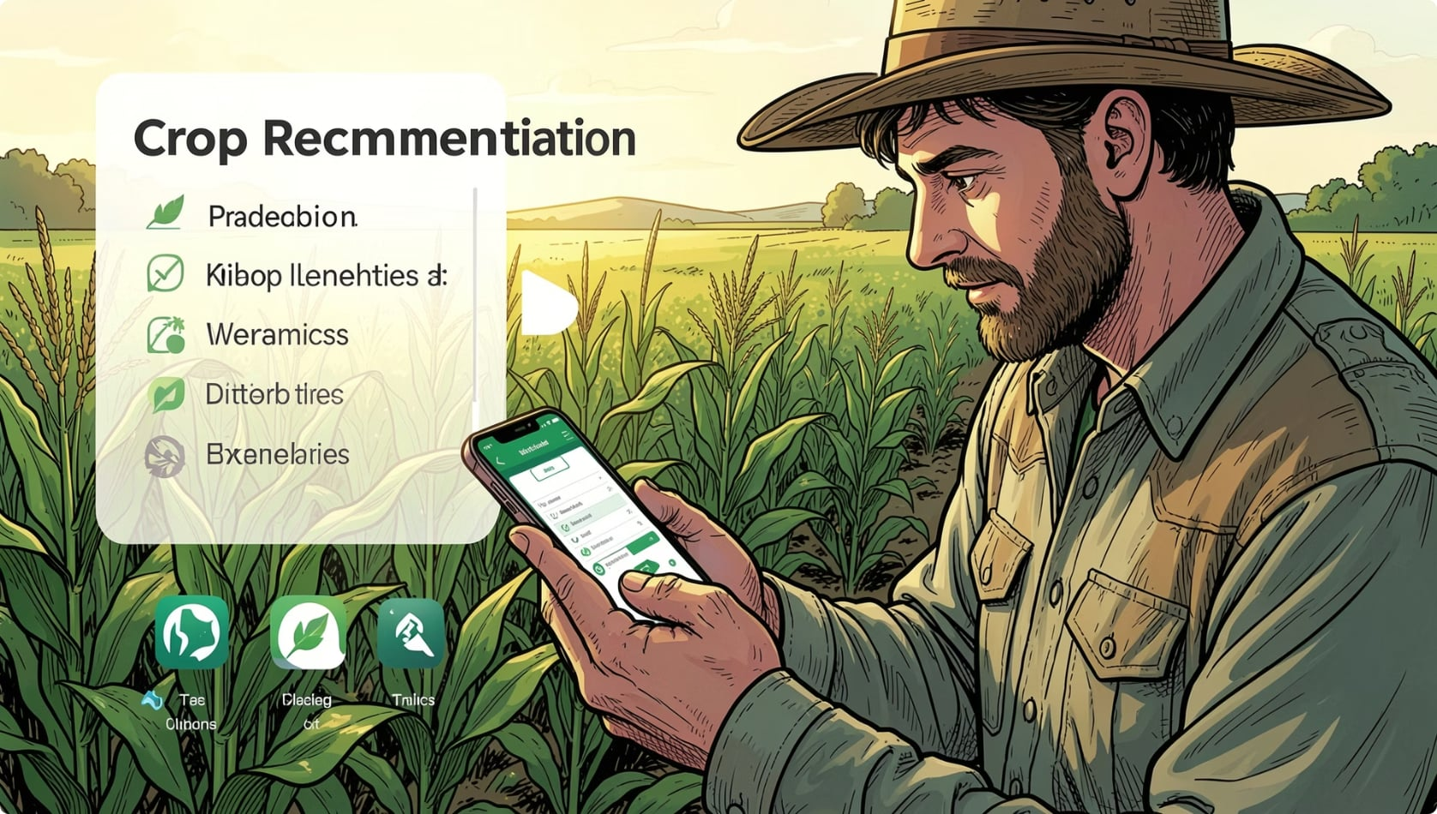
System Architecture & Working
Farmer Inputs
Random Forest
Validate
Scale
Recommend
The pipeline validates inputs, scales features for model stability, and runs a Random Forest ensemble. Outputs include the top-3 ranked crops, a confidence score for each suggestion, parameter-wise improvement tips, and visual comparisons on a radar chart.
Top 3 Recommendations
Presents ranked crops with confidence percentages and optional alternates.

Slide 3


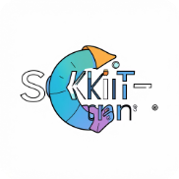



Technology Stack & Key Features
A lightweight, reproducible stack focused on rapid prototyping and responsive delivery. Backend ML is Python-based; frontend delivers interactive charts and session history for repeatable decisions.
Python
Flask
Scikit-learn
Pandas & NumPy
Model training, preprocessing, and APIs.
Lightweight REST API for predictions and session management.
Random Forest implementation, model evaluation tools.
Data wrangling and numeric processing for feature pipelines.
Bootstrap 5
Chart.js
Responsive UI components for field devices and desktop.
Interactive radar and bar charts for suitability and comparisons.
Supports 43+ Crops
Real-time Recommendations
Interactive Dashboard
Trained on diverse regional datasets for generalizability.
Sub-100 ms inference on typical cloud CPU instances.
Top-3 results, radar comparison, parameter suggestions, and session history.
Responsive & Accessible
Designed for low-bandwidth field use and mobile screens.

Slide 4
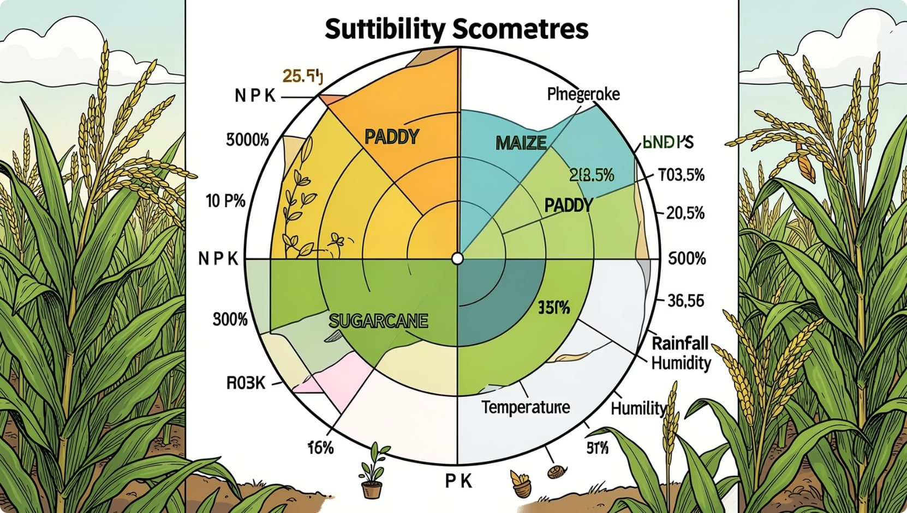
Results & Performance — Sample Prediction
Model metrics: Accuracy: 92%. Average inference time: <100 ms. Parameter suggestions include small pH adjustment and drainage guidance where needed.
Radar visualization highlights relative suitability per parameter. Use the dashboard to toggle crops and view parameter-wise remediation tips (fertilizer, pH correction, irrigation).
1
2
3
4
Input
Output
Top 3 Recommendations
Match Quality
N=80 · P=40 · K=40 · Temp=25°C · Humidity=80% · pH=6.0 · Rainfall=175mm
Recommended Crop: Paddy · Confidence: 96%
1) Paddy — 96% · 2) Sugarcane — 88% · 3) Maize — 72%
High: soil nutrients and rainfall align strongly with paddy suitability.

Slide 5


Conclusion & Future Scope
Conclusion
AI enables data-driven crop selection, improving yield and lowering risk.
OptiCrop provides actionable recommendations, confidence scores, and parameter-level guidance.
Designed for real-world field conditions with a responsive dashboard.
Future Enhancements
Integrate live Weather API and regional forecasts.
Support soil-sensor streaming for automated inputs.
Develop mobile app and multi-language UI for wider adoption.
Add crop price forecasting, pest/disease detection, and irrigation scheduling modules.
Next steps: pilot deployments with local extension services and feedback-driven model retraining to improve regional accuracy.
Thank You

