Slide 1
CREDITWISE – INTELLIGENT LOAN APPROVAL SYSTEM
Mini Project Report Department of Artificial Intelligence And Machine Learning

Slide 2
Abstract
This project proposes an intelligent loan approval system using Machine Learning to predict whether a loan should be approved or rejected based on applicant details such as income, credit score, employment status, and loan amount. It improves accuracy and reduces human bias.

Slide 3
Introduction
Banks receive hundreds of loan applications daily. Manual verification leads to rejection of genuine applicants, approval of risky customers, and increased operational cost. Machine Learning helps automate loan approval decisions.

Slide 4
Objectives
• Analyze historical loan applicant data
• Preprocess and clean the dataset
• Build a machine learning model
• Evaluate model performance

Slide 5
Dataset
Key Attributes:
• Applicant Income
• Credit Score
• Employment Status
• Loan Amount
• Debt-to-Income Ratio
• Property Area
Target: Loan_Approved OR Loan_Rejected

Slide 6
System Flowchart
Data Collection
Preprocessing
Encoding
Training
Evaluation
Prediction

Slide 7
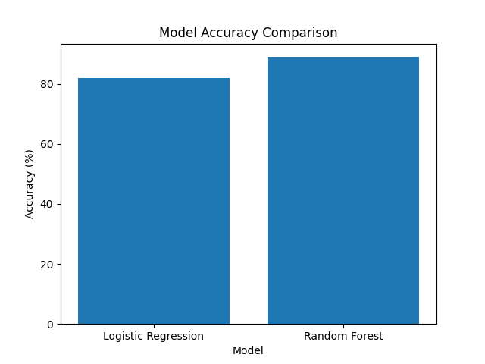
Accuracy Comparison

Slide 8
Technologies
Language: Python
Libraries: Pandas, NumPy, Scikit-learn
Visualization: Matplotlib, Seaborn
IDE: Jupyter Notebook
Models: Logistic Regression, Random Forest

Slide 9
Results
Logistic Regression achieved stable performance.
Random Forest improved prediction accuracy.
The model classified loan approvals with minimal error.

Slide 10
Conclusion
The CreditWise system automates loan approval using Machine Learning. It reduces manual effort, minimizes bias, and improves accuracy. It can be extended as a web application.

Slide 11
Future Enhancements
• Integration with bank databases
• Deep Learning models
• Fraud detection module
• Web-based dashboard

Slide 12
references
Scikit-learn Documentation
Machine Learning with Python – O’Reilly
Kaggle ML Resources

Slide 13
TEAM MEMBERS :
K Priyadharshini
Shaik Baba Azmath
Shaik Muzamil

Slide 14
Thank
you

