Slide 1

COLLEGE MANAGEMENT SYSTEM USING DATA STRUCTURES (JAVA)
Team Members:
Shaik Muzammil-2510040095
Sri Anish Saravan-2510030417
Pillala Sai Krishna-2510040089
Guided by:
Dr. Mahesh Babu A
Institution:
KLH University

Slide 2
The College Management System is a Java-based application developed using core Data Structures to manage student and faculty information efficiently.
THE SYSTEM PERFORMS OPERATIONS SUCH AS:
Managing student records
Managing faculty records
Attendance tracking
Marks entry and grading
Profile updates
Sorting student performance
File-based storage of data
This project demonstrates practical applications of Data Structures in real-world academic systems.

Slide 3
THE FOLLOWING DATA STRUCTURES ARE IMPLEMENTED:
Arrays
Used to store student and faculty details
Linked List
Used to manage attendance records dynamically
Stack
Used to perform Undo / Redo operations in profile updates
Queue
Used to process profile update requests sequentially
Searching Algorithm
Linear search used to find student records
Sorting Algorithm
Used to sort marks and attendance percentage

Slide 4
WORKFLOW OF THE SYSTEM:
Student and faculty data loaded from files
Records stored using arrays
Attendance managed using linked list
Profile update requests processed using queue
Undo/Redo implemented using stack
Sorting applied for marks and attendance ranking
Updated data saved back into files
This improves efficiency and reduces manual effort.

Slide 5
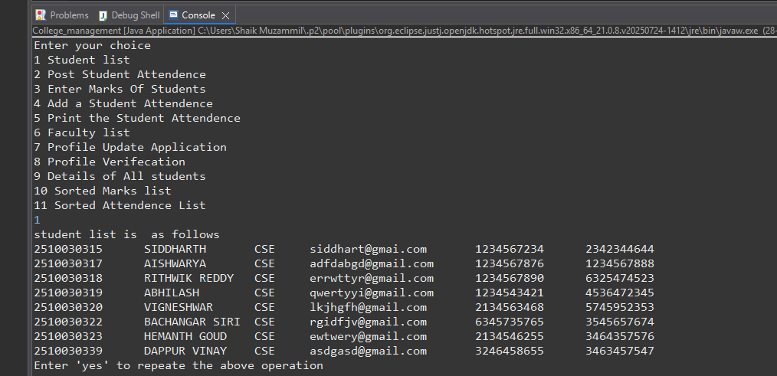
Output:
Display of the Student list

Slide 6
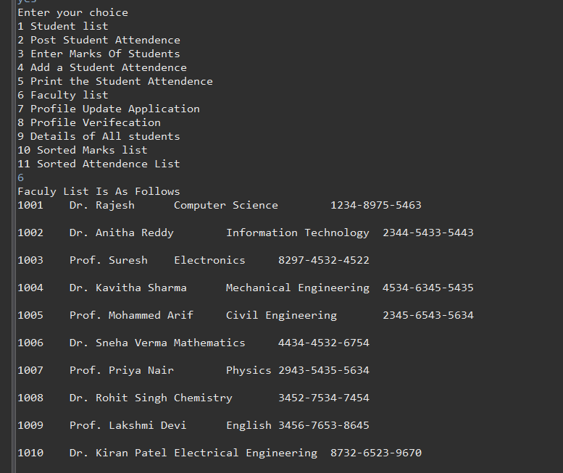
Output:
Display of the Faculty list

Slide 7
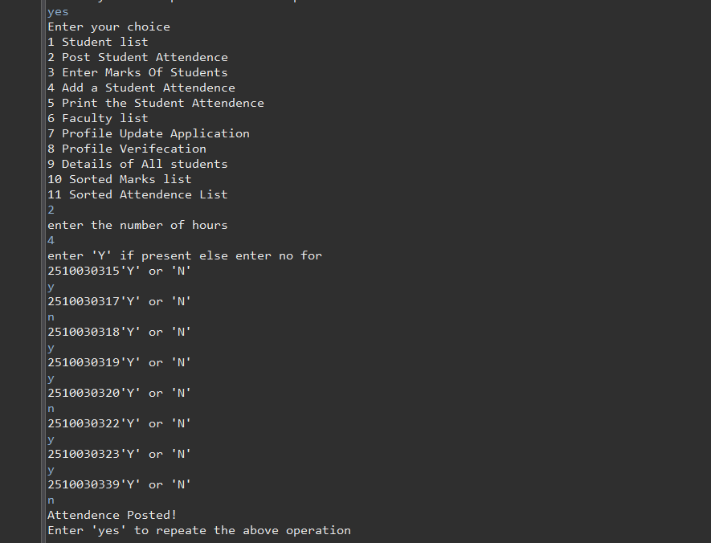
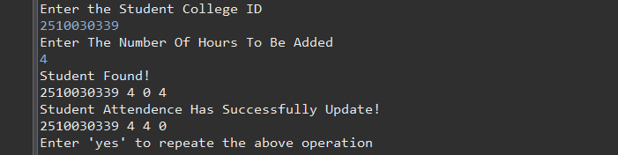
Output:
Posting the Student Attendance
Out put :
To update a student Attendance

Slide 8
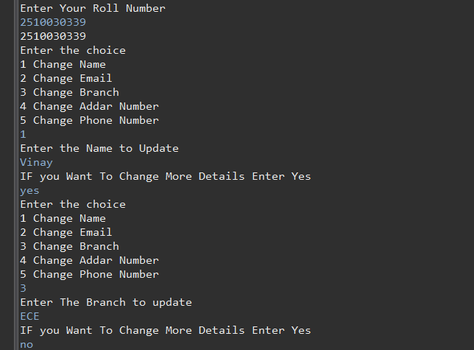
Output:
Applying for profile update

Slide 9
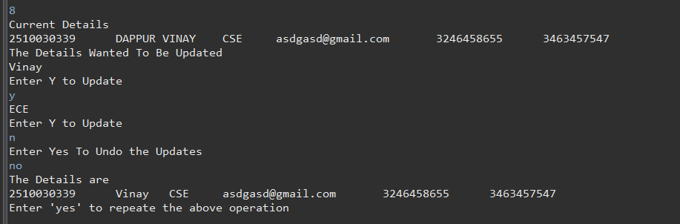
Out put:
To Grant the update

Slide 10
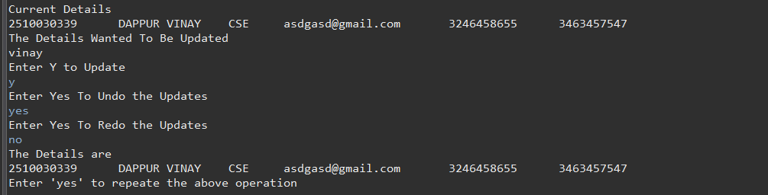
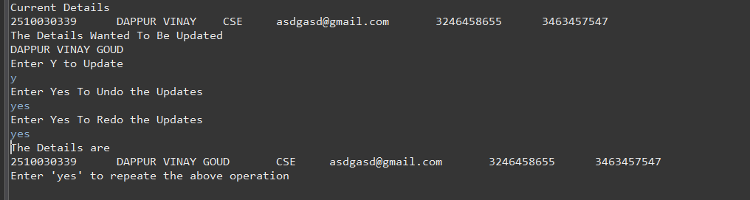
Undo operation
Redo operation

Slide 11
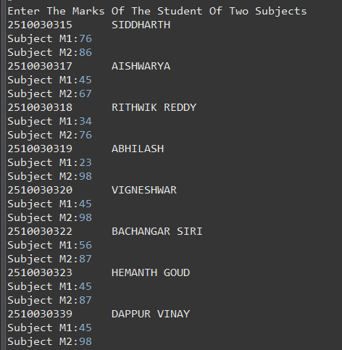
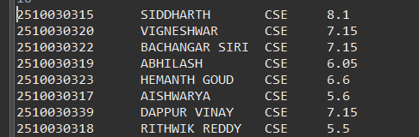
Uploading marks
Sorting by marks

Slide 12
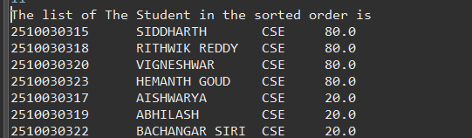
Sorting by Attendance
Sorting by marks

Slide 13
Thank you

