Slide 1

SUBSCRIPTION
MANAGEMENT SYSTEM
A SQL-based solution for managing subscriptions efficiently

Slide 2

Project Overview
02
A database system for organizing customer subscriptions, plans, billing periods and payments.
✓ Manage customer and plan details
✓ Track subscriptions and renewals
✓ Record payment attempts and status changes

Slide 3
Problem Statement & Objectives
03
Problem
Objectives
Subscription information can become difficult to manage when customer, plan, renewal and payment records are not organized in related tables.
✓ Organize data in related tables
✓ Maintain billing and payment records
✓ Track subscription status changes
✓ Improve data integrity through SQL constraints and triggers

Slide 4
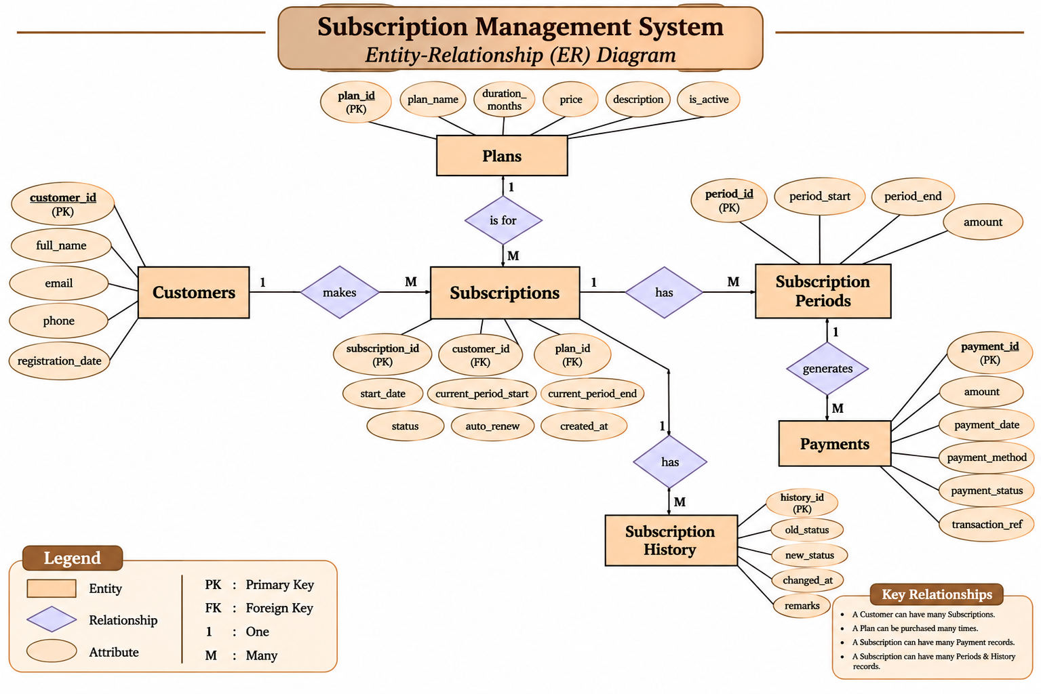
04

Slide 5
Core Database Tables
05
customers
plans
Customer profile and contact details
Subscription plan names, durations and prices
subscriptions
subscription_periods
Customer-plan link and subscription status
Billing periods and renewal records
payments
subscription_history
Payment attempts and outcomes
Subscription status-change audit trail

Slide 6
SQL Concepts Implemented
06
✓ DDL and DML operations
✓ Filtering, sorting and aggregate functions
✓ INNER JOIN, LEFT JOIN and subqueries
✓ CTEs and window functions
✓ Views, indexes and EXPLAIN
✓ Stored procedures with IN / OUT parameters
✓ BEFORE and AFTER triggers

Slide 7

Automation & Data Integrity
07
✓ Payment validation trigger rejects excessive payment amounts.
✓ Successful payment updates the billing period and subscription status.
✓ Status changes are recorded in subscription_ history.
✓ Stored procedures support reusable database operations.

Slide 8
Testing & Results
08
SQL Testing
Trigger Testing
✓ Joins, subqueries, CTEs and window functions executed
✓ Views and indexes created and checked
✓ Stored procedures tested
✓ Invalid payment amount rejected
✓ Valid payment accepted
✓ Billing period updated to PAID
✓ Subscription status updated to ACTIVE

Slide 9
Project Outcome
09
The project demonstrates a structured relational database with practical SQL queries, data validation and automated updates.
Successfully Implemented
Six related tables • Views • Indexes • Stored procedures
• Triggers

Slide 10
Conclusion
10
The Subscription Management System shows how MySQL can organize subscription data, preserve payment history and automate important database operations.
THANK YOU

