Slide 1

Yes Bank Stock Closing Price Prediction
An In-Depth Exploration
with Python and R
Submitting by: SK Nadeem
Reg no:-221FA14069

Slide 2

Content:
development of the code
Step-by-Step Breakdown of the Approach
data summary
Industry Overview: GPU Kernel Performance
Business Problem Statement
Dataset Description and Plan of Action
Exploratory Data Analysis (EDA)
Histogram of data
Correlation matrix
Boxplot, linear regression plot, scatter plot’s
Data Processing
Data splitting
Conclusion

Slide 3
Introduction:-
YES bank stands for Youth Enterprise Scheme Bank. Stock market is one of the major fields that attracts people, thus stock market price prediction is always a hot topic for researchers from both financial and technical domains. In our project our objective is to build a prediction model for close price prediction. A stock market is a public market where you can buy and sell shares for publicly listed companies. Stock Price Prediction using machine learning helps you get an estimate of value of company stock going forward and other financial assets traded on an exchange. The entire idea of predicting stock prices is to gain significant profits. Predicting how the stock market will perform is a hard task to do. There are numerous other factors involved in the prediction, such as the psychological factor – namely crowd behavior etc. All these factors combine to make share prices very difficult to predict with high accuracy.

Slide 4
Data Description:-
Before performing any operation on the dataset, it is important to understand the data. After loading the data, we observed the dataset by checking a few of the first and last rows. We checked the shape of the dataset and there are 185 rows and 5 features columns in our dataset.
Let’s understand the features present in our dataset.
• Date: It denotes date of investment done (in our case we have month and year).
• Open: Open means the price at which a stock started trading when the opening bell rang.
• High: High refer to the maximum prices in a given time period.
• Low: Low refer to the minimum prices in a given time period.
• Close: Close refers to the price of an individual stock at the end of the considered time period.

Slide 5
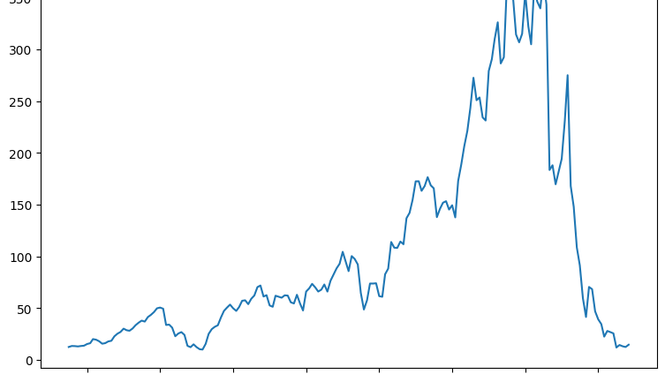
plt.figure(figsize=(9,6))
plt.figure(): This initializes a new figure for plotting. You can think of it as creating a blank canvas.
figsize=(9,6): This sets the size of the figure (width, height). Here, the width is 9 units and the height is 6 units.
2. plt.plot(data['Date'], data['Close’])
plt.plot(): This function is used to create a line plot.
data['Date']: This specifies the data for the x-axis, which appears to be a column labeled 'Date' in the data Frame.
data['Close']: This specifies the data for the y-axis, which is likely a column labeled 'Close' (probably representing closing prices of a stock or other time series data).

Slide 6
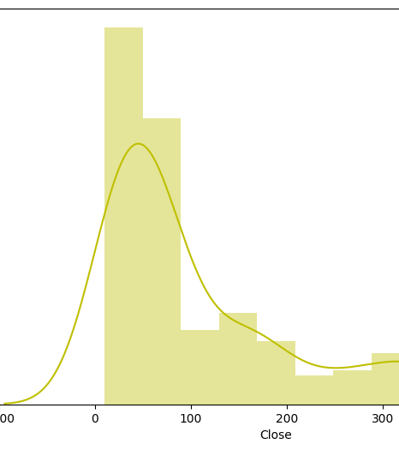
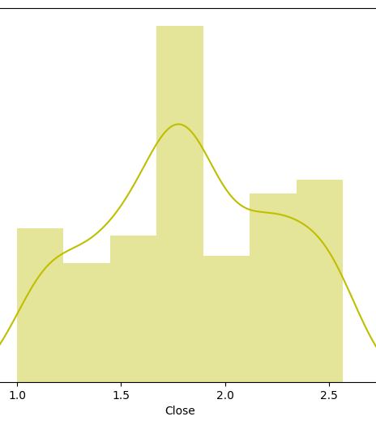

Slide 7
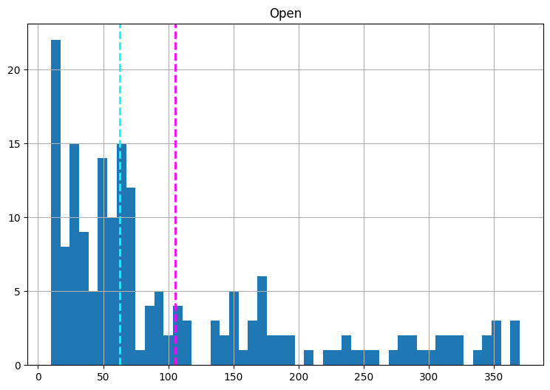
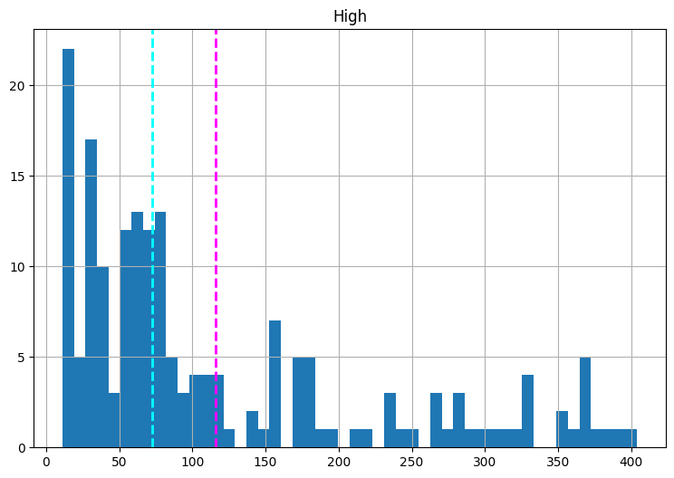
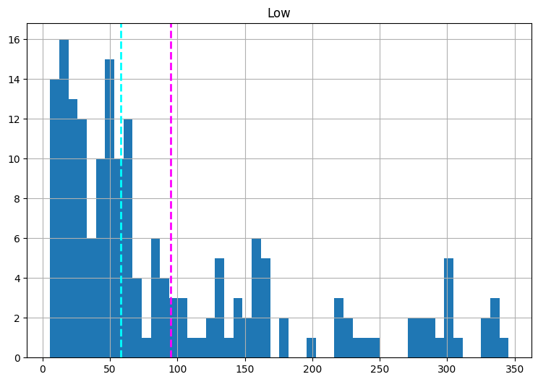
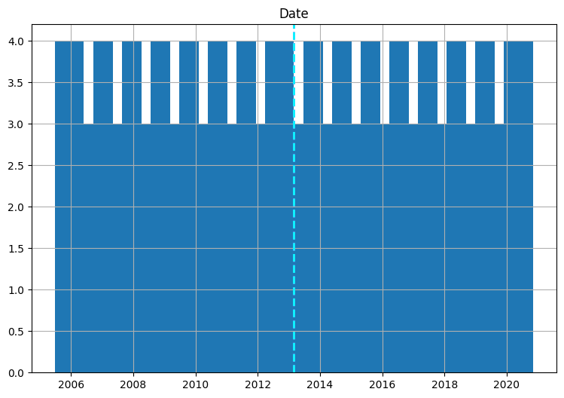
Histograms for each numeric feature in a dataset, excluding the last feature in the list numeric_fea. For each numeric column, it plots the distribution of values, highlighting the mean and median with distinct vertical lines.
Key Steps:
Iterating through columns: The loop goes through all numeric columns in the dataset (numeric_fea), except the last one.
Creating a figure: For each column, a new figure with a size of 9x6 units is created using plt.figure().
Plotting histogram: The histogram of the column's data is plotted with 50 bins. This provides a visual representation of the frequency distribution of the values in the column.
Adding reference lines: Two dashed vertical lines are drawn on each histogram:
One line at the mean (in magenta).
Another line at the median (in cyan).
Setting titles: Each plot is titled with the column name to identify which feature is being visualized.
Displaying plots: Once all histograms are created, the plt.show() command displays them.

Slide 8
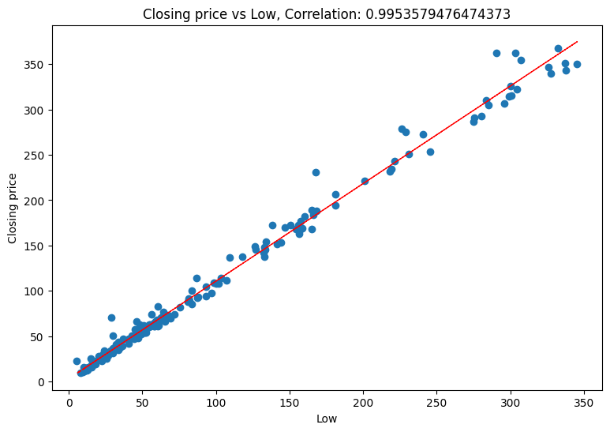
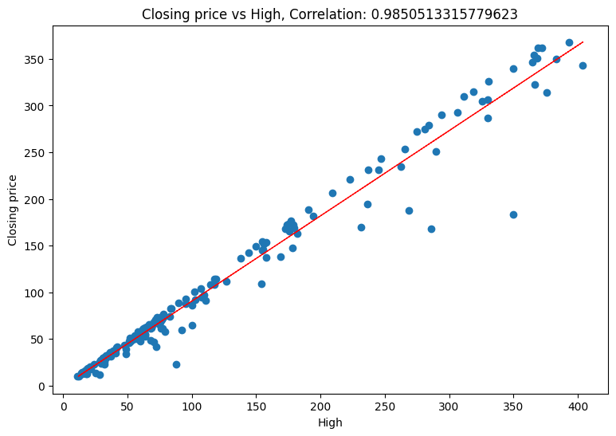
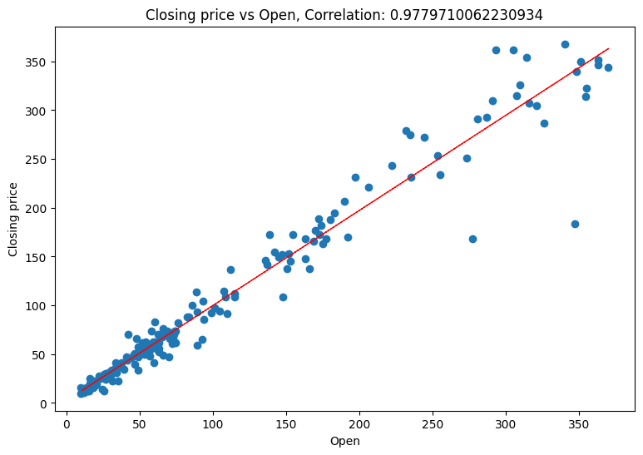
A scatter plot is a common and useful visualization technique to explore the relationship between a dependent variable (i.e., Yes Bank stock closing price) and one or more independent variables. In a scatter plot, each observation is represented as a point on the graph, with the independent variable plotted on the x-axis and the dependent variable plotted on the y-axis.
By examining the scatter plot, we can identify any patterns or relationships between the two variables. For example, if the points on the scatter plot are closely clustered around a straight line, this suggests a strong linear relationship between the two variables. On the other hand, if the points on the scatter plot are more spread out and do not appear to form a straight line, this suggests a weaker relationship or no relationship at all.
By examining the scatter plot, we can determine whether there is a strong or weak relationship between the closing price and the independent variable(s), and whether this relationship is linear or nonlinear. This information can be used to inform the selection of appropriate ML algorithms for predicting the closing price, and to identify any potential issues with the data that may need to be addressed before training the ML model.
From all above graphs we can see that all the independent variable are linearly corelated with dependent variable(i.e., Yes Bank stock closing price). We need to choose appropriate model to deal with multicollinearity in our data.

Slide 9
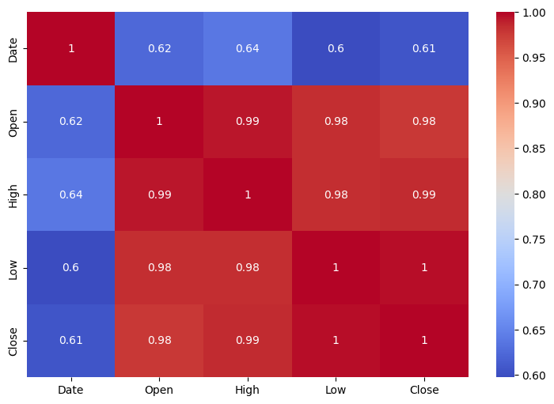
Heat Map:
Heatmap can be used to explore the correlation between the closing price and the independent variables. By examining the heatmap, we can identify any patterns or relationships between the variables, which can inform the selection of appropriate ML algorithms for predicting the closing price.
A heatmap can also be used to identify any potential issues with the data, such as multicollinearity (i.e., high correlation between independent variables).
As from above chart we can see that our data is Multicollinear. Multicollinearity can cause problems for linear regression, because it can lead to overfitting and unreliable coefficient estimates. By identifying variables with high correlations, we can decide whether to remove one of the variables or to use a different ML algorithm that is less sensitive to multicollinearity.

Slide 10
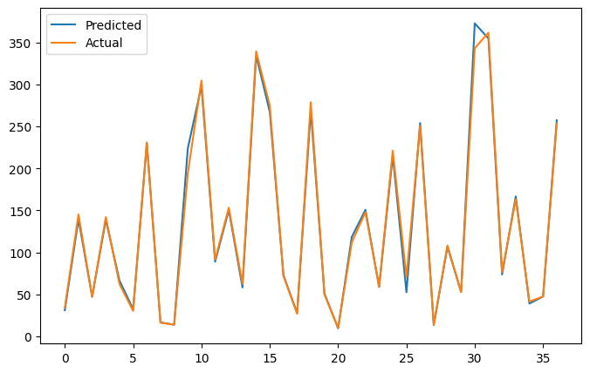
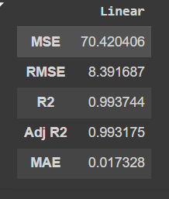
Linear Regression
This code implements a Linear Regression model for predicting values based on training data. Here's a brief summary:
Model Initialization & Training:
A Linear Regression model (reg) is created and trained using X_train and y_train with the reg.fit() function.
Prediction:
Predictions on the test data (X_test) are made using reg.predict(), and the result is stored in y_pred.
Evaluation Metrics:
Metrics such as Mean Squared Error (MSE), Root Mean Squared Error (RMSE), R-squared (R²), Adjusted R-squared, and Mean Absolute Error (MAE) are calculated to evaluate model performance. The results are converted from log-transformed values using 10** and stored in a Data Frame eval.
Visualization:
The predicted and actual values are plotted on a graph for visual comparison, with the predicted values in one line and actual values in another.
This process provides both numerical and visual insights into the model's performance.

Slide 11
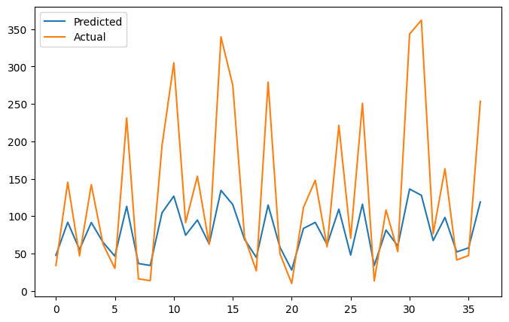
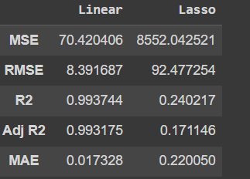
Linear Regression using Lasso Regularization.

Slide 12
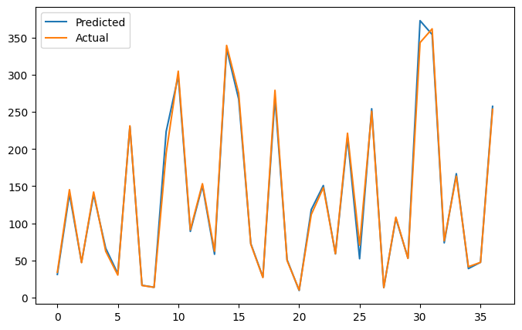
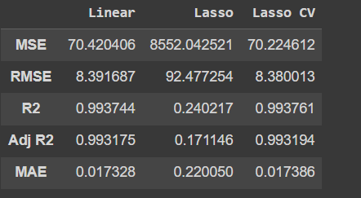
Cross- Validation & Hyperparameter Tuning
Here we use GridSearchCV for optimization. GridSearchCV is more likely to find the optimal set of hyperparameters if the search space is small enough, as it performs an exhaustive search.
By looking at above Data frame we can say that our linear regression with lasso regularization is doing better compare to all others.

Slide 13
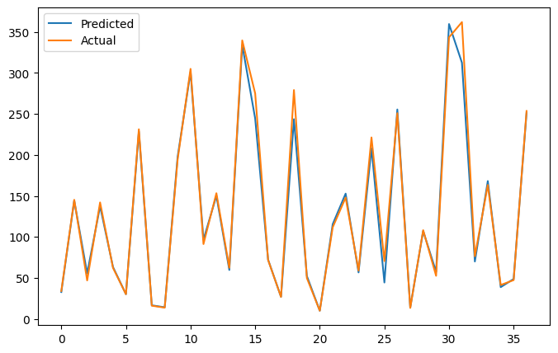
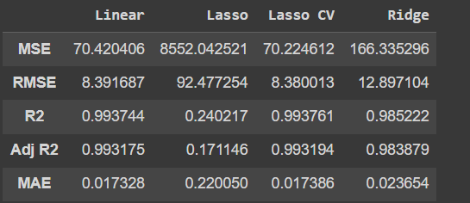
Linear Regression with Ridge Regularization

Slide 14
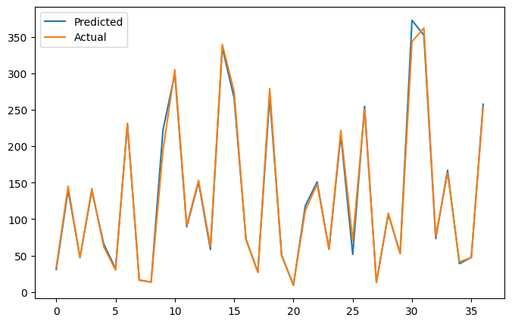
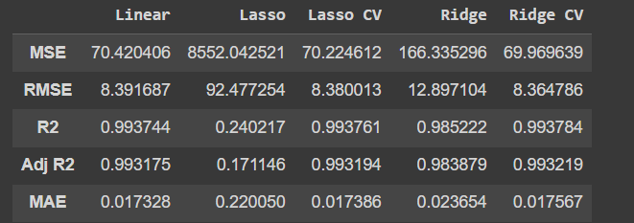
Cross- Validation & Hyperparameter Tuning
Here we use GridSearchCV for optimization. GridSearchCV is more likely to find the optimal set of hyperparameters if the search space is small enough, as it performs an exhaustive search.
By looking at above Data frame we can say that our linear regression with Ridge regularization is doing better compare to all others.

Slide 15
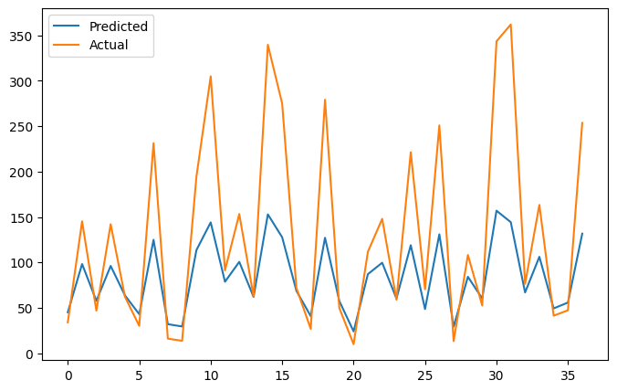
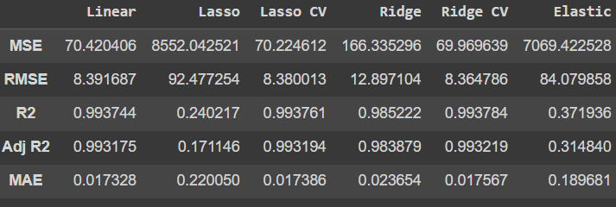
Linear Regression with Elastic Net Regularization

Slide 16

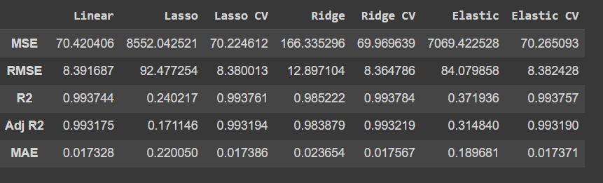
Here we use GridSearchCV for optimization. GridSearchCV is more likely to find the optimal set of hyperparameters if the search space is small enough, as it performs an exhaustive search. Here we tried all the possible regularization methods, but among all Ridge CV is performing better than any other model.
Cross- Validation & Hyperparameter Tuning

Slide 17
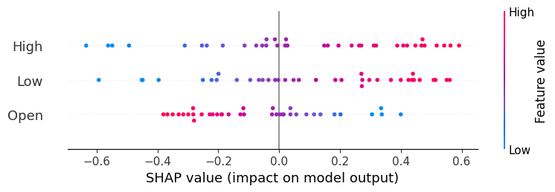
As we take our best performing model as RidgeCV. On the basis of our Hyperparameter Tunning we get our Alpha as 0.01. here we are Gona check feature importance with two methods are as follows:
Coefficient : By looking at the coefficient of model we can say that High has most impact on target variable where as Open has negative correlation with target variable
SHAP : SHAP values quantify the contribution of each feature to the predicted outcome for a particular instance. The summary plot shows the features ranked in descending order of importance, based on the mean absolute SHAP values are calculated for each instance in the test set. By examining the summary plot, we can identify High and Low have the strongest impact on the model's predictions.

Slide 18
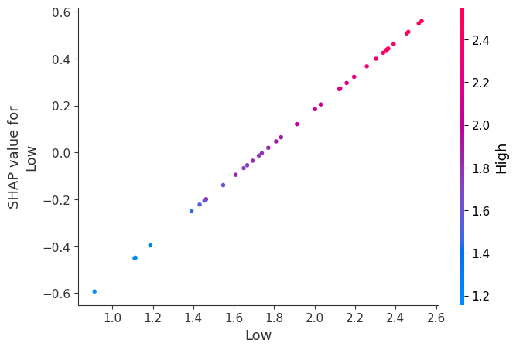
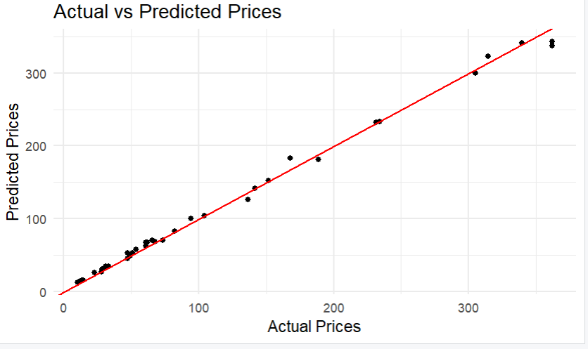
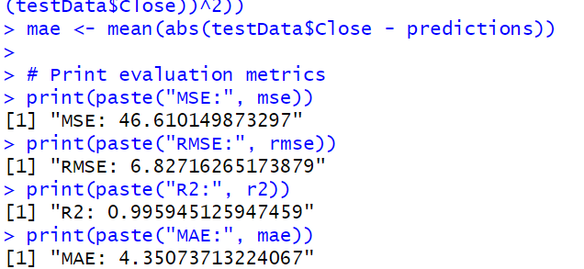
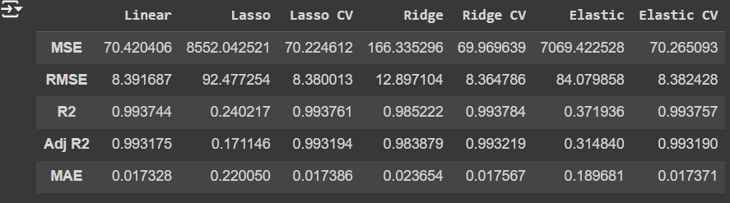
The plotlines are obtained after running the code in python and R respectively.
We got the best fit line after comparing MSE, RMSE, R2, Adj R2, and MAE.

Slide 19
Conclusion:
After making model on Yes bank Stock Closing price predication, we want to conclude that Data has multicollinearity. So for dealing with it we preferred to go for different regularization techniques with cross validation. We made every possible model then on the basis of Mean Squared Error (MSE) and Adjusted R2 (Adj r2) we can see our best performing model is RidgeCV with minimal error. With respective model we tried to do some feature importance for model, Where we find out that High is most impacting feature for target variable also Open is negatively impacting the target variable.

Slide 20
Thank You

