Slide 1
Web Page Design
ECE 3940
Megan O’Byrne
10 September 09

Slide 2
Designing Your Page
Step 1: Design for a Computer Medium
A computer screen is not a printed page
Readability changes depending on color, layout, and format
Different browsers, screens and displays can change how a page looks
From Principles of Web Design
By Joel Sklar

Slide 3

How We Read Text
Following normal reading habits, the users eye moves from left to right

Slide 4

How We View Screens
Looking at a screen, the users eye scans in a more clockwise pattern

Slide 5
How Will Your Users Read/View?
If a page uses a lot of text, the user will read in a more traditional, left to right manner.
If a page has more graphical elements, the user is more likely to take in the whole page.

Slide 6





Accepted Relative Areas of Importance

Slide 7
Questions to Ask Yourself
What is the purpose of my website?
Who is my main audience?
My secondary audience?
What information do I want to present?

Slide 8
Designing Your Site
Step 2: Plan your sites hierarchy
How are your pages linked together?
How many links exactly?
Where does the user go next?

Slide 9

A Structure That is More Wide Than Deep

Slide 10
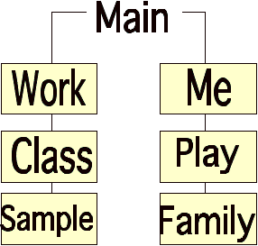
A Structure That is More Deep Than Wide

Slide 11
Designing Your Content
Step 3: The “do’s” of good web design
Name files consistently and logically
Keep a consistent look and feel
Use colors that are high in contrast
Design for low bandwidth

Slide 12
Designing Your Content
More do’s
Use active white space
Design for interaction
Use hypertext linking effectively
Design for accessibility

Slide 13
Designing Your Content
Step 4: Things to avoid, aka, the “don’ts”
Don’t overuse media
Don’t make users scroll too much
Don’t flood pages with content
Don’t choose colors or images that make the page hard to read

Slide 14
Designing Your Content
Don’t forget to title everything: images and pages
Don’t assume that your users know where to go
DON’T USE FRAMES!

Slide 15
Getting Started
Select a design tool/program
Determine page layout
Re-read assignment sheet and rubrics
Consider how best to represent “you”

Slide 16
Examples
The worst: www.webpagesthatsuck.com
Similar to this assignment: http://iml.jou.ufl.edu/Homepages/

