Slide 1

Web browser

Slide 2
A web browser is
a software application for
retrieving, presenting and traversing
information resources on the
World Wide Web.

Slide 3
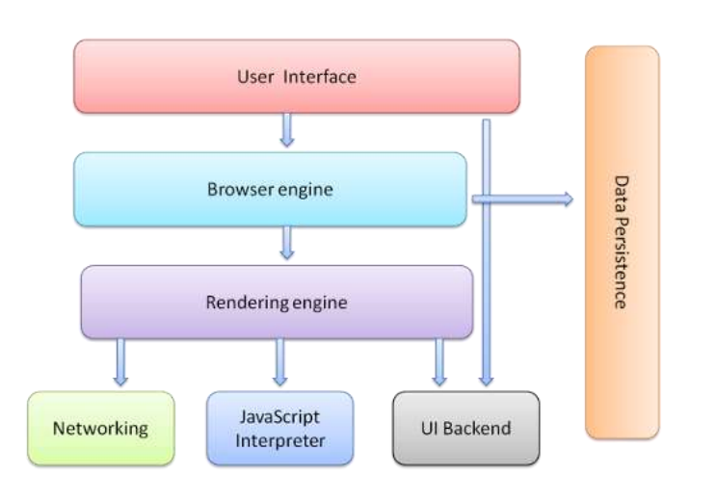
The browser's main components

Slide 4
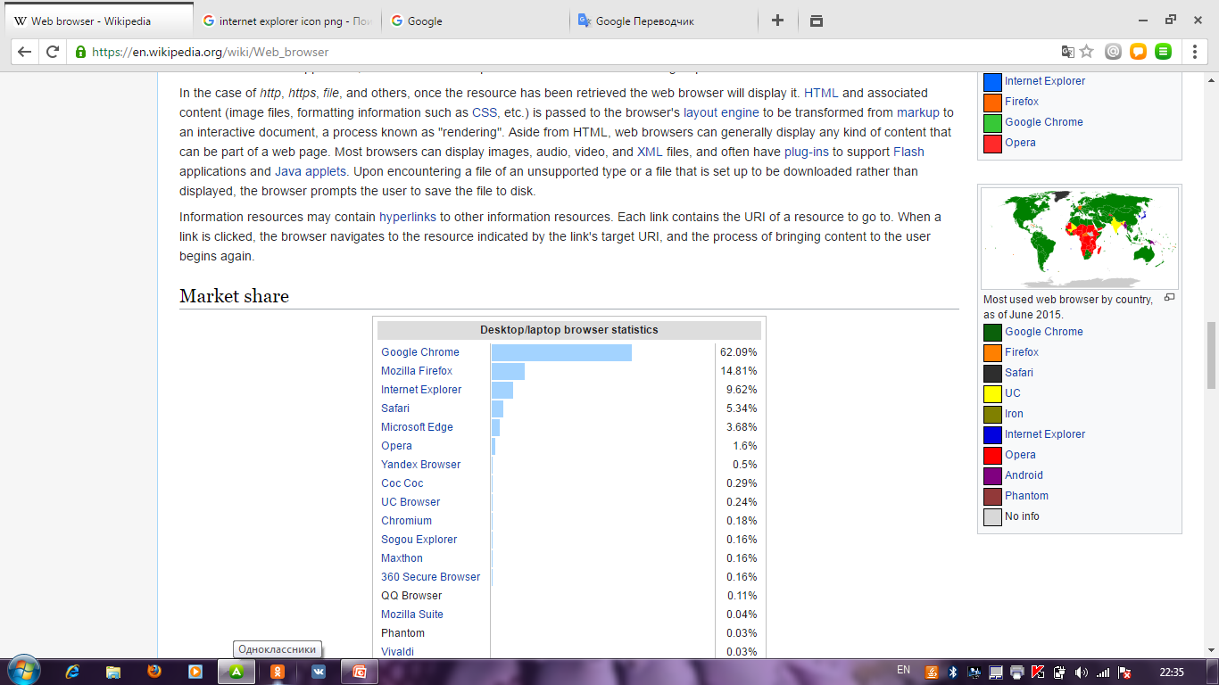
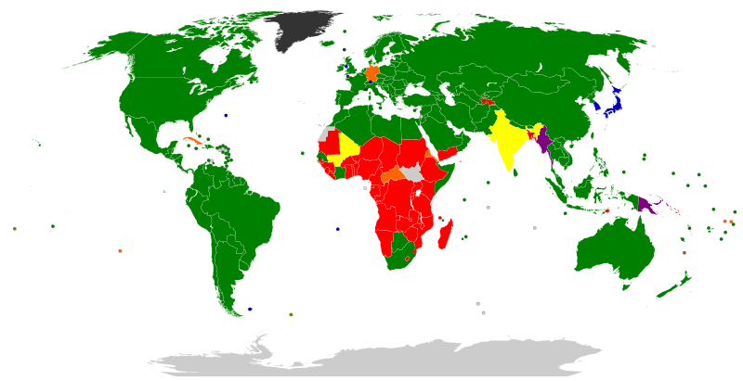
Most used web browser by country, as of June 2015.

Slide 5


The two most popular types of web browsers include:
Google Chrome, Internet Explorer

Slide 6
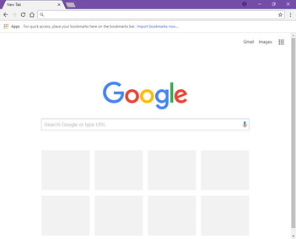

Google Chrome is
a freeware web browser
developed by Google.

Slide 7
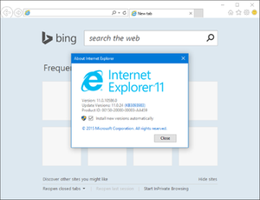

Internet Explorer is a series of graphical web browsers developed by Microsoft.

Slide 8
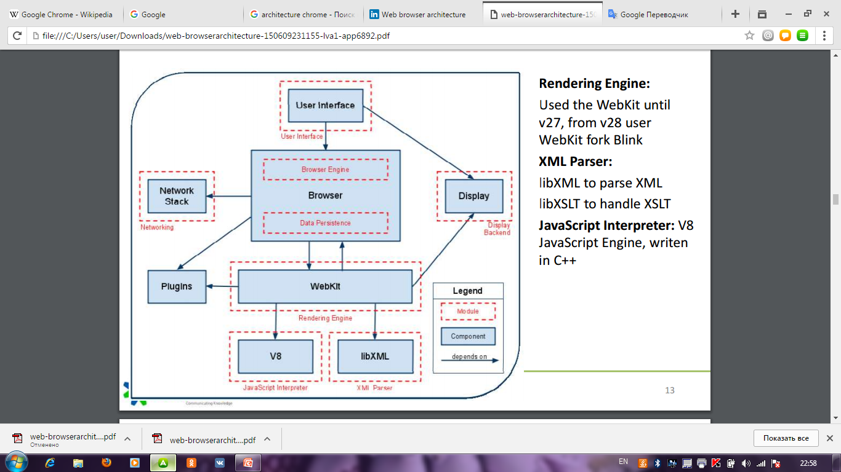
Architecture of Chrome

Slide 9
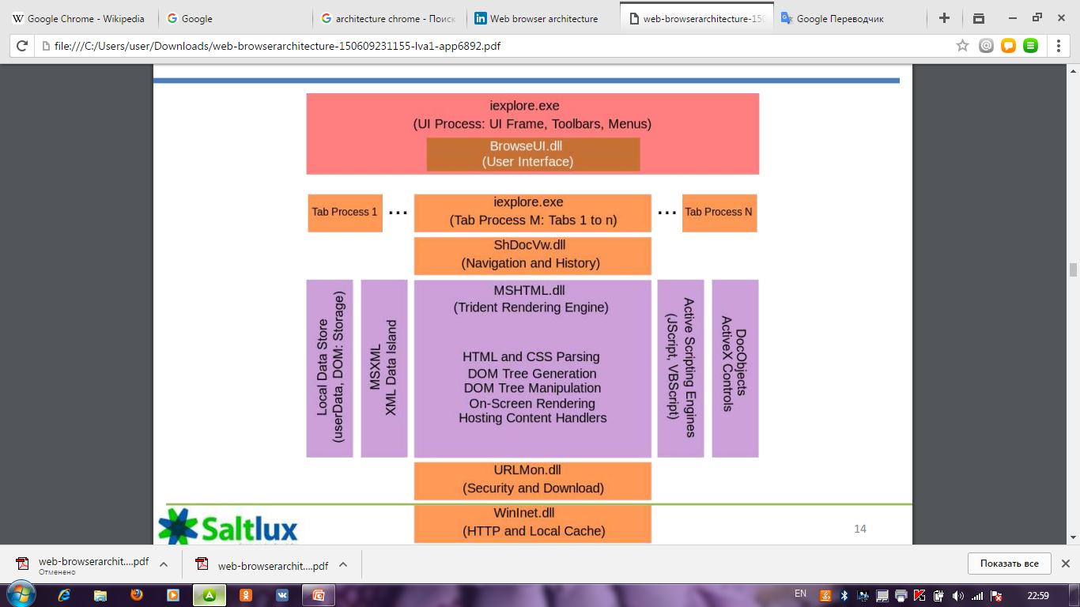
Architecture of IE

Slide 10

Advantages: simple design making it easy to use, extremely fast, it loads pages very quickly, takes only seconds to install Disadvantages: Chrome uses up a lot of memory (RAM) when running it. If you accidently close the browser, Chrome will close all the tabs opened without warning.

Slide 11
Advantages: Comes installed already on computer
Some websites can only be used with Internet Explorer
Some applications are optimized for IE
Disadvantages: No add-on support
Slows down with newer versions
Targeted by hackers

Slide 12
Thank you for your attention!

