Slide 1
CHAPTER 8 INTRODUCTION TO INTERNET
CLASS – IV
SUBJECT - COMPUTER

Slide 2
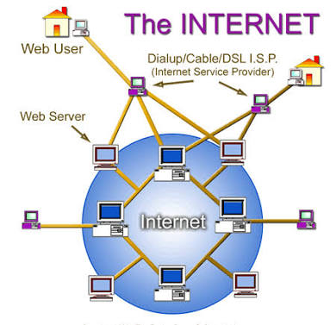
INTRODUCTION TO INTERNET

Slide 3
Content
What is network ?
Definition of Internet
Use of Internet
Requirements to connect Internet
Common Internet terms
Define Internet Explorer
Main parts of Internet Explorer

Slide 4
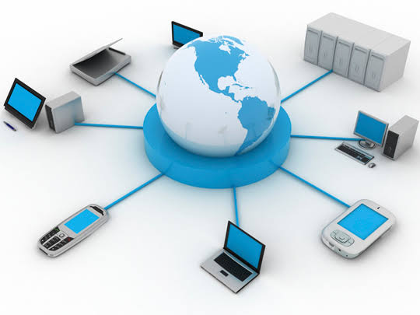
What is network?
When two or more computers are
connected with each other we
call it a computer network.

Slide 5
Definition of Internet
Internet is a network in which millions of computers are connected to one another to share information.
Internet is also called International Network
Internet is connected to the computer by the means of cables, telephone wires or some wireless media of communication

Slide 6
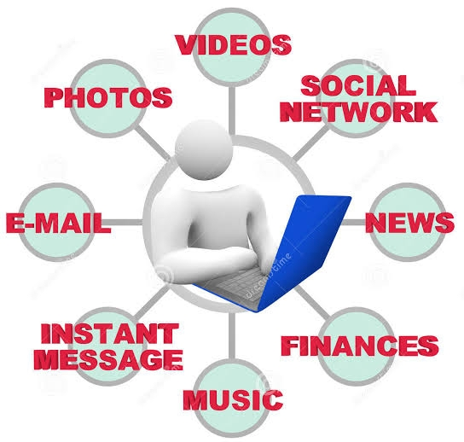
Use of Internet
Search information on any topic
Share information with others
Send and receive emails
Buy or sell products
Play online games
Participate in social networking sites
Listen to music
Watch movies

Slide 7
INTERNET AND ITS USES
Education : Internet is a valuable source for a lot of information. Data and information related all fields are updated in the internet. Students can spend a few minutes over the internet to read their relevant study materials. Many students use internet for intense research on their projects.
Communication : With internet, communication has become better and easier. One can call and talk to someone over the internet. Video calls are an interesting option with communication through internet. Mailing is one another form of communication, which is widely used in daily corporate life.

Slide 8
Current Updates : Daily updates and current happenings are made available in the Internet instantly. Internet is considered the real time hub for all updates about politics, sports, entertainment, science, business and many other fields.
E-Commerce : Other than using internet for business purposes, a business itself can be started and accomplished through the internet. E-Commerce has lot of advantages like reaching the customers easily, giving a lot of information about the business, clearing customer queries instantly and making the payment also possible over the internet.

Slide 9
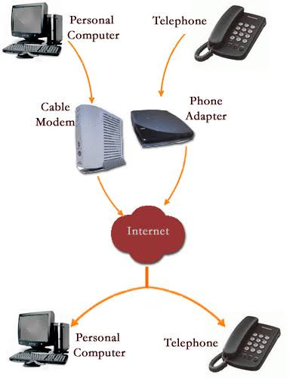
Requirements to connect Internet
Computer
telephone or cable line
modem
Software
ISP (Internet Service Provider)

Slide 10
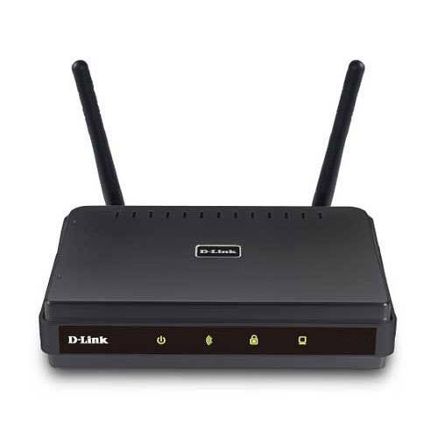
Main Internet terms
Modem
Modem is short for "Modulator-Demodulator." It is a hardware component that allows a computer or another device, such as a router or switch, to connect to the Internet. It converts or "modulates" an analog signal from a telephone or cable wire to digital data (1s and 0s) that a computer can recognize. Similarly, it converts digital data from a computer or other device into an analog signal that can be sent over standard telephone lines.

Slide 11
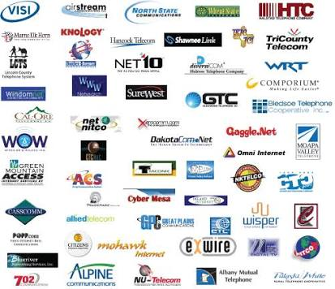
ISP (Internet Service Provider)
An Internet service provider is an organization that provides services for accessing, using, or participating in the Internet.

Slide 12
Common Internet Terms
Website
. A collection of related web pages that provide information
Web Page
. Contains text, pictures, sounds, videos, animations
Home Page
. The main page of any website
WWW (World Wide Web)
. The Largest collection of information in the form of website
Web Browser
. A special software to open websites

Slide 13
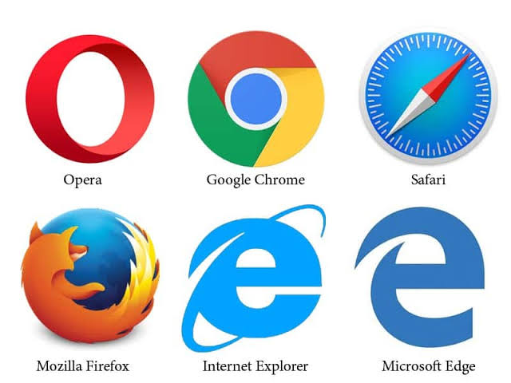
Examples of Web Browsers

Slide 14
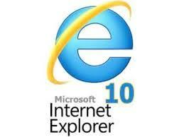
Internet Explorer
Internet Explorer is the most common web browser available almost on every computer as it comes with all new edition of Windows

Slide 15
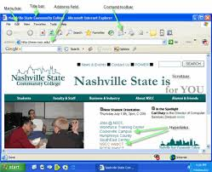
Main parts of Internet Explorer

Slide 16
Main parts of Internet Explorer
Title Bar – shows title of the page
Menu Bar – shows various items for operation on web page
Tool Bar – Has shortcut buttons for various operations
Address Bar – important part of web browser where the page address is to be typed

Slide 17
Examples of Toolbar
Back button
Used to go back to previous page and Internet settings
Forward button
When we want to move to any previous page, Forward button takes us back to the next pages

Slide 18
THANK YOU
GO THROUGH ALL THE SLIDES
PROPERLY

