Slide 1

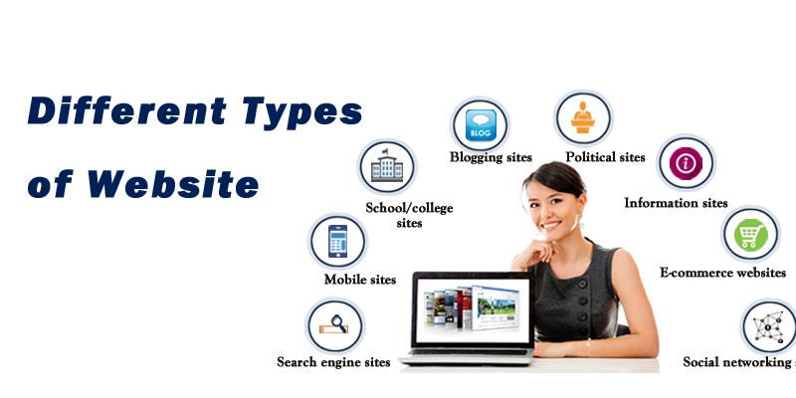

Slide 2

Websites have many functions and can be used in various fashions; a website can be a personal website, a commercial website for a company, a government website or a non-profit organization website.

Slide 3
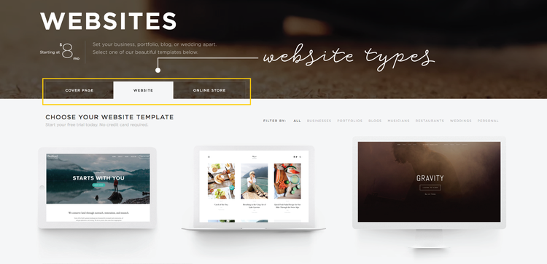
Different Types of Websites Based On Design

Slide 4
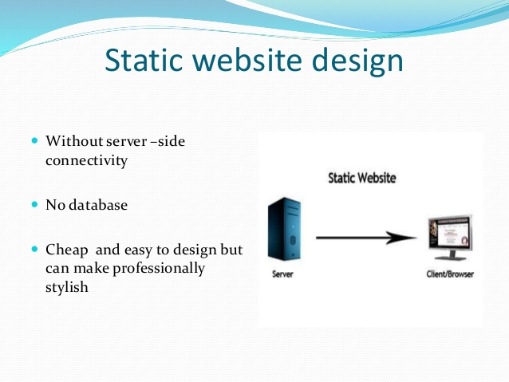
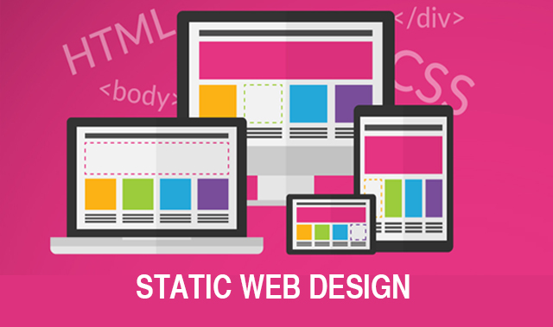
Static Website
They have a simple design where the content doesn’t change depending on the device or screen. Static Websites are generally designed using HTML code and they are only for information purpose.

Slide 5
Interesting, right?
This is just a sneak preview of the full presentation. We hope you like it! To see the rest of it, just click here to view it in full on PowerShow.com. Then, if you’d like, you can also log in to PowerShow.com to download the entire presentation for free.

