Slide 1

PALOALTO CYBERSECURITY
by
Shaik Mohammad Rafi
Roll No. 224G1A3353
Department of Computer Science and Engineering (AI & ML)
Srinivasa Ramanujan Institute of Technology
(Affiliated to JNTUA & Approved by AICTE) (Accredited by NAAC with ‘A’ Grade & Accredited by NBA (EEE, ECE & CSE)
Rotarypuram Village, B K Samudram Mandal, Ananthapuramu – 515701.
2024 - 2025

Slide 2
Contents
Course Objective
Introduction
Technology
Applications
Modules
Real Time applications
Learning outcomes
GitHub Link
Queries

Slide 3
Course Objective
Course Objective: The Palo Alto Cybersecurity Internship provides a strong foundation in cybersecurity by focusing on key areas such as network security, threat detection, and incident management. Through interactive labs, real-world case studies, and guided projects, participants gain hands-on experience in safeguarding systems and data from cyber threats. The program also covers the fundamentals of firewalls, VPNs, and various security protocols, preparing students for industry-level challenges and helping them build a career in the cybersecurity field.

Slide 4
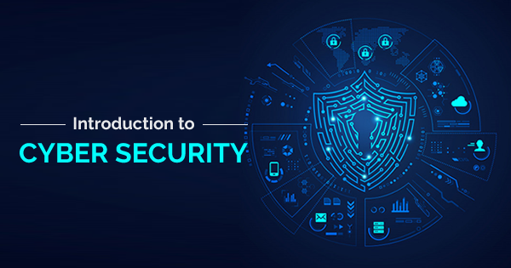
Introduction
Palo Alto Networks, established in 2005,
is a global leader in cybersecurity, renowned for
its comprehensive and innovative security
solutions across industries. The company's
cybersecurity platform incorporates advanced
technologies such as artificial intelligence (AI),
machine learning (ML), and automation to offer
sophisticated threat detection, prevention, and
response capabilities.
Cybersecurity, as a field, involves protecting systems, networks, and data from digital attacks, which are often intended to compromise sensitive information, extort money, or disrupt business operations. It utilizes various tools, strategies, and techniques to defend against unauthorized access, data breaches, and other cyber threats. With the growing reliance on technology, the importance of strong cybersecurity measures continues to rise globally.

Slide 5
Technology
Cybersecurity technologies are the tools and methods used to protect systems, networks, and data from unauthorized access, cyberattacks, and damage. With cyber threats continuously evolving, organizations and individuals need robust technologies to prevent, detect, and respond to these threats. Below are key technologies that are commonly used in cybersecurity:
1,Firewalls:
Firewalls serve as a protective barrier between a trusted internal network and untrusted external networks. They monitor and filter both incoming and outgoing traffic based on established security rules, blocking harmful traffic while permitting legitimate communications. There are different types of firewalls, including hardware firewalls, software firewalls, and next-generation firewalls (NGFWs), which offer additional features like intrusion prevention.

Slide 6
Technology
2. Antivirus and Antimalware Software
These tools are designed to detect, prevent, and remove malicious software such as viruses, worms, and ransomware. They continuously scan systems for potential threats, ensuring that malware does not compromise devices.
3. Encryption
Encryption transforms data into a coded format to protect it from unauthorized access. It keeps information confidential by requiring a decryption key to read or access the data. This method is commonly used for transmitting sensitive information online, such as during online transactions or in messaging apps.

Slide 7
Technology
4. Virtual Private Networks (VPN)
Virtual Private Networks (VPNs) establish a secure, encrypted connection between a user’s device and a remote server, ensuring that data transmitted over public networks remains private. They are commonly used to protect user privacy and secure communications, especially in public Wi-Fi environments.
5. Data Loss Prevention (DLP)
Data Loss Prevention (DLP) technologies are designed to prevent sensitive data from being accessed or transmitted outside of authorized users or locations. These tools monitor and control data whether it is at rest, in use, or in transit, effectively helping to prevent data breaches.

Slide 8
Technology
6. Intrusion Detection and Prevention Systems (IDPS)
An Intrusion Detection and Prevention System (IDPS) monitors network traffic for suspicious activity and can issue alerts or take action to block potential threats. Intrusion Detection Systems (IDS) passively observe and report on attacks, whereas Intrusion Prevention Systems (IPS) actively work to block these attacks in real time.
7. Multi-factor Authentication (MFA)
Multi-Factor Authentication (MFA) improves security by requiring users to provide multiple forms of identification before gaining access to systems or data. Common methods include a combination of something you know, such as a password; something you have, like a security token; and something you are, such as biometric data.

Slide 9
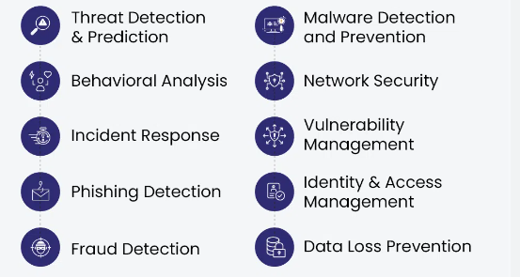
Applications
To protect your data and systems, it is essential to have a range of cybersecurity tools and techniques available. Here are some key applications of cybersecurity:

Slide 10
Applications
Software Security Application security is essential for protecting applications crucial to business operations. It involves controls such as code signing and application whitelisting, which help unify security rules with elements like file-sharing permissions and multifactor authentication. The integration of artificial intelligence (AI) in cybersecurity is expected to enhance software security further.
Risk Management Cybersecurity encompasses risk management, data integrity, security awareness training, and risk analysis. It focuses on evaluating risks and controlling potential damage from those risks, which is vital for protecting sensitive information and ensuring data security.
Identification and Access Control (IAM) Identity and Access Management (IAM) involves controlling who can access specific sections of data. Management regulates access to data, networks, and computer systems, ensuring cybersecurity measures are in place to identify users and enforce access controls. IAM can be implemented through both software and hardware and often utilizes role-based access control to maintain security across an organization.

Slide 11
Applications
Planning for Disaster Recovery and Business Continuity
Data recovery strategies enable organizations to maintain operations in the event of data loss, attacks, or disasters. This application of cybersecurity emphasizes the importance of regular data backups and investing in systems that facilitate business continuity. By implementing effective models and techniques, organizations can effectively manage severe data loss and ensure ongoing operations.
Security During Software Development During the software development process, security measures help identify flaws to ensure compliance with regulations and standards. Cybersecurity tools thoroughly test, scan, and analyze the software to uncover any bugs, vulnerabilities, or weaknesses that could be exploited by hackers or competitors.
Protecting Critical Systems Cybersecurity plays a vital role in preventing attacks on large servers connected to wide-area networks. It enforces strict industry standards for safety, requiring users to adhere to cybersecurity precautions to protect their devices. This approach involves real-time monitoring of all applications and regular evaluations of network security, servers, and users.
Network Security Surveillance Continuous network monitoring involves searching for signs of harmful or intrusive behavior. This practice is often combined with other security tools, such as firewalls, antivirus software, and Intrusion Detection and Prevention Systems (IDPS). Network security monitoring can be performed manually or automatically through specialized software.

Slide 12
Modules
Module 1: Overview of the Cybersecurity Landscape The contemporary cybersecurity landscape is a dynamic and hostile environment characterized by advanced threats and increasingly sophisticated attackers. This lesson provides an overview of the current cybersecurity landscape, addresses the challenges associated with Software as a Service (SaaS) applications, outlines various security and data protection regulations and standards, identifies cybersecurity threats and attacker profiles, and explains the stages involved in the cyber-attack lifecycle.
Module 2: Essentials of Network Security in a Connected World In this module, we will explore how millions of routers transmit Transmission Control Protocol/Internet Protocol (TCP/IP) packets using a variety of routing protocols across local and wide area networks. Additionally, we will examine the role of the Domain Name System (DNS) in translating internet addresses, such as www.paloaltonetworks.com, into routable IP addresses.

Slide 13
Modules
Module 3: Introduction to Cloud Security in Cloud Computing The transition to cloud computing offers not only cost savings and operational efficiencies but also significant technological advantages. Users can access data and applications from any location, projects can scale effortlessly, and resource consumption can be monitored effectively.
Module 4: Essentials of the Security Operations Center (SOC) This module provides a high-level introduction to the fundamental concepts of Security Operations Centers (SOC) and Security Operations (SecOps). It offers an overview of the Security Operations framework, highlighting its critical components and functions in maintaining cybersecurity.

Slide 14
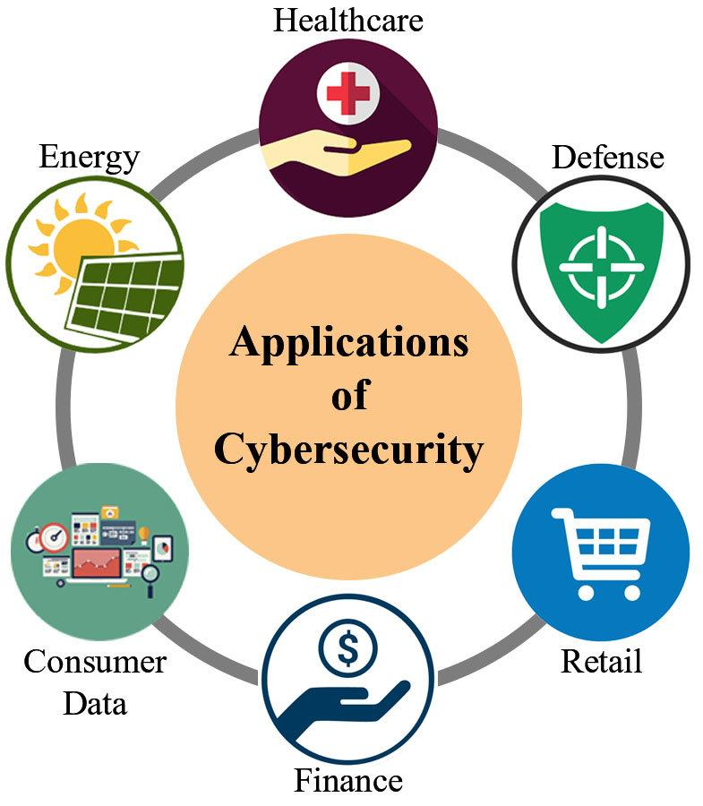
Real Applications
Cybersecurity plays an important role in different sectors by safeguarding digital infrastructure, data, and communications. Here are some key applications of cybersecurity across industries and use cases:

Slide 15
Real Time Applications
Cybersecurity plays a crucial role across various sectors by safeguarding digital infrastructure, data, and communications. Here are some key applications of cybersecurity across industries and use cases:
1. Healthcare
The healthcare industry manages a significant amount of sensitive patient information, making it a crucial sector for cybersecurity. Key applications include:
Medical Device Security: Protecting internet-connected medical devices from cyber threats and unauthorized access to ensure patient safety and data integrity.
2. E-Commerce and Retail E-commerce platforms manage sensitive customer data, including payment information and personal details, making cybersecurity vital for:
Customer Data Protection: Encrypting sensitive customer information, such as credit card details and personal identities, to safeguard against unauthorized access.
Secure Online Transactions: Implementing SSL/TLS encryption and other security measures to facilitate safe financial transactions.
Preventing Fraud: Identifying and mitigating fraudulent activities, including phishing, fake reviews, and account takeovers.
Supply Chain Security: Ensuring the integrity and security of digital supply chains to protect against disruptions and threats.

Slide 16
Real Time Applications
3. Government and Defense Government agencies, particularly those in defense and intelligence, are frequent targets for cyber espionage and attacks. Key applications of cybersecurity in this sector include:
National Security: Safeguarding critical national infrastructure (CNI), such as power grids, water systems, and transportation networks, from cyberattacks.
Cyber Warfare: Defending against and conducting cyber operations during geopolitical conflicts.
Data Protection: Securing classified government information, military communications, and defense systems to maintain confidentiality and integrity.
E-Government Services: Ensuring that digital government services, such as tax filing and voting, are secure and protected against tampering.
6. Telecommunications Telecom providers encounter a range of threats, including data breaches, denial-of-service attacks, and malware. Key cybersecurity applications in this sector include:
Network Security: Safeguarding communication networks to prevent eavesdropping and attacks on core infrastructure.
Data Privacy: Protecting user data, call records, and messages from unauthorized access or theft.
Secure 5G Infrastructure: Implementing security measures to defend the next generation of cellular networks against cyber threats.
DDoS Protection: Preventing distributed denial-of-service attacks that could disrupt communication networks.

Slide 17
Learning Outcomes
After completing this training, you should be able to:
Explain the current cybersecurity landscape.
Recognize various cybersecurity threats.
Assess different types of malware and cyber-attack techniques.
Understand the relationship between vulnerabilities and exploits.
Identify how spamming and phishing attacks are carried out.
Describe vulnerabilities, attacks, and advanced persistent threats related to Wi-Fi.
Explain perimeter-based Zero Trust security models and identify the capabilities of the Palo Alto Networks prevention-first architecture.
Outline the basic operations of enterprise networks, including common networking devices, routing protocols, network types and topologies, and services such as DNS.
Describe cloud computing models, virtualization, hypervisors, options for public cloud service providers, and private deployment options.

Slide 18
Learning Outcomes
Explain the DevOps strategy that integrates teams to identify and resolve issues, automate deployment processes, and minimize time to market.
Describe the evolution of data centers through a combination of traditional and cloud computing technologies.
Detail how Secure Access Service Edge (SASE) solutions assist organizations in adopting cloud and mobility concepts.
Explain how SaaS solutions offer data classification, visibility into sharing and permissions, and threat detection within applications.
Describe how the Prisma Cloud security platform identifies and mitigates security risks.

Slide 19
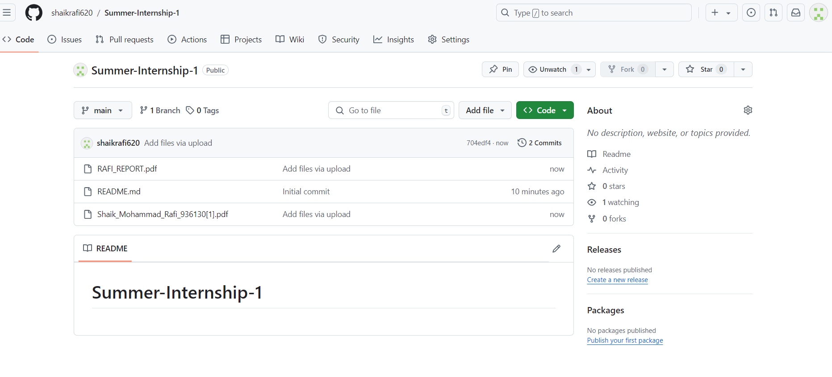

Git Hub Dashboard
Repository Name Like: Summer Internship - I
Under that include document, presentation and Certificate(Pdf).

Slide 20
Any Queries?

Slide 21
Thank You!!!

