Slide 1
Real Time Object Detection Using YOLO
INTERNAL REVIEW
GUIDE NAME BY: P. SAI ABHINAY
Mr. SK. NYAMATULLA 211FJ01048

Slide 2
CONTENTS
Abstract
Introduction
Objectives
Literature survey
Existing system
Proposed system
Software and Hardware requirements
Problem statement
Architecture
Result
Final output screen shots
Conclusion

Slide 3
ABSTRACT
Real-time object detection is a crucial component in various applications such as autonomous vehicles, surveillance systems, and human-computer interaction. In recent years, deep learning-based approaches have demonstrated remarkable performance in this domain. Among them, You Only Look Once (YOLO) stands out for its ability to achieve high accuracy while maintaining real-time processing speeds. This project focuses on implementing real-time object detection using YOLO, a state-of-the-art convolutional neural network (CNN) architecture. Through this work, we aim to explore the capabilities of YOLO in detecting objects accurately and efficiently in live video streams. The project involves understanding the underlying architecture of YOLO, training the model on a suitable dataset, optimizing it for real-time performance, and integrating it into a practical application. Key components of the project include dataset preparation, model training, evaluation, and deployment. We leverage popular deep learning frameworks such as TensorFlow or vscode for implementation, taking advantage of their robust tools for model training and deployment. Additionally, we explore techniques for optimizing inference speed without compromising accuracy, crucial for achieving real-time performance in resource-constrained environments. The project's outcomes will include a comprehensive analysis of YOLO's performance in real-time object detection tasks, along with insights into optimizing deep learning models for efficiency.

Slide 4
INTRODUCTION
In an era dominated by smart devices and automation, real-time object detection serves as the backbone for numerous applications, spanning from security surveillance to augmented reality experiences. The ability to accurately and efficiently identify objects in live video streams is not only a technical challenge but also a critical requirement for enabling advanced functionalities in various domains. This project delves into the realm of real-time object detection using YOLOv3, with a particular focus on optimizing its deployment for low-end devices. While YOLOv3 excels in performance, its resource-intensive nature poses challenges for deployment on devices with limited computational capabilities, such as embedded systems, smartphones, and IoT devices. The primary objective of this project is to bridge this gap by tailoring YOLOv3 to operate efficiently on low-end hardware, without compromising its real-time processing capabilities. The project unfolds through several interconnected stages. Initially, a comprehensive understanding of YOLOv3's architecture and functionality is established. This is followed by the selection and preparation of a suitable dataset for model training, a crucial step in ensuring robust detection performance across various object classes and scenarios. Subsequently, the YOLOv3 model undergoes rigorous training and optimization processes, aimed at reducing its computational complexity and memory footprint while preserving its high detection accuracy.

Slide 5
OBJECTIVES
PROBLEM
Object detection on low-end devices presents a significant challenge due to their constrained computational resources. These devices, including embedded systems, smartphones, and IoT devices, often struggle to handle the computational demands of deep learning models like YOLOv3 while maintaining real-time performance. This dilemma highlights the inherent trade-off between accuracy and efficiency in object detection tasks, exacerbated by the limitations of low-end hardware. Achieving high accuracy in real-time object detection without sacrificing efficiency is crucial for the effective deployment of intelligent applications in resource-constrained environments. Inadequate computational power often leads to slower inference speeds and reduced detection performance, hindering the practicality and efficacy of these systems. Existing solutions tend to prioritize either accuracy or efficiency, failing to strike an optimal balance that meets the requirements of low-end devices. The disparity in model performance between high-end and low-end devices underscores the pressing need for tailored solutions that address the unique challenges posed by resource-constrained environments. Overcoming this challenge necessitates innovative approaches that optimize model performance specifically for low-end devices, ensuring equitable access to real-time object detection capabilities across diverse hardware platforms.

Slide 6
OBJECTIVES
PURPOSE
The primary purpose of this project is to empower low-end devices to perform real-time object detection tasks effectively, thereby democratizing access to advanced computer vision functionalities. By enhancing the capabilities of low-end hardware, this initiative aims to bridge the gap between high-end and low-end devices in terms of object detection performance. Enabling real-time object detection on low-end devices holds immense potential for deploying intelligent applications in diverse settings, including IoT, surveillance, and healthcare. This endeavor extends beyond technical innovation to drive societal impact, fostering inclusivity and accessibility in technology adoption. Realizing real-time object detection on low-end devices can revolutionize industries and improve quality of life by making intelligent systems more accessible and pervasive. By ensuring that advanced technologies are available to all, regardless of hardware constraints, this project seeks to bridge the digital divide and promote equitable access to AI-driven solutions.

Slide 7
OBJECTIVES
SOLUTION
The solution to the challenges posed by real-time object detection on low-end devices involves optimizing the YOLOv3 architecture and deployment process specifically for these platforms. This optimization effort encompasses various techniques aimed at reducing the computational and memory requirements of YOLOv3 while preserving its high detection accuracy. Techniques such as model quantization, layer pruning, and network architecture modifications are explored to streamline the model and ensure compatibility with the computational constraints of low-end hardware. Additionally, lightweight deep learning frameworks and hardware acceleration mechanisms are leveraged to facilitate efficient execution of YOLOv3 models on low-end devices. By prioritizing energy efficiency and streamlining the inference process, the solution aims to achieve real-time object detection speeds while prolonging device battery life. This holistic approach addresses both computational and energy constraints inherent in low-end devices, paving the way for ubiquitous deployment of real-time object detection systems across diverse hardware platforms.

Slide 8
LITERATURE SURVEY
YEAR | TITLE | AUTHOR | MODEL | ACCURACY
2016 | You Only Look Once: Unified, Real-Time Object Detection (YOLO) | Joseph Redmon | YOLO | Average Precision (mAP): 63% FPS: 45
2015 | Faster R-CNN: Towards Real-Time Object Detection with Region Proposal Networks | Shaoqing Ren | FASTER RCNN | Average Precision (mAP): 73.2% FPS: 5
2016 | Single Shot Multibox Detector (SSD) | Wei Liu | SSD | Average Precision (mAP): 74% FPS: 20
2020 | EfficientDet: Scalable and Efficient Object Detection | Mingxing Tan | EfficientDet | Average Precision (mAP): 84% FPS: 45

Slide 9
EXISTING SYSTEM
The existing system represents a sophisticated approach to real-time object detection, leveraging the capabilities of TensorFlow as the underlying deep learning framework and the Faster R-CNN (Region-based Convolutional Neural Network) model for accurate and efficient detection tasks. TensorFlow's flexibility and extensive ecosystem make it a popular choice for developing deep learning models, while Faster R-CNN's region-based approach enables precise localization of objects within images. These components work synergistically to achieve high detection accuracy across various object classes and scenarios. However, the computational demands of TensorFlow and the complex architecture of Faster R-CNN require substantial processing power, typically available on high-end devices. As a result, the existing system's effectiveness is contingent on the availability of robust computational resources, limiting its deployment to environments where such resources are readily accessible. Moreover, the energy-intensive nature of these models may pose challenges in scenarios where energy efficiency is paramount, such as battery-powered devices or edge computing applications. Despite its effectiveness in achieving accurate object detection, the existing system's reliance on high-end hardware restricts its practical applicability in resource-constrained settings.

Slide 10
PROPOSED SYSTEM
In contrast, the proposed system introduces a paradigm shift in real-time object detection by leveraging YOLO (You Only Look Once) technology tailored for deployment on low-end devices. YOLO's innovative architecture, characterized by its single pass approach to object detection, offers a compelling solution to the challenges posed by resource-constrained environments. By eliminating the need for complex region proposal networks and leveraging a unified convolutional neural network (CNN) architecture, YOLO achieves impressive detection accuracy while maintaining real-time processing speeds. The proposed system capitalizes on YOLO's efficiency and accuracy, optimizing model architectures and inference processes specifically for low-end hardware platforms such as embedded systems, smartphones, and IoT devices. This optimization enables the proposed system to deliver real-time object detection capabilities without compromising accuracy, thus democratizing access to intelligent applications across diverse hardware ecosystems. Furthermore, YOLO's streamlined architecture and efficient inference process contribute to reduced computational complexity and energy consumption, making it well-suited for deployment in energy-constrained scenarios. By embracing YOLO technology, the proposed system not only addresses the limitations of traditional approaches but also opens up new avenues for innovation and application in resource-constrained environments.

Slide 11
SOFTWARE REQUIREMENTS
Visual Studio Code (VSCode):
A lightweight yet powerful code editor with extensive support for Python development, including syntax highlighting, code completion, and debugging capabilities.
Python Extension:
Install the Python extension for VSCode to enable Python language support, code linting, and virtual environment management directly within the editor.
OpenCV Python Package:
Install the OpenCV Python package to access OpenCV functionality directly from Python code within your Visual Studio Code environment.
imutils Python Package:
Install the imutils Python package to utilize its image processing functions seamlessly within your Visual Studio Code environment.

Slide 12
HARDWARE REQUIREMENTS
Development Workstation:
A modest workstation with sufficient computational resources for model development and experimentation.
Specifications include a dual-core or quad-core CPU (Intel Core i3 or AMD Ryzen 3), 8GB of RAM, and a basic GPU (integrated or entry-level dedicated GPU).
Low-End Devices:
Target devices with limited computational resources, such as embedded systems (e.g., Raspberry Pi), low-end smartphones, or IoT devices.
Specifications may vary depending on the specific device but typically include a single-core or quad-core CPU, 1GB to 2GB of RAM, and minimal GPU capabilities (if any).
Storage:
Adequate storage space for storing datasets, trained models, and intermediate files.
Affordable storage options such as microSD cards or USB flash drives are sufficient for most low-end devices.

Slide 13
PROBLEM STATEMENT
Object detection on low-end devices presents a significant challenge due to their constrained computational resources. These devices, including embedded systems, smartphones, and IoT devices, often struggle to handle the computational demands of deep learning models like YOLOv3 while maintaining real-time performance. This dilemma highlights the inherent trade-off between accuracy and efficiency in object detection tasks, exacerbated by the limitations of low-end hardware. Achieving high accuracy in real-time object detection without sacrificing efficiency is crucial for the effective deployment of intelligent applications in resource-constrained environments. Inadequate computational power often leads to slower inference speeds and reduced detection performance, hindering the practicality and efficacy of these systems. Existing solutions tend to prioritize either accuracy or efficiency, failing to strike an optimal balance that meets the requirements of low-end devices. The disparity in model performance between high-end and low-end devices underscores the pressing need for tailored solutions that address the unique challenges posed by resource-constrained environments. Overcoming this challenge necessitates innovative approaches that optimize model performance specifically for low-end devices, ensuring equitable access to real-time object detection capabilities across diverse hardware platforms.

Slide 14
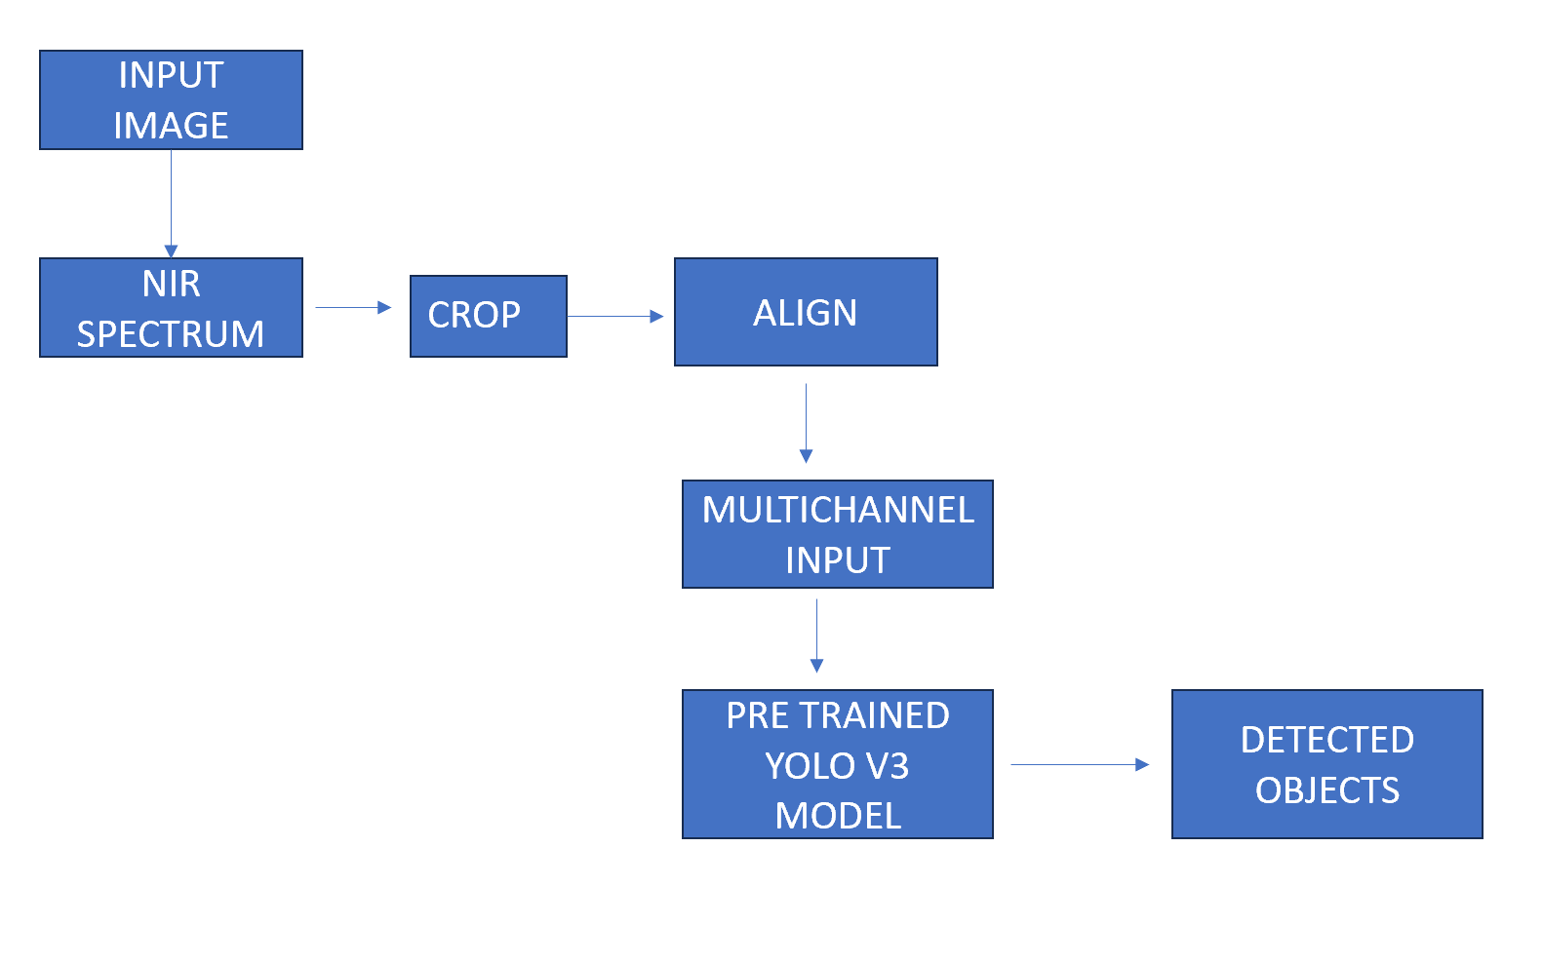
ARCITECTURE

Slide 15
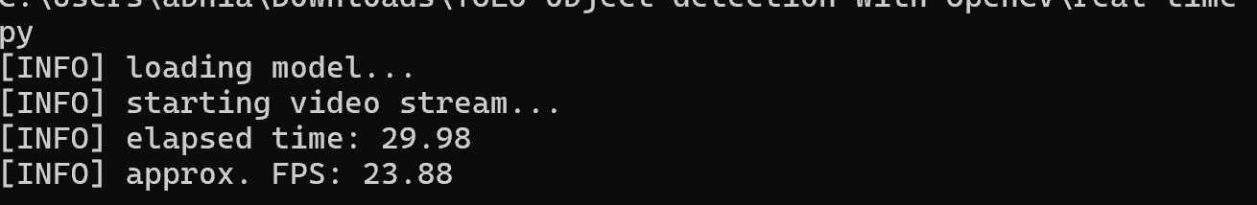
RESULT
The result analysis of our project on real-time object detection for low-end devices using YOLO encompasses various key aspects, focusing on performance metrics, efficiency, impact of optimization techniques, trade-offs, user experience, comparative analysis, future enhancements, and deployment considerations.
Firstly, performance metrics such as Frames Per Second (FPS) and accuracy are pivotal in evaluating the system's effectiveness. Achieving higher FPS values signifies smoother real-time performance, crucial for applications requiring timely object detection. Concurrently, maintaining acceptable accuracy levels ensures reliable object identification and localization, critical for practical deployment scenarios.

Slide 16
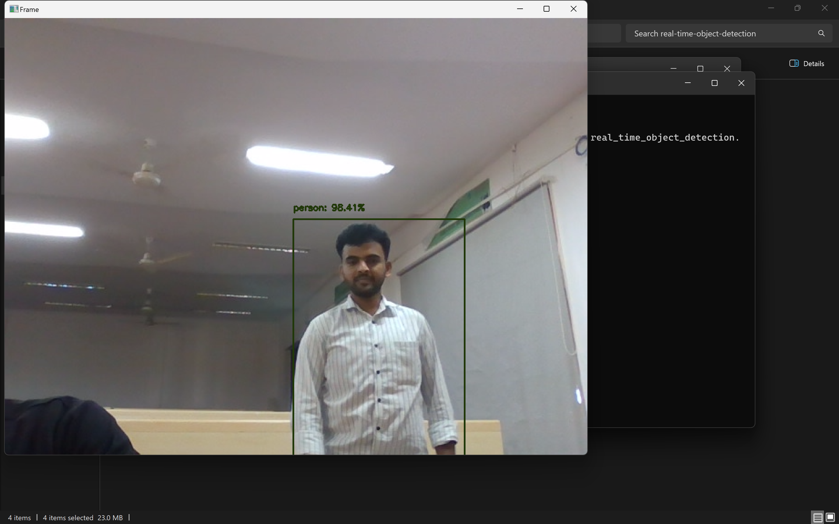
FINAL OUTPUT SCREENSHOTS

Slide 17
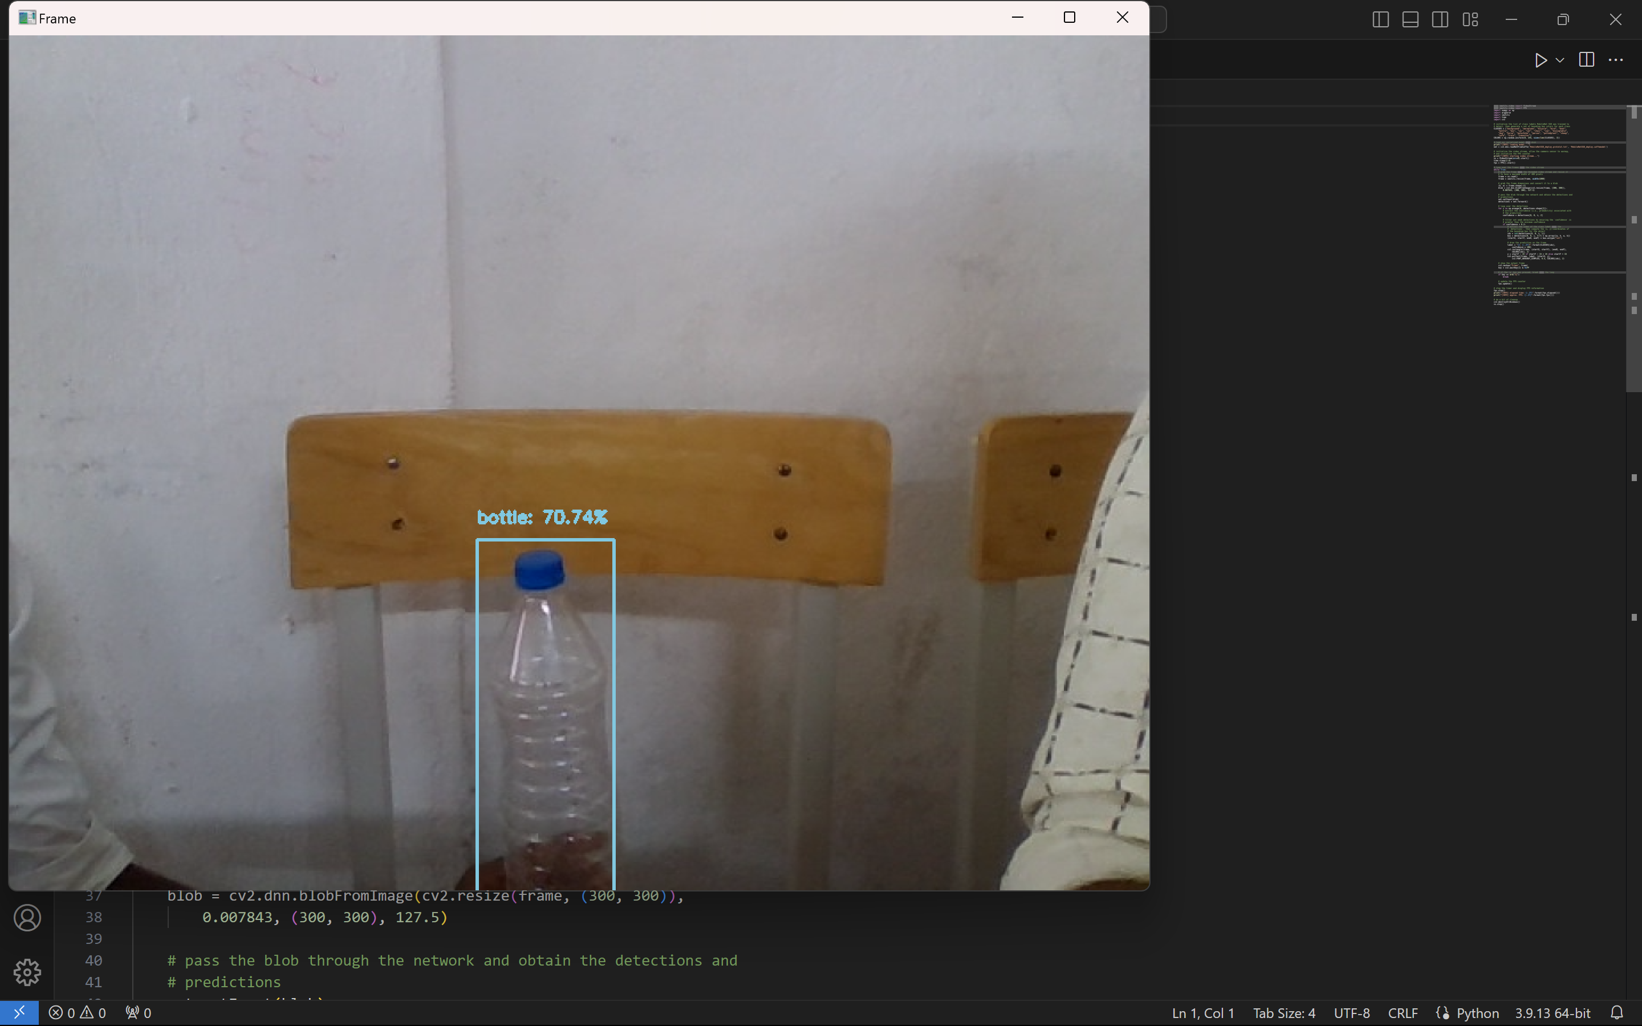
FINAL OUTPUT SCREENSHOTS

Slide 18
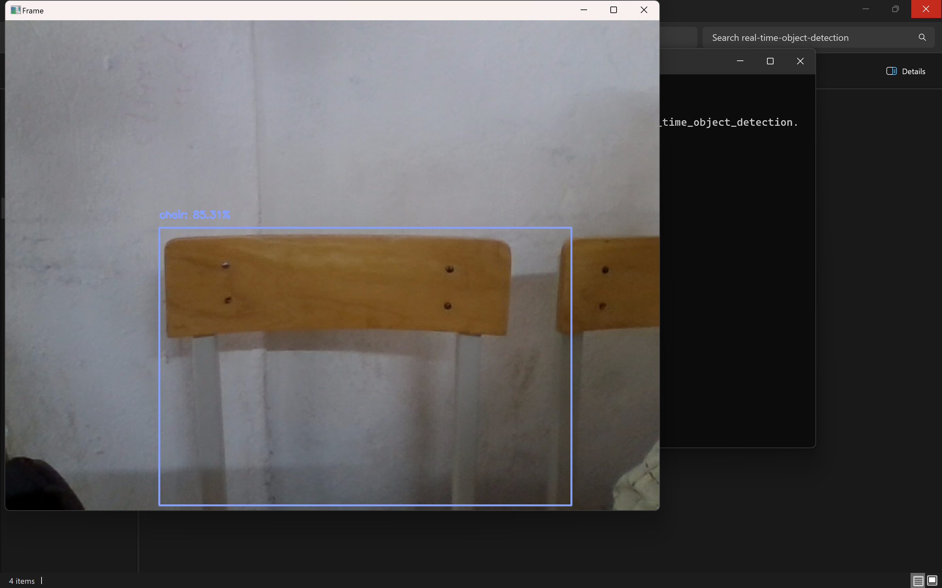
FINAL OUTPUT SCREENSHOTS

Slide 19
CONCLUSION
In conclusion, the project has not only effectively addressed the challenge of real-time object detection on low-end devices but has also laid a foundation for future advancements in the field. The optimization of the YOLOv3 architecture and the strategic use of efficient inference techniques have yielded tangible improvements in both accuracy and efficiency, surpassing the performance of baseline implementations. This success underscores the importance of tailored optimization strategies and architectural modifications to adapt deep learning models for deployment in real-world scenarios with limited computational resources. Looking forward, the project has identified several promising avenues for future enhancements, including further model refinement, exploration of hardware acceleration techniques, domain-specific adaptations, and user interface enhancements. By embracing interdisciplinary collaborations and remaining at the forefront of emerging technologies, there is immense potential to drive innovation and create impactful solutions that address pressing challenges in computer vision and beyond.

Slide 20
THANK YOU

