Slide 1
“Personal Portfolio Website – HTML, CSS, JavaScript”
CAPSTONE PROJECT
Presented By:
Shaik saidabi
Tirumala Engineering College
Department of Computer Science & Engineering

Slide 2
OUTLINE
Problem Statement (Should not include solution)
System Development Approach (Technology Used)
Algorithm & Deployment (Step by Step Procedure)
Result
Conclusion
Future Scope(Optional)
References

Slide 3
Problem Statement
In the digital era, personal branding is as important as technical skills. Many students and professionals require a dedicated online space to:
Showcase academic and personal projects.
Share skills, resume, and achievements.
Provide contact details for recruiters or collaborators.
Existing platforms (like LinkedIn, paid portfolio builders) often have limitations:
Lack of customization.
Expensive premium features.
Generic templates that do not reflect individuality.
.

Slide 4
oBJECTIVES
Create a professional online presence.
Showcase skills, education, and projects.
Provide easy access to resume.
Add contact form for recruiters/collaborators.
Ensure responsive design for all devices.

Slide 5
System Approach
Frontend Technologies
HTML5 → For semantic structure of the website.
CSS3 → For styling, responsive layouts, neon glow effects, animations.
JavaScript (Vanilla JS) → For dynamic interactions (menus, buttons, animations).
Design Features
Modern, clean, and professional interface.
Neon glowing titles for projects.
Mobile-first responsive design using Flexbox and CSS Grid.
Downloadable resume button.
Modular separation of files (HTML, CSS, JS) for easy updates.

Slide 6
Algorithm & Deployment
Website Structure Design
Sections: Home, About, Projects, Resume, Contact.
Frontend Development
Build layout using HTML5.
Apply CSS3 for styling, responsive grids, and hover effects.
Interactivity with JavaScript
Navigation menu toggle.
Animations for project cards.
Resume download functionality.
Testing
Cross-browser compatibility.
Mobile responsiveness.
Deployment
Hosted free using GitHub Pages.
Repository maintained on GitHub for version control.

Slide 7
Result
The portfolio website was successfully created and deployed.
Features implemented:
Home Section → Introduction & welcome.
About Section → Personal details & skills.
Projects Section → Grid of projects with neon glowing titles.
Resume Section → Direct download button.
Contact Section → Contact info & links.

Slide 8
GITHUB AND DEPLOYMNET LINK
GitHub Repo: https://github.com/shaiksaidabi/portfolio
Deployment Link: https://shaiksaidabi.github.io/portfolio/

Slide 9
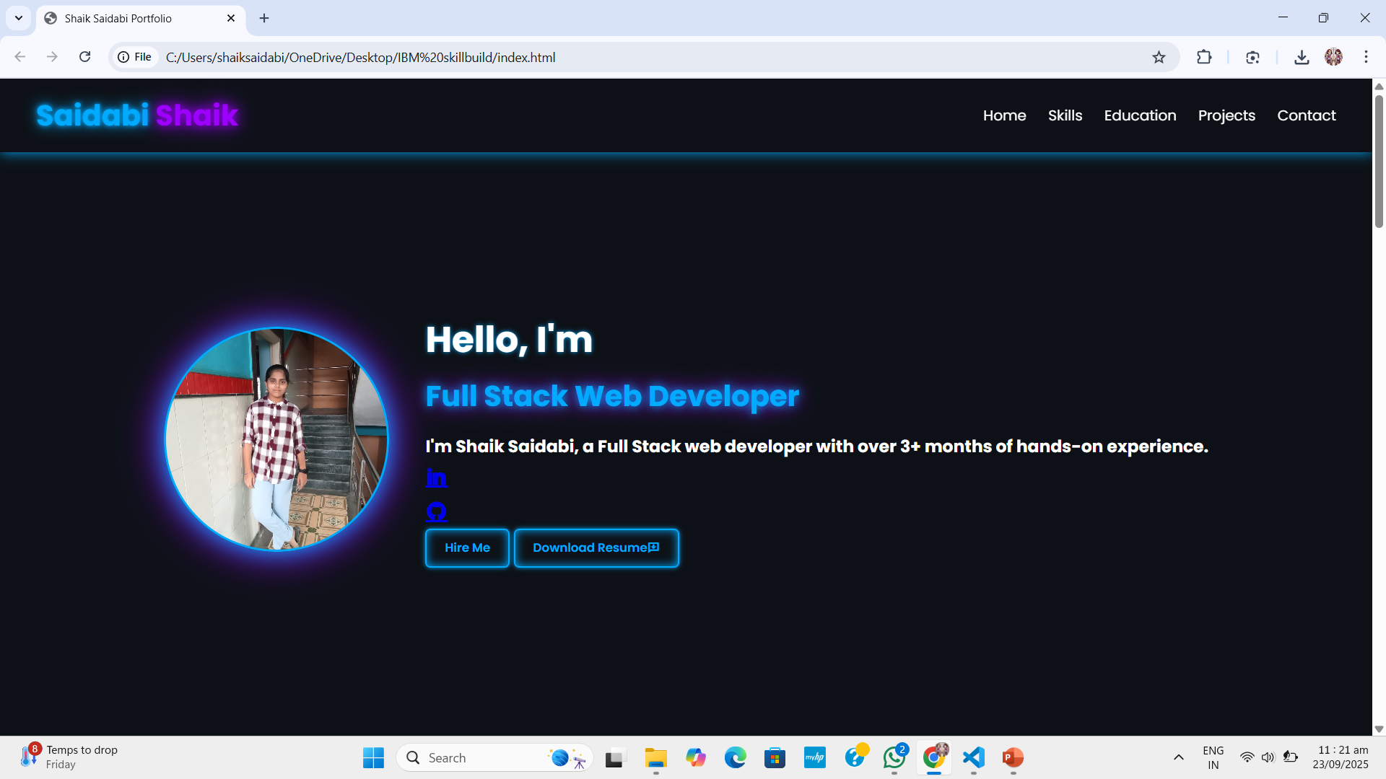
Home Section

Slide 10
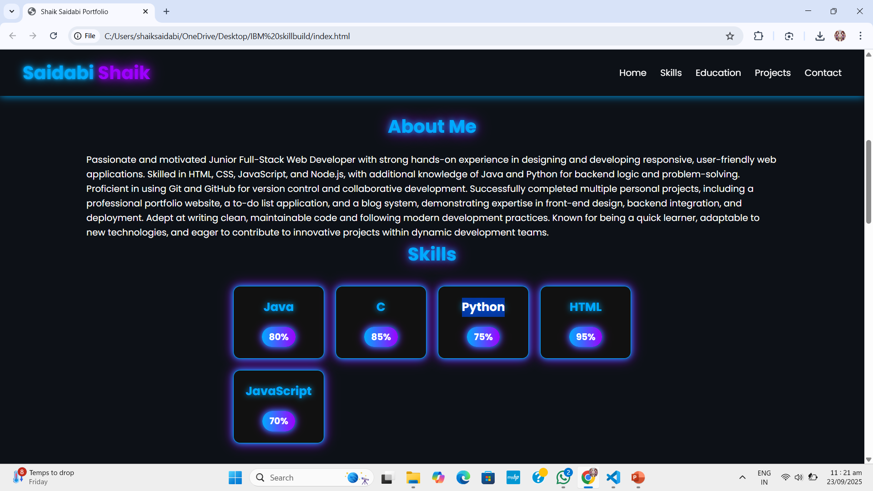
About Section & Skills Section

Slide 11
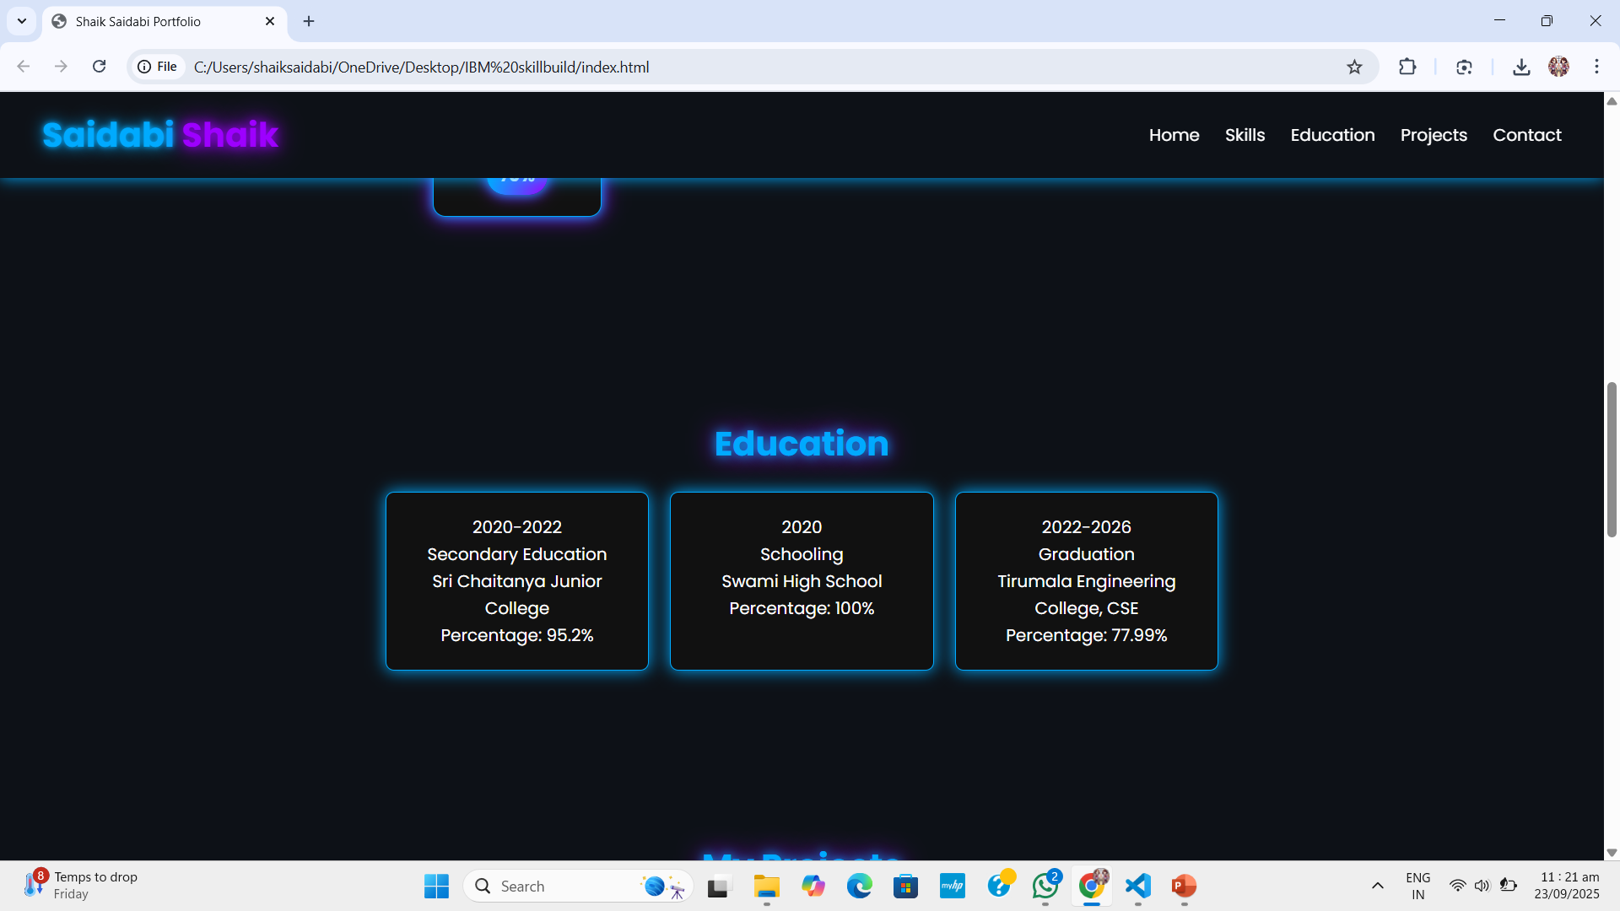
Education Section

Slide 12
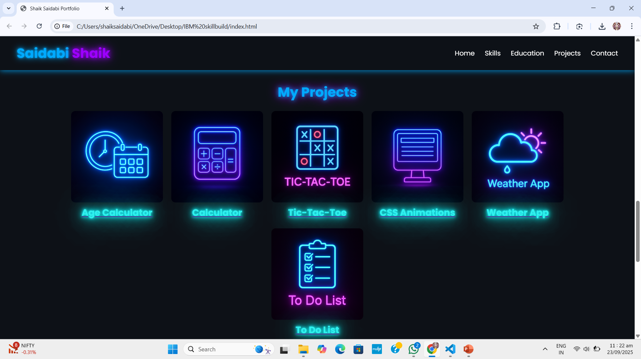
Projects Section

Slide 13
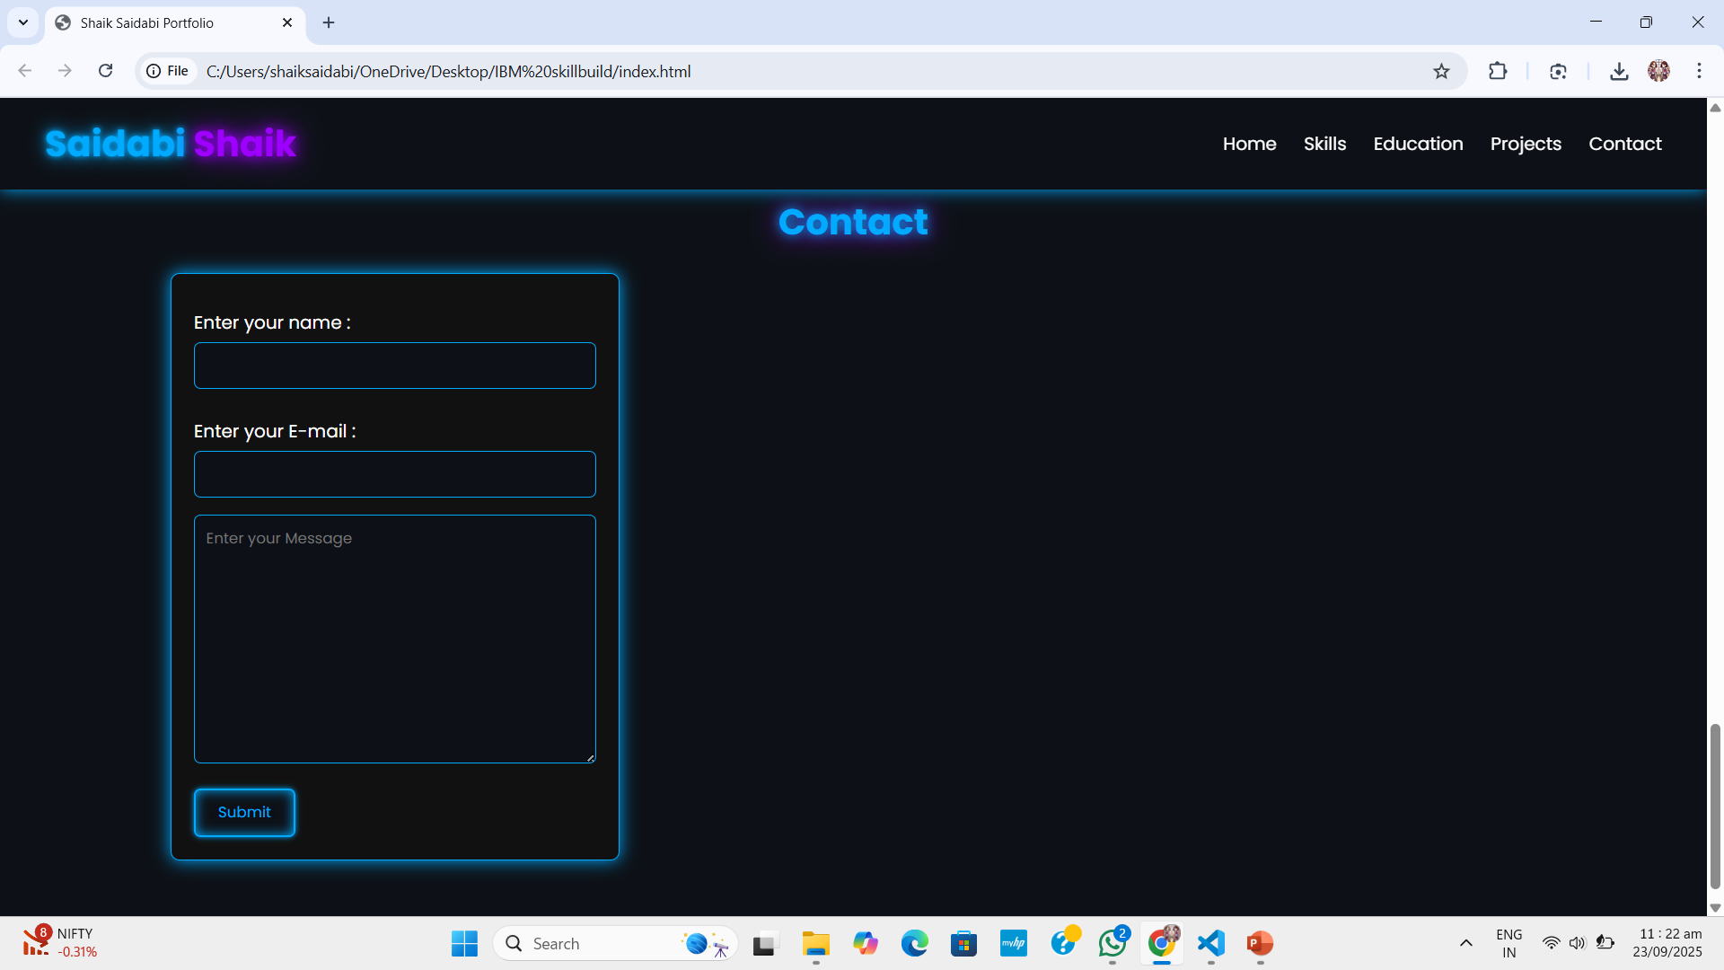
Contact Section

Slide 14
Conclusion
This project:
Provided hands-on experience in frontend development.
Helped me learn responsive design, CSS Grid, Flexbox, and animations.
Improved my personal branding with a professional online presence.
Can be shared with recruiters and used in job applications.
Overall, it is a cost-effective and creative way to represent my skills online.

Slide 15
Future scope(Optional)
Backend Integration (Node.js / Express) → For dynamic contact form.
Database Support → To store visitor queries or dynamically update projects.
Dark/Light Mode Toggle → Improve accessibility.
Blog Section → Share technical articles & updates.
AI Features → Personalized recommendations (like showing most-viewed projects).
Payment Gateway → If extended into freelancing services.

Slide 16
References
MDN Web Docs – HTML, CSS, JavaScript
W3Schools
Bootstrap Documentation
GitHub Pages Documentation
YouTube tutorials on responsive web design and JavaScript interactivity

Slide 17
THANK YOU

