Slide 1
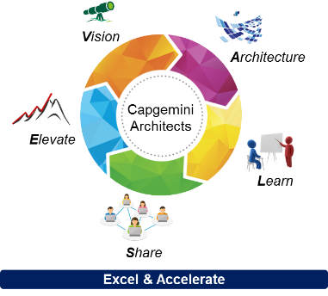
StarterPack MicroServices Ref 2017-ArchiValse#3
Internal Document only
February 2017 – v1.2

Slide 2
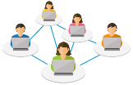


What is this StarterPack?
This StarterPack aims at giving you a first bunch of documents, Group references and feedbacks around Microservices. The objective is not to present a perfect state of the art or inventory of Capgemini references, but to provide you a first level of inputs, contacts and reusable content on similar projects, in order to accelerate and improve your entry in this domain and help you on your project / proposal.
It gathers many feedbacks from the Architects Community, as well as some general documents (Capgemini or external) on Microservices.
V
A
L
Sharing
E

Slide 3
Thanks to all contributors to this document:
James Devaney
Andy Glover
Michael Osborne
Craig Wappett
Justin Cooke
Jean-Pierre Le Hénaff
Edmond Segalen
Pascal Haget
Kai Schroeder
Al Liubinskas
Tony Jarriault
Neeraj Sidhaye
Joakim Lindbom
Michael Cirikovic
Thilo Hermann
Philippe Triquenot
Pierre-Loïc Ropars
Cornelia Görs
Carsten Rasmussen
Nick Walter
Mick Broderick
Casimir Artmann
Manuel Sevilla
Philippe Gentil
Thomas Alby
Anthony Joseph
Jean-Guillaume Lalanne
Skander Guetari
Julien Bellanger
Christophe Dupas
Neels Burger
Yann Le Thieis
Rahul Murudkar
Subir Sarbabidya
Markus Kokott
Gururaj Joshi
Rahul Murudkar
David Rutter
Aliasgar Muchhala

Slide 4
MicroServices Subject Matter Experts
One key point to support this sharing approach around each Top Trend is to build a Subject Matter Experts (SME) Network
In this objective, we created the following mailing list:
All contributors to this StarterPack have been already added to this mailing list. If you also work on a MicroServices project, or have some expertise that you can share on this topic, please advise us to add you in this list.
Archi-SME-Microservices@capgemini.com
V
A
L
Sharing
E

Slide 5

Agenda
Useful links and documents to start with Microservices
Reference – Automotive Sector – Cloud Native Apps for OpenShift based on devonfw
Move to microservices architecture (Lufthansa)
Microservices architecture for a service platform (Disney)
Move to microservices architecture (Capgemini)
Store Worker & Global store sales tools (IKEA)
Digital Car Key (Automotive client)
Modernizing application portfolio (European Parliament)
From Monolithic to Microservices (Adecco)
Platform for application development based on microservices (Schufa)
State of the Art (Amadeus)
Digital Factoring Platform (CALF)
Microservices platform to support digital transformation (UK Ministry of Justice)
Microservices platform for delivering digital services (HMRC)
Return of Experience
Air Waybill and Capacity Management solution (SouthWest Airlines)
Deployement of microservices on AWS (PSA)
Platform for application development based on microservices (BEC)
Integration microservices on eBusiness platform (Royal Mail Group)
Other projects
Microservices platform for delivering Commerce Marketplace

Slide 6

Useful links to start with Microservices
Capgemini White Paper (June 2016) – Microservices in cloud-based Infrastructure: https://www.capgemini.com/resources/microservices-in-cloud-based-infrastructure
IBM Redbook (April 2016) – Microservices from Theory to Practice: Creating Applications in IBM Bluemix Using the Microservices Approach: http://www.redbooks.ibm.com/abstracts/sg248275.html?Open
RedHat White Paper (February 2016) – Achieve a successful microservices architecture: https://www.redhat.com/en/resources/microservices-improved-architecture-design
Video – Microservices explained by Martin Fowler: https://www.youtube.com/watch?v=wgdBVIX9ifA
Blog – Martin Fowler’s Microservices Resource Guide: https://martinfowler.com/microservices/
Blog - Microservice architecture patterns and best practices: http://microservices.io/index.html

Slide 7

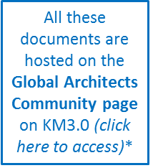
Useful reports and analyses to start with MicroServices
Best Practices for MicroServices Architectures (Aliasgar Muchhala, Capgemini, May 2017)
Microservices Have An Important Role In The Future Of Solution Architecture (Forrester, July 2015)
Key takeaways: Important Benefits For Future Enterprise Solution Architectures; Microservices Are Components, APIs, Or Both; Strategy Must Address Development And Runtime Dependencies, Careful preparation and measured approach
How To Capture The Benefits Of Microservice Design (Forrester, May 2016)
Key takeaways: Developers Find Pragmatic Microservices, Microservices Are Remaking App Platforms, the 3 phases of adoption
The Rise Of The Headless Content Management System (Forrester, March 2016)
Key takeaways: Headless Content Management Systems Offer A Different Approach Over Existing Strategies; Warning: Headless Content Management Is For Do-It-Yourself Shops; Get Ready For Microservice Architecture
Scope Vs Size: A Pragmatic Approach to Microservice Architecture (WSO2)
Key takeaways: Middleware capabilities like integration engines as well as tools that are being used, and distributed deployment with functional containers should be included in the architecture built with Microservices.
Overcoming Ongoing Digital Transformational Challenges with a Microservices Architecture (Cognizant):
Key takeaways: Why IT organizations must embrace microservices (loosely-coupled architectures speed development, testing & deployment…)
Microservice Architecture vs. Service Oriented Architecture (TMNS, 2015)
Best Practices for Microservices (MuleSoft, June 2015)
Microservice Architecture For Integrations (Capgemini, 2017)
Point of View on MicroServices Architectures and case study for Ladbrokes (contact: Rahul Murudkar and Craig Wappett)
CA Technologies Offers and contacts (CA, 2017)
Presentation of CA Technologies offers around Microservices and API factory, and useful points of contact and trainings for Capgemini
*https://km3.capgemini.com/community/12745

Slide 8

Return of Experience – Microservices platform for delivering digital services
HMRC
Multi Channel Digital Tax Platform
Client:
Project:
Contacts:
Public
James Devaney
Andy Glover
Michael Osborne
Craig Wappett
Sector:
Quick Description:
We have built experience of micro services architecture in the Digital area of HMRC over the last years.
James has delivered and operates an ‘internal’ (not exposed directly to citizens) micro services platform that supports digital integration and extensions to HMRC systems of record
The micro services themselves perform a diverse range of functions: digital API-enabling HMRC systems of record (for consumption by other internal or not internal services), providing extensions to systems of record, bulk data transfers and batch processing
The platform is entirely open source and is deployed to HMRC’s internal (Fujitsu provided) cloud. Capgemini provides and manages everything up from an empty IaaS VM. The platform briefly comprises: Puppet infra as code, Nginx/Consul software load balancing and service discovery, Java with Spring Boot, Hystrix fault tolerance, ELK log shipping/analytics, Graphite/Grafana for metrics, RabbitMQ, MongoDB and fully automated continuous delivery pipelines using Bamboo.
Andy is our lead architect in a large team of people working on HMRC’s ‘Multi Channel Digital Tax Platform’ (MDTP):
MDTP is a HMRC designed micro services platform for delivering digital services as web or restful API to citizens, businesses and other government departments. It is the HMRC’s primary online presence for all UK taxpayers.
The platform is open source and provides for scala/play! based micro services that use MongoDb, with all services running active-active across multiple cloud providers in the UK. Developers use modern tooling and a Jenkins based continuous delivery pipeline to deliver multiple releases per day in an agile environment.
Capgemini has approximately 200 people working on this platform across a wide range of disciplines including architects, developers, QAs, UEX, content design and scrum masters. Most of them work as part of HMRC’s Digital Delivery Centres, for which Capgemini provide whole, highly skilled teams. The DDCT in Telford in which ~150 Capgemini people work was recently praised as ‘world class’ by HMRC’s interim CIO, Mike Potter and is generating much interest across UK Public Sector.
James, Andy and Michael work together and report to Craig, all part of the Architecture Group and all happy to expand further or join up as you wish.

Slide 9
Return of Experience – Microservices platform to support digital transformation
UK Ministry of Justice
Microservice platform to support digital transformation
Client:
Project:
Contacts:
Public
Justin Cooke
Sector:
Quick Description:
Delivery of a new platform to support the digital transformation of the UK legal system into a paperless environment
Need for a rapidly scalable architecture based on open source technologies with complex integration requirements
A micro services architecture resolved traditional problematics (long expensive release cycles, scaling…)
We integrated the Domain Driven Design (DDD) methodology into the agile delivery process to generate logical and business domain models, enabling rapid development of business services and a fast feedback loop to the business
The delivery organization was aligned to the micro services concept by assigning ownership of each service to a specific delivery team and applying a program wide set of design and coding standards
The scale of the platform with its interfaces with many external agencies, we created an asynchronous event driven platform based on the JEE 7 framework in which each micro service interacted with an internal event store and only allowed communication with other services through RESTful APIs or public message events
Scalability was achieved by ensuring that services were stateless and by applying CQRS concepts to decouple the read side of each service from the write therefore enabling the views to be scaled independently to the write modules.
From the beginning, we leveraged the cloud, developed automated continuous delivery build pipelines, fostered a DevOps culture and made extensive use of tools such as Jenkins, Sonarqube and Ansible to automate and provide rapid feedbacks
You can find a more detailed description of this project in the comments of this slide (incl. micro services architecture key challenges, security features…)
Notes:
The Ministry of Justice required support in delivering a new platform to support the digital transformation of the UK legal system into a paperless environment. The client required an architecture rapidly scalable and based on open source technologies and standards with complex integration requirements. A micro services architecture resolves many of the risks endemic with a traditional 3 tier monolithic architecture such as long painful expensive release cycles and challenges in scaling to enterprise volumes.
A micro services architecture has a number of key challenges (How do we break down the capabilities into distinct micro services? How do we ensure that those services are efficiently maintainable, scalable and reusable? How do we align our organizational structure to support a micro services architecture? How do we model the business domain in a way that supports micro services and event sourcing? How do we ensure that micro services are sufficiently decoupled? How do we leverage the benefits of cloud and address the risks associated with a distributed system securely?)
We integrated the Domain Driven Design (DDD) methodology into the agile delivery process to generate a logical domain model for the project that identifies the logical services that interact to deliver the required functionality. Business services are modelled using the DDD concepts of bounded contexts, aggregates, commands, events and process managers. These map directly to the logical and physical solution building blocks which enables rapid development of business services and a fast information feedback loop to the business stakeholders, utilizing a ubiquitous domain language enabling the business services to be understood, discussed and realized in an agile way.
The delivery organization was aligned to the micro services concept by assigning ownership of each service to a specific delivery team and applying a program wide set of design and coding standards based on principles which were applied as part of both automated and qualitative continuous assurance processes.
The scale of the platform with its interfaces with many external agencies made it a good candidate for eventual rather than transactional consistency. To do this we created an asynchronous event driven platform based on the JEE 7 framework in which each micro service interacted with an internal event store and only allowed communication with other services through RESTful APIs or public message events based on open standards. Again, the DDD approach proved invaluable in modelling the events and interactions within and between services.
Scalability was achieved by ensuring that services were stateless and by applying CQRS concepts to decouple the read side of each service from the write therefore enabling the views to be scaled independently to the write modules.
From the very inception of the program and the initial prototype services we leveraged the cloud and developed automated continuous delivery build pipelines. We fostered a DevOps culture and made extensive use of tools such as Jenkins, Sonarqube and Ansible to automate the build process to establish an automated software delivery cycle providing rapid feedback to developers on QA.
With large distributed platforms, security is challenging and in this case the client implemented an independent identity management solution to provide authentication of all messages coming into the system. By creating a common platform on which to build micro services, we introduced a mechanism for implementing system wide cross-cutting features such as access control (attribute based) and message auditing using interceptor components to ensure such features were implemented in a consistent manner across each micro service.

Slide 10


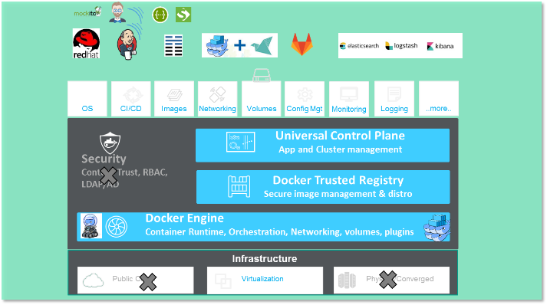
Return of Experience – Digital Factoring Platform
CALF
Client:
Digital Factoring Platform
Project:
Contacts:
Banking
Jean-Pierre Le Hénaff
Edmond Segalen
Sector:
Quick Description:
Development platform in a Public Cloud
DevOps oriented (Jenkins, Rancher, Nexus, SonarQube, Gitlab)
Based on Docker
Production platform in-house
Based on Docker Datacenter
➔ Please contact Jean-Pierre Le Hénaff for more information

Slide 11
Return of Experience – State of the Art
AMADEUS
Client:
State of the Art
Project:
Contacts:
Transports
Pascal Haget
Sector:
Quick Description:
State of the Art on Complex Transactional Systems (Word document, 8 pages)
Distributed Architectures (commodity hardware, MicroServices)
Middleware and OTF framework (Amadeus)
Complete bibliography
Language: French
➔ Please contact Pascal Haget for more information

Slide 12

Return of Experience – Move to Microservices architecture
Lufthansa
Client:
Move to Microservices architecture
Project:
Contacts:
Transports
Kai Schroeder
Sector:
Quick Description:
Been working as the architect on a program, where the central system changed development approach from waterfall to agile, with the tech delivery changing from central system to microservices
The “new” system is being explained to business people as “biggest dwarf” to explain the microservices approach
In essence, the system is a UI layer with logic underneath to visualize the capacity and price planning of 3+ Lufthansa airlines. The available functionality includes ways to manipulate the complex settings to steer capacity and pricing algorithms.
➔ Please contact Kai Schroeder for more information

Slide 13
Return of Experience – Microservices architecture for a service platform
Disney
Client:
Microservice architecture theme park
Project:
Contacts:
Entertainment
Steve Rogers
Al Liubinskas
Sector:
Business Issues:
This major theme park wanted to enrich their guest’s experience even before they arrived at the park. They engaged with Capgemini over five years ago to build an entirely new guest service platform that would engage their customers from the moment they began to plan their visit, to improve their experience in the hotel and in the park and even after they leave.
The applications that have been developed serve operations, resort staff and the guests themselves
Capgemini Solution:
Capgemini have been providing system development & system integration for this major theme park for over five years
Capgemini assist in requirements, analysis, design, development and testing of applications, some of which include:
Cast Applications (Applications that help Park and resort staff), Reservation Systems, Check-in folio management, Door lock Management, Charge Account management, Dining Reservation systems, Mobile Lobby App (iPhone and Android), Property management Systems, Availability, Room fulfillment, Integration with payment systems, Theme Park Magical express (This is an application used by Cast members to manage the guest Experience from Airport Arrival to departure (Transportation + Baggage tracking to the room ..etc), Theme Park Vacation Club (This is a to manage Vacation club members points and reservations), Mobile apps to plan your visit and manage your membership points
Most of the technology is based on Java Server pages and Facets, plus newer applications developed on angular JS. Middle Tier: Websphere, Jboss, Azul JVM
Heavily involved in designing, building, maintaining entire ReST paradigm based middle tier, along with Sonic Eventing/ESB infrastructure
We also worked on HTTP caching, Object caching and other good performance techniques for end user
A Microservice architecture is now being used
Client benefits:
The applications have been able to scale to meet an increasing demand for park services
Customers rate the applications very highly

Slide 14
Return of Experience – Air Waybill and Capacity Management solution
Southwest Airlines
Client:
Air Waybill and Capacity Management solution
Project:
Contacts:
Transports
Al Liubinskas
Sector:
Context:
Cargo management solution providing Air Waybill management, flight capacity management capabilities for a large US airline. Delivered complex eventing solution to manage irregular operation scenarios of Flight and Shipment lifecycle
Key Capabilities:
Custom built Microservices based application based on Spring to iteratively deliver Microservices from foundational capabilities like capacity and schedule management to transactional capabilities like Air Waybill and customer data mgmt.
Services communicate both synchronously with REST services and asynchronously through eventing pattern with AKKA and Gemfire.
Ability to provide multiple tiers of scalability based on services with high demand (Air Waybill) against services with low demand (Customer mgmt.).
Rapid development, deployment and testing using feature team based approach responsible for full stack development of the features from UI to Microservices
Technologies:
Spring, AngularJS, Pivotal GemFire, Pivotal TCServer, Rundeck, Jenkins, SonarQube, Nexus, Checkstyle, Karma, REST

Slide 15
Return of Experience – Deployement of microservices on AWS
PSA
Deployement of microservices on AWS
Client:
Project:
Contacts:
Transports
Tony Jarriault
Sector:
Quick Description:
In the contexte of a Connected Car project with PSA, we are working on the deployment of microservices, hosted on the AWS cloud solution (serverless)
The objective is that we can call microservices APIs from a connected vehicle / terminal, in order to address partners’ back-ends.
In a first step, the objective is to offer parking management services (on-street / off-street)
➔ Please contact Tony Jarriault for more information

Slide 16
Return of Experience – Move to microservices architecture
Capgemini
Move to microservices architecture
Client:
Project:
Contacts:
IT
Neeraj Sidhaye
Sector:
Quick Description:
We have moved some of our services to micro services architecture and it’s in progress for other services
Example 1: Audit service
Dedicated Audit service on MQ interface. All other modules push message to audit queue for auditing
This audit EAR is deployed on a dedicated cluster, and loosely coupled from all other services, no inter service communication
Audit service is the only owner of Audit DB, meaning it has its own DB and schema
Example 2: Dedicated micro service for Admin and Runtime operations on client/user repository
We have a client and user repository where all CRUD operations get performed by different modules
We have now exposed 2 services: one for only admin operations (add, update, delete) and one for only runtime operations (read only)
Most of the modules only required to read information based on various filters, so would use run-time service (dedicated service EAR)
Only admin module needs to execute write/update/delete operations, and for this we have a dedicated service for admin operations only
You can take a look on my article on micro services design principle on my blog:
http://extremeportal.blogspot.co.uk/2016/11/microservicesapi-design-principles.html
➔ Please contact Neeraj Sidhaye for more information

Slide 17
Return of Experience – Store Worker & Global store sales tools
IKEA
Store Worker & Global store sales tools
Client:
Project:
Contacts:
Retail
Joakim Lindbom
Sector:
Quick Description:
Project 1: New store worker sales tool
Windows 10 tablet with a fully micro service architecture in the back-end. Started approximately 1 year ago and is now in pilot mode (used in 10+ stores globally) and we’re preparing for a wider roll-out
Development and maintenance is with Capgemini. I’m partly involved.
Project 2: Global store sales tool
This is a 15+ years old application (front-end VB.NET, back-end Java) where I’m driving a revitalisation and modernisation effort. We’ve established some micro services for new and revamped functionality. We also spent some time with analysis of the existing legacy code and are just about to start practically to refactor/rewrite it into micro services (where it makes sense).
Estimated time plan is 3+ years.
I’ve been advocating micro services (connected with DevOps) at the IKEA account for 1.5 years and since 3-4 months, there’s really a general buzz around it and many people are curious and want to act. More to follow…
➔ Please contact Joakim Lindbom for more information

Slide 18
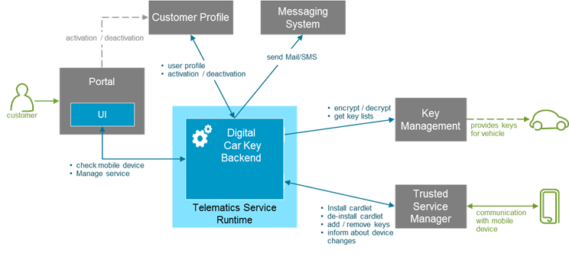
Return of Experience – Digital Car Key
Anonymized
Re-Born in the Cloud
Client:
Project:
Contacts:
Automotive
Michael Cirikovic
Thilo Hermann
Sector:
Project Content
Best Practices
Smartphones can be used as virtual car key via NFC and over the air key provisioning
Lighthouse project for the whole connect car platform:
Spring based microservice architecture on Pivotal Cloudfoundry
Continuous delivery approach
DevOps transformation in progress
Customer success story: first migration from classical JEE IBM stack to best-of-breed PaaS based on Pivotal Cloudfoundry
Strong business partner alliance: close collaboration between Capgemini, Pivotal and Client
State of the art delivery approach: optimal time to market by leveraging continuous delivery and Rightshoring (DE + IN)

Slide 19
Return of Experience – Modernizing application portfolio
European Parliament
Modernizing application portfolio
Client:
Project:
Contacts:
Public
Philippe Triquenot
Sector:
Quick Description:
I currently work as Solution Architect for the DG TRAD of the European Parliament with a strong focus on re-designing / modernizing the application portfolio and the applications communication flows.
The goals are :
Remove existing silos by putting in place and generalizing the exposition of APIs as micro-services,
Manage and govern service portfolio,
Migrate legacy applications from their current technical stack to more recent standards adopted to avoid/remove obsolescence,
Migrate or rewrite existing "old fashioned" SOAP services to micro-services.
Define and promote the adoption of development best practices (Continuous Integration, Test Driven Development, coding standards)
From a more technical point of view, the technical stack is relatively simple and based on Java 7 / Tomcat 7 / Spring / Spring Integration / Spring MVC / JAX-RS / Oracle 11g database.
This mission started in 05/2014 and is still on going.
➔ Please contact Philippe Triquenot for more information

Slide 20
Return of Experience – From Monolithic to Microservices
ADECCO
Declic – From Monolithic to Microservices
Client:
Project:
Contacts:
Temporary work
Pierre-Loïc ROPARS
Sector:
Quick Description:
Capgemini team of around 45 people (France and India)
Evolution of an existing monolithic application to a Micro services approach
Clients stakes:
Modularization of existing application
Capacity to handle more evolutions in parallel
Reduction of the delay between needs expression and roll-out in production
Application integration with workers and clients portals in the frame of a digital strategy
On going project, 1st delivery scheduled for April 2017: services pour le workers portal (requests for advances on salary, employment certificates).
➔ Please contact Pierre-Loïc ROPARS for more information

Slide 21
Return of Experience – Platform for application development based on microservices
SCHUFA
Platform for application development
Client:
Project:
Contacts:
Banking
Cornelia Görs
Sector:
Quick Description:
APPS and INFRA are working on a project to build a platform for application development based on micro services architecture (since September 2016)
The platform uses Kubernetes Cluster, Docker Container and various other tools like Ansible, DEIS and Jenkins
This platform is comparable to the Capgemini Apollo platform
➔ Please contact Cornelia Görs for more information

Slide 22

Return of Experience – Platform for application development based on microservices
BEC
Platform for application development
Client:
Project:
Contacts:
IT for Finance
Carsten Rasmussen
Sector:
Quick Description:
I am on an engagement for BEC, a financial sector IT services provider serving 25 smaller banks in Denmark
BEC has started a journey towards micro services and API’s on top of their legacy mainframe monolith and we have a small team leading the overall architecture work and the security stream
Next steps will be to extend the micro services architecture into decentralized development and deploying a PaaS in the datacenter to execute the micro services.
➔ Please contact Carsten Rasmussen for more information

Slide 23
Return of Experience – Integration microservices on eBusiness platform
Royal Mail Group
eBusiness platform
Client:
Project:
Contacts:
Postal
Nick Walter
Mick Broderick
Sector:
Quick Description:
Within the RMG eBusiness platform we have over 30 integration Microservices running in production, with a pipeline of more planned to go-live this year. Each are Java, Apache Camel, Jetty (HTTP servlet engine) and are packaged as Fat Jars using Spring-Boot.
We have developed services that take inputs, and output to REST JSON / SOAP XML / JMS Queue / Database / sFTP / STMP Email & Flat files.
In terms of databases we interact with most: MongoDB, Redis, MySQL and SQL-Server.
We also have services that interact with SaaS vendors like “SalesForce”.
Our design principals for Micro services centre around DDD, having a single responsibility and owning a single domain
For example we have a Barcode Image Service. Its sole purpose is to take a message over HTTP, generate a Barcode Image and return that as an encoded JPG back to the caller. We have others that are more pipeline services, these call multiple downstream Micro services and aggregate / enrich a single response back.
These are deployed and load balanced across multiple servers (as our services are stateless), deployment is done via Jenkins. In order to monitor the activity and health of the services we output various metrics & logs, which are collected by our monitoring stack. We can then create graphs using Graphana & Hystrix-Dashboard.”

Slide 24
Return of Experience – Exposing Microservices with APIm for External Consumption
Royal Mail Group
BIG API Management
Client:
Project:
Contacts:
Postal
David Rutter
Sector:
Quick Description:
Provides customers with a secure, managed access to RMG APIs:
eBusiness Microservices developed by Capgemini
internal RMG APIs provided by the Business Integration Gateway
Developer portal for customers to self service API subscriptions and access API documentation and API testing
Customer Solutions Team to assist customers
In House “Center of Excellence” Support projects that are providing new APIs
Implemented as an Agile Project: distributed, multi-discipline team Capgemini + RMG: Team work
New APIs onboarded using a Capgemini factory
Test Driven development, Shift Left, Shift Right; testing integrated with Alertsite, provides monitoring, dashboard and alerting
API Support by Capgemini: 24x7 offshore
Business Goals
Accelerated customer onboarding for APIs
Increased visibility of APIs and usage
Improved business customer satisfaction
Revenue growth through new channels
New customer … from intro to development within 6 hours compared to the 10 day SLA prior to API Management. Impressive! Customer Solutions
After 12 months,
- 400 companies using the live APIs - 1000 more companies registered
“I consider the APIM Capability delivery to be a great example of how partnering with Capgemini maximises our ability to achieve our outcomes“. Technology Programme Director

Slide 25




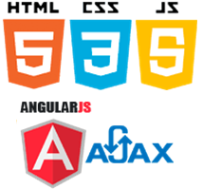


























Return of Experience – Microservices platform for delivering Commerce Marketplace
Large FMCG
Marketplace Platform connecting B&M Retail Stores with Online Consumers
Client:
Project:
Contacts:
Retail
Gururaj Joshi
Sector:
Quick Description:
We have built experience of micro services architecture in delivering custom built commerce marketplace.
Customer is large consumer goods company owned by Global FMCG with distribution covering over 2 million retail
outlets across India directly and its products are available in over 6.4 million outlets in the country & Is the market leader in Indian consumer products with presence in over 20 consumer categories with over 700 million Indian consumers using its products.
Commerce Platforms Connects Brick & Mortar Stores to Online consumer across country.
Commerce Marketplace platform was built based on Ruby / Sinatra iteratively delivering microservices like City & Store Selection, Login, OTP generation/ Validation, Store Product catalog (Multiple Ordered set by Price, Availability, Promotion …etc) , Geo location Services , Product recommendations for users, Offers Products, etc.
Has ability to provide multiple scale based on read & browse services with high demand (Product Catalog) against services with low demand (Order placement).
Services communicate with RESTfull services (Stateless).
Rapid development, Automated deployment and Testing
Deployed in cluster of Passenger , Cassandra & MySQL, load balanced & cached across multiple layers.
Used Talend for real time ETL of product catalogs
API caters to native Android & iOS apps and AngularJS website as omni channel experience.
Used Akamai/NGINIX for API / HTTP caching, Media (Picture/Videos), resources caching for end user experience.
The platform is entirely based on open source components.
Landing Page
Search
Catalogs
Cart
Notification
Recommendations
Order Mgmt
Micro Services
Micro Services
Micro Services
Other Systems
Why Micro Services based architecture

Slide 26
Return of Experience – Various Projects (1/2)
Client | Sector | Description | Contacts
? | Healthcare | I was involved in a Master Data Management design last fall where we suggested to use standard micro-services using REST API in Healthcare | Casimir Artmann
Several | Telcos | We also had public examples from telecos where they have used the same approach | Casimir Artmann
Several | Several | References on Citibank, Wellsfargo and Unilever | Manuel Sevilla
HSBC | Banking | Project with Mulesoft | P. Gentil, T. Alby
CALF | Banking | Project with WSO2 | Anthony Joseph
Airbus Helicopters | Transports | Project based on microservices with light homemade infrastructure | J.G. Lalanne
CA CIB | Banking | Comparative study on Microservices (on going) | Skander Guetari
Orange | Telcos | Deployment of a Microservices infrastucture. DevOps and containers orchestration parts will be deployed soon. | Julien Bellanger
Capgemini INFRA & Group IT | IT | Studies for proposing a CaaS solution | Christophe Dupas

Slide 27
Return of Experience – Various Projects (2/2)
Client | Sector | Description | Contacts
? | ? | We are instrumental in delivering a Micro service architecture on the MoJ Common Platform Program. This is structured on top of a CQRS and Event sourced Architecture. Due to Delivery Challenges, we sometimes struggle to get a coherent implementation that matches the design aspirations, specifically where the domain modelling sometimes fall short and the services aren’t of sufficient granularity. | Neels Burger
Cisco | Telcos | We build micro services at Cisco | Al Liubinskas
HSBC | Banking | We are currently defining a micro services based architecture for HSBC (new application for payment by transfert) | Yann Le Thieis
Ladbrokes | Bet | We are doing micro service in Ladbrokes engagement | Rahul Murudkar
Capgemini | IT | Inside the global I&D Insights as a Service Platform, development of an application based on microservices architecture | Subir Sarbabidya

Slide 28

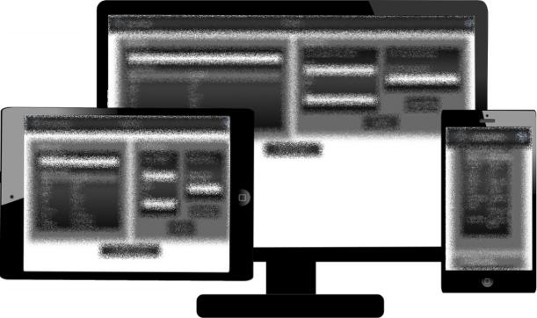

Reference – Automotive Sector – Cloud Native Apps for OpenShift based on devonfw enhancing the existing Point of Sales Apps for Car Manufacturer
Task Description
Contacts:
Agile development of device-independent web apps (mobile, tablet, notebook, desktop) supporting salespersons starting with extra equipment recommendations and analysis of historical orders
Assurance of short release cycles for reduced time-to-market due to support newly detected use cases in an agile environment
Design of a robust, cloud native architecture for micro services to be developed and operated on a PaaS (OpenShift)
Markus Kokott
Thilo Hermann
Service provided by Capgemini
Detect and refine use cases during RDV workshops with stakeholders such as salespersons and IT staff
Definition of Minimum Viable Products (MVPs) as base for the design of micro services
Construction and realization of the web portal comprise of micro services based on devonfw with Java backend and Angular frontend components
Implement DevOps processes based on Production Line to support continuous deployment to OpenShift
Operate app in Capgemini's datacenter as PoC
Benefit for the Customer
Very flexible and dynamic controlling of app development with a clear focus on value for the apps' end users (MVPs)
Short development cycles of 4-6 weeks per app until beta test phase can be started with test users without affecting existing systems
Elimination of release planning due to separation of micro services and usage of OpenShift as PaaS
Reduced efforts for operational topics, capacity planning and procuring due to cloud native app design for PaaS

Slide 29

We Need You
The strength of this community is based on the knowledge of its members and their ability to share it
So, if you have any other:
Reference architectures
Return on experience
Partner or Startup that would be relevant on this topic
Or other useful element on MicroServices which have not been shared for the moment, please contact us to enrich this StarterPack.
The up-to-date version of this StarterPack, and all the related documents are available on the Architects Community KM3.0

Slide 30

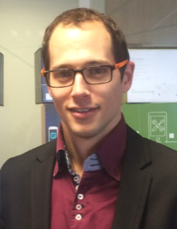

Thank You!
Adrien CALVAYRAC
Solution Architect
Architects Community Sharing Stream Leader
Fabien GIOE
Architects Community Knowledge Manager
Mobile: +33 628926645
adrien.calvayrac@capgemini.com
Mobile: +33 671666924
fabien.gioe@capgemini.com
Contact: DL Global Architecture (architecture.global@capgemini.com)

