Slide 1

CODE REFACTORING AND BUG FIXING REPORT
ON
NOTE TAKING APPLICATION
Shaik Shaheer

Slide 2
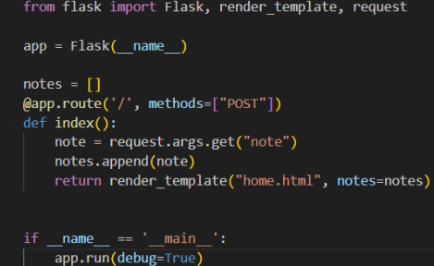
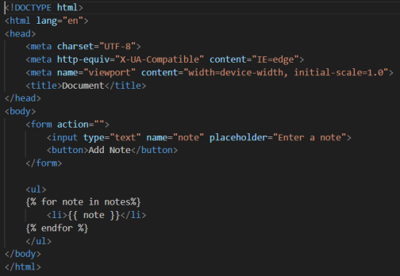
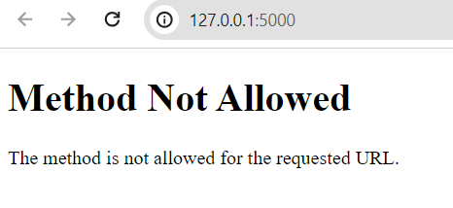
BEFORE BUG DETECTION :
CODE
OUTPUT

Slide 3
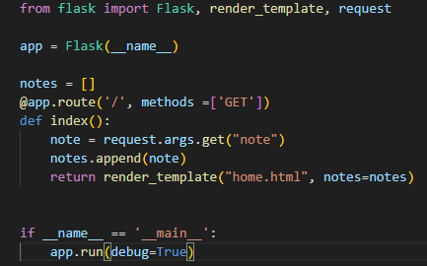
BUG DETECTION :
We must switch to the Method "GET" since the "POST" method isn't enabling us to render the template.

Slide 4
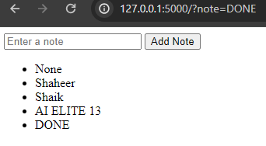
BUG RECTIFICATION :
OUTPUT
It's operating correctly now that the bug has been fixed.

Slide 5

THANK YOU

