Slide 1
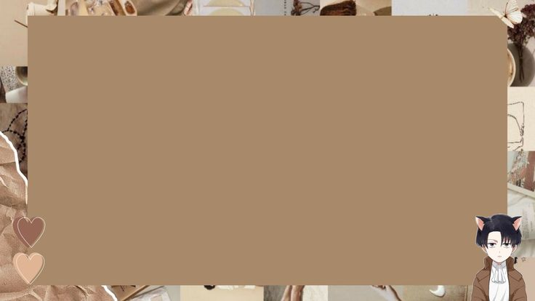
CONVERT NORMAL IMAGE TO SKETCH
IMAGE USING PYTHON

Slide 2
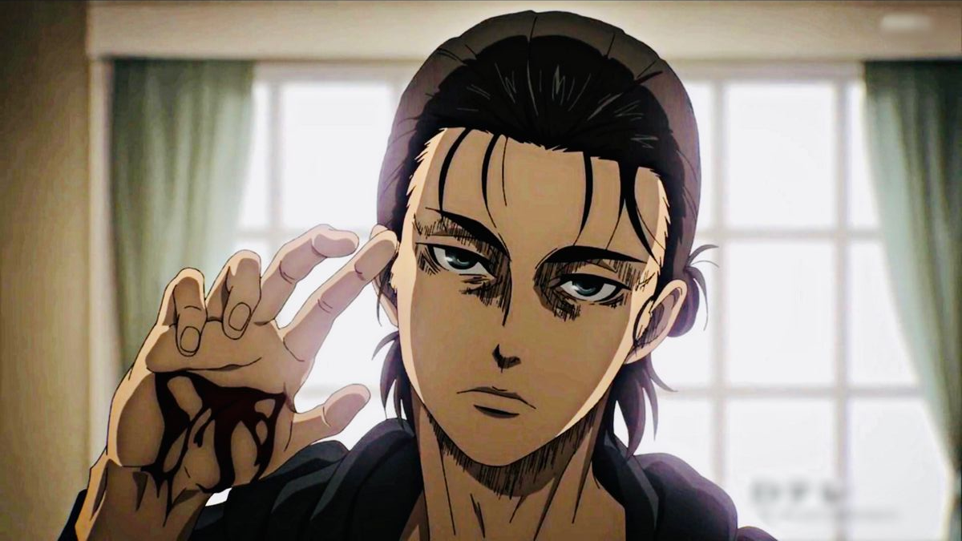
INPUT IMAGE

Slide 3
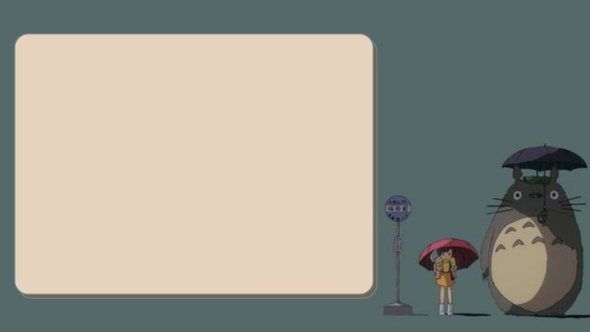
STEPS FOR WRINTING THE CODE
1.First import all the modules
2.Add the colors which are required
3.Create the objects

Slide 4
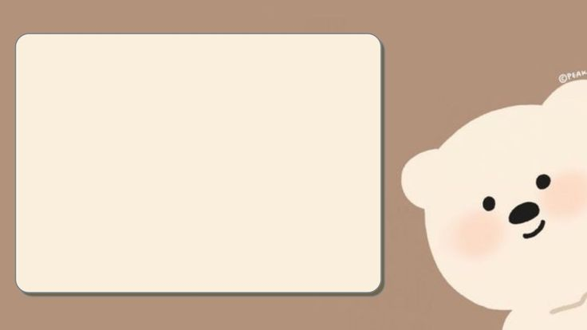
STEPS FOR WRITING THE CODE
4.Now define the fuction for choosen image
5.Again define the function to convert the image
6.Using cv2 module load the image

Slide 5
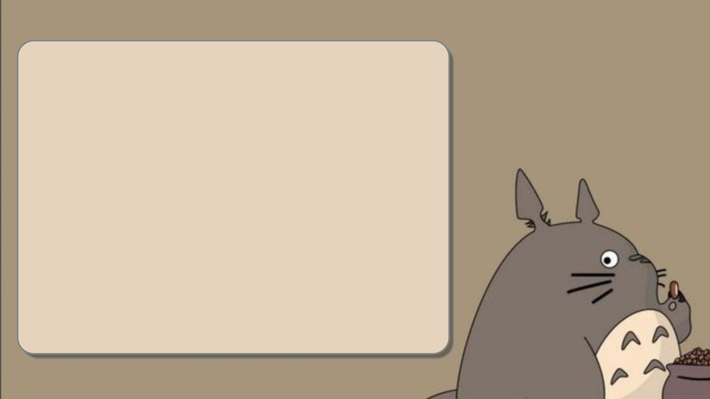
STEPS FOR WRITING THE CODE
7. Now convert one colorspace to another
8.Add the scale length for adjustment of image color
9.Add two buttons

Slide 6
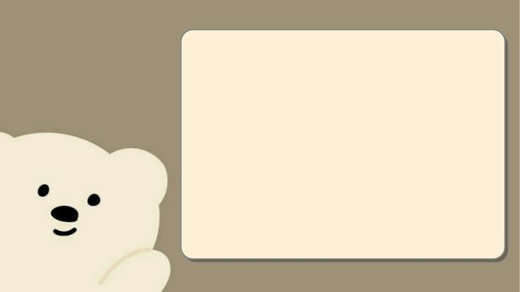
STEPS FOR WRITING THE CODE
10.Button.1 for the choosing the image
11.button.2 for the saving the image

Slide 7

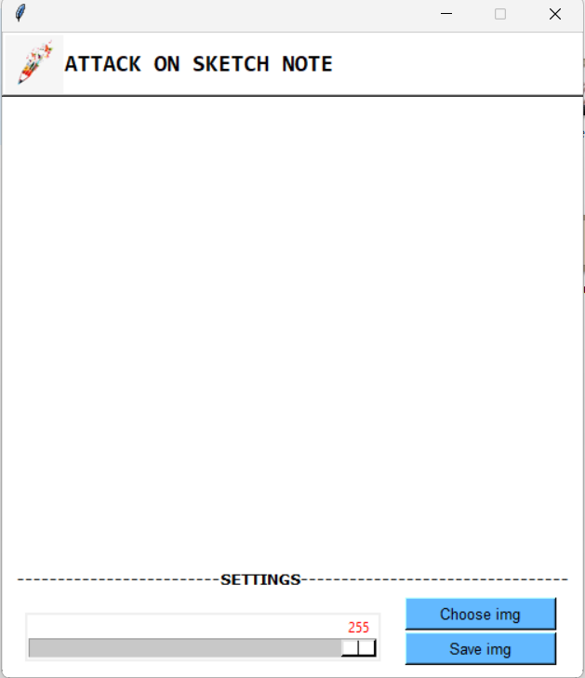
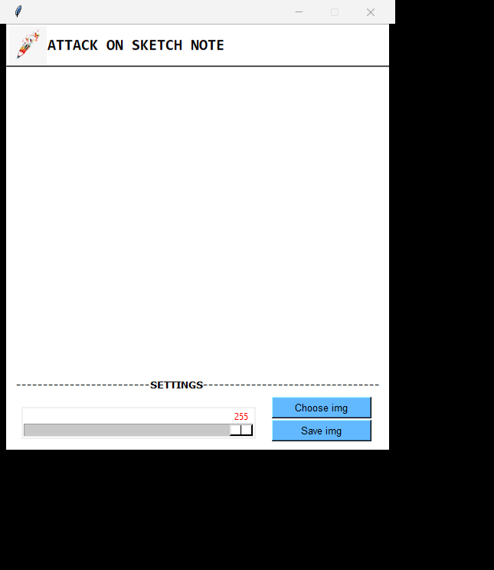
AFTER EXECUTION OF THE CODE

Slide 8

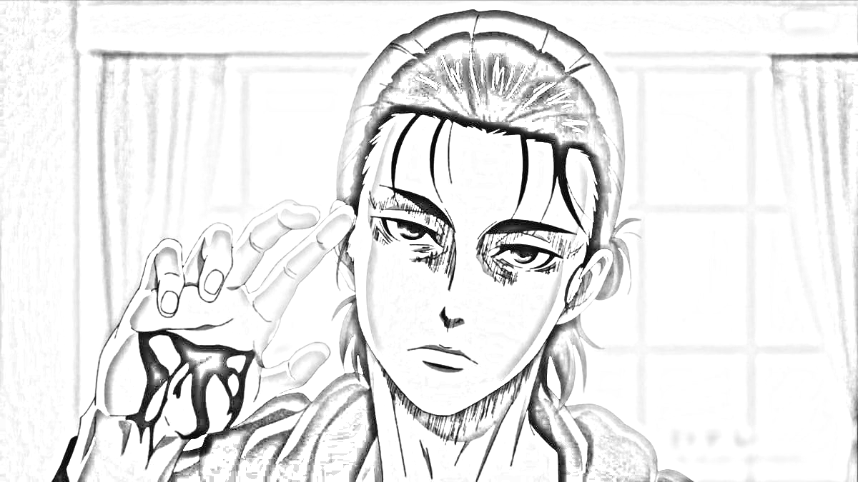
OUTPUT OF THE CODE

Slide 9


