Slide 1
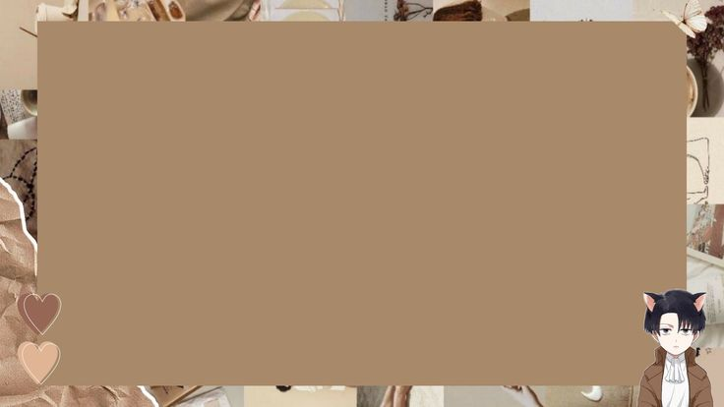
CONVERT NORMAL IMAGE TO SKETCH
IMAGE USING PYTHON

Slide 2
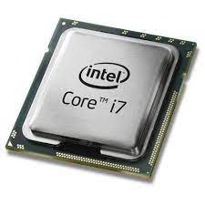




REQUIREMENTS
Software
Hardware
Visual studio code
Python(IDLE)
Image
Terminal
Processor
Windows or MAC
CPU and GPU
HDD free space

Slide 3
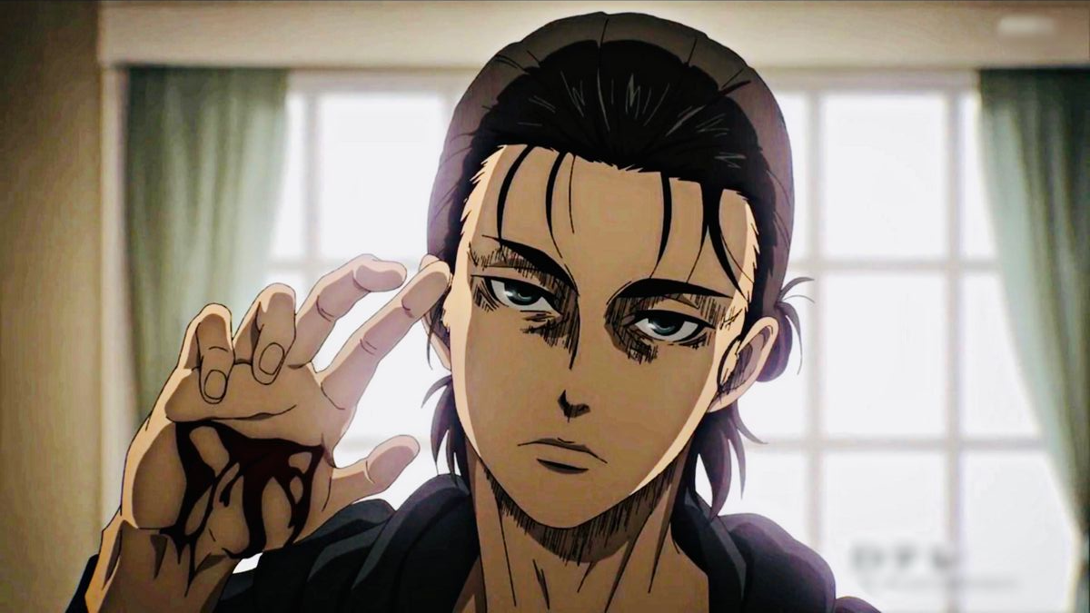
INPUT IMAGE

Slide 4
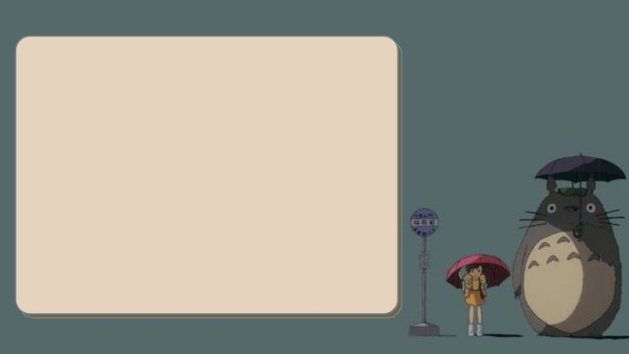
STEPS FOR WRINTING THE CODE
1.First import all the modules
2.Add the colour which are required
3.Create the objects
4.Now define the function for choose image
5.Again define the function to convert the image
6.Using cv2 module load the image

Slide 5
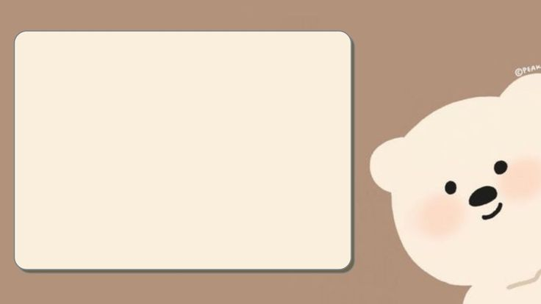
STEPS FOR WRITING THE CODE
7. Now convert one colour to another
8.Add the scale length for adjustment of image colour
9.Add two buttons
0.Button.1 for the choosing the image
11.button.2 for the saving the image

Slide 6
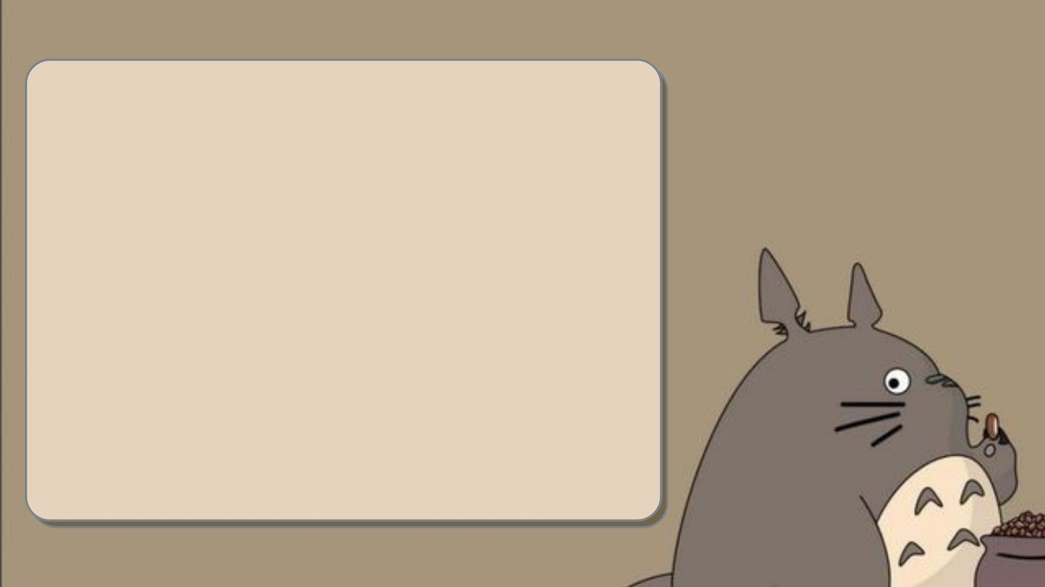
ADDING SELFIE CAMERA
1.Create window
2. Create selfie button and sketch button to the window
3. Now click on selfie button
4.The web cam will be open on another window

Slide 7
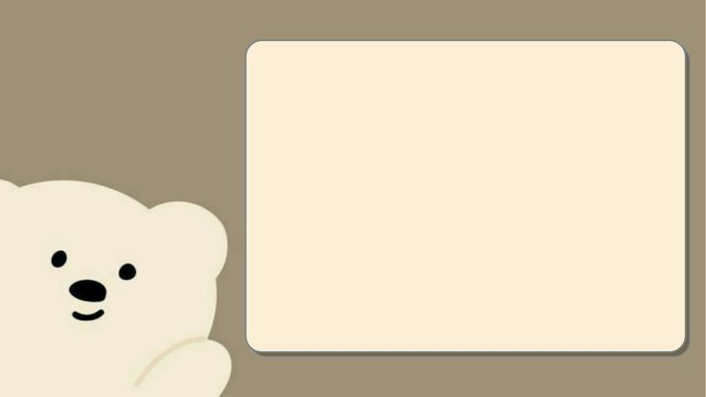
CONVERTING IMAGE TO SKETCH
5.For capturing the image ….press the S button
6.For closing the cam …..press the Q button
7.Now choose the image from the folder..
8.Convert it into pencil sketch…….

Slide 8

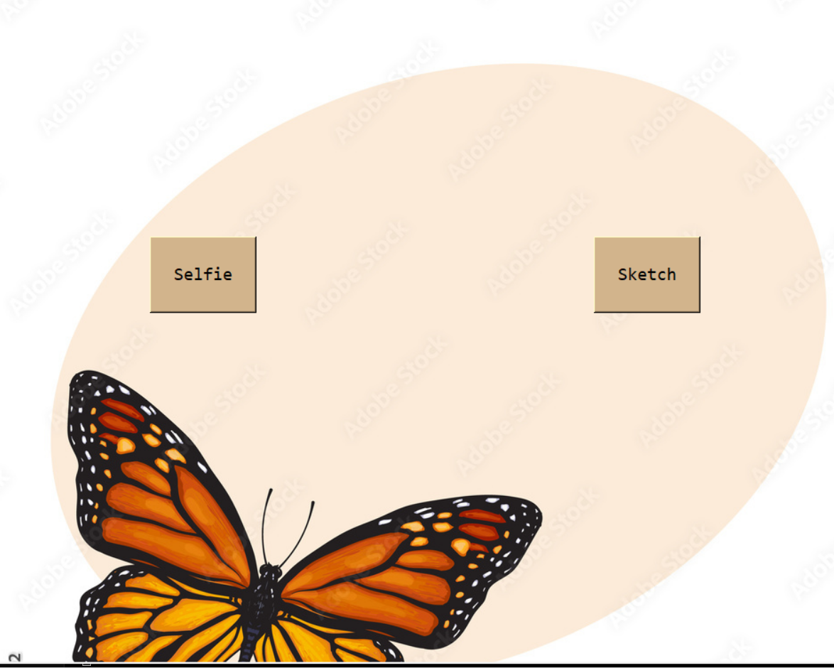
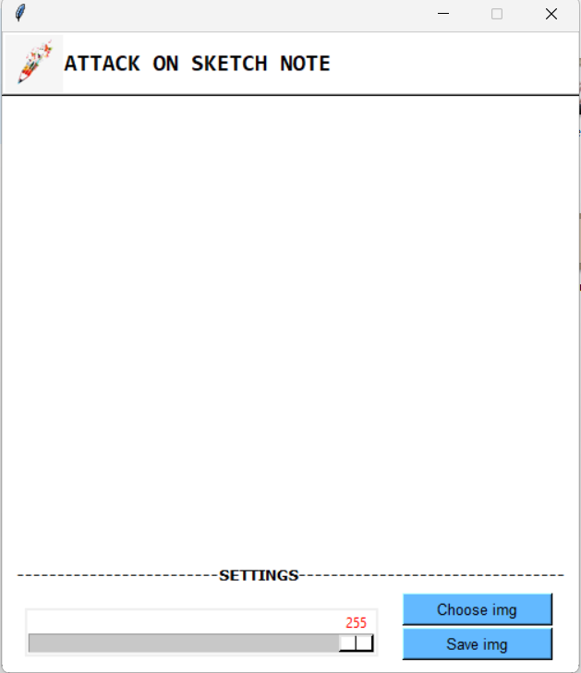
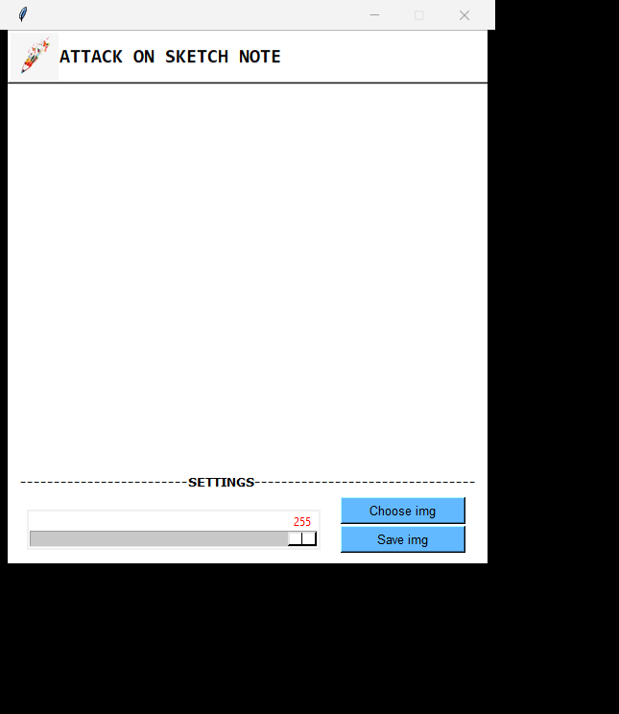
AFTER EXECUTION OF THE CODE

Slide 9

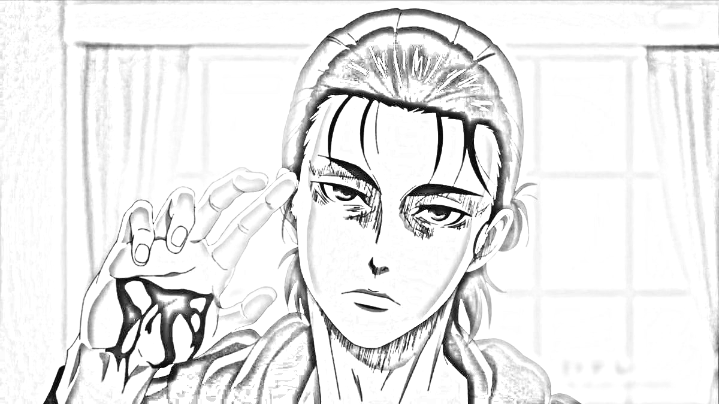
OUTPUT OF THE CODE

Slide 10


