Slide 1



ONLINE PAYMENT FRAUD DETECTION WITH CNN
N.GAYATHRI LAKSHMI PRIYA
SK.SUHEILA MUKTHYARUNNISA
S.DIVYA SRI
Y.B.S.SOWJANYA

Slide 2


WHY
Nowadays, credit card has become the modern tool for, online payments, and many e-transactions have a credit card transaction the credential from the credit card is used by the third-party to deduct money. due to this, we need to analyze and find the best solution to detect the maximum number of frauds in online systems. we will try to implement machine learning algorithms and will further compare which deep learning algorithm works best and will test this with real time dataset.

Slide 3

WHY AI/ML?
Machine learning (ML) is the science of creating and applying algorithms capable of analyzing and learning from past events.
ML is the perfect use case in fraud detection and prevention.
The weakest point of traditional fraud detection systems is that they heavily depend on human labor. The work of the top analysts is time and money-consuming
ML algorithms can process and learn more information. Thus, higher workloads result in better fraud detection algorithms.
A wonderful serenity has taken possession of my entire soul

Slide 4




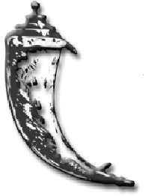





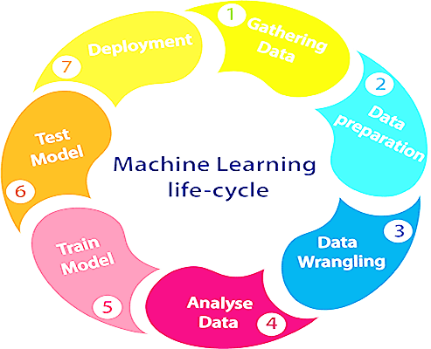
TOOLS & TECHNOLOGIES
SPYDER
PANDAS
AIML
SKLEARN
FLASK
TENSORFLOW
HTML
CSS
PYTHON
KERAS
02
04

Slide 5
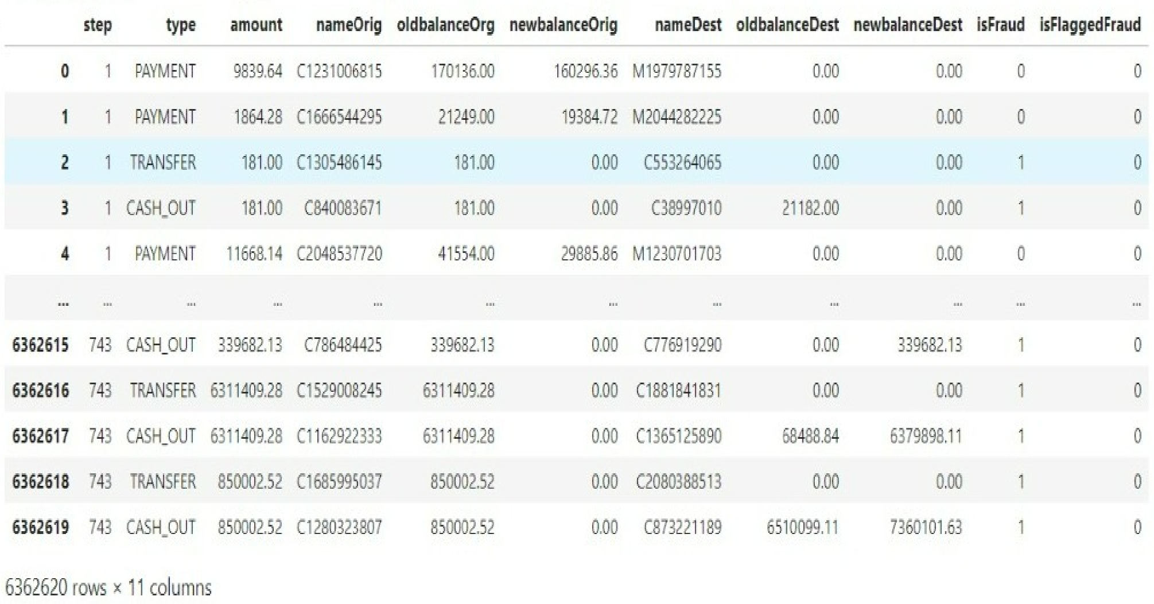
IMPLEMENTATION ML MODELS
Till now maximum algorithms implemented by Decision Tree, KNN, Logistic Regression, Random Forest for Online Payment Fraud Detection Dataset.
But here we implemented Support Vector Machine(SVM) & K Nearest Neighbour Machine learning algorithms.
Using traditional algorithms the result will be biased due to inequality in data.
But for a change we implemented Machine learning dataset to Deep learning.

Slide 6
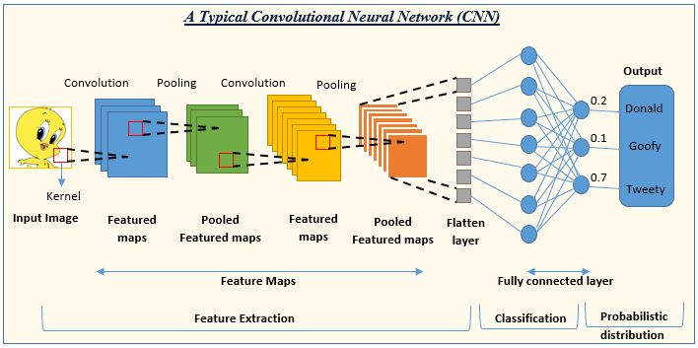
NEURAL NETWORKS

Slide 7
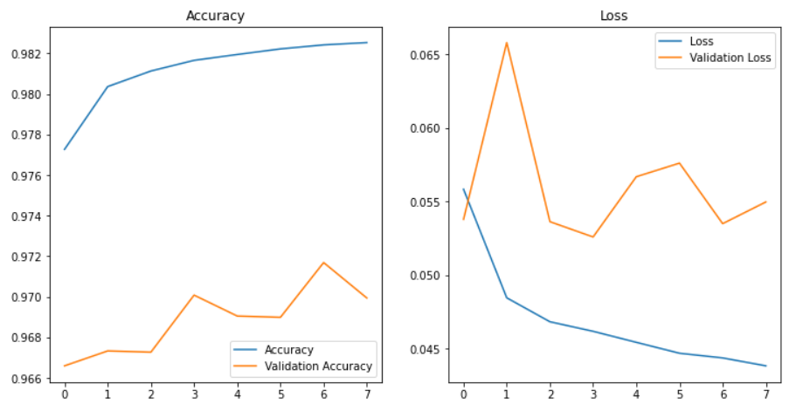
DATA VISUALIZATION FOR CNN
When compiling your model you need to choose a loss function and an optimizer. The loss function is the quantity that will be minimized during training.
The optimizer determines how the network will be updated based on the loss function.

Slide 8
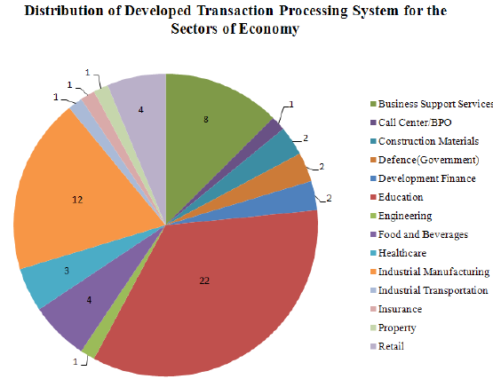
FLASK-FRONT END DEVELOPMENT
Flask is a web application framework written in Python.
Flask is flexible. It doesn’t require you to use any particular project or code layout. However, when first starting, it’s helpful to use a more structured approach.
To avoid many common pitfalls that new developers encounter, and it creates a project that’s easy to expand on.
REAL WORLD APPLICATIONS

Slide 9

Accuracy
DEEP LEARNING ALGORITHM
MACHINE LEARNING ALGORITHM
TYPE OF ALGORITHM | ACCURACY ACQUIRED
K-Nearest Neighbours (KNN) | 93.678475
Support Vector Machine (SVM) | 95.22153
TYPE OF ALGORITHM | ACCURACY ACQUIRED
Convolutional Neural Networks (CNN) | 99.8445243
CONCLUSION
In this Online Payment Fraud Detection System project, machine learning algorithms were briefly compared in fraud detection, also a detailed comparative analysis is provided. It is seen that various algorithms give different accuracy in performance. We predicted whether the transaction is fraud or not with Deep learning model.
THANK YOU

