Slide 1
Machine Learning & Deep Learning: An Introduction
A Beginner-Friendly Tour of the Algorithms Behind Modern AI — Session 08/25/2026
01 / FOUNDATIONS
Core Concepts
What is ML, really?
From hand-written rules to learned rules
Linear Regression
Predicting continuous numbers
Regularization
Keeping models simple (Ridge & Lasso)
Logistic Regression
Predicting yes/no probabilities
02 / CLASSIC ALGORITHMS
Classification & Ensembles
Neighbors, Margins & Trees
k-NN, SVM, and Decision Trees
Teamwork Models
Random Forests & Boosting
Bonus Analytics Tools
Forecasting, cause vs. coincidence, and catching outliers
03 / DEEP LEARNING & BEYOND
Neural Networks & Success
How Networks Learn
Layers, weights, and gradient descent
Attention & Transformers
The revolutionary idea behind ChatGPT
Model Evaluation
How do we know if a model is actually any good?
Notes:
Welcome slide, pitched at beginners — no assumed background beyond basic algebra. This session (08/25/2026) introduces the ML/DL algorithm toolbox at an intuitive level: what each method does, why it works, and when you'd reach for it. Walk through the roadmap in plain language before diving into any formulas so the class has a mental map of where we're headed.

Slide 2
FROM HAND-WRITTEN RULES TO LEARNED RULES
What Is Machine Learning, Really?
01 / PARADIGM SHIFT
Traditional vs. ML
Traditional Programming
You write the rules, feed in the data, and get answers.
Machine Learning Flips It
You feed in data + known answers, and the computer works out the rules.
Example: Instead of hand-coding complex loan approval rules, show the model thousands of past outcomes and let it detect patterns.
02 / CORE COMPONENTS
Every Model Has 3 Parts
1. Representation
How the model turns inputs into a prediction (a line, a decision tree, or a neural network).
2. Evaluation
A loss function that scores how far off or "wrong" a prediction was from reality.
3. Optimization
An algorithm to systematically adjust the model parameters to make that loss smaller.
03 / EVOLUTION
The Maturity Ladder
Descriptive
What happened? (dashboards, simple aggregations)
Diagnostic
Why did it happen? (root-cause, correlation studies)
Predictive ML MAIN ZONE
What will happen next? This is where most modern ML algorithms live.
Prescriptive
What should we do? (decision engines, optimization)
Notes:
Ground the whole session before any formulas: traditional software is rules-in, answers-out; ML is examples-in, rules-out. Every algorithm we cover today — no matter how different it looks — is just a different choice of Representation + Evaluation + Optimization. The analytics maturity ladder also helps place today's material: most of what follows is 'predictive' analytics, building on the descriptive/diagnostic techniques from earlier sessions.

Slide 3

Predicting a Number
Linear Regression
θ = (XᵀX)⁻¹Xᵀy
The formula that finds the best-fit line directly
Error = average of (actual − predicted)²
How we measure how 'wrong' a line is
What Linear Regression Does
Best-Fit Line: Draws the straight line that best fits a scatter of points.
Least Squares: 'Best fit' means the line that minimizes total squared distance to every point.
One-Step Solution: Can be solved exactly in one step using the Normal Equation formula.
Linearity: Works best when the relationship really is roughly a straight line.
Gradient Descent (Alternative Fit)
The Analogy: Like a hiker lost in thick fog, feeling for the steepest downhill slope underfoot at each step.
Scalability: Useful when the exact formula is too slow (huge datasets, many features).
Learning Rate: The step size controls how big each downhill step is.
Step Tuning: Too big a step overshoots; too small takes forever to reach the bottom.
Notes:
Running example for this slide: predicting house price from square footage. Two ways to fit the same line: solve for it directly with the Normal Equation, or walk toward it step by step with Gradient Descent — like a hiker in the fog feeling out the steepest downhill direction at every step until they reach the valley floor. The direct formula gets expensive with lots of features, which is when gradient descent — and the regularization we cover next — become useful.

Slide 4
PREDICTING YES/NO (OR ONE OF SEVERAL CLASSES)
Logistic Regression
σ(z) = 1 / (1 + e⁻ᶻ)
The Sigmoid — squashes any number into a 0–1 probability
softmax → picks probabilities
Same core concept, extended to multi-class scenarios
How It's Trained & Used
Probability Output: Maps inputs to a continuous value between 0 and 1, representing class probability.
Loss Function: Uses cross-entropy loss to measure how far predictions are from the true 0 or 1 labels.
Optimization: Adjusts model weights iteratively to maximize correct class confidence and shrink total loss.
Reading the Model
Classification: Despite its name, it is fundamentally a classification method, not a regression one.
Decision Boundary: Draws a straight decision boundary that separates classes as cleanly as possible.
Coefficients: Each coefficient indicates how strongly a specific feature pushes the output toward 'yes' or 'no'.
Multi-Class: Extends naturally to predict multiple categories (e.g., cat, dog, bird) using a softmax layer.
Notes:
Running example: predicting whether a loan applicant will default, using income and debt as features. Logistic regression takes a weighted sum of the inputs (just like linear regression) but then runs it through the sigmoid function so the output is always a valid probability between 0 and 1. Training nudges the weights so predicted probabilities line up with the true yes/no labels. Softmax is the same trick generalized to picking among several categories at once.

Slide 5
RIDGE VS. LASSO VS. ELASTICNET
Keeping Models Simple: Regularization
01 / L2 Regularization
Ridge
Error + a penalty for large coefficients
Shrinks every coefficient a little
In Plain Words:
Discourages any coefficient from getting too big
Effect:
Shrinks all coefficients, none reach zero
Best Use Case:
Many features that overlap/correlate
02 / L1 Regularization
Lasso
Error + a penalty for non-zero coefficients
Can shrink some coefficients to zero
In Plain Words:
Also discourages using unnecessary features at all
Effect:
Can drive weak coefficients to exactly zero
Best Use Case:
Automatically drop useless features
03 / Combined Penalty
ElasticNet
A blend of both ideas at once
Combines L1 and L2 penalties
In Plain Words:
A blend of both Ridge and Lasso ideas
Effect:
Shrinks and can zero out coefficients
Best Use Case:
Lots of correlated features, want some sparsity
Notes:
The problem: a model that fits the training data too perfectly often fits its noise too (overfitting). Regularization fixes this by penalizing the model for using large coefficients — it's a 'keep it simple' rule. Ridge shrinks everything a bit; Lasso can shrink some features all the way to zero, effectively deciding they're not needed at all.

Slide 6
"YOU ARE THE AVERAGE OF YOUR NEIGHBORS"
k-Nearest Neighbors (k-NN)
How It Works
• To predict a new point, find its k closest points in the training data
• Classification: let those neighbors vote on the label
• Regression: average their values
• There's no real 'training' — it just remembers all the data
Distance Used to Find Neighbors | Idea
Euclidean | Straight-line distance (as the crow flies)
Manhattan | Distance moving only along grid lines (city blocks)
Minkowski | A general formula that includes both above
Choosing k
• Small k (like 1): follows the data very closely — can be noisy
• Large k: smooths things out — can miss real patterns
• Pick k by trying a few values and checking what predicts best
Where It Struggles
• Slow to predict on huge datasets — checks distance to every point
• Features on different scales (e.g. age vs. income) can distort distance
• With too many features, everything starts looking equally 'far away'
Notes:
k-NN is the most intuitive algorithm in the deck: just look at what's nearby and go with that. The two design choices that matter are the distance metric (how do we measure 'nearby') and k (how many neighbors to consult). Emphasize that it needs scaled features and struggles as the number of features grows — a gentle first mention of the 'curse of dimensionality'.

Slide 7
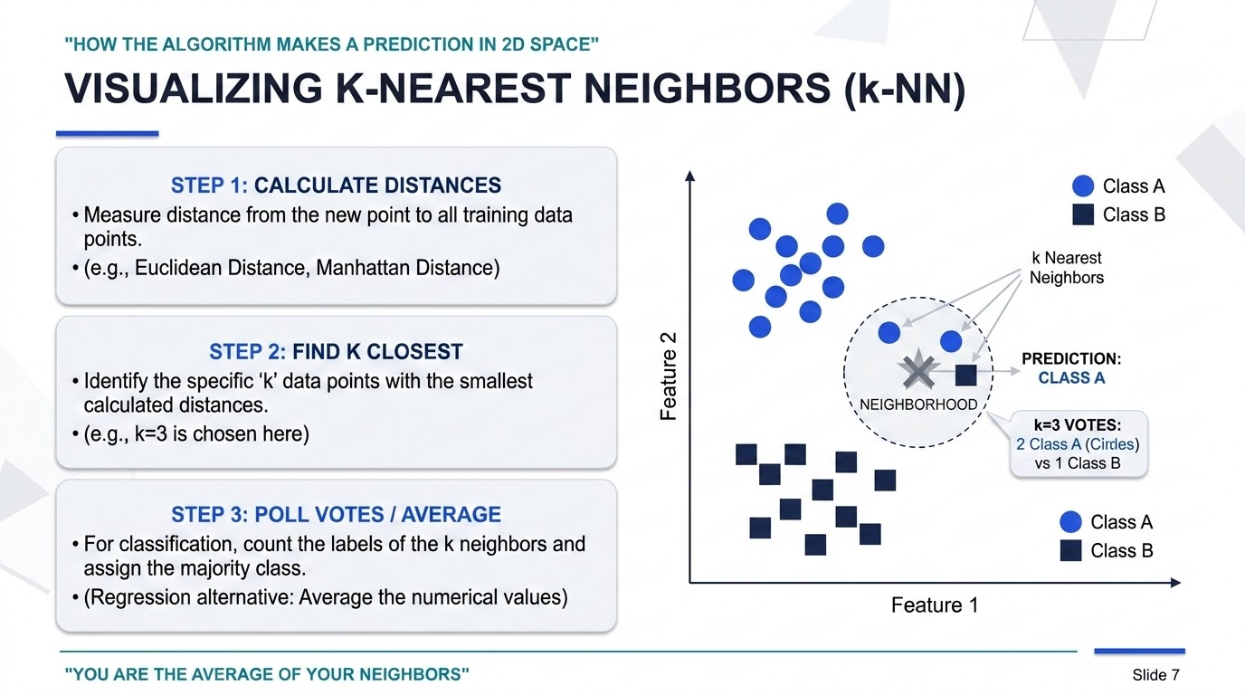

Slide 8
DRAW THE WIDEST POSSIBLE STREET BETWEEN CLASSES
Support Vector Machines (SVM)
Find the boundary line that maximizes the gap to the nearest points on each side
The 'margin' — SVM's core idea
tuneMargins & Support Vectors
Support vectors: The handful of closest points that actually define the boundary line.
Free movement: Every other data point could move around freely without changing the decision boundary at all.
C as a dial: Low C allows some margin violations for a wider, more tolerant boundary "street".
High C constraint: Insists on zero mistakes, forcing a narrower, much stricter boundary.
blur_onThe Kernel Trick
Non-linear limits: Often classes can't be split by a straight line—such as two concentric, nested circles.
Curved boundaries: Kernels allow SVM to map data into higher dimensions to draw complex curves without explicit coordinate math.
Linear kernel: Standard straight-line division for linearly separable scenarios.
RBF kernel: Highly flexible, curved boundary representing a highly reliable default choice.

Slide 9
DRAW THE WIDEST POSSIBLE STREET BETWEEN CLASSES
Support Vector Machines (SVM)
Find the boundary line that maximizes the gap to the nearest points on each side
The 'margin' — SVM's core idea
tuneMargins & Support Vectors
Support vectors: The handful of closest points that actually define the boundary line.
Free movement: Every other data point could move around freely without changing the decision boundary at all.
C as a dial: Low C allows some margin violations for a wider, more tolerant boundary "street".
High C constraint: Insists on zero mistakes, forcing a narrower, much stricter boundary.
blur_onThe Kernel Trick
Non-linear limits: Often classes can't be split by a straight line—such as two concentric, nested circles.
Curved boundaries: Kernels allow SVM to map data into higher dimensions to draw complex curves without explicit coordinate math.
Linear kernel: Standard straight-line division for linearly separable scenarios.
RBF kernel: Highly flexible, curved boundary representing a highly reliable default choice.

Slide 10
LIKE PLAYING 20 QUESTIONS WITH YOUR DATA
Decision Trees
help_outline
The Basic Idea
• Repeatedly ask yes/no questions about features (e.g., "Is age > 30?") to split the data.
• Each split tries to make the resulting groups as 'pure' as possible (mostly one class).
• Keep splitting until groups are pure enough or a stopping rule kicks in.
insights
How We Score a Split
Gini Impurity
How often you'd mislabel a random point if you guessed randomly based on the group's class distribution.
Entropy / Info Gain
How much 'surprise' or disorder is reduced in the group after performing the split.
report_problem
The Overfitting Trap
• A tree grown all the way down can perfectly memorize the training data — and generalize badly.
Pruning (limiting depth, requiring a minimum group size) keeps the tree robust and prevents memorization.

Slide 11
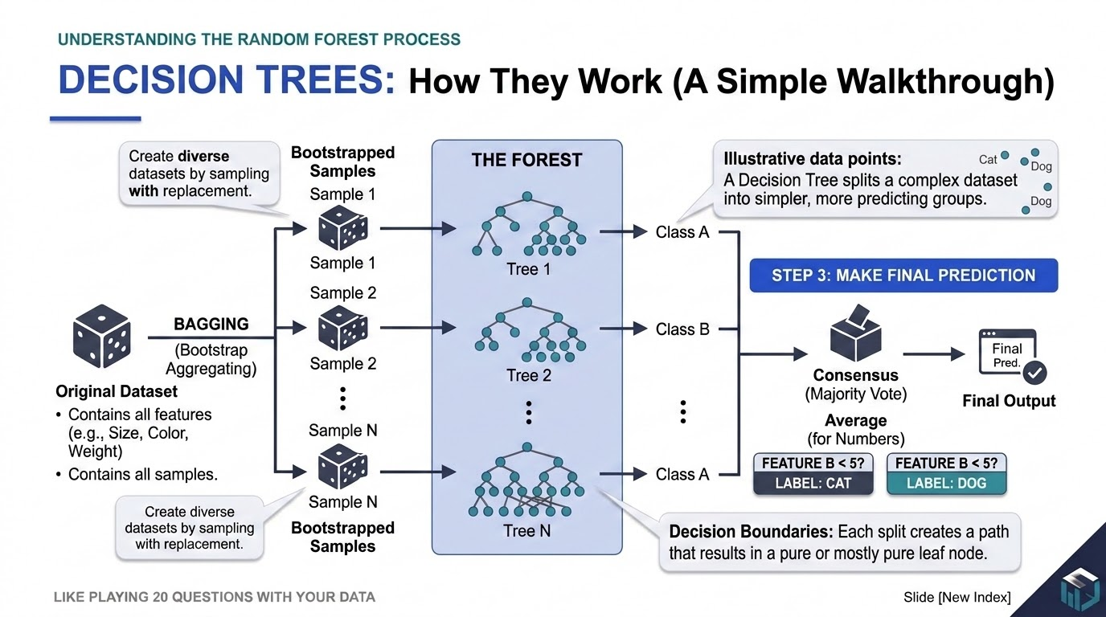

Slide 12
WISDOM OF THE CROWD, APPLIED TO TREES
Random Forests
The Core Idea
• A single decision tree is easily fooled by noise in its training data
• So instead, train hundreds of trees, each on a random, slightly different sample of the data
• Let every tree vote, and go with the majority (or average, for numbers)
• One tree's mistakes tend to get outvoted by the rest
One Extra Trick
• Each tree is also only shown a random subset of the features at every split
• This keeps the trees from all making the exact same mistakes
• More variety among the trees makes the group vote more reliable
A Built-In Report Card
• Since each tree only sees part of the data, the leftover part can quietly test it
• This gives a free, ready-made estimate of how well the forest generalizes
• No separate test set required to get this estimate
Which Features Mattered?
• Random Forests can rank features by how much they helped reduce mistakes
• Useful for understanding what's actually driving the predictions
Notes:
Random Forest is the 'wisdom of the crowd' idea applied to trees: many imperfect, slightly different trees, averaged together, tend to outperform any single one. The two sources of randomness — random data samples and random feature subsets per split — are what make the trees different enough from each other for averaging to actually help.

Slide 13
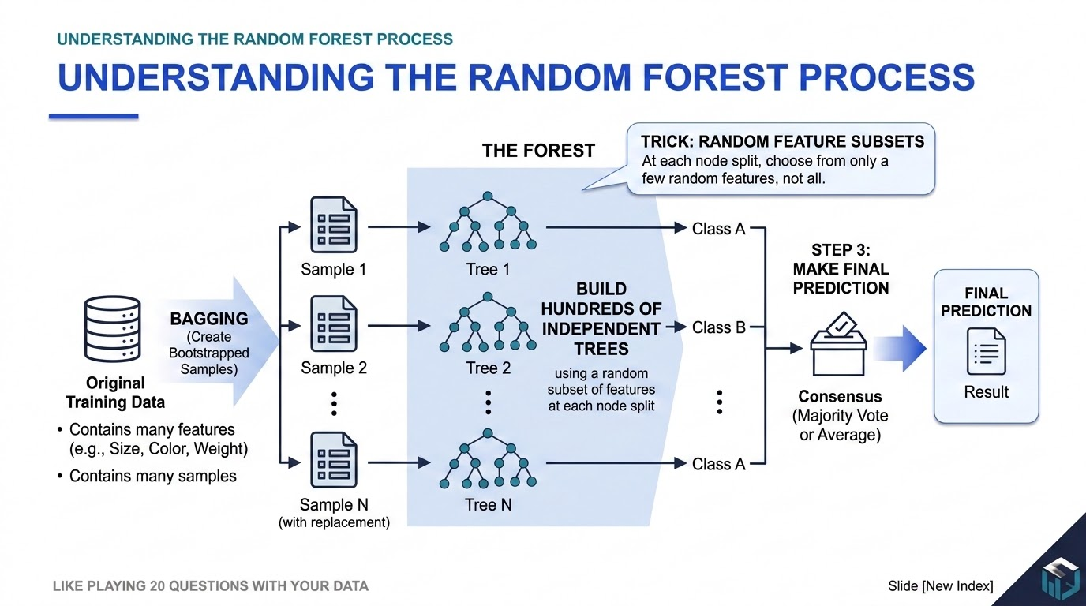

Slide 14
EACH NEW TREE FIXES THE LAST ONE'S MISTAKES
Boosting & XGBoost
New prediction = old prediction + (a small tree trained on the leftover errors)
The boosting loop, repeated many times
 | Random Forest (Bagging) | XGBoost (Boosting)
How trees are built | All at once, independently | One at a time, each learning from the last one's errors
Good analogy | A panel of independent experts voting | A student redoing a draft based on feedback
Why XGBoost Is So Popular
• Usually squeezes out very high accuracy on structured/tabular data
• Has built-in safeguards against overfitting (it penalizes overly complex trees)
• A 'learning rate' controls how much each new tree is allowed to change the prediction
Notes:
Boosting builds trees sequentially instead of in parallel: each new tree is trained specifically to correct the mistakes the ensemble has made so far. This tends to produce very accurate models but needs care to avoid overfitting, since it will happily keep chasing residual errors. XGBoost and LightGBM are fast, well-regularized implementations of this idea.

Slide 15
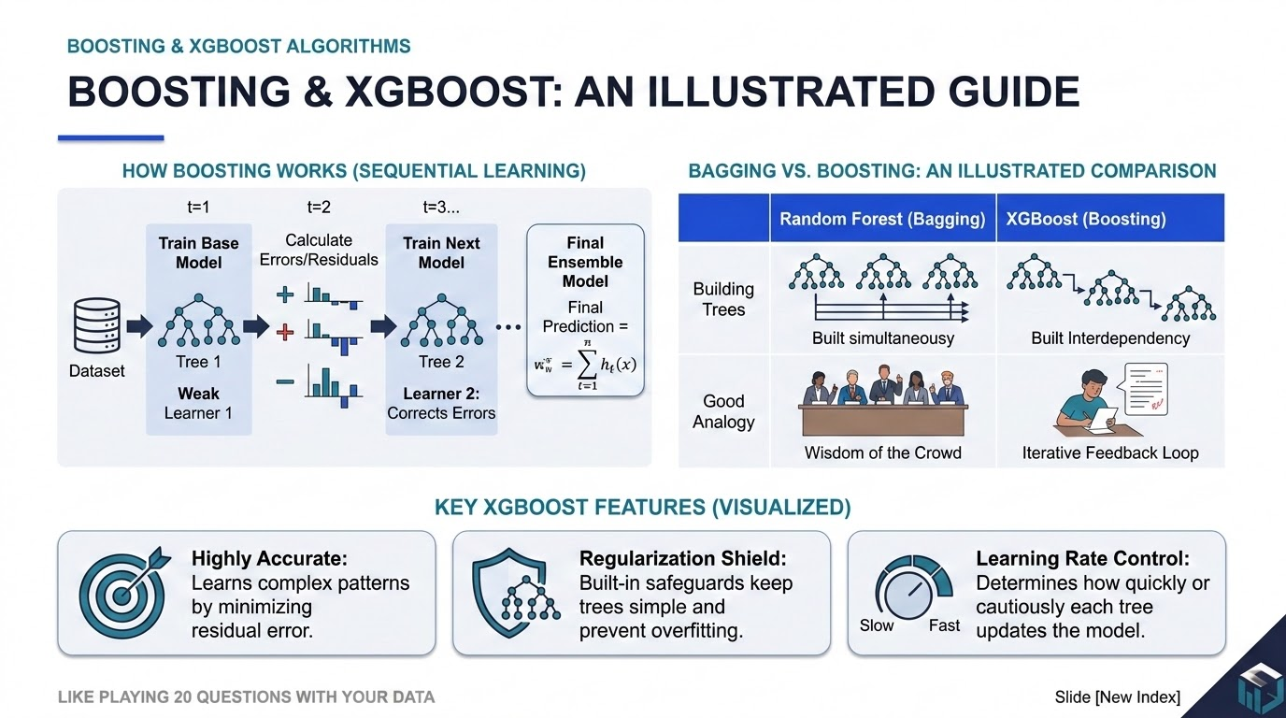

Slide 16
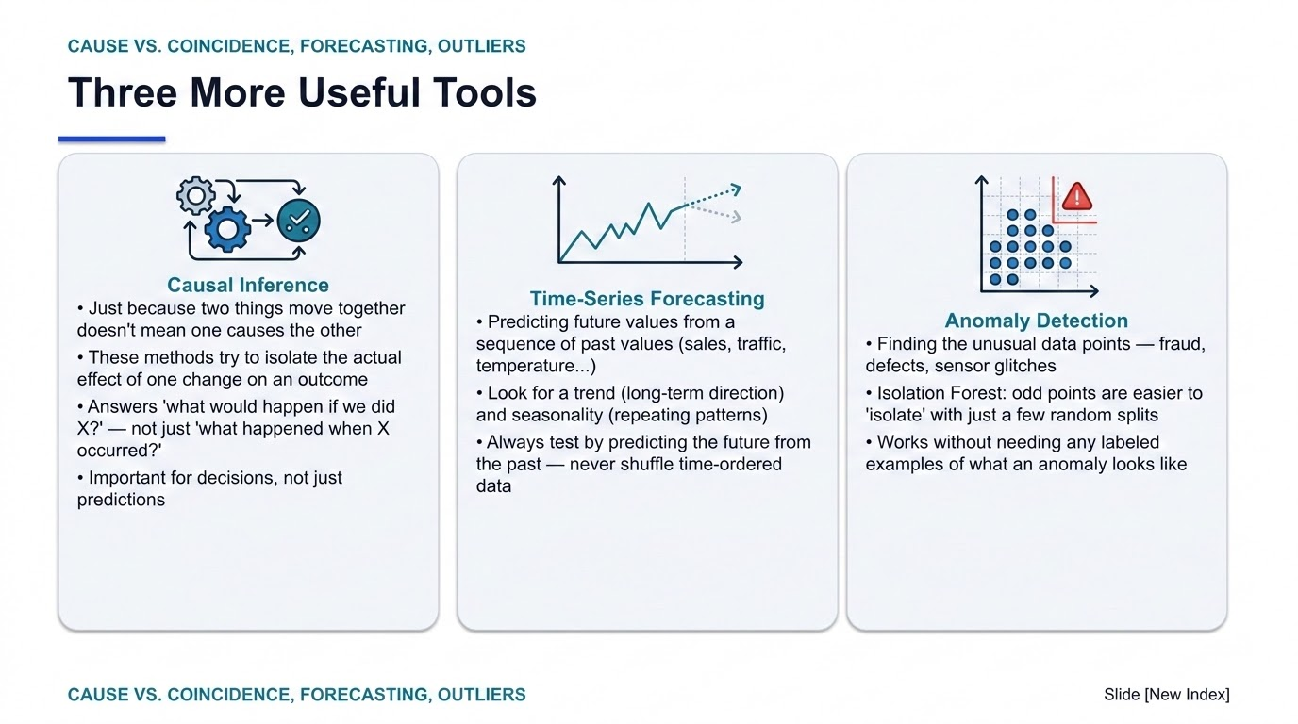

Slide 17
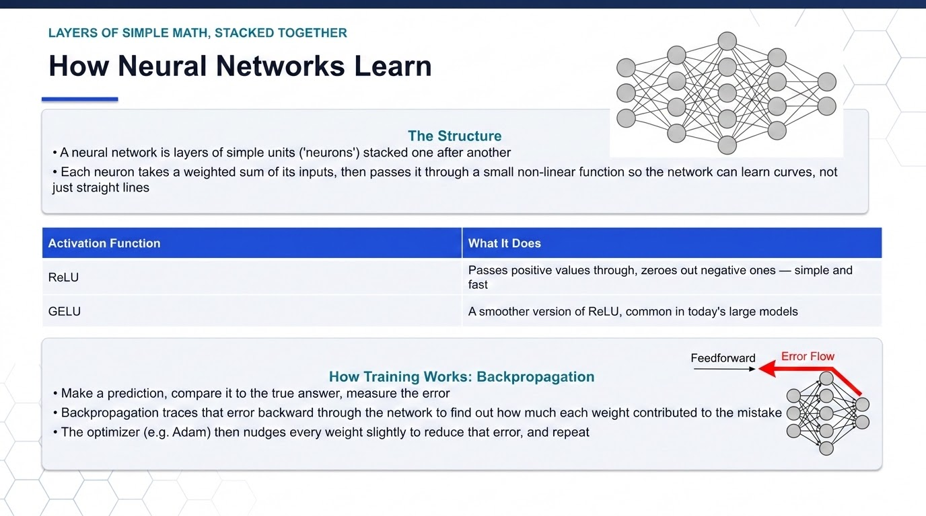

Slide 18
THE IDEA BEHIND CHATGPT
Attention & Transformers
Attention(Q,K,V) = softmax(QKᵀ/√dₖ) V
Formal version — every word looks at every other word and decides how relevant it is
In Plain Words
• Every word in a sentence 'looks around' at all the other words
• It decides which other words are most relevant to understanding it right now
• Example: in "the animal didn't cross the street because it was tired", attention helps the model figure out 'it' means the animal, not the street
• The model then blends information from the relevant words to build understanding
Why This Was a Big Deal
• Older models read text one word at a time, in order — slow, and easy to 'forget' earlier words
• Attention lets a model look at the whole sentence at once, in parallel — much faster to train
• This is the core building block inside GPT, BERT, and most modern language models
Notes:
This is the mechanism behind today's large language models, so it's worth spending real time on the intuition before showing the formula. The core idea: for every word, compute how much it should 'pay attention to' every other word, then combine information accordingly. The formula is just the precise, matrix version of that same idea — show it, but don't dwell on the linear algebra with a beginner audience.

Slide 19
BIAS-VARIANCE, PRECISION & RECALL
Is the Model Actually Good?
Too Simple vs. Too Complicated
• Underfitting (high bias): e.g. fitting a straight line to data that actually curves like a parabola
• Overfitting (high variance): the model memorized noise instead of the real pattern
• The goal is the sweet spot in between — check this by testing on data the model never saw
Metric | The Question It Answers
Precision | Of everything I flagged as 'yes', how much was right?
Recall | Of everything that was actually 'yes', how much did I catch?
F1 | A single score balancing precision and recall
Picking the Right Metric
• Example: spam filter — missing a spam email (low recall) is annoying but a false alarm blocking a real email (low precision) may be worse
• There's no universally 'best' metric — pick the one that matches what mistakes actually cost your business
• Accuracy alone can be misleading when one class is much rarer than the other
Notes:
The two failure modes to teach clearly: underfitting (model too dumb) and overfitting (model too good at memorizing training data, bad at new data). For classification metrics, use a concrete relatable example (spam filter, medical test) to make precision vs. recall stick — the tradeoff between 'catching everything' and 'not crying wolf' is intuitive once grounded in a real scenario.

Slide 20
WHICH TOOL DO I REACH FOR?
Putting It All Together
If your problem looks like... | A good starting point is...
Small/medium data, need to explain the result | Linear/Logistic Regression, a single Decision Tree
Tabular data, want the best accuracy | Random Forest or XGBoost
Small dataset with a clear separation between groups | SVM
Quick baseline, small dataset | k-NN
Images or grid-like data | Deep learning (CNNs)
Text or sequences | Transformers (attention-based)
'What happens if we change X?' questions | Causal inference
Finding rare/unusual events | Isolation Forest (anomaly detection)
Notes:
Closing slide: there's no single 'best' algorithm — the right choice depends on your data size, whether you need to explain the model, and what kind of data you have (tabular, image, text). Encourage students to start simple (a regression or a single tree) and only reach for something more complex once a simple baseline stops being good enough.

