Slide 1

Validating What You Built
Diagnostics for Regression, Classification, Trees & Clustering
BDA POP — SESSION 09/01/2026

Slide 2
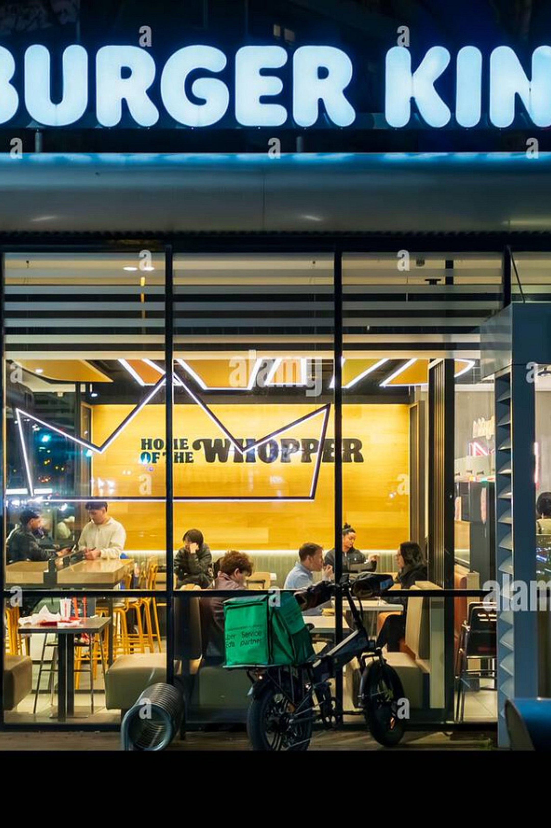


Why Validation Is Not Optional at Scale
At Zomato- or Swiggy-scale, a model doesn't get to be "probably fine."
Revenue Forecasting
A model 20% off skews marketing budgets across hundreds of cities.
Delivery Classifier
Failures on unseen restaurants break service commitments — and customer trust rarely recovers.
The Rule
Every production model is validated twice: against a threshold, then against unseen data.

Slide 3
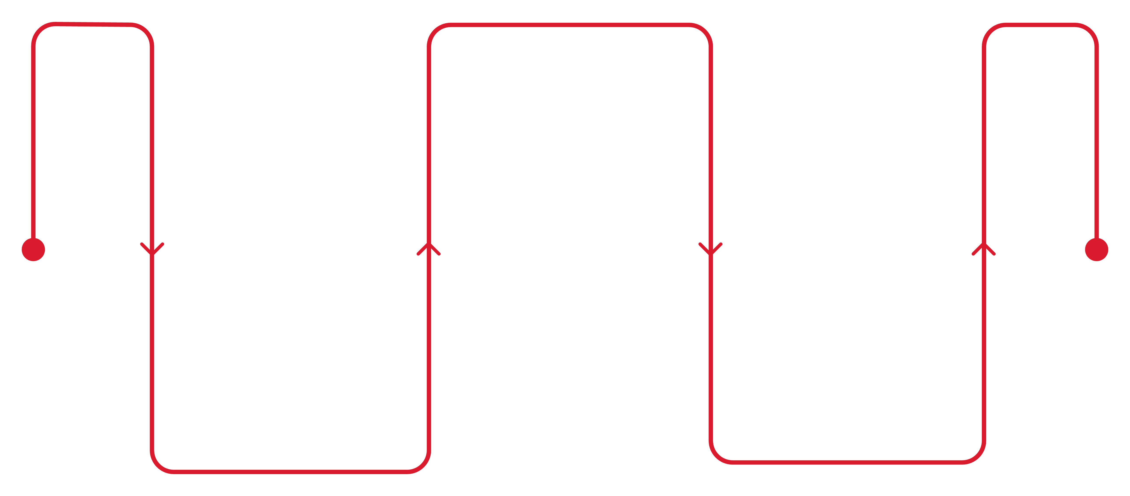
The Protocol, in One Line
Fit it, score it against a holdout set the model never saw, and evaluate against a stated threshold.
A metric with no threshold is an opinion; a metric with a threshold is a decision.
Score Holdout
Compute metrics on unseen data
Evaluate Threshold
Fit Model
Train on development data
Compare metric to stated cutoff

Slide 4
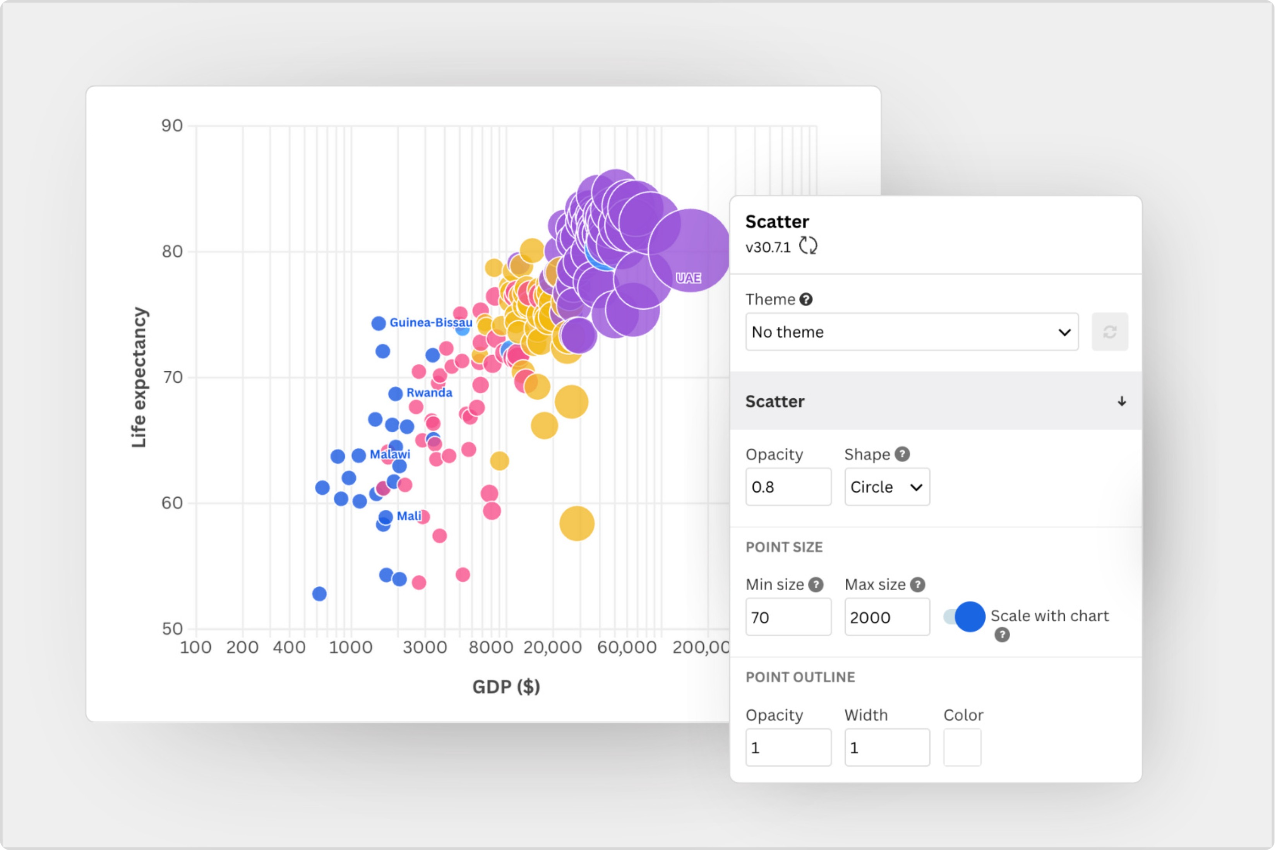

Linear Regression — Predicting Restaurant Revenue
Model Setup
Features: distance_center_km, votes — 30% holdout.
Results
: 0.84 ≥ 0.60 ✅
RMSE: ~17% of mean ≤ 20% ✅
Residuals scatter randomly — no funnel, no curve.

Slide 5
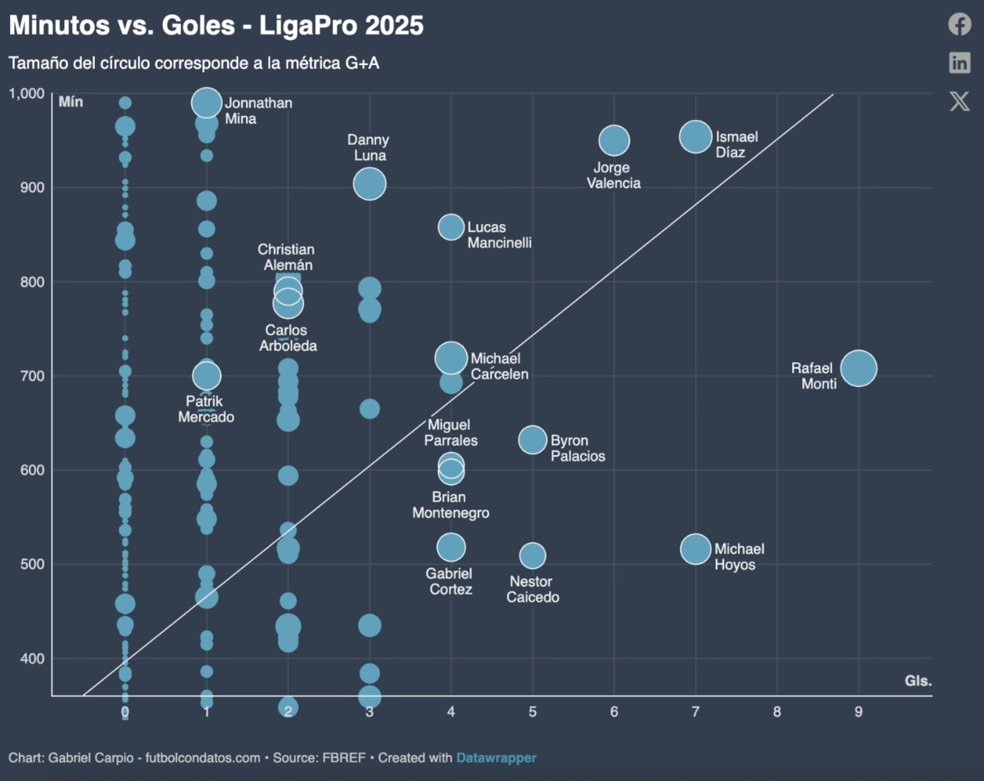
Logistic Regression — Predicting Delivery Availability
The Trap
Headline metrics clear the bar — but the confusion matrix reveals a deeper problem.
Holdout AUC: 0.77 (≥ 0.70) ✅
Holdout Accuracy: 73% (≥ 70%) ✅
Recall, "no delivery" class: ~20% (≥ 50%) 🚩
The model defaults to predicting "yes, delivery." Any staffing decision built on this would severely under-plan for offline-only locations — a miss headline metrics never surface.

Slide 6
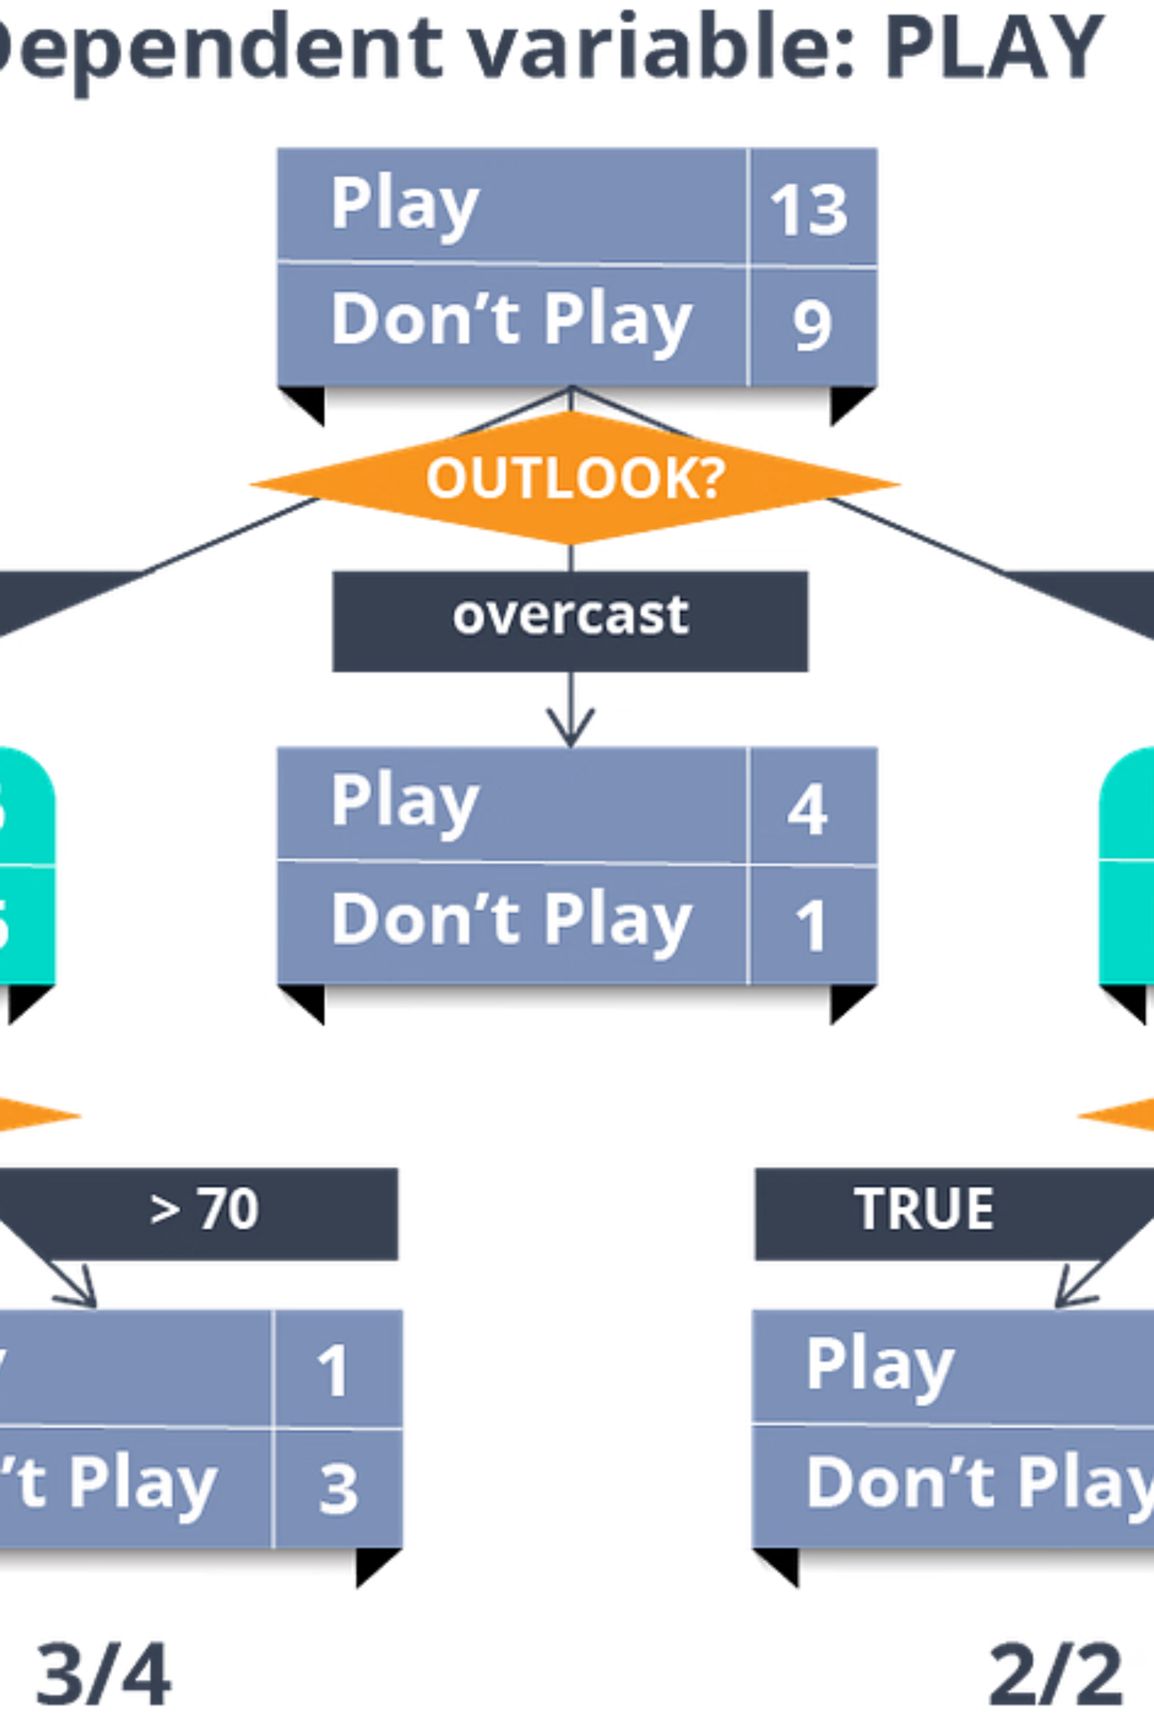
Decision Tree — The Diagnostic Catching a Real Problem
An unconstrained tree on weak-signal predictors hits 100% training accuracy — then collapses to 40% holdout accuracy, worse than chance.
Unpruned
Train–holdout gap: ~60 pts 🚩
Pure memorization.
Pruned
Train–holdout gap: ~6 pts ✅
Collapsed to a single split.

Slide 7


Decision Tree — The Real Lesson
What Diagnostics Did
Caught overfitting — flagged false confidence before shipping.
Revealed weak features — these predictors carry little signal for price tier.
Directed the fix — find better features, not a fancier model.

Slide 8
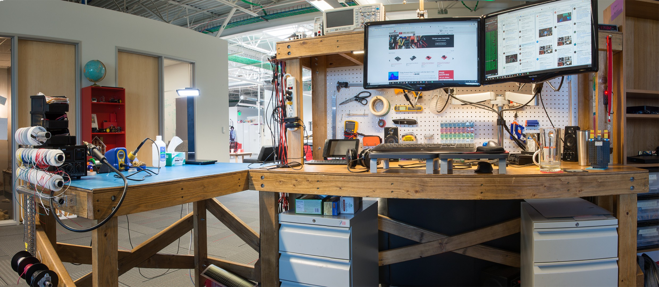

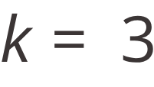
k-Means Clustering — Restaurant Segments
No Holdout Labels — So What Now?
Test values 2–5 and compare silhouette scores.
Best , silhouette = 0.42
"Clearly separated" threshold: ≥ 0.50 🚩
Cost and rating alone produce overlapping clusters — real but fuzzy. A starting point for judgment, not a hard rule.

Slide 9
The Second Engine: Database Aggregate Functions
Everything above ran in R, in memory. In production, the same evaluate step runs as an aggregate query against the platform's database.
Same Grammar
Same Protocol
Consistent Findings
group_by() / summarise() pushes to live SQL with no code changes.
Linear model errors and delivery rates as grouped aggregates confirm stability across both engines.
Delivery rate climbs from Budget (40%) to Luxury (88%) — matching logistic regression in one query.

Slide 10

Summary: Every Model, One Glance
Model | Metric | Value | Threshold | Status
Linear Regression | Holdout R^2 | 0.84 | ≥ 0.60 | Pass
Linear Regression | Holdout RMSE (% mean) | ~17% | ≤ 20% | Pass
Logistic Regression | Holdout AUC | 0.77 | ≥ 0.70 | Pass
Logistic Regression | Recall, "no delivery" | ~20% | ≥ 50% | Flagged
Decision Tree (unpruned) | Train–holdout gap | ~60 pts | ≤ 15 pts | Flagged
Decision Tree (pruned) | Train–holdout gap | ~6 pts | ≤ 15 pts | Pass
k-Means (k=3) | Avg. silhouette | 0.42 | ≥ 0.50 | Flagged
3 of 7 checks flagged. A model can pass its headline metric and still fail a component check that matters more to the business — the case for running diagnostics on every model.

