Slide 1


BIG DATA ANALYTICS — PROGRAM OF PRACTICE
Validating Big Data Models at Scale
A hybrid diagnostic framework — R for statistical rigor, SQL for in-database scale
Regression · Classification · Clustering
BDA POP — Hybrid Model Validation (R + SQL)
1 / 10
Notes:
This session is about one idea: validation isn't optional at big-data scale, and it doesn't have to live in one tool. We diagnose in R because that's where the statistical depth lives, then push the scoring step into SQL because that's where the row counts live. By the end of this deck you'll have a repeatable pattern for regression, classification, and clustering diagnostics that works whether you're validating on a laptop or a live warehouse table.

Slide 2

EXECUTIVE SUMMARY
The Hybrid Architecture: R + SQL
R diagnoses
Residuals, ROC curves, silhouette — the statistical depth SQL can't express.
MODEL VALIDATION PIPELINE
SQL scales
Window functions and aggregates score millions of rows in place.
R — Diagnose
SQL — Score
Fit · Residuals · ROC
Window fns · Aggregates
One protocol
Fit, score, evaluate against a threshold — every model, either engine.
coefficients / centroids move — not the data
Rule of thumb: prototype and diagnose on a sample in R; once the metric and threshold are set, run the evaluate step as a query against the full table.
BDA POP — Hybrid Model Validation (R + SQL)
2 / 10
Notes:
This is the mental model for the whole deck: R and SQL aren't competing tools, they're two stages of the same pipeline. You diagnose where the statistical libraries live, then you deploy the scoring logic to where the data already sits, so you never pull a billion-row table into memory just to compute an average.

Slide 3

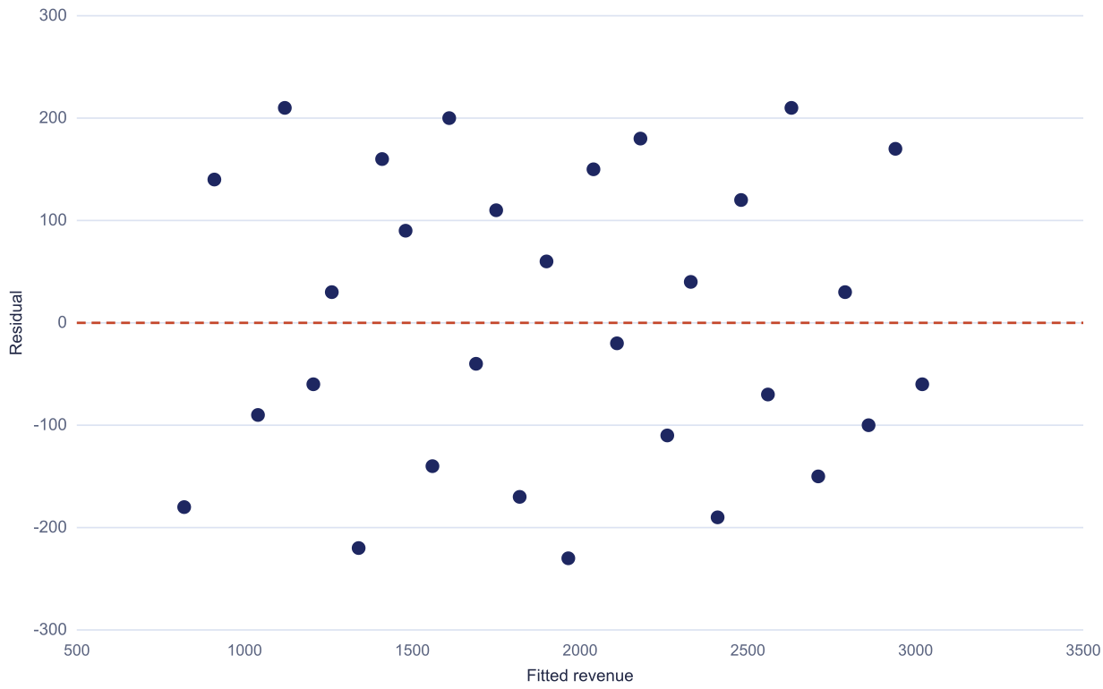
LINEAR REGRESSION
Diagnostic Framework & Key Metrics
R² and Adjusted R²
Share of variance the model actually explains.
RESIDUALS vs. FITTED VALUES
RMSE
Typical error, in the same units as the target.
Residual plot
No funnel, no curve — errors scatter randomly around zero.
HOLDOUT R²
HOLDOUT RMSE
0.84
≥ 0.60
17%
≤ 20% mean
No pattern in the scatter = model isn't missing a trend
BDA POP — Hybrid Model Validation (R + SQL)
3 / 10
Notes:
R² tells you the headline story, but it can't tell you whether the model is systematically wrong somewhere specific — only the residual plot can. Here the scatter is flat and random around zero across the whole range, which is exactly what a well-specified model looks like. A curved or funnel-shaped residual plot would be the red flag, even with a great R².

Slide 4

LINEAR REGRESSION
In-Database SQL Scaling
Score in place
SQL
Predictions land in the warehouse, not in R's memory.
WITH scored AS (
SELECT
actual_revenue,
predicted_revenue,
actual_revenue - predicted_revenue
AS residual,
AVG(actual_revenue) OVER ()
AS mean_actual
FROM model_scores
)
SELECT
1 - SUM(POWER(residual, 2))
/ SUM(POWER(actual_revenue
- mean_actual, 2)) AS r_squared,
SQRT(AVG(POWER(residual, 2)))
AS rmse
FROM scored;
Window functions
AVG() OVER() computes the mean without a second pass.
One query, full table
R² and RMSE recomputed on every row, on a schedule.
Why this matters: the R model only supplies coefficients — scoring millions of restaurants never has to leave the database.
BDA POP — Hybrid Model Validation (R + SQL)
4 / 10
Notes:
This is the exact same R² and RMSE definition from the last slide, just expressed as one aggregate query. The window function computes the grand mean in the same pass as everything else, so the whole evaluate step is a single scan of the table — no row-by-row loop, no pulling data out to R.

Slide 5


CLASSIFICATION
Diagnostic Framework & Confusion Matrices
Precision
Of the positive calls, how many were right.
HOLDOUT CONFUSION MATRIX (n = 2,000)
 | Predicted: Positive | Predicted: Negative
Actual: Positive | 612 True Positive | 188 False Negative
Actual: Negative | 95 False Positive | 1,105 True Negative
Recall
Of the true positives, how many got caught.
F1 score
Harmonic mean — punishes a weak side, either side.
Precision 86.6% · Recall 76.5% · F1 81.2%
Accuracy alone (86%) looked fine — the matrix is what caught the recall gap.
BDA POP — Hybrid Model Validation (R + SQL)
5 / 10
Notes:
Accuracy and AUC both look healthy on their own, and that's exactly the trap a headline metric sets. The matrix breaks the same result into four numbers, and here the false-negative cell is the one that matters most — it tells you which real cases the model is quietly missing, something no single summary number can show you.

Slide 6
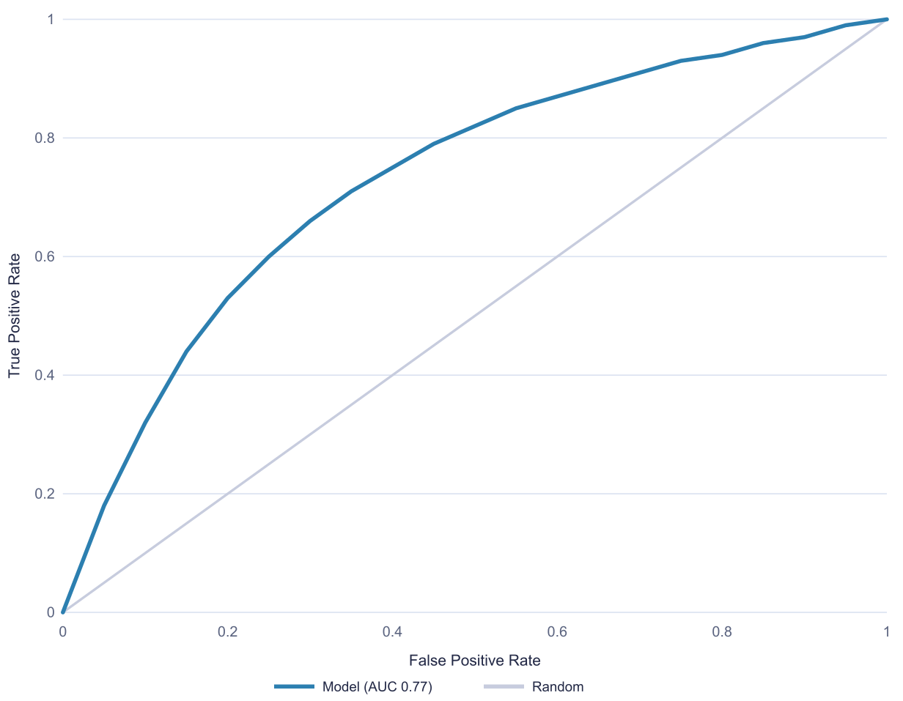
CLASSIFICATION
Advanced Evaluation & R ROC Curves
AUC
ROC CURVE — HOLDOUT SET
Separability across every possible cutoff, not just one.
TPR vs. FPR
Plotted at each threshold to trace the ROC curve.
Above the diagonal
Distance from the diagonal is real signal.
R
roc_obj <- roc(holdout$actual,
holdout$pred_prob)
plot(roc_obj, print.auc = TRUE,
col = "#2C7FB0", lwd = 2)
BDA POP — Hybrid Model Validation (R + SQL)
6 / 10
Notes:
The curve bows well above the diagonal, which is the visual version of an AUC comfortably above 0.5 — a random classifier would trace that dashed diagonal line exactly. This is the same holdout set from the confusion matrix slide; AUC and the matrix are two independent checks on the same model, and both need to pass.

Slide 7

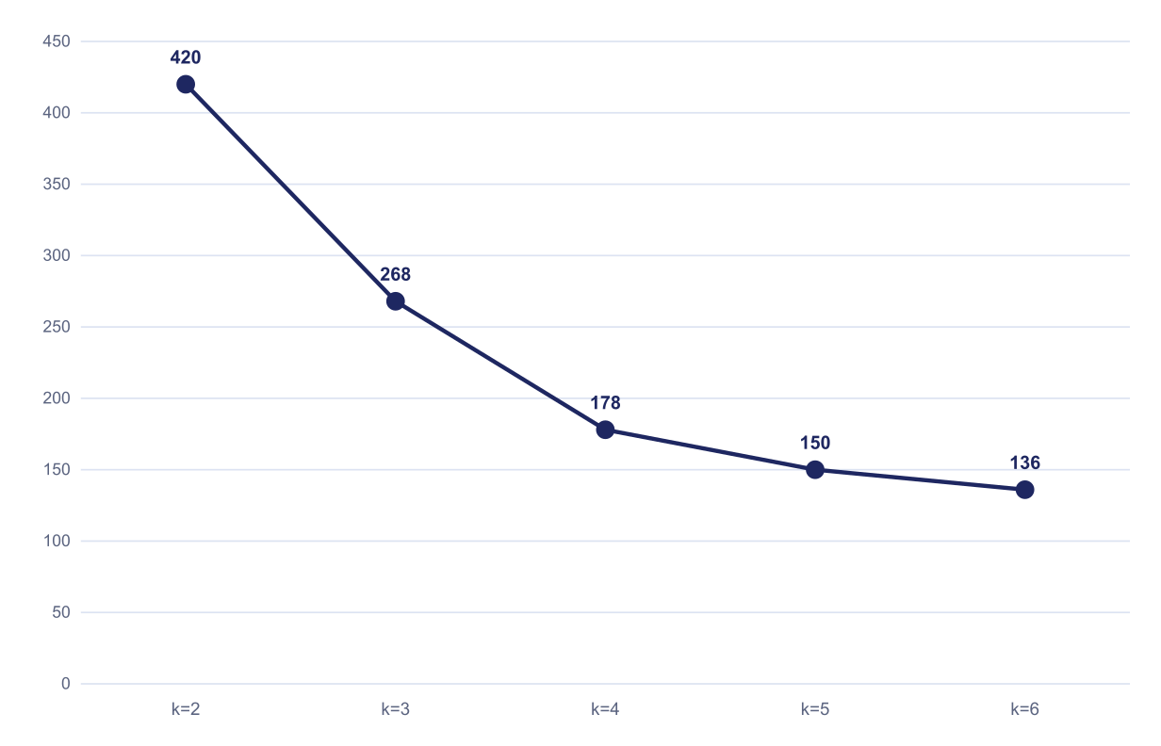

UNSUPERVISED CLUSTERING
Validation Framework: WCSS vs. BCSS
WCSS
Within-cluster spread — smaller means tighter clusters.
WCSS BY CLUSTER COUNT (ELBOW)
BCSS
Between-cluster spread — bigger means cleaner separation.
Silhouette score
Combines both into one −1 to 1 verdict per point.
SILHOUETTE, BEST k (k = 3)
elbow ≈ k=3
0.42
≥ 0.50 target
Diminishing returns past k=3 — but silhouette says the segments still overlap.
BDA POP — Hybrid Model Validation (R + SQL)
7 / 10
Notes:
The elbow chart and the silhouette score are answering two different questions. The elbow says three clusters is where adding more stops paying off in tightness. Silhouette says even at three, points aren't cleanly closer to their own cluster than the next one — 0.42 against a 0.50 bar. Both checks matter before you build a plan on top of the segments.

Slide 8
UNSUPERVISED CLUSTERING
In-Database Centroid Distance
Centroids as a lookup
SQL
A handful of rows — cheap to join against.
WITH distances AS (
SELECT
r.restaurant_id, c.cluster_id,
SQRT(
POWER(r.cost_scaled
- c.cost_centroid, 2) +
POWER(r.rating_scaled
- c.rating_centroid, 2)
) AS dist,
ROW_NUMBER() OVER (
PARTITION BY r.restaurant_id
ORDER BY dist
) AS rn
FROM restaurants r
CROSS JOIN centroids c
)
SELECT restaurant_id, cluster_id,
dist AS wcss_contribution
FROM distances WHERE rn = 1;
CROSS JOIN + window
Every row compared to every centroid, ranked.
ROW_NUMBER() = 1
Nearest centroid, and its distance, in one pass.
Why this matters: WCSS for millions of rows becomes one grouped SUM() over this same result set.
BDA POP — Hybrid Model Validation (R + SQL)
8 / 10
Notes:
Centroids are tiny — three or four rows — so the cross join stays cheap even at scale; it's the row count on the restaurants side that would kill this in R's memory. ROW_NUMBER over the ranked distances picks each row's nearest centroid, and summing that distance column grouped by cluster reproduces WCSS as a single aggregate query.

Slide 9


ARCHITECTURE GUARDRAILS
Big Data Diagnostics Best Practices
Threshold governance
Drift monitoring
Set the bar before scoring — a metric with no threshold is an opinion.
Recompute R² and AUC on a rolling holdout, on a schedule.
Compute placement
Reproducibility
Diagnose in R, score in SQL — move the model, not the data.
Version coefficients and thresholds together, same as code.
BDA POP — Hybrid Model Validation (R + SQL)
9 / 10
Notes:
These four guardrails are what keep the hybrid pattern from drifting apart in production: agree on thresholds up front, re-check them on a schedule rather than once at launch, keep the heavy compute where the data already lives, and version the model artifact the same way you'd version code.

Slide 10
CONCLUSION
Next Steps
1
Adopt fit → score → evaluate for every model, every time
2
Prototype diagnostics in R, then push scoring into SQL
3
Re-run every metric on a live holdout, not once at launch
Questions?
BDA POP — Hybrid Model Validation (R + SQL)
10 / 10
Notes:
The takeaway to leave the room with: R and SQL aren't a choice you make once — they're two stages every model passes through, diagnose then deploy. Bring a model of your own next session and we'll run this exact protocol on it live. Happy to take questions now.

