Slide 1


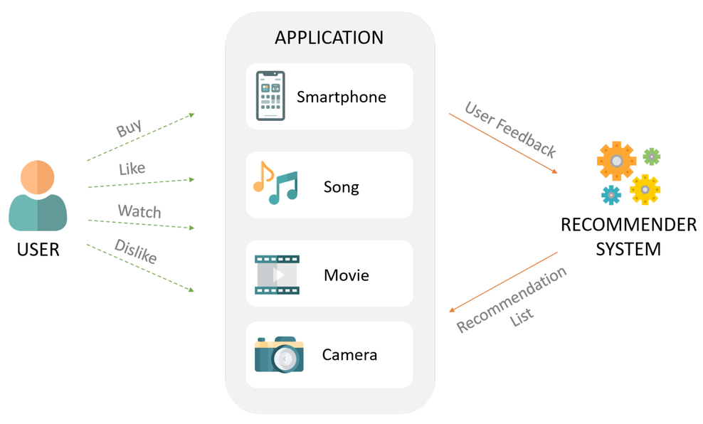
Music Recommendation System
AU1940034 Varun Deliwala
AU1940142 Shail Patel
AU1940267 Sahil Miskeen
GAN-Jedis

Slide 2
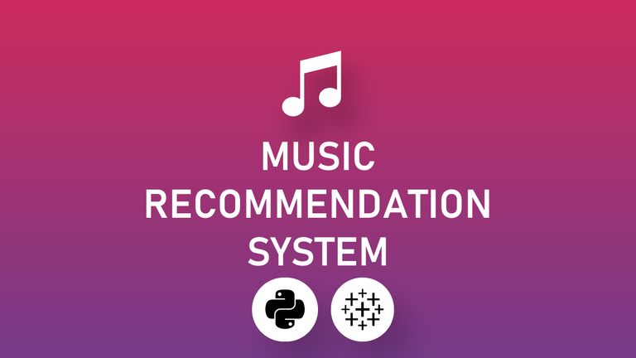
INTRODUCTION
The number of hours an average person spends on listening to music, be it while working or studying or during one’s leisure time, is substantially increasing day by day. With the increase of user base on applications like spotify, it often becomes difficult to discover new music that matches one’s interests. So, the main aim of the project here is to identify the best solutions for music recommendation.
HTTPS://TOWARDSDATASCIENCE.COM/CREATE-MUSIC-RECOMMENDATION-SYSTEM-USING-PYTHON-CE5401317159

Slide 3

Problem Statement
To use K Nearest Neighbors to provide the user with recommendation of songs based on what the user has been listening to in the past. This is a supervised learning problem where the input will be the previous songs and the output will be the recommended songs. This will be a personalized user experience differing from user to user.

Slide 4
EXISTING BODY OF WORK
The approches taken till now for music recommendation systems are based on deep neural networks. These deep neural networks work on the basis of content based filtering taking into account different variables like the past listening history of the user, listening time of various genres etc. (1)
Logistic regression has been applied to build a recommendation system. This takes into account the listening history of the user and predicts whether or not the user will like another song or not. Howevr this is a very strict recommendation system and the results are quite poor. (2)
KNN is another ML algorithm which allows the recommendation system to make a comparison between K different songs and predict the next closest neighbor which corresponds to the song and gives us that song as a recommended song.
https://www.frontiersin.org/articles/10.3389/fams.2019.00044/full
https://www.researchgate.net/publication/336162555_A_Music_Recommendation_System_Based_on_logistic_regression_and_eXtreme_Gradient_Boosting

Slide 5
APPROACH
Visualization of the variables and relation between them
Understood the variables which we will be working with. (needs domain knowledge) and performing preprocessing on data
Removing the highly correlated variables to reduce redundancy of the dataset

Slide 6
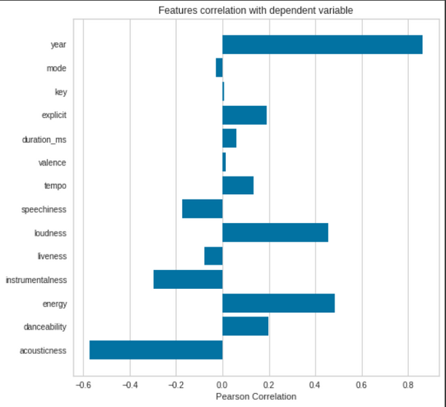
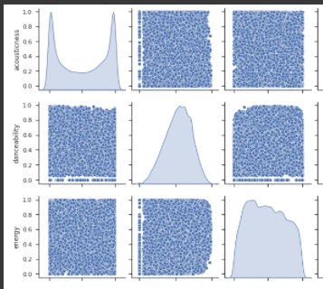
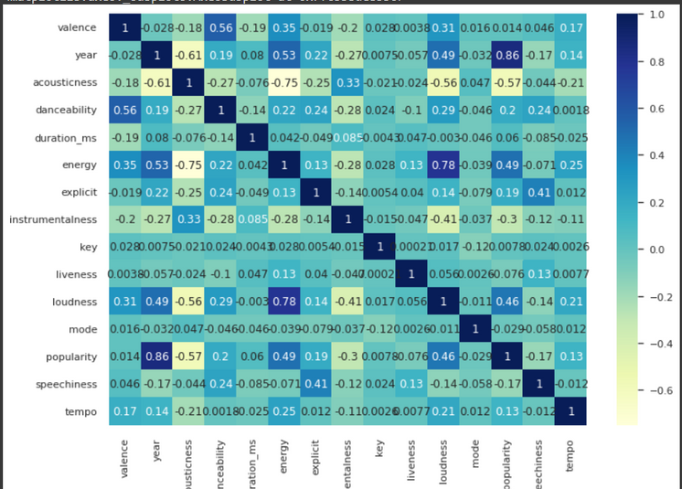
RESULTS AND ANALYSIS
Capturing non linear relations between the
variables
Depicting the correlation between variables
and the variable named "popularity" from the dataset
Understanding the correlation between variables and remove the dependent variables

Slide 7
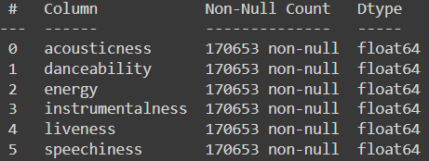
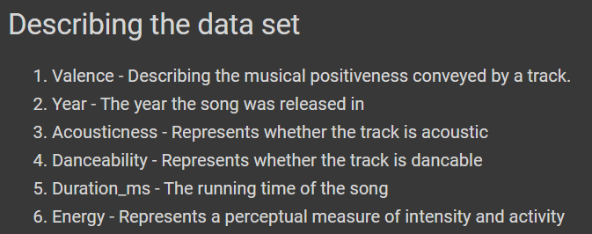
The type of variables we will be working with
Description of the variables

Slide 8
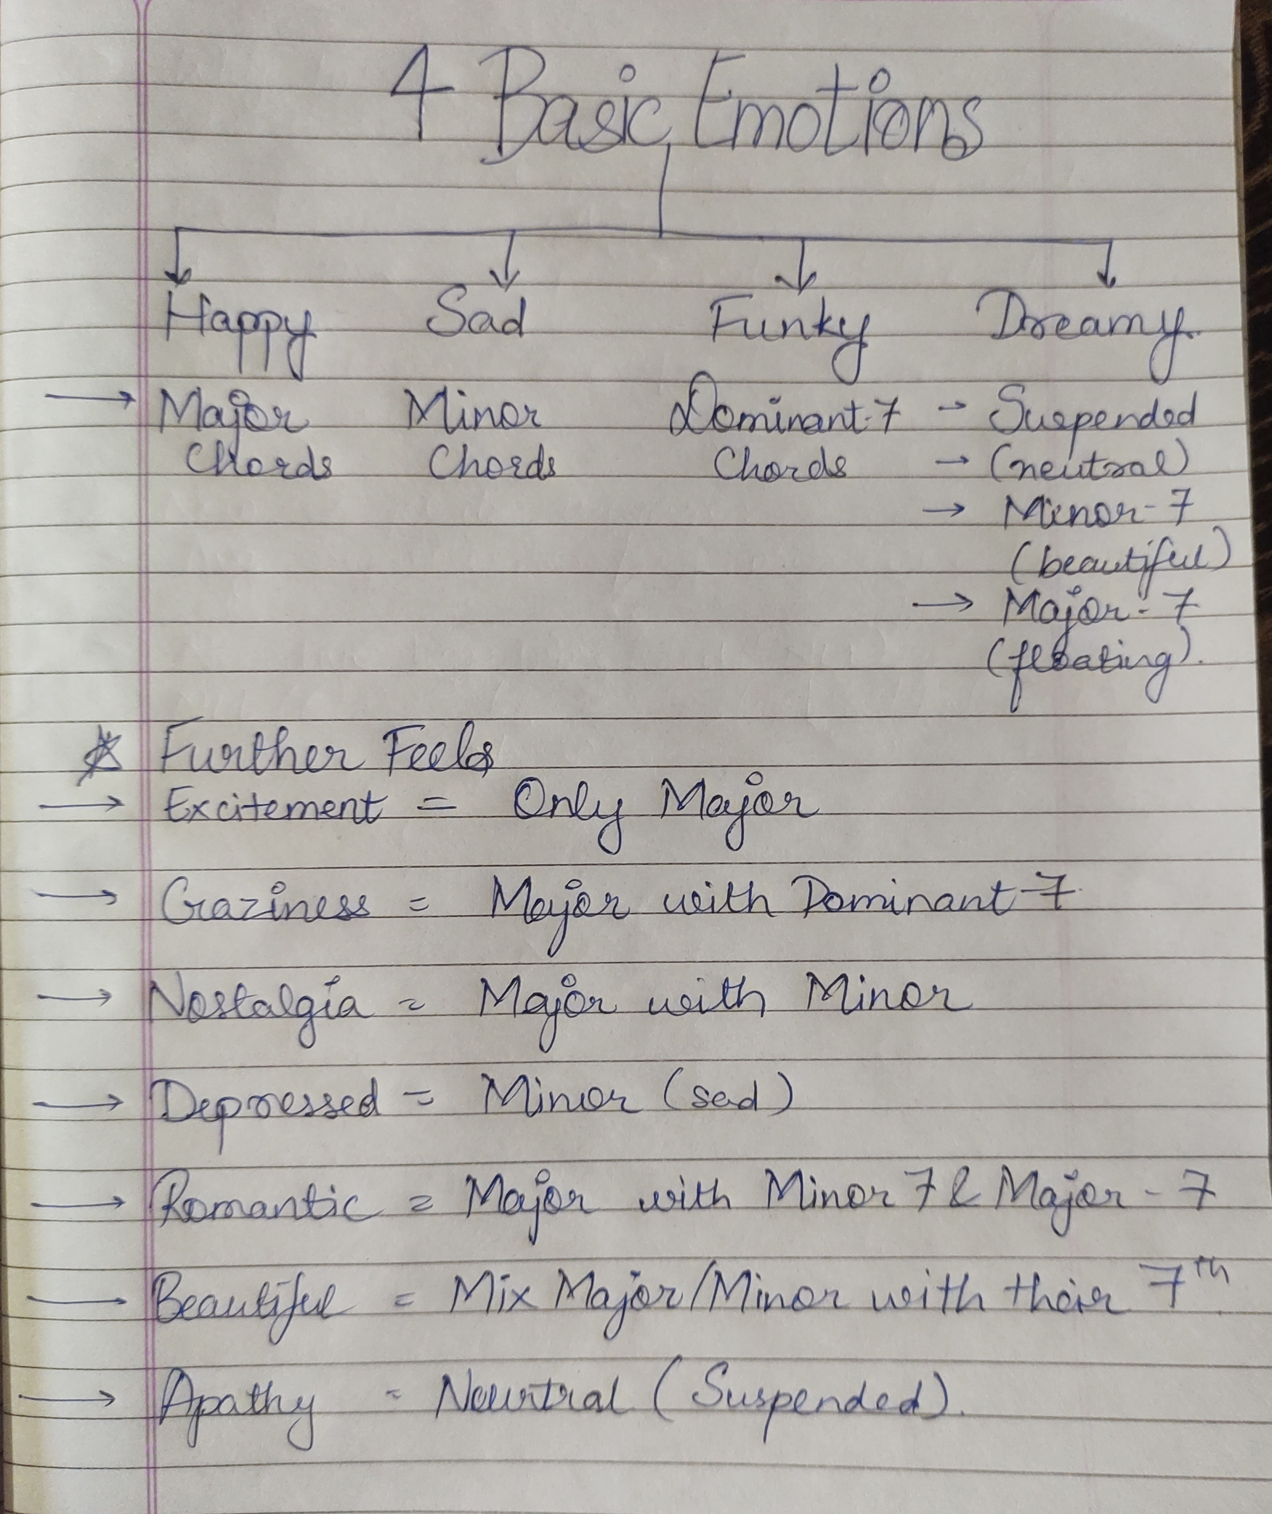
RESULTS
Trying to find a relation between the variables we are working with and what chords causes that variables to change. This would be able to give us a deeper understanding as what drives what variables and we would be able to pick up the variables which matter the most to us.

Slide 9
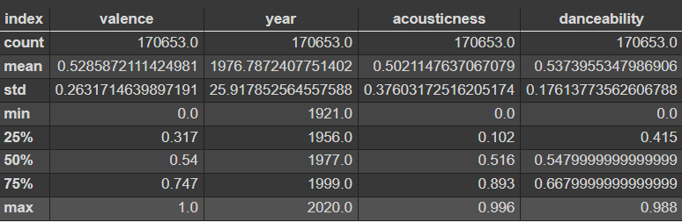
RESULTS
Understanding the spread of the data for all variables
to know which variables we need to scale down. We will
be using standard scaler in order to scale down the
variables.

Slide 10
CONTRIBUTION OF EACH MEMBER
Varun Deliwala
Picked up the dataset, decided about how the final design should look like. Looking up for dimensionality reduction techniques that best work with this dataset.
Sahil Miskeen
Understanding the variables and how much each variable affects the song (has experience in music). Looking up for dimensionality reduction techniques that best work with this dataset.
Shail Patel
Preprocessing on the dataset, working with the code. Visualizations and planning future tasks.

Slide 11

Future Work
Finding the best dimensionality reduction techniques in order to work with our dataset.
Further on from now we will be starting to work with KNN and prepare the final model.
Choosing the optimal value of K will be the success of our recommendation system. Designing how we will be able to give this service to users.
Make a simple service in which the user is required to enter the credentials of his/her Spotify account and the recommendations would be made.

Slide 12

References
https://pandas.pydata.org/
https://scikit-learn.org/stable/
https://kaggle.com
https://towardsdatascience.com/prototyping-a-recommender-system-step-by-step-part-1-knn-item-based-collaborative-filtering-637969614ea
https://www.frontiersin.org/articles/10.3389/fams.2019.00044/full
https://www.researchgate.net/publication/336162555_A_Music_Recommendation_System_Based_on_logistic_regression_and_eXtreme_Gradient_Boosting

