Slide 1
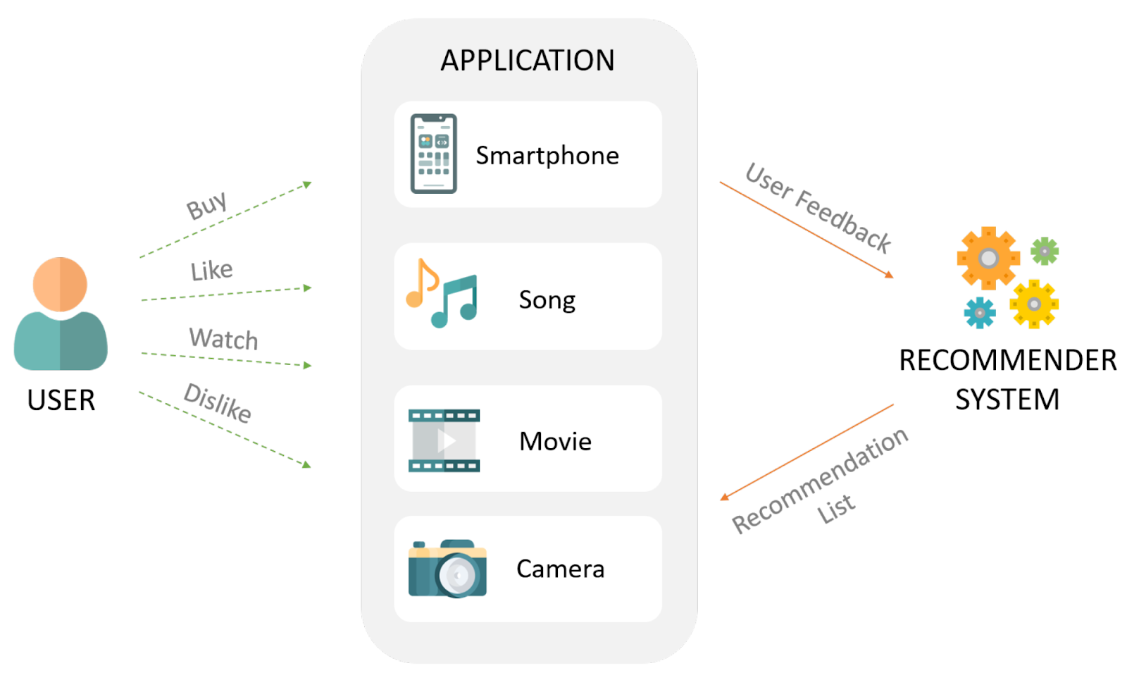
Music-Recommendation System
Gan-Jedis
By,
AU1940142 – Shail Patel
AU1940267 – Sahil Miskeen
AU1940034 – Varun Deliwala

Slide 2

Introduction
The number of hours an average person spends on listening to music, be it while working or studying or during one’s leisure time, is substantially increasing day by day. With the increase of user base on applications like Spotify, it often becomes difficult to discover new music that matches one’s interests. So, the main aim of the project here is to identify the best solutions for music recommendation.

Slide 3

Problem Statement
To use K Nearest Neighbors to provide the user with recommendation of songs based on what the user has been listening to in the past. This is a supervised learning problem where the input will be the previous songs and the output will be the recommended songs. This will be a personalized user experience differing from user to user.

Slide 4
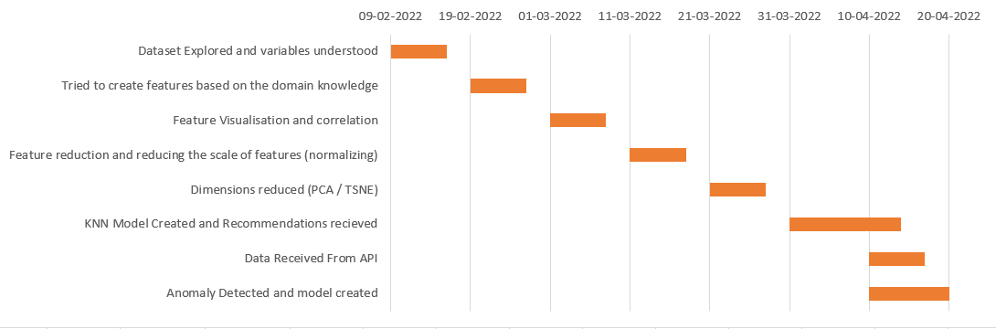
Gantt Chart

Slide 5
Existing Body of Work
The approaches taken till now for music recommendation systems are based on deep neural networks. These deep neural networks work on the basis of content based filtering taking into account different variables like the past listening history of the user, listening time of various genres etc. (1).
Logistic regression has been applied to build a recommendation system. This takes into account the listening history of the user and predicts whether or not the user will like another song or not. However this is a very strict recommendation system and the results are quite poor (2).
KNN is another ML algorithm which allows the recommendation system to make a comparison between K different songs and predict the next closest neighbor which corresponds to the song and gives us that song as a recommended song.
1.https://www.frontiersin.org/articles/10.3389/fams.2019.00044/full
2.https://www.researchgate.net/publication/336162555_A_Music_Recommendation_System_Based_on_logistic_regression_and_eXtreme_Gradient_Boosting

Slide 6
Approach
We started with performing analysis of the data available (spread, missing values, correlation etc.)
After having performed EDA - removing the highly correlated variables - feature engineering - new feature (intensity)
Reduce dimensionality - PCA and TSNE (on genre_dataset)
Baseline KNN model K = 10
Developed Spotify system to get the songs data (the features attributed to the songs)
We then moved to recommendation of songs based on the songs provided by the user.
We observed an interesting thing where in we tried to recommend songs with the year mentioned and without the year mentioned.
We created 2 models for the same.
1 - considering the year
2 - without considering the year

Slide 7
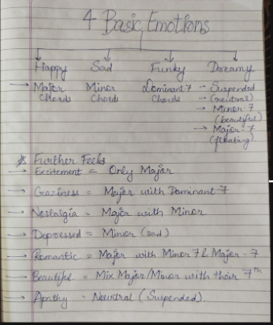
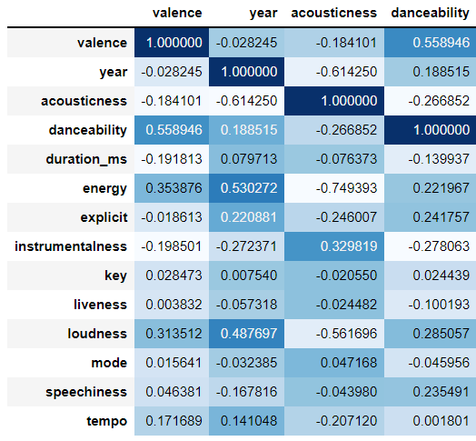
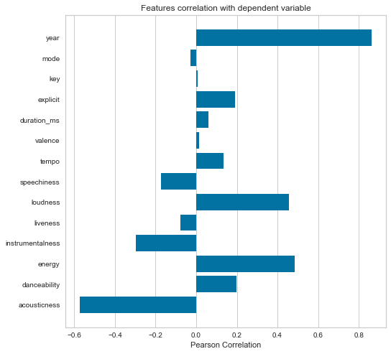
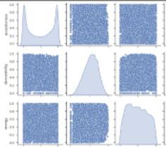
Results

Slide 8
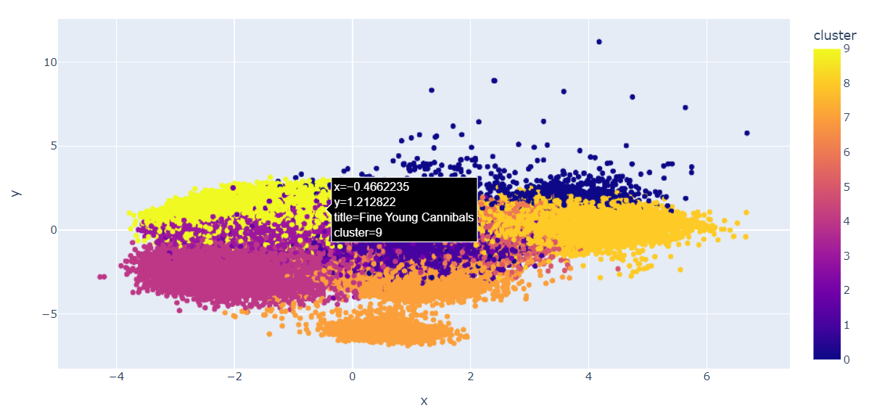
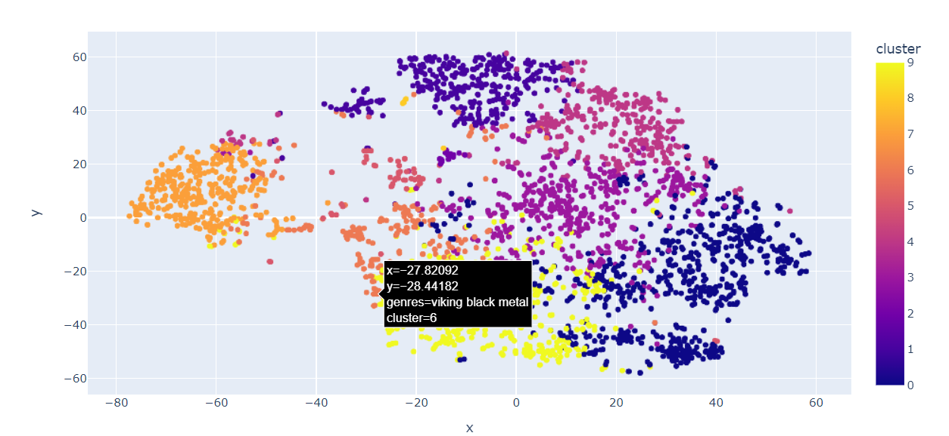
Results
TSNE performed on the genre of the songs. Total Clusters = 10
TSNE performed on the genre of the songs. Total Clusters = 10
Connects songs with genres which help in better prediction

Slide 9
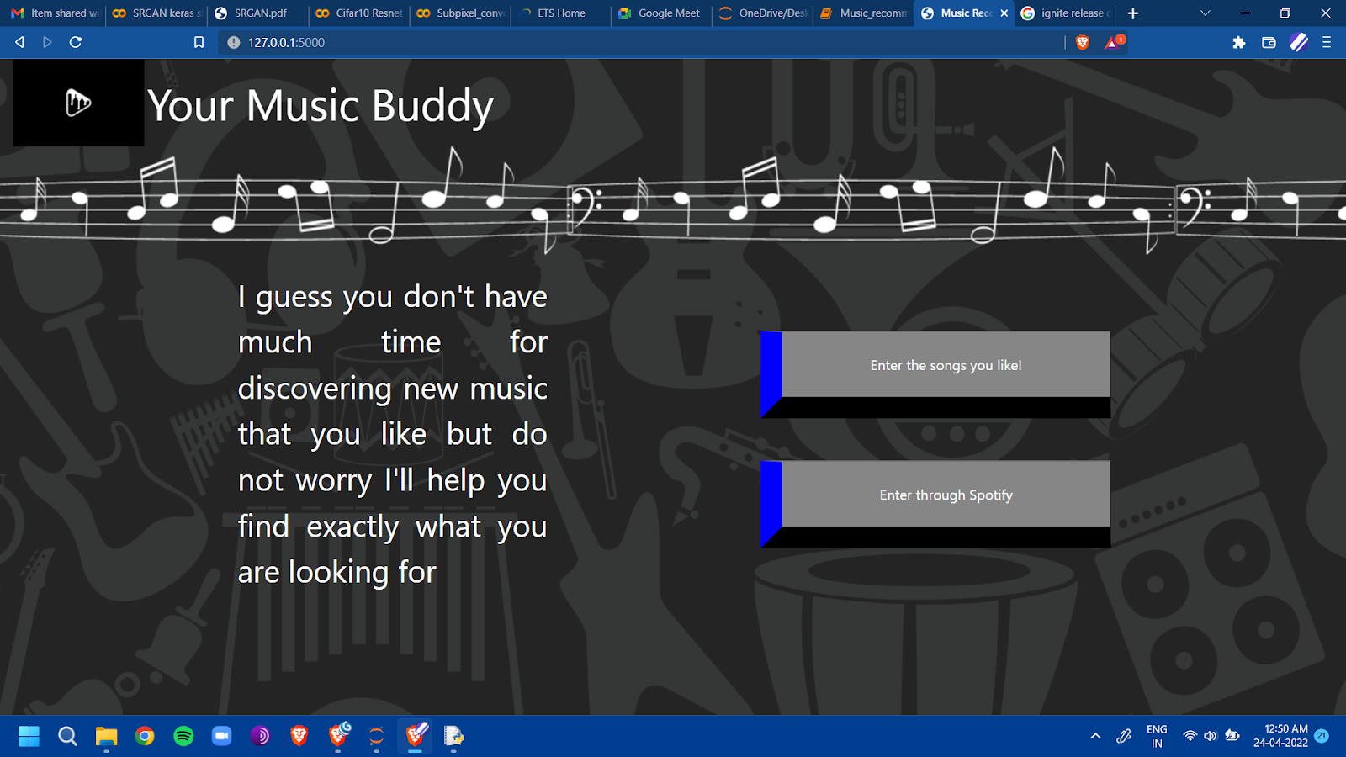
Results

Slide 10
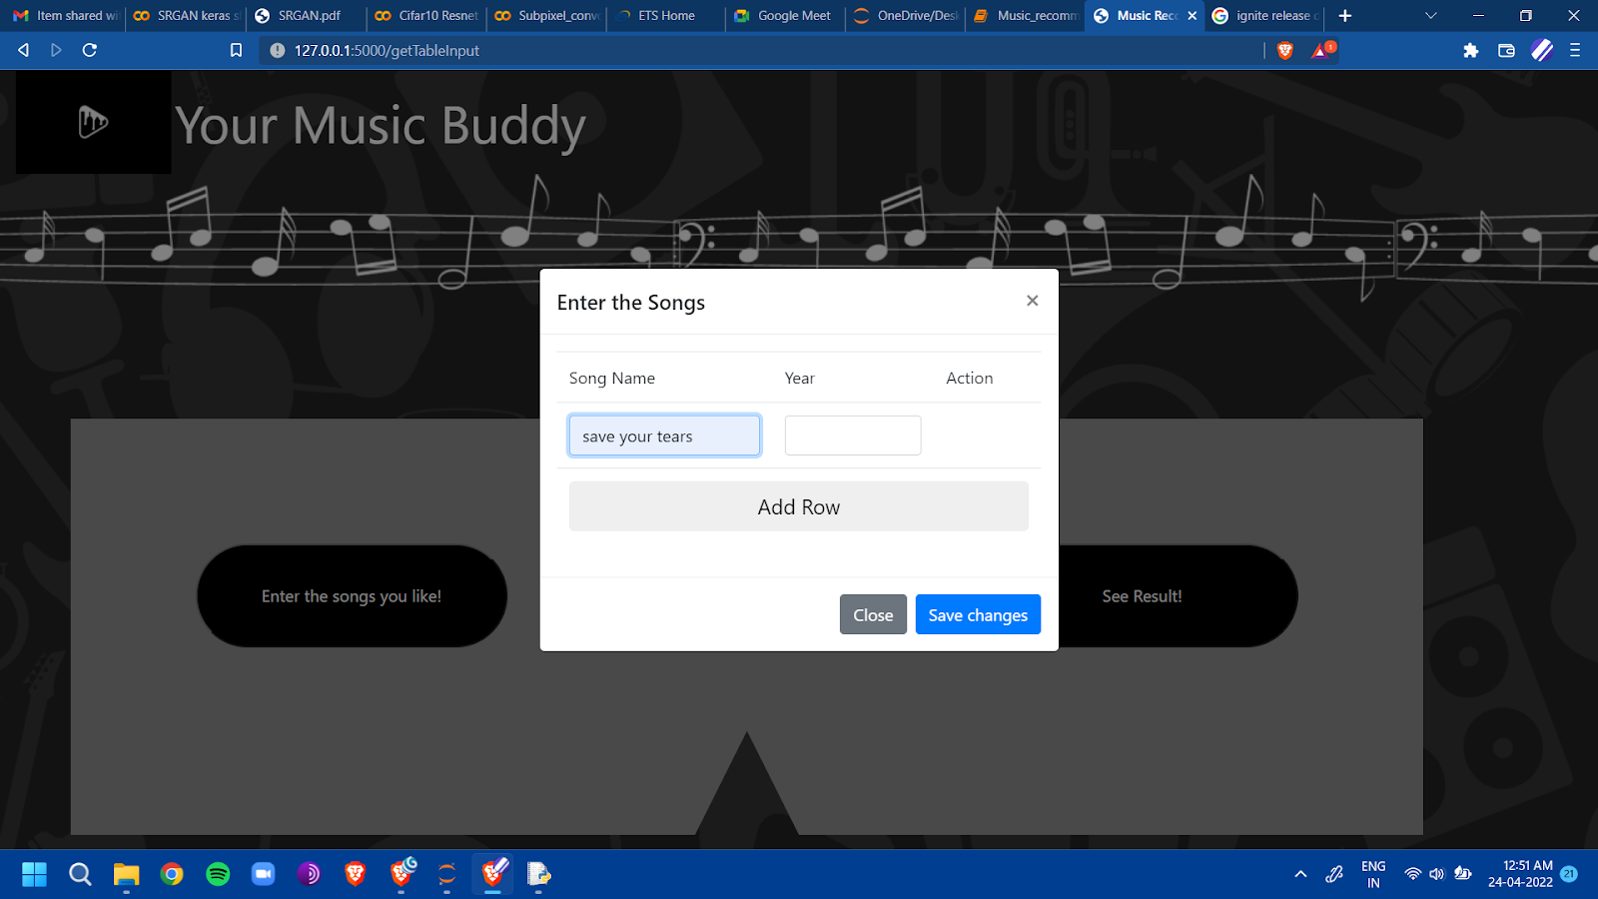
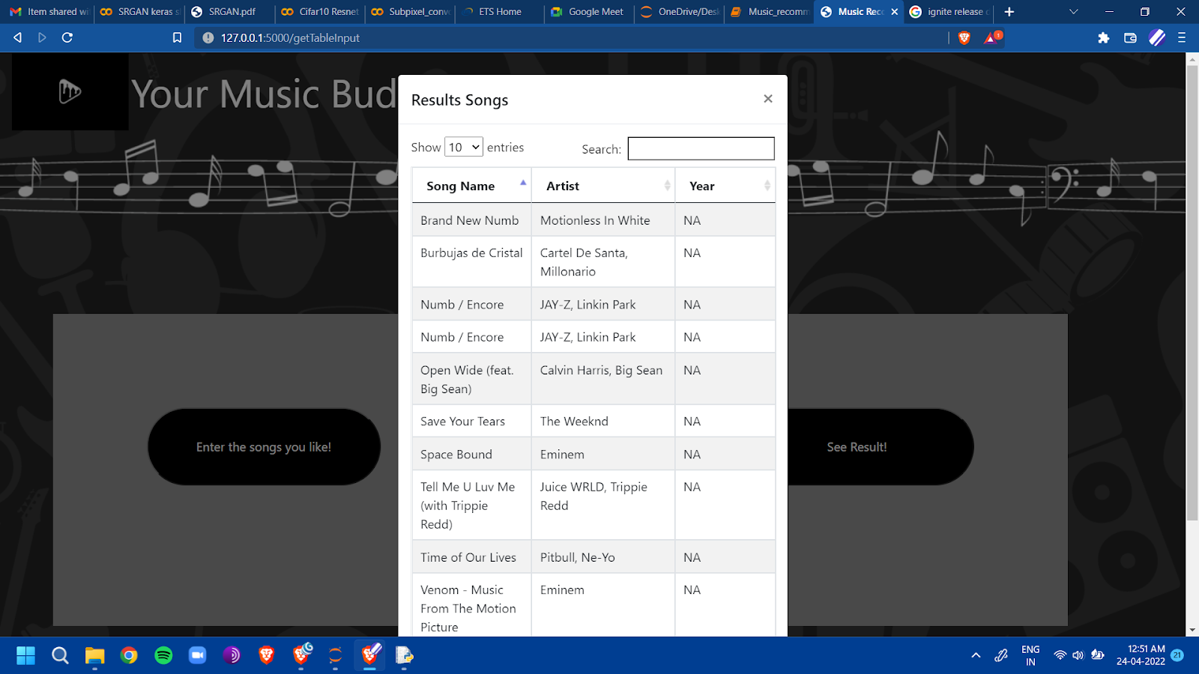
Results (Without Year)

Slide 11
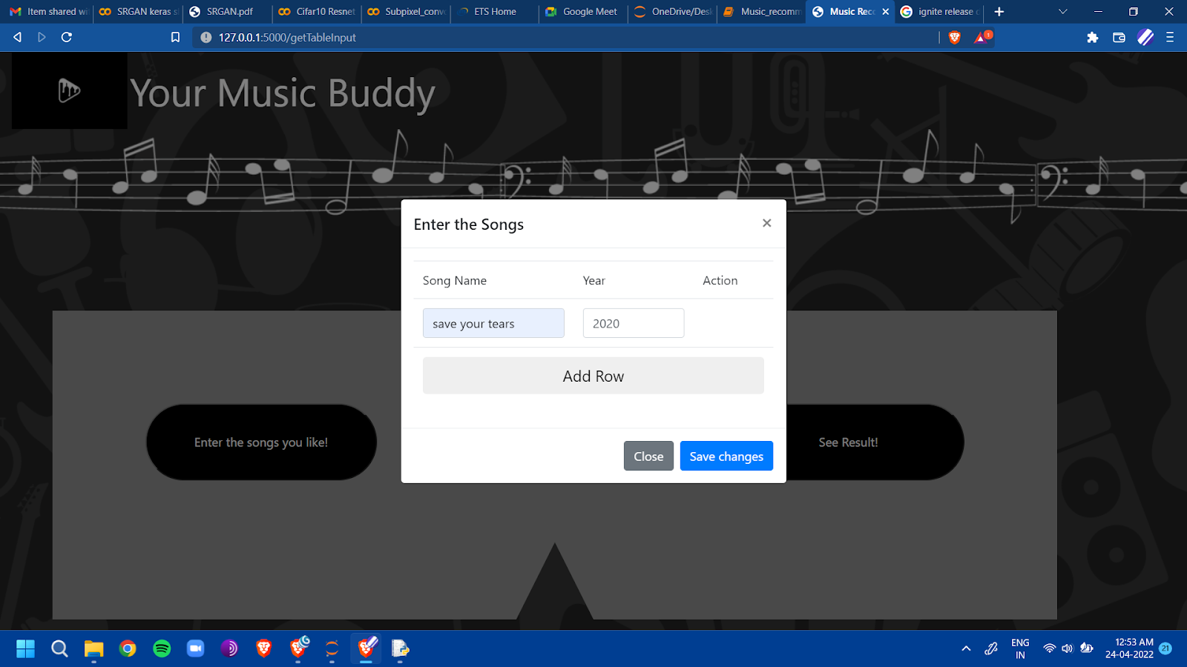
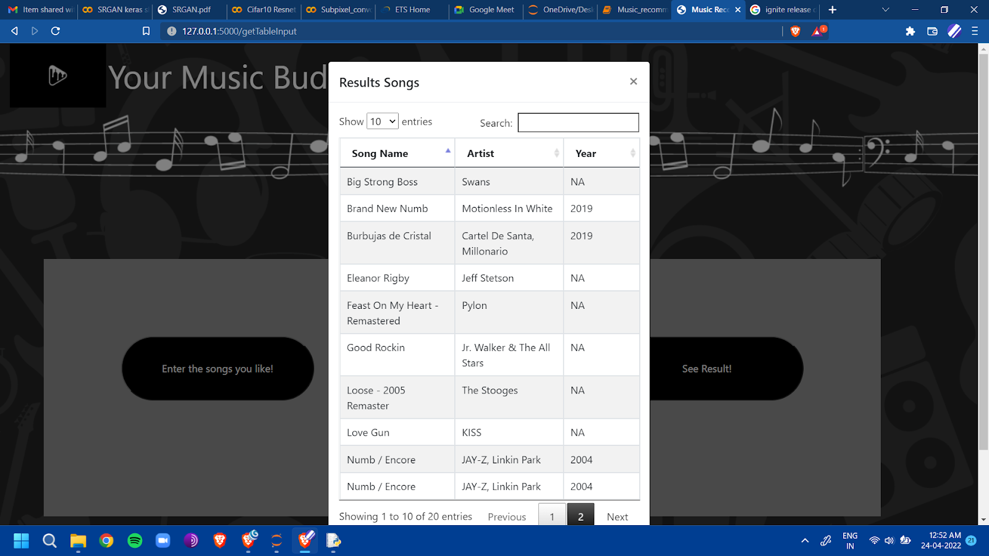
Results (With Year)

Slide 12
Conclusion
While solving the problem of song recommendation the major issue that we faced was recommendation vs prediction. While predictive algorithms worked on the basis that once a user listens to a song from a particular artist it becomes a high possibility that the user might listen to another song from the same artist. However appropriate it may seem it be delusional sometimes. Artists often incorporate various elements in their different songs and this leads to different genres of music. This would be undesirable for a recommendation system as it should suggest songs based on the genre and not on basis of the artist.
Year played a major role (than expected) in providing recommendations. This was observed when the songs we wanted recommendations for were antiquated; the recommended songs were also of the same time. Thus we could infer that even though the genre of the song may be the same; the features attributed to the genre changes over time. As when the songs recommended were analyzed there seemed to be a slight change in the genre of songs that were recommended with year / without year.

Slide 13
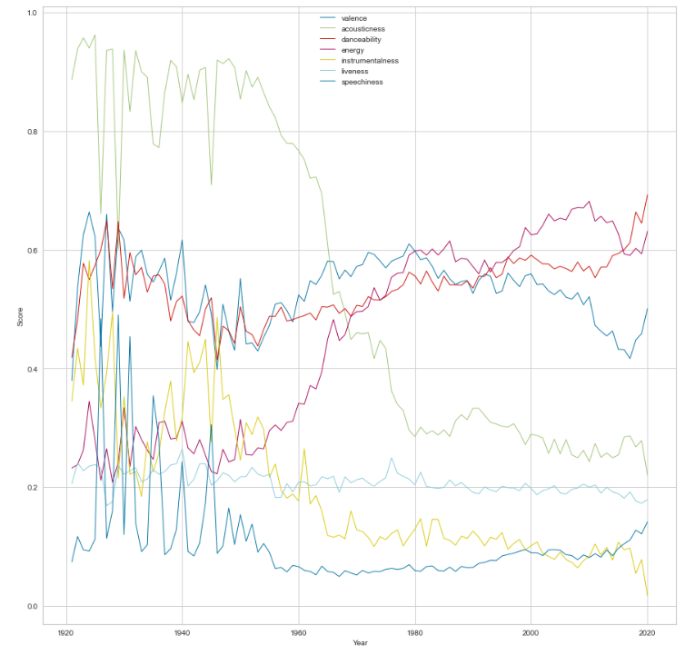
Conclusion

Slide 14
Role of Each member
Shail Patel
Developed the model and observed the anomaly in the recommendations.
Sahil Miskeen
Varun Deliwala
Developed the UI/UX part and integrated it with the backend.
Worked with the dataset
Preprocessing, Visualization.

Slide 15
References
https://pandas.pydata.org/ https://scikit-learn.org/stable/
https://kaggle.com
https://towardsdatascience.com/prototyping-a-recommender-system-step-by-step-part-1-knn-item-based-collaborative-filtering-637969614ea
https://www.frontiersin.org/articles/10.3389/fams.2019.00044/full https://www.researchgate.net/publication/336162555_A_Music_Recommendation_System_Based_on_logistic_regression_and_eXtreme_Gradient_Boosting
https://silo.tips/download/project-report-cs-240a-applied-parallel-computing-k-nearest-neighborhood-based-m
https://www.kaggle.com/datasets/mrmorj/dataset-of-songs-in-spotify
https://deepnote.com/@zi-xiao-li/Spotify-fd3c414d-44ef-42d2-b9f4-51d7faf159c7
https://www.kaggle.com/code/richardcsuwandi/spotify-time-series-analysis/notebook
A Deep Temporal Neural Music Recommendation Model Utilizing Music and User Metadata Hai-Tao Zheng 1,* , Jin-Yuan Chen 1 , Nan Liang 1 , Arun Kumar Sangaiah 2 , Yong Jiang 1 and Cong-Zhi Zhao 3
Liao, K., 2018. Prototyping a Recommender System Step by Step Part 1: KNN Item-Based Collaborative Filtering. [online] Medium. Available at: <https://towardsdatascience.com/prototyping-a-recommender-system-step-by-step-part-1-knn-item-based-collaborative-filtering-637969614ea> [Accessed 20 March 2022].
M. Schedl, “Deep Learning in Music Recommendation Systems,” Frontiers, 01-Jan-1AD. [Online]. Available: https://www.frontiersin.org/articles/10.3389/fams.2019.00044/full. [Accessed: 28-Mar-2022].
“A music recommendation system based on logistic regression ...” [Online]. Available: https://www.researchgate.net/publication/336162555 A Music Recommendation System Based on logistic regression and eXtreme Gradient Boosting. [Accessed: 28-Mar-2022].

