Slide 1
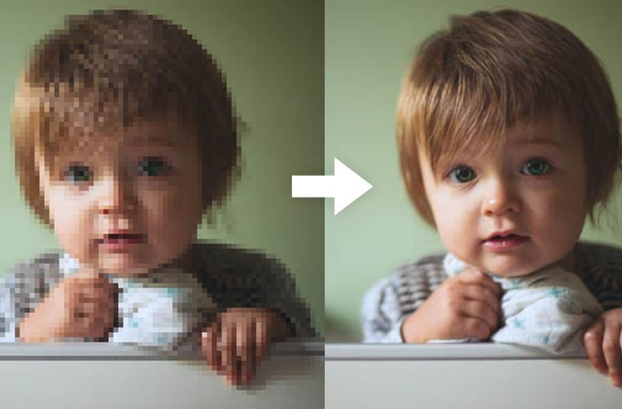
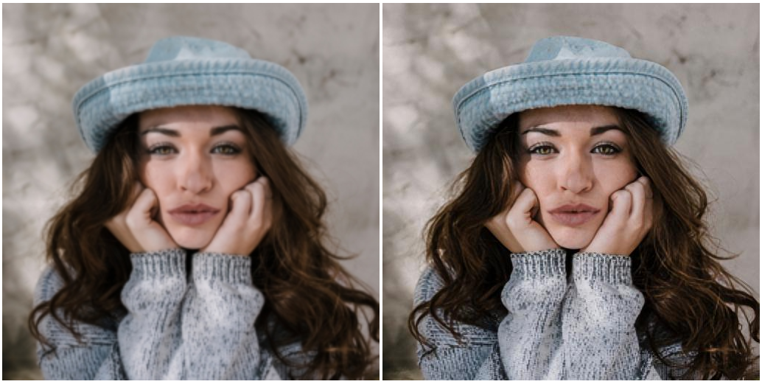
Single Image Super Image Resolution
Varun Deliwala AU1940034
Jap Purohit AU1940109
Shail Patel AU1940142
Sahil Miskeen AU1940267

Slide 2
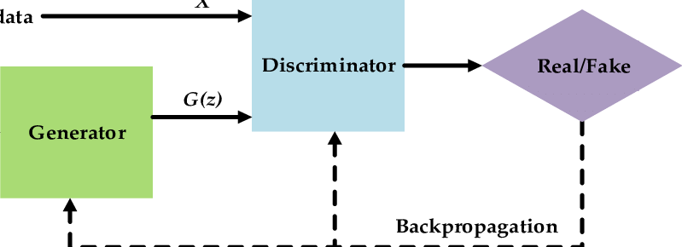
Introduction
An image may have a lower resolution due to a smaller spatial resolution i.e. due to a result of degradation. The task of super image resolution is of crucial importance. We are often faced with situations where in we are needed to work with high resolution images. However high resolution images are often expensive in terms of memory and computation. These problems can be overcomed by the use of image processing algorithms thus leading to the concept of super image resolution.

Slide 3
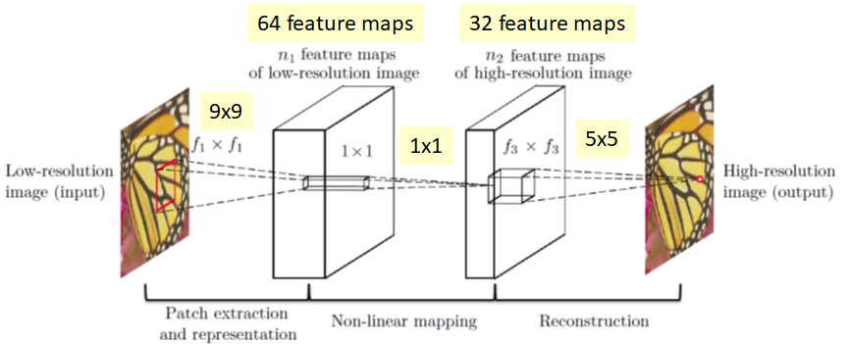
Problem Statement
Our objective is to take a low resolution image and produce an estimate of a corresponding high‑resolution image. Using deep learning and GAN models in order to convert a low resolution image to an image of the desired higher resolution is what we achieve to do in our current project. One of the most important tasks of super image resolution is interpolating. Although simple to implement this technique does not give us the desired output in most cases. That is the reason we need to come up with more complex models in order to get the accuracy desired.

Slide 4
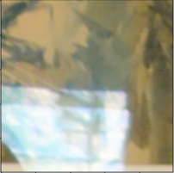
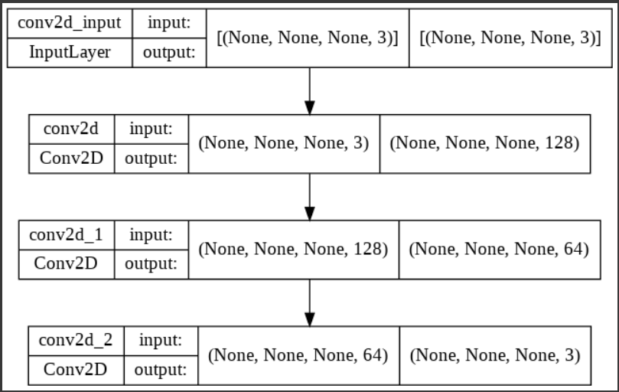
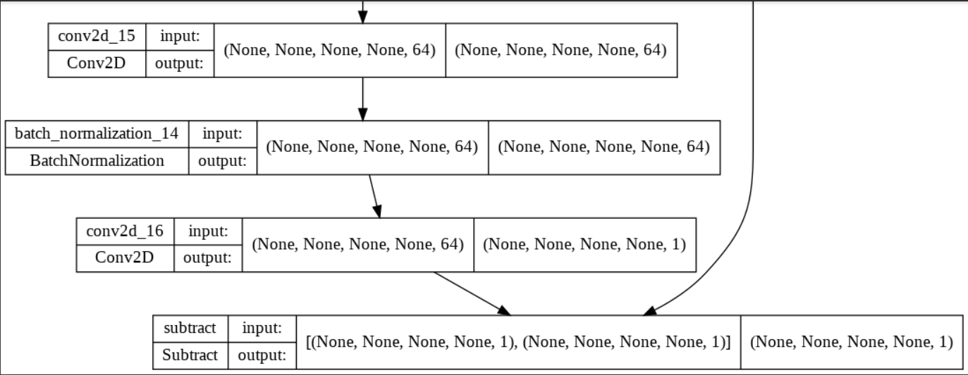
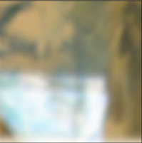
Existing body of work
Resnet Architecture for image denoising
SRCNN Model
Bicubic interpolated image

Slide 5
Approach
Uptil now we have implemented the models from two different papers.
1. Image Denoising
2. SRCNN (Super resolution using convolutional neural network).
Before moving to single image super image resolution it is important to work with comparitevly simpler models in order to understand the mechanism behind more complex models. Image denoising aims at reducing any noise from the image.
We have recreated the paper on DNCNN which relates to image denoising. The noise has been introduced by us. The noise introduced is gaussian in nature. Our model as shown in results slide helps in reducing the noise which exists inside the image. The accuracy we have achieved is around 80 percent which is good for day to day usage.
Next we have created the paper on SRCNN which is the most basic paper which aims at super resolution. The model of which has been attached in the previous slide.

Slide 6
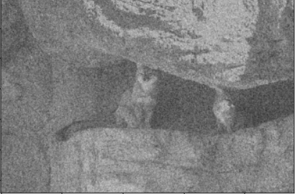
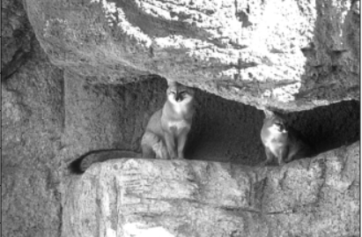
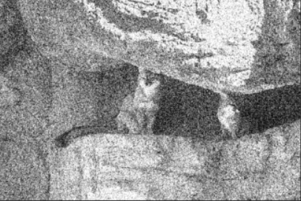
Results
Image Denoising
Image Resolution SRCNN
MSE Between Images | MSE Along Column 1 | MSE Along Column 2 | MSE Along Column 3
OG Image and Model Predicted Image | 24.369102 | 23.836807 | 21.772045
OG Image and Bicubic interpolated image | 81.4683 | 25.0627 | 72.3014
Noisy Image
Clean Image
Model Predicted Image

Slide 7
Role of each group member
Varun Deliwala (AU1940034) – Getting the dataset required for model training. Selecting out of all the available datasets which dataset would be compatible as well as feasible with google colab. Understanding the research paper.
Jap Purohit (AU1940109) – Report generation, overview of the processes done and managing the flow of the project. Understanding the research paper.
Shail Patel (AU1940142) – Working with the code. Implementing models as interpreted by Sahil. Producing user friendly outputs. Understanding the research paper.
Sahil Miskeen (AU1940267) – Interpreting models (as required) from the papers which have been implemented by us on real life images. Understanding the research paper.

Slide 8
Future Work
From now on we will start working with GAN (General Adversial Networks) model. The Generator function will try to fool the Discriminator function on the basis of whether the Generator function has produced a desirable super resolved image or not. We will be using the original dataset which has actually been used while trying super image resolution for the first time. The Image Net Dataset.
Apart from this we are going to try (hypothesis) whether we can get the user to enter the desired resolution of the image so as to provide a more dynamic experience to the user.

Slide 9
References
Image Super-Resolution Using Deep Convolutional Networks Chao Dong, Chen Change Loy, Member, IEEE, Kaiming He, Member, IEEE, and Xiaoou Tang, Fellow, IEEE
Beyond a Gaussian Denoiser: Residual Learning of Deep CNN for Image Denoising Kai Zhang, Wangmeng Zuo, Yunjin Chen, Deyu Meng, and Lei Zhang
https://github.com/SaoYan/DnCNN-PyTorch
https://github.com/tegg89/SRCNN-Tensorflow

