Slide 1
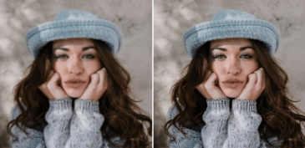
Super Image Resolution
Gan-Jedis
By,
Varun Deliwala AU1940034
Jap Purohit AU1940109
Shail Patel AU1940142
Sahil Miskeen AU1940267

Slide 2
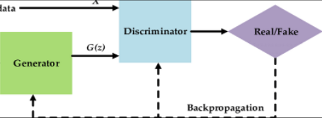
Introduction
The number of hours an average person spends on listening to music, be it while working or studying or during one’s leisure time, is substantially increasing day by day. With the increase of user base on applications like Spotify, it often becomes difficult to discover new music that matches one’s interests. So, the main aim of the project here is to identify the best solutions for music recommendation.

Slide 3
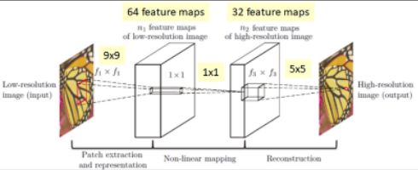
Problem Statement
Our objective is to take a low resolution image and produce an estimate of a corresponding high‑resolution image. Using deep learning and GAN models in order to convert a low resolution image to an image of the desired higher resolution is what we achieve to do in our current project.

Slide 4
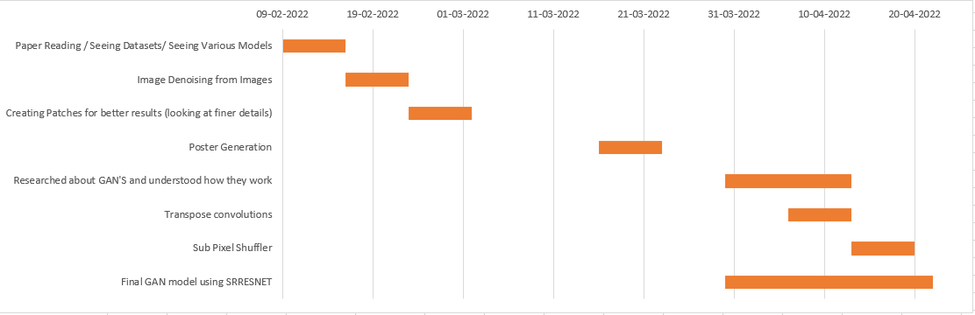
Gantt Chart

Slide 5
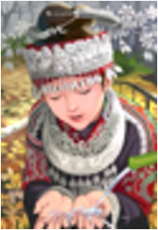
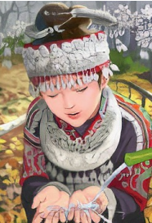
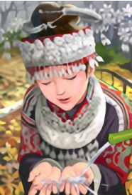
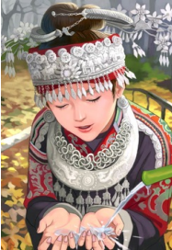
Existing Body of Work
Interpolation Based Techniques (Bicubic, Bilinear etc)
Example Based Techniques (Reconstruction based on an already existing database)
Recursive networks (SRCNN, SRGAN)
Bicubic
GAN
SRRESNET
ORIGINAL
Photo-Realistic Single Image Super-Resolution Using a Generative Adversarial Network Christian Ledig, Lucas Theis, Ferenc Huszar, Jose Caballero, Andrew Cunningham, ´ Alejandro Acosta, Andrew Aitken, Alykhan Tejani, Johannes Totz, Zehan Wang, Wenzhe Shi Twitter

Slide 6
Approach
Learning basics of Denoising, SRCNN to understand how neural networks work.
Reading research papers about different architectures achieving the purpose of image super resolution. Such as SRCNN(1), Checkerboard artifact free sub-pixel convolution(2), Real-Time Single Image and Video Super-Resolution Using an Efficient Sub-Pixel Convolutional Neural Network(3), General Adversarial Networks(4).
Started with working with GAN on MNIST Dataset to get an understanding about the working of GAN’S.
Implemented SRGAN based on the knowledge gained from the process we undertook to reach the final step
Image Super-Resolution Using Deep Convolutional Networks Chao Dong, Chen Change Loy, Member, IEEE, Kaiming He, Member, IEEE, and Xiaoou Tang, Fellow, IEEE
Checkerboard artifact free sub-pixel convolution A note on sub-pixel convolution, resize convolution and convolution resize Andrew Aitken*, Christian Ledig*, Lucas Theis*, Jose Caballero, Zehan Wang, Wenzhe Shi* Twitter, Inc.
Real-Time Single Image and Video Super-Resolution Using an Efficient Sub-Pixel Convolutional Neural Network Wenzhe Shi1 , Jose Caballero1 , Ferenc Huszar´ 1 , Johannes Totz1 , Andrew P. Aitken1 , Rob Bishop1 , Daniel Rueckert1 , Zehan Wang1 (Twitter)
Generative Adversarial Nets Ian J. Goodfellow, Jean Pouget-Abadie∗ , Mehdi Mirza, Bing Xu, David Warde-Farley, Sherjil Ozair† , Aaron Courville, Yoshua Bengio‡ Departement d’informatique et de recherche op ´ erationnelle ´ Universite de Montr ´ eal ´ Montreal, QC H3C 3J7

Slide 7
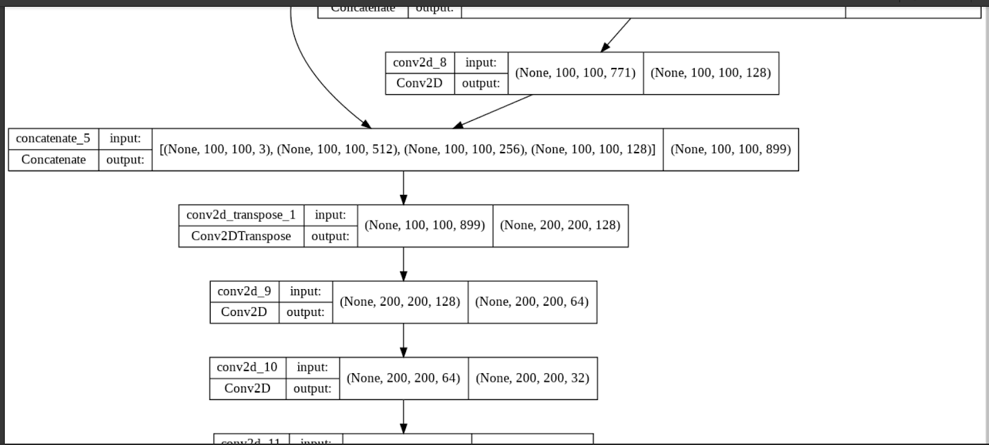
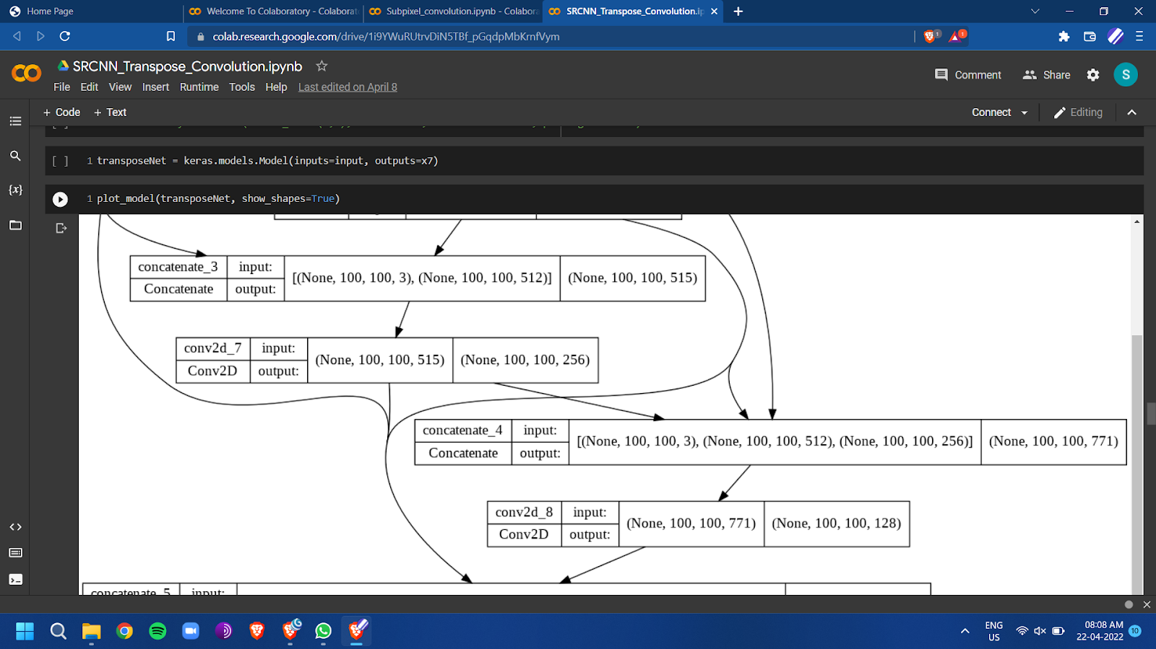
APPROACH 1 (Transpose convolution)
For transpose convolutions we have used dense net architecture to save the features from previous layers and increase the resolution based on that.

Slide 8
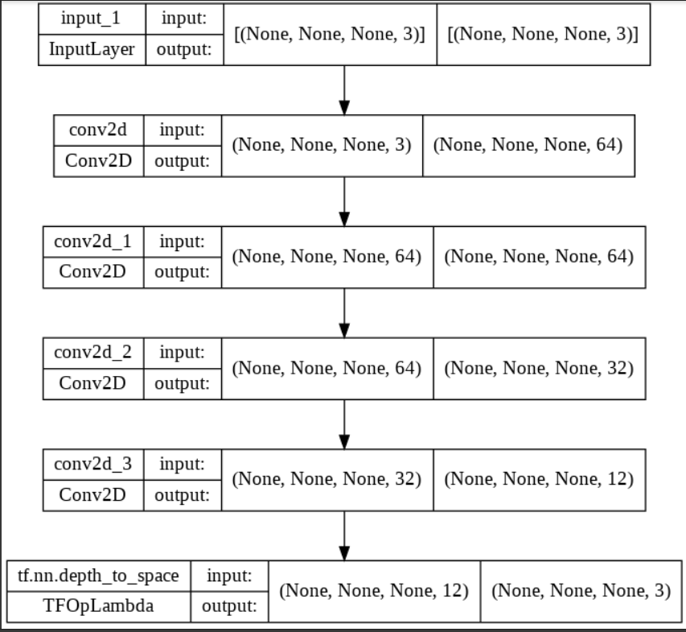
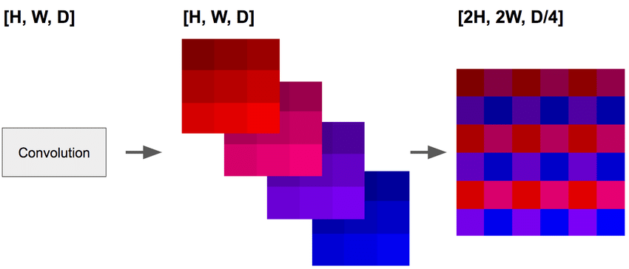
APPROACH 2 (Sub Pixel Convolution)
Sub Pixel Convolution has a much simpler architecture. The main point is the last layers where it combines the features of all previous layers and uses the depth of the features and converts them into space.

Slide 9
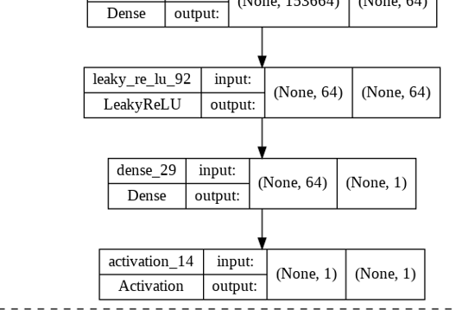
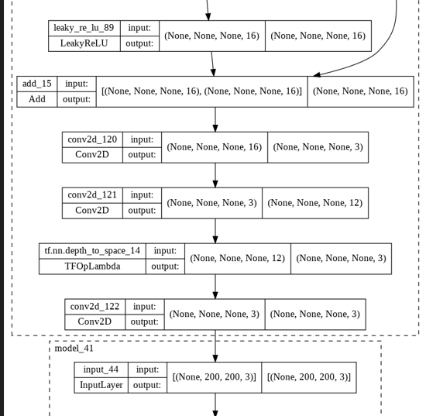
APPROACH 3 (Generative Models)
The 2 models SRRESNET (generator) and the discriminator
Function work side by side. SRRESNET works on vgg loss
Discriminator works on MSE loss.

Slide 10
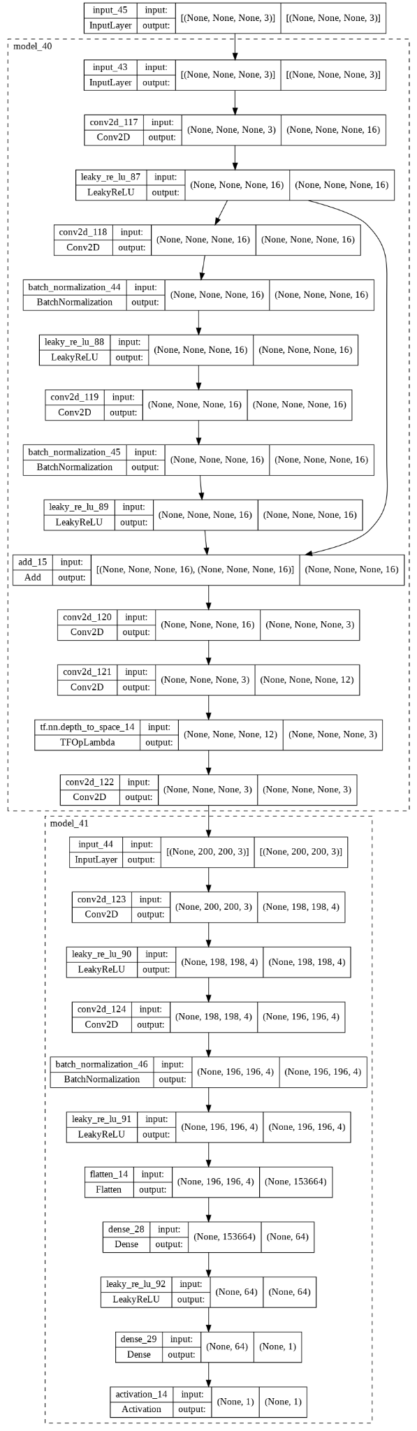
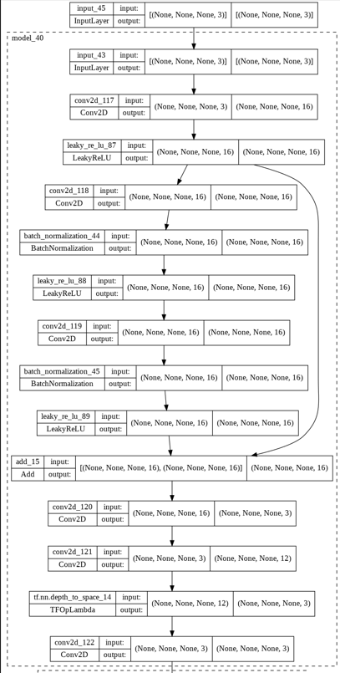
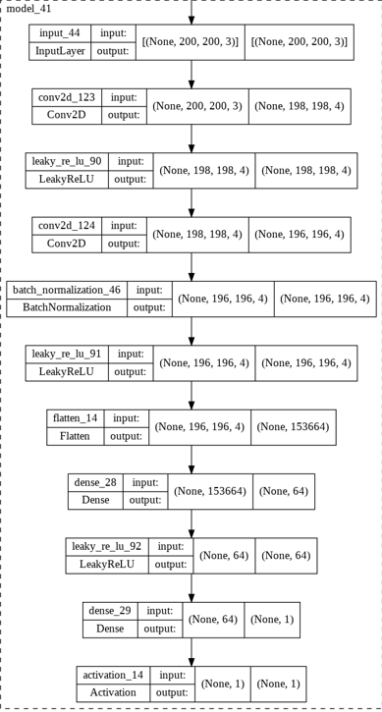

Slide 11
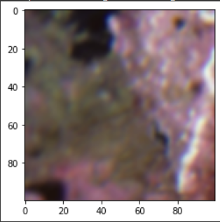
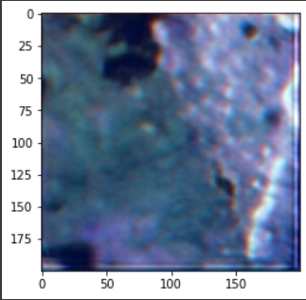
Results
(Transpose Convolution)
As observed from the images there is a color shift when we use a simple transpose convolution to increase the image resolution. This issue is a lot less prevalent in pixel shuffler which looks at pixel level convolutions.

Slide 12
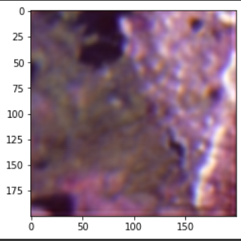
Results (Sub Pixel Convolution / Pixel Shuffler)
As mentioned before the high resolution resulting from sub pixel convolution has a lower color shift and a much better result.

Slide 13
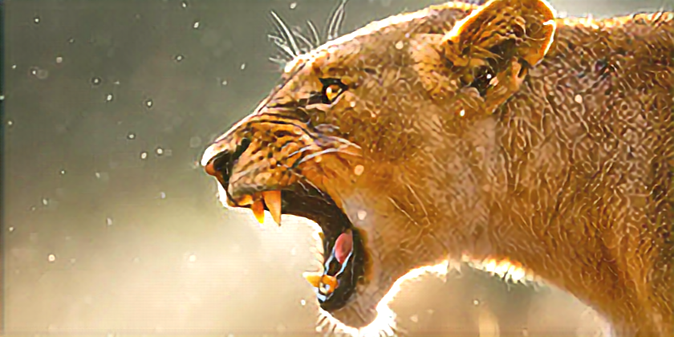

Results (GAN Model)
The GAN model has a much lower color shift as evident from the given images.
210 * 105
840 * 420

Slide 14
Conclusion
Throughout the entire journey we took to achieve the final results we found out that GAN’S provided the best results for the task of super image resolution among the other techniques we tried. The drawbacks of each method are described below.
Bicubic interpolation - Linear operation thus leading to loss of data
SRCNN (using transpose convolution) - Leading to checkerboard artifacts which showcases blockiness of the images (not desired). Due to a lack of training colour shift can be prominently seen.
SRCNN (using subpixel convolution) - Can solve the problem mentioned above to a certain extent but highly refined images were not outputted. The problem of colour shifting seems to be lesser in sub pixel convolution since they work on a much finer level.
Ultimately GAN’S proved to be the most effective solution for the problem we sought to solve.

Slide 15
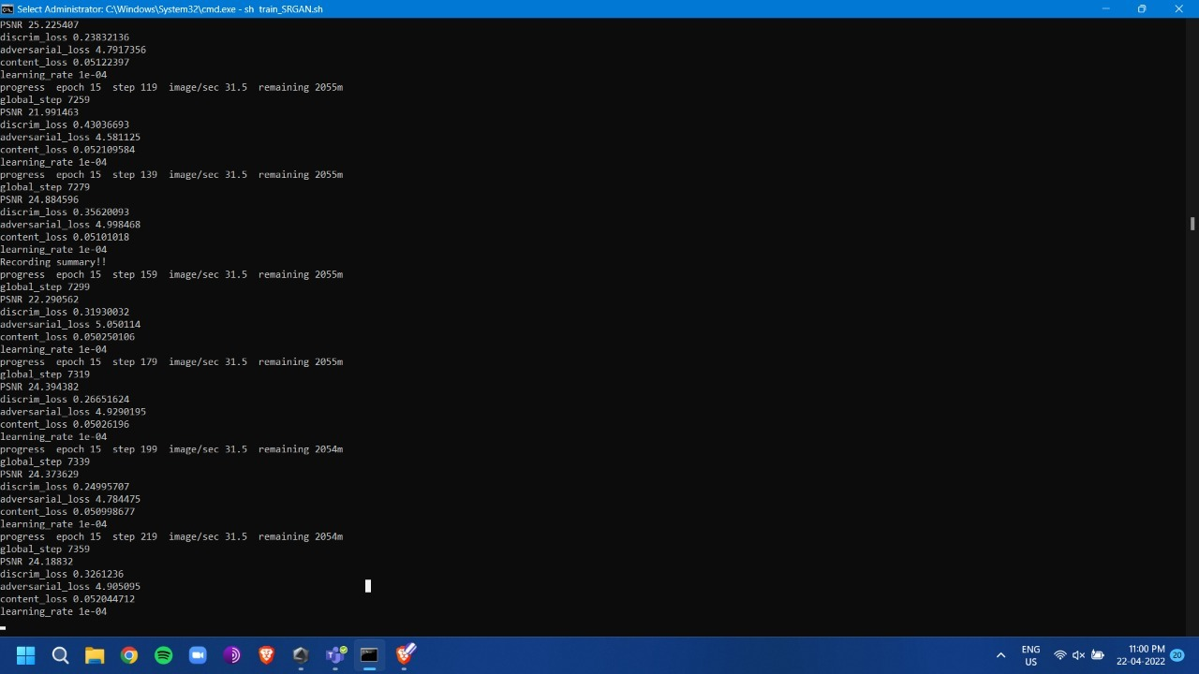
Drawbacks Of GAN
The training is very extensive and time consuming. It requires a lot of power and resources to give the desired output.
The model is very difficult to build because each task requires a new model to be configured for that particular task. (Task Specific)
Very poor performance if the training is not fulfilled.

Slide 16

Shail Patel
Sahil Miskeen
Preprocessing the data and developing the final GAN model. Analyzing the papers.
Preprocessing the data and analysing the techniques.
Analyzing the papers.
Jap Purohit
Varun Deliwala
Developing the architecture for the models.
Analyzing the papers.
Gathering the dataset for being able to perform tasks on.
Analyzing the papers.

Slide 17

Image Super-Resolution Using Deep Convolutional Networks Chao Dong, Chen Change Loy, Member, IEEE, Kaiming He, Member, IEEE, and Xiaoou Tang, Fellow, IEEE
Beyond a Gaussian Denoiser: Residual Learning of Deep CNN for Image Denoising Kai Zhang, Wangmeng Zuo, Yunjin Chen, Deyu Meng, and Lei Zhang
https://github.com/SaoYan/DnCNN-PyTorch
https://github.com/tegg89/SRCNN-Tensorflow
Checkerboard artifact free sub-pixel convolution A note on sub-pixel convolution, resize convolution and convolution resize Andrew Aitken*, Christian Ledig*, Lucas Theis*, Jose Caballero, Zehan Wang, Wenzhe Shi* Twitter, Inc.
Real-Time Single Image and Video Super-Resolution Using an Efficient Sub-Pixel Convolutional Neural Network Wenzhe Shi1 , Jose Caballero1 , Ferenc Huszar´ 1 , Johannes Totz1 , Andrew P. Aitken1 , Rob Bishop1 , Daniel Rueckert1 , Zehan Wang1 (Twitter)
Generative Adversarial Nets Ian J. Goodfellow, Jean Pouget-Abadie∗ , Mehdi Mirza, Bing Xu, David Warde-Farley, Sherjil Ozair† , Aaron Courville, Yoshua Bengio‡ Departement d’informatique et de recherche op ´ erationnelle ´ Universite de Montr ´ eal ´ Montreal, QC H3C 3J7

