Slide 1


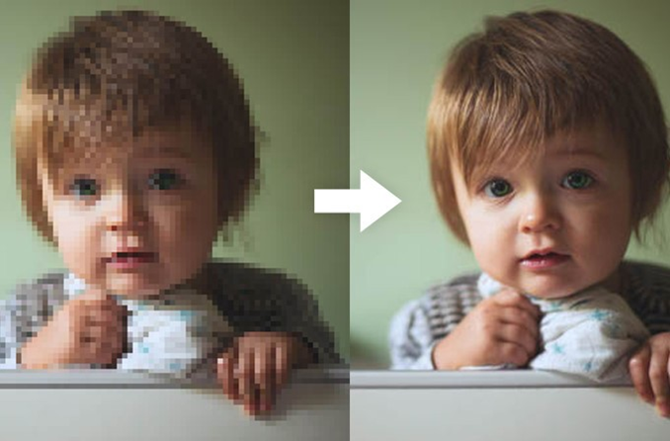
Super Image Resolution
Varun Deliwala AU1940034
Shail Patel AU1940142
Sahil Miskeen AU1940267
Jap Purohit AU1940109
GANJedis

Slide 2
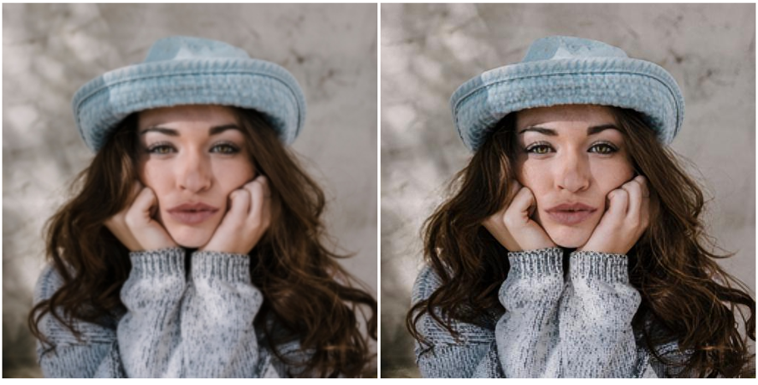
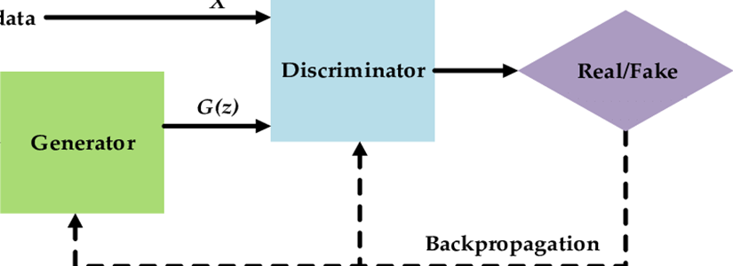
INTRODUCTION
The task of super image resolution is of crucial importance. We are often faced with situations where in we are needed to work with high resolution images. However high resolution images are often expensive in terms of memory and computation. Super image resolution allows us to save time and money required to transport high resolution images and videos by taking low resolution images/videos and converting them to the desired high resolution.

Slide 3
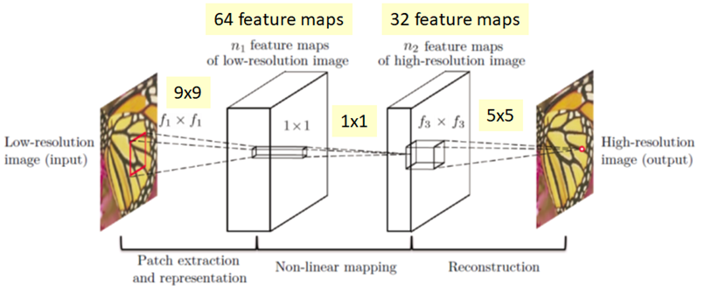
Problem Statement
Our objective is to take a low resolution image and produce an estimate of a corresponding high‑resolution image. Using deep learning and GAN models in order to convert a low resolution image to an image of the desired higher resolution is what we achieve to do in our current project.

Slide 4
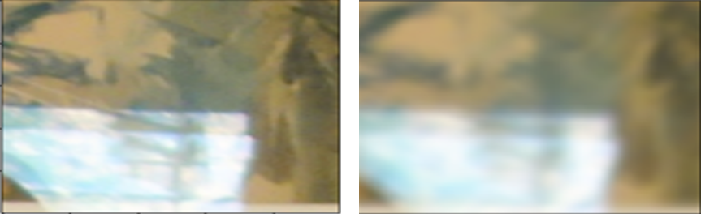
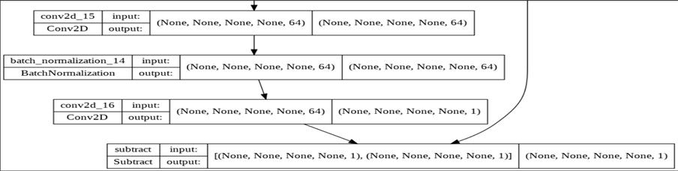
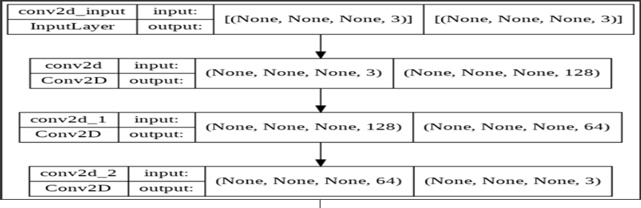
EXISTING BODY OF WORK
Bicubic Interpolated Image
•Bicubic interpolation is one the traditional approach used for the improving the image resolution.
SRCNN MODEL
•SRCNN is a deep convolutional neural network that learns how to translate low-resolution pictures to high-resolution images from start to finish.
Image Super-Resolution Using Deep Convolutional Networks Chao Dong, Chen Change Loy, Member, IEEE, Kaiming He, Member, IEEE, and Xiaoou Tang, Fellow, IEEE
Resnet Architecture for Image Denoising
•Resnet Image Denoising is used to remove reduce the image from the image.
Beyond a Gaussian Denoiser: Residual Learning of Deep CNN for Image Denoising Kai Zhang, Wangmeng Zuo, Yunjin Chen, Deyu Meng, and Lei Zhang

Slide 5
The architecture
SRCNN MODEL HYPERPARAMATERS
IMAGE DENOISING HYPERPARAMETERS
LOSS=["MSE"], LEARNING_RATE=0.001,
BETA_1=0.9, BETA_2=0.999, EPSILON=1E-07,
LOSS=["MSE"],
LEARNING_RATE=1E-3,
BETA_1=0.9,
BETA_2=0.999,
EPSILON=1E-07,

Slide 6
APPROACH
Till now we have implemented the models from two different papers.
1. Image Denoising
2. SRCNN (Super resolution using convolutional neural network).
Before moving to single image super image resolution it is important to work with comparitevly simpler models in order to understand the mechanism behind more complex models. Image denoising aims at reducing any noise from the image.
We have recreated the paper on DNCNN which relates to image denoising. The noise has been introduced by us. The noise introduced is gaussian in nature. Our model as shown in results slide helps in reducing the noise which exists inside the image. The accuracy we have achieved is around 80 percent which is good for day to day usage.
Next we have created the paper on SRCNN which is the most basic paper which aims at super resolution. The model of which has been attached in the previous slide.

Slide 7
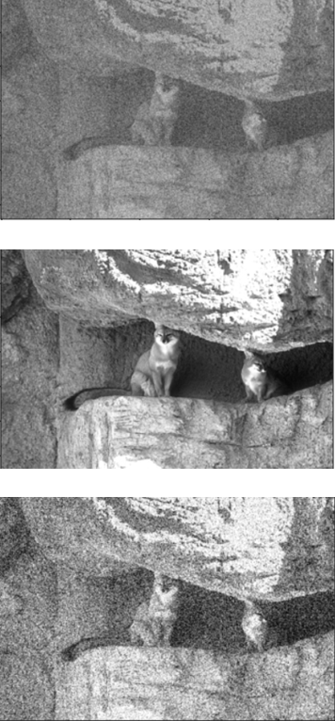
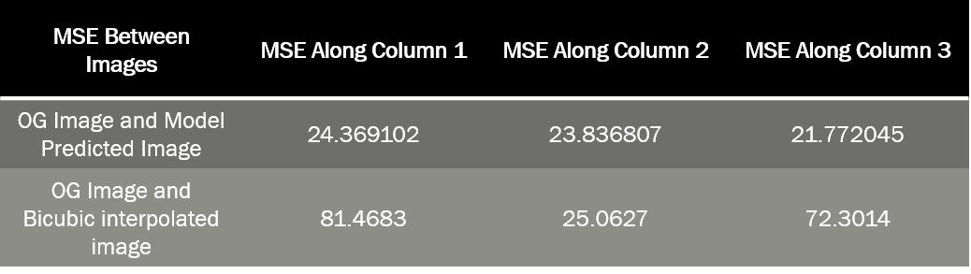
RESULTS
Image Resolution SRCNN
Noisy Image
Clean Image
We were able up to remove 70-80 percent of noise from the noisy image.
Minimum Square error was found to be minimum for SRCNN model in comparison between the SRCNN model and Bicubic interpolated model.
Model Predicted Image

Slide 8
ROLE OF EACH MEMBER
Sahil Miskeen
Interpreting models (as required) from the papers which have been implemented by us on real life images. Understanding the research paper.
Shail Patel
Working with the code. Implementing models as interpreted by Sahil. Producing user friendly outputs. Understanding the research paper.
Varun Deliwala
Getting the dataset required for model training. Selecting out of all the available datasets which dataset would be compatible as well as feasible with google colab. Understanding the research paper.
Jap Purohit
Report generation, overview of the processes done and managing the flow of the project. Understanding the research paper.

Slide 9
Future Work
From now on we will start working with GAN (General Adversial Networks) model. The Generator function will try to fool the Discriminator function on the basis of whether the Generator function has produced a desirable super resolved image or not. We will be using the original dataset which has actually been used while trying super image resolution for the first time. The Image Net Dataset.
Apart from this we are going to try (hypothesis) whether we can get the user to enter the desired resolution of the image so as to provide a more dynamic experience to the user.

Slide 10
REFERENCES
Image Super-Resolution Using Deep Convolutional Networks Chao Dong, Chen Change Loy, Member, IEEE, Kaiming He, Member, IEEE, and Xiaoou Tang, Fellow, IEEE
Beyond a Gaussian Denoiser: Residual Learning of Deep CNN for Image Denoising Kai Zhang, Wangmeng Zuo, Yunjin Chen, Deyu Meng, and Lei Zhang
https://github.com/SaoYan/DnCNN-PyTorch
https://github.com/tegg89/SRCNN-Tensorflow

