Slide 1


FLIGHT PRICE PREDICTION
By shailaj joshi

Slide 2
PROBLEM STATEMENT
Anyone who has booked a flight ticket knows how unexpectedly the prices vary. The cheapest available ticket on a given flight gets more and less expensive over time. This usually happens as an attempt to maximize revenue based on - 1. Time of purchase patterns (making sure last-minute purchases are expensive) 2. Keeping the flight as full as they want it (raising prices on a flight which is filling up in order to reduce sales and hold back inventory for those expensive last-minute expensive purchases) So, you have to work on a project where you collect data of flight fares with other features and work to make a model to predict fares of flights. This project contains two phase-
Data Collection Phase :You have to scrape at least 1500 rows of data. You can scrape more data as well, it’s up to you, More the data better the model. In this section you have to scrape the data of flights from different websites (yatra.com, skyscanner.com, official websites of airlines, etc).
Data Analysis Phase: After cleaning the data, you have to do some analysis on the data. Do airfares change frequently? Do they move in small increments or in large jumps? Do they tend to go up or down over time? What is the best time to buy so that the consumer can save the most by taking the least risk? Does price increase as we get near to departure date? Is Indigo cheaper than Jet Airways? Are morning flights expensive?

Slide 3
ASSUMPTIONS
Assuming that the responses we have is our complete dataset and based on the prices of the flights which we scraped from different websites like skyscraper., MakeMyTrip.
Considering that the factors such as airline name, date of journey, source, destination, route, departure time, arrival time, duration, total stops and the target variable price are enough to predict the flight price and also these factors are responsible to predict the correct price.

Slide 4
Steps For EDA(Exploratory Data Analysis)
Collect the data &gain the domain knowledge
Confirm data types and their probabilities
Measures of dispersion
a)Variance
b)Std.dev
c)Range
Skewness right &left kutosis
Thinner peak
Wider peak
Graphical representation 1.Histogram
2.Boxplot
3.Barplot
4.Dot plot
5.Stem &leaf
Measures of central tendency
1.Mean
2.Median
3.Mode

Slide 5
EDA
We have collected the data and gained domain knowledge by understanding the audience and problem statement.
All the data types are of object type except total stops and target variable price which is of integer.
As the data type of all factors is object, thus we could only find mode and the frequency of the most occurring option in the answers of the questions asked.
As data is not continuous thus we could not find standard deviation or variance but yes we could depict the range in which audience responses are falling.
As data is not continuous thus we could not find skewness, we could find correlation by encoding the object data type
Then we used histogram to depict the graphical representation.
airline_name object
source object
destination object
date_of_journey object
departure_time object
arrival_time object
duration object
total_ s int64
route object
target_variable_price int64
dtype: object

Slide 6
DIFFERENT AIRLINES TAKEN

Slide 7
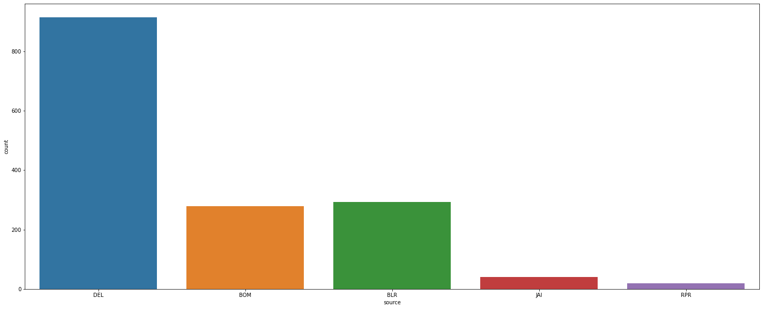
Data visualization- SOURCE

Slide 8
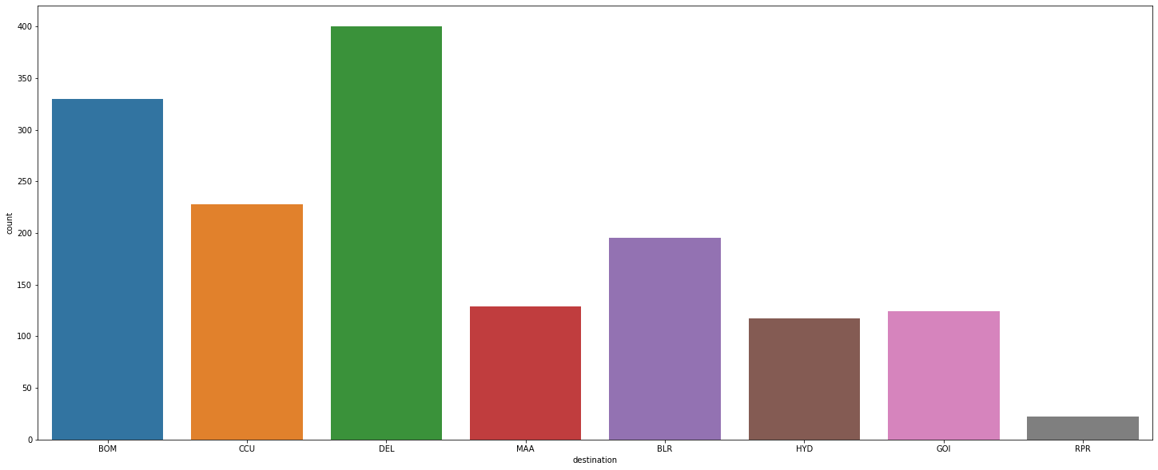
Data visualization- DESTINATION

Slide 9
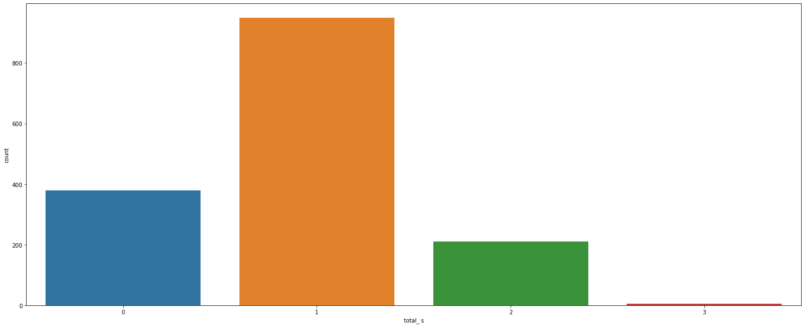
Data visualization- TOTAL NO OF STOPS

Slide 10
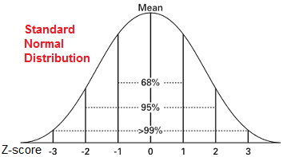
HANDLING missing values and outliers
. To remove the null values, for float data types we use mean of remaining data and for object data types we use mode of remaining data.
Also, the object data types are encoded as then it is easy to operate on the variables.
Now we need to check whether outliers are present in the data or not. For that we need to check if the z value/z score of all the factors is exceeding the range (-3,3). As we want the data to be normally distributed in the range of (-3,3) as the data be in the 99% domain. Thus, this will be the best data to work with.

Slide 11

Data Input-output relationship
Now here we know that there are 9 independent variables which are contributing to predict the dependent variable that is the Flight Price . Here the relationship is of Linear Regression.
Thus, assuming they follow a linear regression model, the relationship between the input variables or independent variables and the output variable or dependent variable is:
where Xi is the explanatory/9 independent variables and Yi is the dependent variable/Flight Price. f is the function, Beta is the unknown parameters and ei is the error terms.

Slide 12
CORRELATION
Correlation is a statistical term describing the degree to which two variables move in coordination with one another. If the two variables move in the same direction, then those variables are said to have a positive correlation. If they move in opposite directions, then they have a negative correlation. Here we see the below relationship
We see that the factors affecting the Flight Price are Total Stops and Route. Also, the negative factors affecting the Flight Price is the Destination, Arrival Time, Departure Time, Duration Time.
target_variable_price 1.000000
total_ s 0.422928
route 0.225330
source 0.079861
airline_name 0.057139
destination 0.018346
arrival_time -0.025582
departure_time -0.125522
duration -0.249817
Name: target_variable_price, dtype: float64

Slide 13
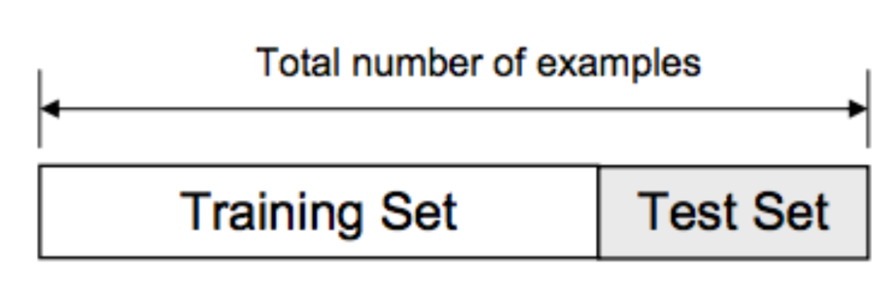
Data splitting for building model
Using the random state, we divide the training and testing data in the ratio of 0.8 and 0.2 meaning 20% of the data is the testing data and training data is 80%
As the total data is of 1467 data points,
Train data=1173
Test data=294

Slide 14
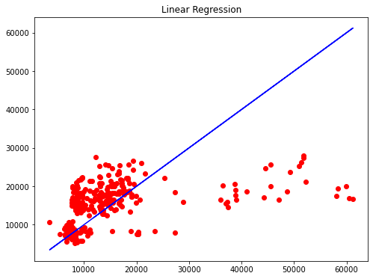
MODEL OUTPUT
Here we see that our data points are in line with the blue line which is the ideal line or slope of the linear regression equation. Thus, this shows that the model is perfectly fitted, neither under fitted nor over fitted.
Here the model accuracy is almost the same to 80% but the cross-validation score is increased to 60% % which is less than the model accuracy which means that the model is over fitted or the data points are less and we need more to get better cv score

Slide 15
CONCLUSION
We did Exploratory information Investigation on the highlights of this dataset and saw how each include is distributed.
We dissected each variable to check in the event that information is cleaned and ordinarily distributed. We cleaned the information and evacuated NA values. We tried to find the correlation and based on the outcomes, we accepted whether or not there's a relation between the Price of the flight and the other factors, we see that the positive factors affecting the Flight Price are Total Stops and Route, But the most important positively affecting factor is Total Stops as it with increase in the stops, Flight price is increasing. Also, the negative factors affecting the Flight price are Duration, Departure time, arrival time. We used the linear regression model to predict the Flight price .
We got a model with an 80% accuracy which is good. Just a disadvantage that the data available to train the model is biased as the data is scraped from one particular website- skyscanner.com. Data quality can be improved. The more accurate the data the better the model will be trained.
This model can be used people travelling to understand how exactly the prices vary with the variables. They can accordingly plan there journey with the received data . Further, the model will be a good

