Slide 1


Housing: Price prediction
By shailaj joshi

Slide 2
PROBLEM STATEMENT
Houses are one of the necessary needs of each and every person around the globe and therefore housing and real estate market is one of the markets which is one of the major contributors in the world’s economy.
A US-based housing company named Surprise Housing has decided to enter the Australian market. The company uses data analytics to purchase houses at a price below their actual values and flip them at a higher price. For the same purpose, the company has collected a data set from the sale of houses in Australia
The company is looking at prospective properties to buy houses to enter the market. You are required to build a model using Machine Learning in order to predict the actual value of the prospective properties and decide whether to invest in them or not. For this company wants to know:
• Which variables are important to predict the price of variable?
• How do these variables describe the price of the house ?

Slide 3
ASSUMPTIONS
The data set provided to us is the universe for us to work on and build the model
We are assuming that the 81 variables are the only variables or independent variables that affect the housing price
Housing Price is unaffected by pandemic or war.
Assuming they follow a linear regression model

Slide 4
Steps For EDA(Exploratory Data Analysis)
Collect the data &gain the domain knowledge
Confirm data types and their probabilities
Measures of dispersion
a)Variance
b)Std.dev
c)Range
Skewness right &left kutosis
Thinner peak
Wider peak
Graphical representation 1.Histogram
2.Boxplot
3.Barplot
4.Dot plot
5.Stem &leaf
Measures of central tendency
1.Mean
2.Median
3.Mode

Slide 5
EDA
We have collected the data and gained domain knowledge by understanding the audience and problem statement.
All the data types are of object type, integer type and float type.
As the data type of all factors is object, thus we could only find mode and the frequency of the most occurring option in the answers of the questions asked.
As data is not continuous thus we could not find standard deviation or variance but yes we could depict the range in which audience responses are falling.
As data is not continuous thus we could not find skewness, we could find correlation by encoding the object data type
Then we used histogram to depict the graphical representation.

Slide 6
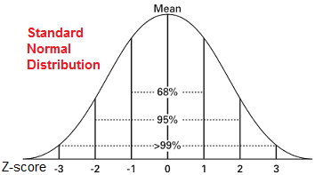
HANDLING missing values and outliers
. To remove the null values, for float data types we use mean of remaining data and for object data types we use mode of remaining data.
Also, the object data types are encoded as then it is easy to operate on the variables.
Now we need to check whether outliers are present in the data or not. For that we need to check if the z value/z score of all the factors is exceeding the range (-3,3). As we want the data to be normally distributed in the range of (-3,3) as the data be in the 99% domain. Thus, this will be the best data to work with.

Slide 7

Data Input-output relationship
Now here we know that there are 80 independent variables which are contributing to predict the dependent variable that is the Sale Price of House. Here the relationship is of Linear Regression.
Thus, assuming they follow a linear regression model, the relationship between the input variables or independent variables and the output variable or dependent variable is:
where Xi is the explanatory/80 independent variables and Yi is the dependent variable/Sale Price. f is the function, Beta is the unknown parameters and ei is the error terms.

Slide 8
CORRELATION
Correlation is a statistical term describing the degree to which two variables move in coordination with one another. If the two variables move in the same direction, then those variables are said to have a positive correlation. If they move in opposite directions, then they have a negative correlation. Here we see the below relationship
We see that the factors affecting the House Sale Price are OverallQual,GrLivArea,GarageCars,GarageArea But the most important positively affecting factor is OverallQual as it Rates the overall material and finish of the house which is important factor when a person is buying a house. Also, the negative factors affecting the Sale Price is the BsmtQual, ExterQual, KitchenQual and GarageFinish

Slide 9
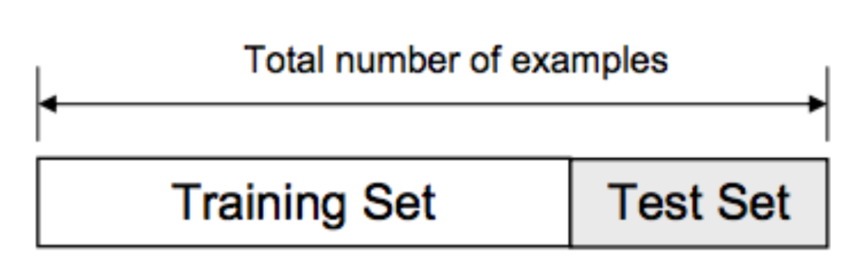
Data splitting for building model
Using the random state, we divide the training and testing data in the ratio of 0.8 and 0.2 meaning 20% of the data is the testing data and training data is 80%
As the total data is of 564 data points,
Train data=451
Test data=113

Slide 10
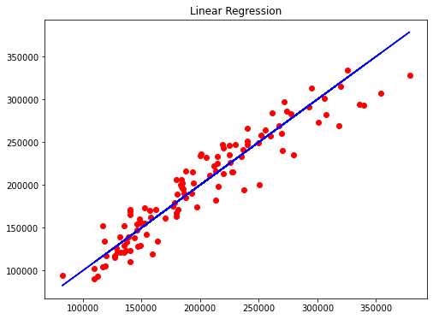
MODEL OUTPUT
Here we see that our data points are in line with the blue line which is the ideal line or slope of the linear regression equation. Thus, this shows that the model is perfectly fitted, neither under fitted nor over fitted.
Here the model accuracy is almost the same to 89.05% but the cross-validation score is increased to 87.34% which is close to the model accuracy which means that the model is not over fitted.

Slide 11
Predicting the Sale Price for the provided test data
First, we have to handle the missing/null values and data pre-processing is done then this data is then fed into the trained model and we get the output.
We got the housing prices for the provided test data

Slide 12
CONCLUSION
We dissected each variable to check in the event that information is cleaned and ordinarily distributed. We cleaned the information and evacuated NA values. We tried to find the correlation and based on the outcomes, we accepted whether or not there's a relation between the Sale Price of the house and the other factors, we see that the factors affecting the House Sale Price are OverallQual,GrLivArea,GarageCars,GarageArea But the most important positively affecting factor is OverallQual as it Rates the overall material and finish of the house which is important factor when a person is buying a house. Also, the negative factors affecting the Sale Price is the BsmtQual, ExterQual, KitchenQual and GarageFinish. We used the linear regression model to predict the Sale Price of House.
We got a very good model with an 89% accuracy which is very good. Just a disadvantage that the data available to train the model is little less and thus needs to be improved. The more the data the better the model will be trained.
This model will be used by the management to understand how exactly the prices vary with the variables. They can accordingly manipulate the strategy of the firm and concentrate on areas that will yield high returns. Further, the model will be a good way for the management to understand the pricing dynamics of a new market.

