Slide 1

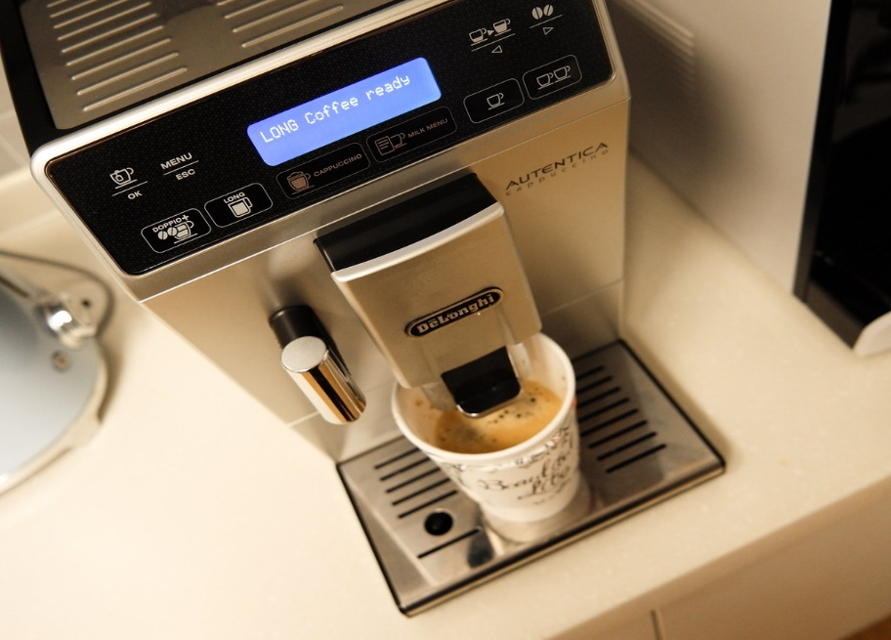
Coffee Machine
Presented By Under the guidance of
Shailaja Dhumale Mrs. Pavithra

Slide 2



Slide 3
A coffee that you don’t have to make yourself. It’s enough to press a couple of buttons on the machine and you get a cup of energy; but first, we should teach the machine how to do it.In this project, you will work on programming a coffee-machine simulator.
The machine works with quite typical products:Coffee, milk, sugar, and plastic cups.If it runs out of something, it shows a notification.The machine can make three types of coffee: espresso, cappuccino, and latte.Since nothing’s for free, it also collects the money.
The coffee vending machine mixes the instant powder such as coffee, tea, juice, chocolate to different tastes delicious beverage.
It is with entire stainless steel structure, large capacity, coin recognizer, automatic cups fall, digital sales calculation, adjustment of drink taste, simple to use.

Slide 4


Slide 5
How does a coffee machine work?
The instant coffee – or, for that matter, tea, chocolate or other powder – is stored in containers within the machine. The user makes a payment and a measured amount of the appropriate powder is dispensed into a cup and mixed with water (and milk and/or sugar if these options are selected).

Slide 6
Existing System :
In Offices daily numbers of cups of tea/coffee are consumed, there is no record of number of cup consumed in a day, and number of cup consumed by a particular person.
In this way lots of wastage occurs every day. This problem of wastage can be reduced or stop by using this project.
Proposed System : To reduce human interface and provide security by Automation of machine using modern technologies and waste reduction.
To add the security feature the consumer is provided with card which is fed with consumer id.
Whole information of that user is fed to that smart card so the details of the consumer through this card is digitally recorded and updated to the company database.

Slide 7
Software Requirements :
Core Java
Eclipse
Minimum Hardware Requirements :
Processor : Pentium IV 1Ghz
Hard disk : 80GB (Optional)
RAM :1GB

Slide 8


Slide 9
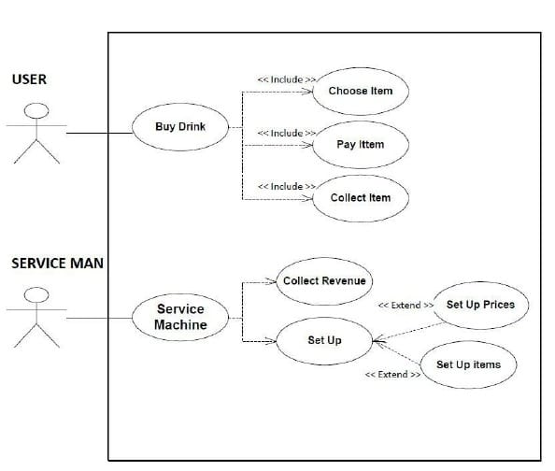
UseCase Diagram

Slide 10
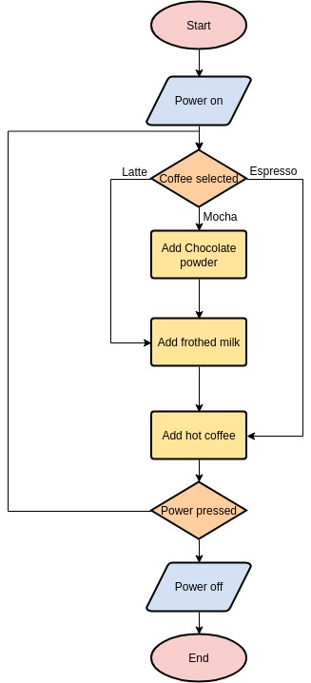
Flow Diagram

Slide 11


Slide 12
Coffee Machine:
Automatic espresso machines provide you - cup after cup - coffee made from coffee beans, freshly ground at the touch of a button. From a shot of espresso to a café , cappuccino or latte macchiato with fresh frothed milk from the integrated milk . And options to customize your coffee every step of the way.
A coffee maker is a device that makes the coffee brewing process simple. These are available with many variants ranging from fully automatic espresso machines to simple kettle drip.

Slide 13
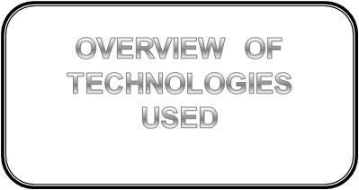

Slide 14
JAVA : It is a simple programming language. Java makes writing, compiling, and debugging programming easy.
On November 13, 2006, Sun released much of its Java virtual machine as free, open-source software. On May 8, 2007, Sun finished the process, making all of its JVM’s core code available under open-source distribution terms.
The principles for creating java were simple, robust, secured, high performance, portable, multi-threaded, interpreted, dynamic, etc. In 1995 Java was developed by James Gosling, who is known as the Father of Java.
Currently, Java is used in mobile devices, internet programming, games, e-business, etc.
It helps to create reusable code and modular programs. Java is a class-based, object-oriented programming language and is designed to have as few implementation dependencies as possible.
A general-purpose programming language made for developers to write once run anywhere that is compiled Java code can run on all platforms that support Java.
Java applications are compiled to byte code that can run on any Java Virtual Machine. The syntax of Java is similar to c/c++.

Slide 15
Eclipse : Eclipse is one of the most popular open source Java IDEs available today. Most Java developers use Eclipse more than any other Java tool available on the internet.
The Eclipse Foundation allows development by providing the infrastructure, and a structured process of development. The Eclipse Foundation has built its open source community and ecosystem of products and services since 2001.
Eclipse IDE (integrated development environment) for Java has been the leading development environment with a market share of 65% as of today.
It can be extended with an additional software component. Eclipse calls these software components as plugins, which can grouped into features.
Many companies have extended Eclipse IDE on top of the Eclipse framework. It is also available as IDE for other languages.

Slide 16


Slide 17
Integration and Testing
Integration
Integration is all about combining the individual parts of the system and making the system into a single unit. Here in this “Coffee Machine” we are combining the modules.
Testing
1. Compilation Test: Stress testing is done early on, because it gives us time to fix some of the unexpected deadlocks and stability problems that only occur when components are exposed to very high transaction volumes.
2. Execution Test: The program is successfully loaded and executed with no execution errors. The complete performance of the project “Coffee Machine” is good.

Slide 18



Slide 19
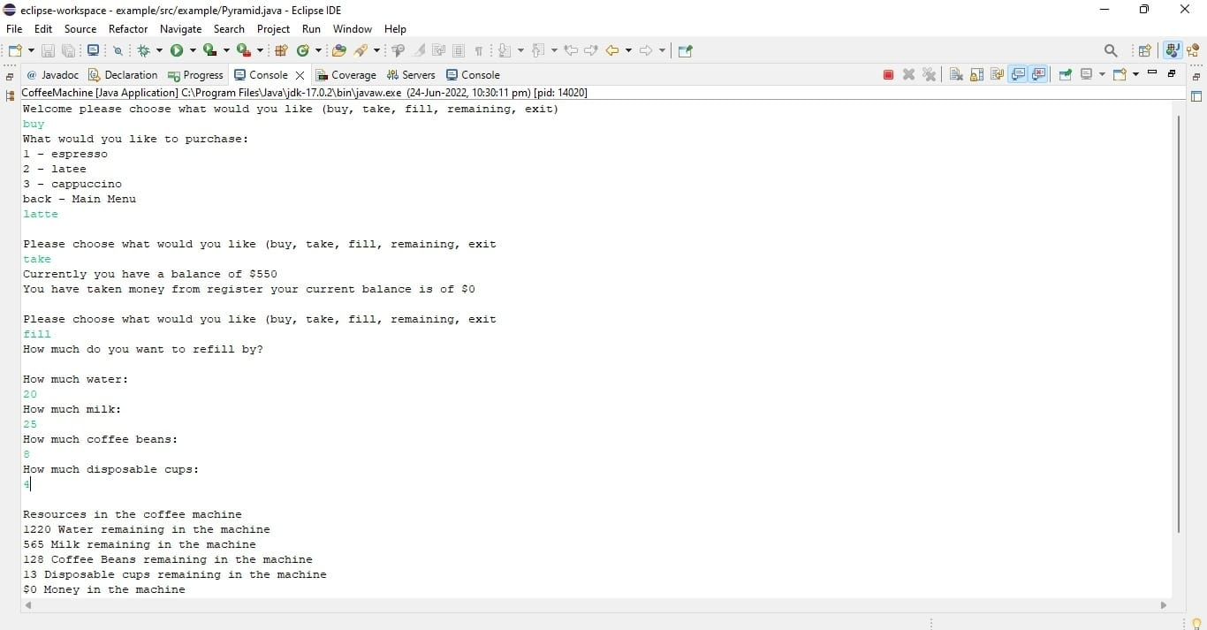
Output :

Slide 20
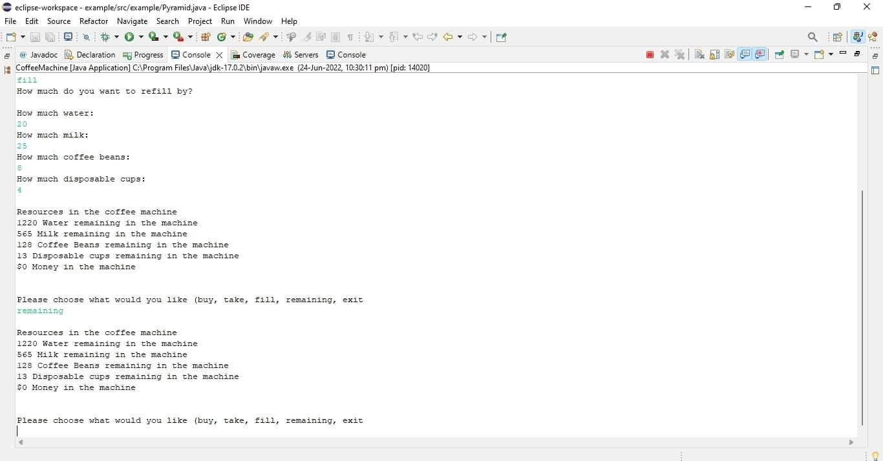

Slide 21


Slide 22
Conclusion :
when we realize that we have all made a code that could actually work as a user friendly coffee machine.
This code can actually provide a variety of options to user and also return balance money for customer.
This verilog code has been successfully verified using the tool and the desired outputs have been achieved .
Coffee machines System enhances productivity ,reduces system development cost and acceleres tome to market.
Coffee machine give fast response and easy use by an ordinary person.

Slide 23
Future Scope

Slide 24
Future coffee machines are expanding their selections.
Some machines are simply stocking healthy drinks.
Sometimes coffee machines expand to include obscure drinks.
Occasionally a futuristic coffee machine will provide high-quality basics that every person needs and drinks with on a daily basis.
We can implement frontend and backend in this project as of now I have created only console based project where I can do crud operation.

Slide 25
Future vending machines are expanding their selections.
Some machines are simply stocking healthy items.
Sometimes vending machines expand to include obscure food items.
Occasionally a futuristic vending machine will provide high-quality basics that every person needs and cooks with on a daily basis

Slide 26
References

Slide 27
https://www.javapoint.com/how-to-use-eclipse-for-java
https://www.javapoint.com/file-operations-in-java
https://www.w3schools.com/java/java inheritance.asp

Slide 28

Thank You

