Slide 1
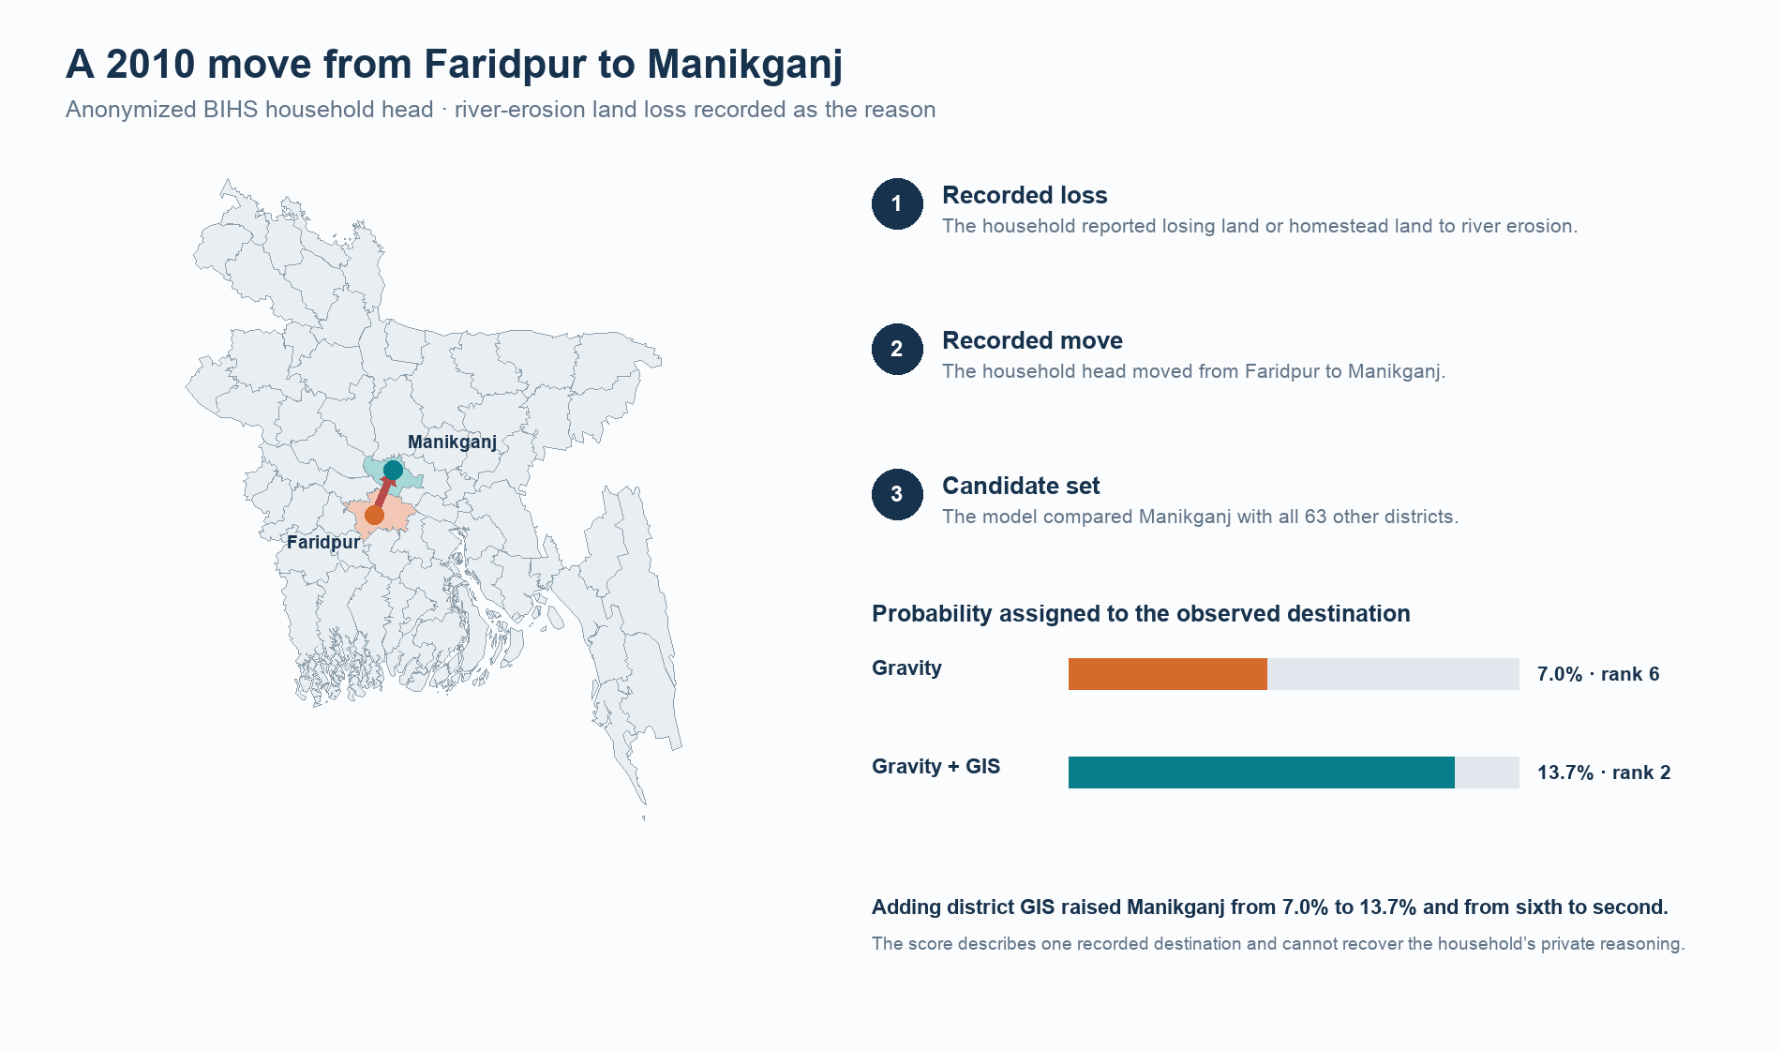
BANGLADESH • CLIMATE MOBILITY
Where do climate-affected households go?
Revealed destination choice after flood and river erosion
Shail Belani • Undergraduate Researcher
Northwestern University
01
Notes:
Open with the household, not the model. One surveyed household lost land and a homestead to river erosion, then moved from Faridpur to Manikganj in 2010. The study asks why that district became the destination.
[Sources]
Local frozen output: outputs/figures/anonymized_household_destination_story.png
BIHS public-use surveys: https://doi.org/10.7910/DVN/OR6MHT
[/Sources]

Slide 2
ONE ANONYMIZED HOUSEHOLD
A lost homestead became a destination decision
River erosion
Move in 2010
Manikganj chosen
The survey records loss of land or homestead as the reason for moving.
The household leaves Faridpur. Its exact address and identity remain private.
Among 64 districts, the GIS model ranks the observed destination 2nd; gravity ranks it 6th.
Observed-destination probability: 7.0% gravity → 13.7% GIS
02
Notes:
This is the central human story. The probabilities are out-of-fold predictions, so the model did not train on this household when scoring it. The example illustrates prediction, not a causal claim about why the family moved.
[Sources]
Local frozen out-of-fold prediction table and figure: outputs/figures/anonymized_household_destination_story.png
BIHS migration module documentation: https://doi.org/10.7910/DVN/OR6MHT
[/Sources]

Slide 3
EMPIRICAL DESIGN
The test is simple: can destination geography beat distance?
1 Observe a move
2 Offer 64 districts
3 Score the choice
BEMP and BIHS identify an origin district, an observed destination district, and a migration event.
Every Bangladeshi district is a candidate. The baseline uses distance and population; the expanded model adds GIS measures.
Grouped cross-validation asks how much probability each model assigns to the destination that was actually chosen.
Households stay in one fold; harder tests also withhold whole origins and a later wave.
03
Notes:
The comparison is between a transparent distance-population baseline and a GIS-expanded conditional logit. Main estimates group validation folds by household. Separate origin-held-out and later-wave tests ask whether the destination utility travels. The outcome is observed district choice conditional on moving, not whether a household moves.
[Sources]
Local methods and frozen claims: publication/manuscript/manuscript.md
Radiation model: https://doi.org/10.1038/nature10856
Global Human Settlement Layer: https://doi.org/10.2760/098587
[/Sources]

Slide 4
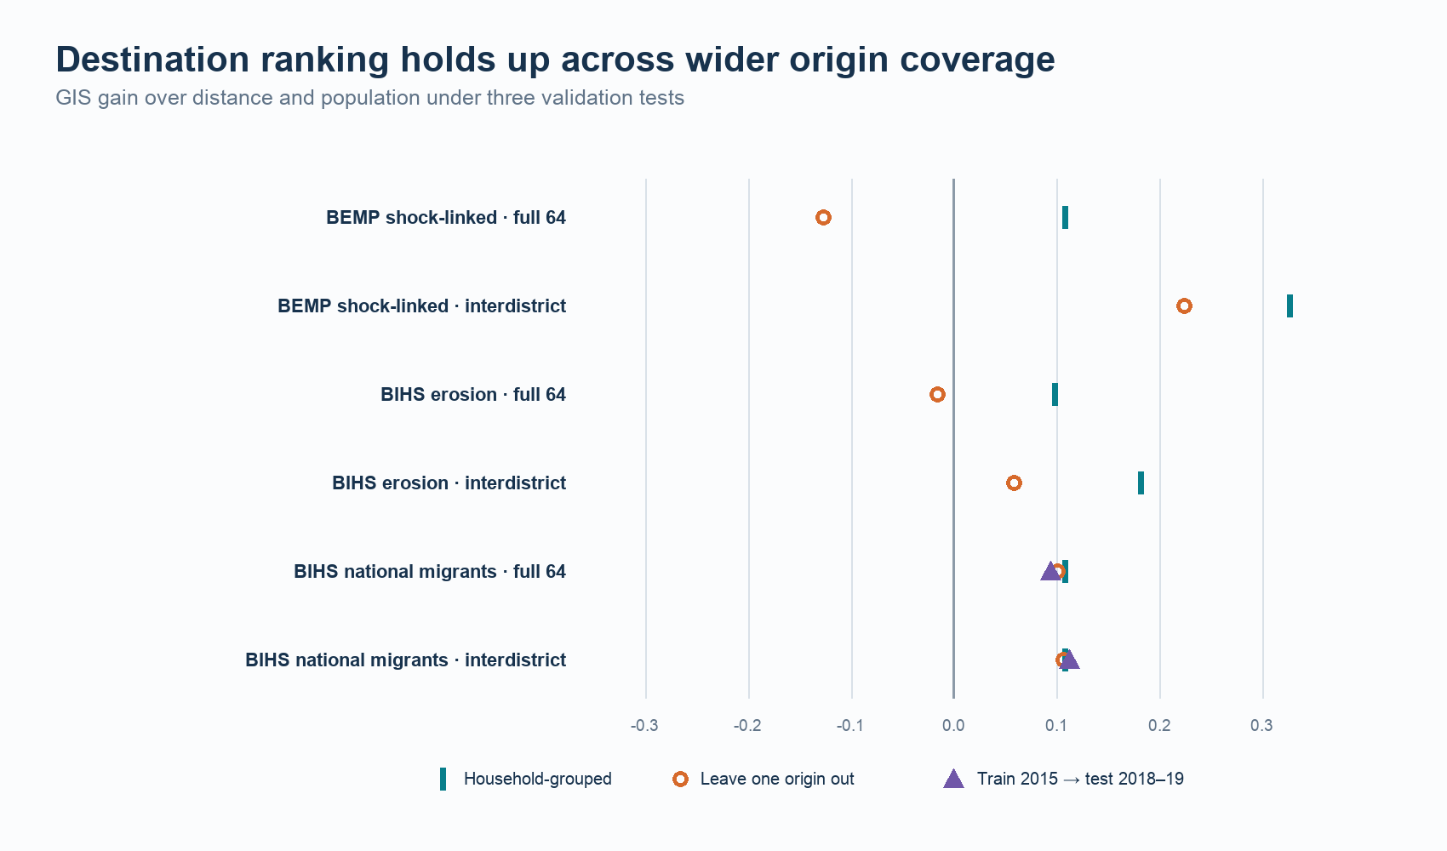
INDEPENDENT REPLICATION
The BIHS result survives unseen origins and a later wave
+0.101
Leave one origin out
1,857 BIHS migrants
+0.094
Train 2015, test 2018–19
1,383 later-wave migrants
Held-out log-loss improvement over fitted gravity. Positive values favor GIS.
04
Notes:
Lead with the independent BIHS transport result. The sample covers all 64 origin districts. GIS retains a 0.101 log-loss gain when each test origin is removed from training and a 0.094 gain when a 2015 model predicts 2018–19 migrants. These are not climate-labeled migrants; they test geographic and temporal portability of the destination specification.
[Sources]
Local validation output: outputs/tables/bihs_replication_validation.csv
BIHS public-use data: https://doi.org/10.7910/DVN/OR6MHT
[/Sources]

Slide 5
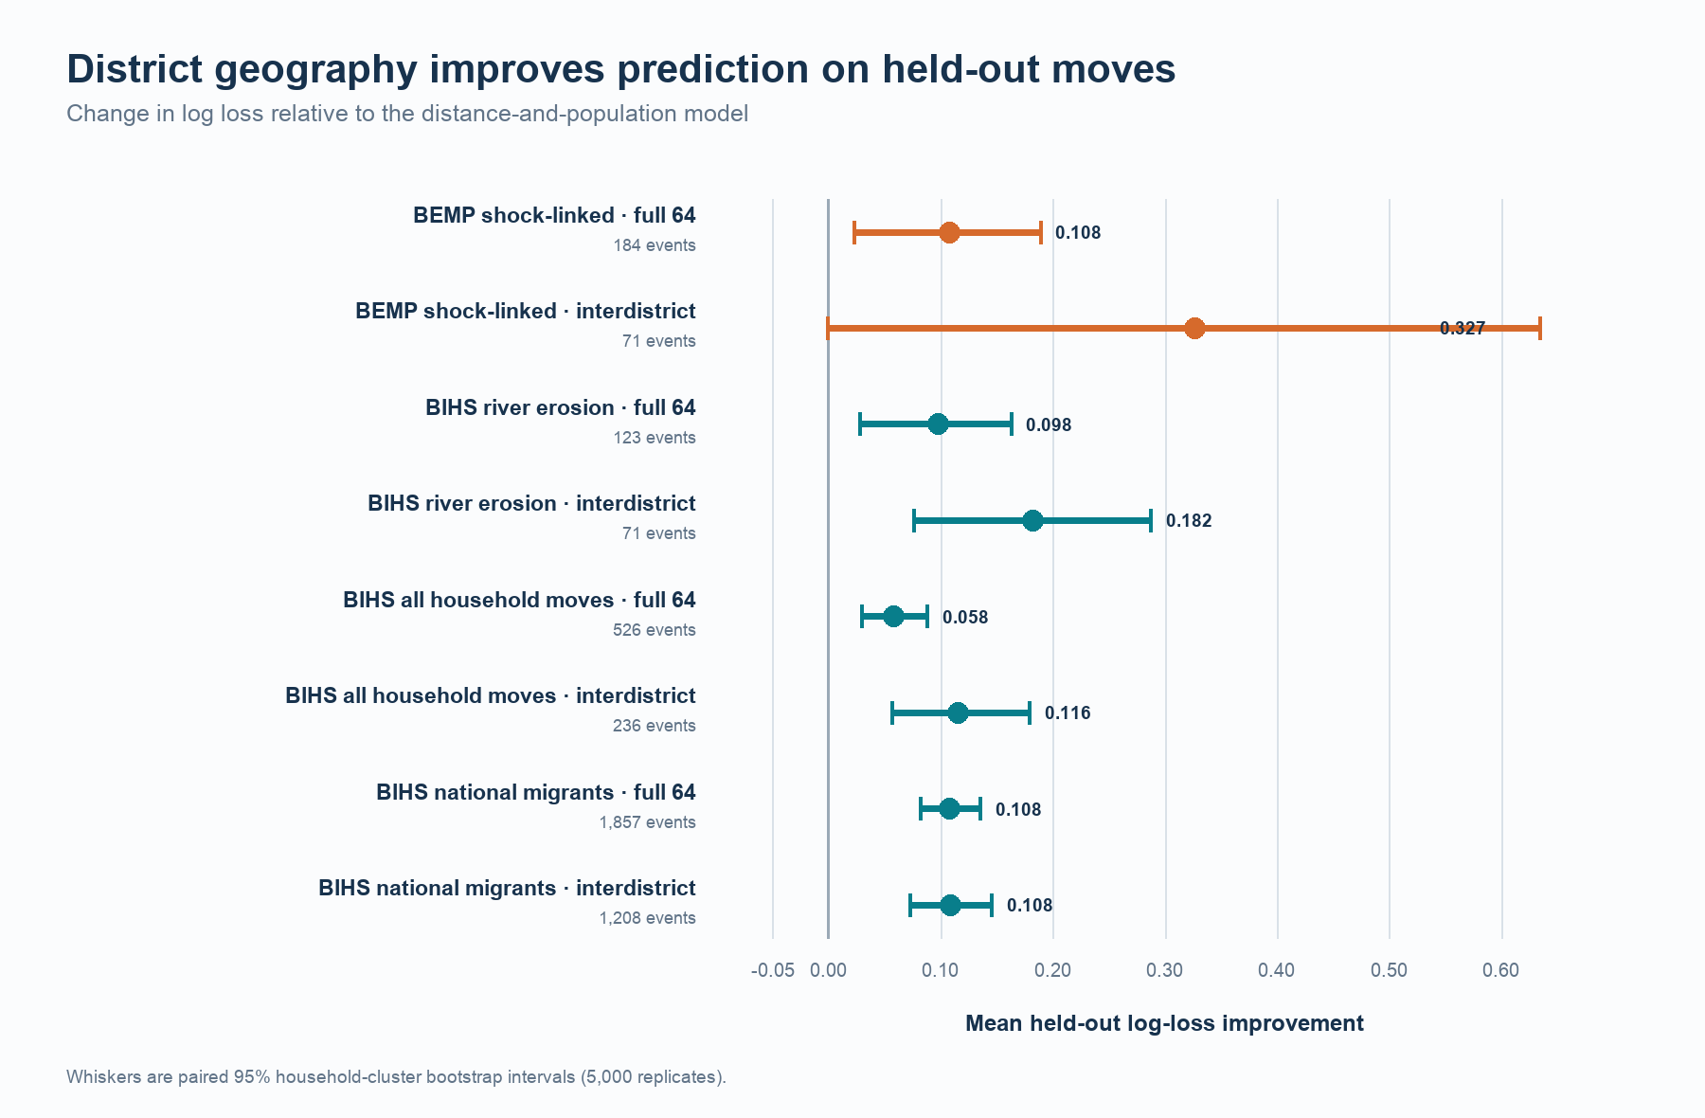
CLIMATE-SPECIFIC EVIDENCE
Two climate samples reproduce the grouped gain
Same model, different surveys
BIHS erosion moves: +0.098 across 123 relocations from 29 origins.
BEMP shock-linked moves: +0.108 across 184 later relocations from 7 origins.
05
Notes:
The climate-specific samples use the same destination outcome and fixed feature set. BIHS independently identifies erosion-related land loss as the move reason; BEMP provides the stronger sequence from a recorded shock to a later relocation. Prior BEMP research asks whether shocks change migration likelihood, type, or distance. This project conditions on a move and predicts its district.
[Sources]
Local frozen summary: outputs/tables/cross_dataset_replication_summary.csv
BEMP public-use data: https://doi.org/10.5281/zenodo.18229498
BIHS public-use data: https://doi.org/10.7910/DVN/OR6MHT
Existing BEMP incidence paper: https://doi.org/10.1007/s11111-025-00478-7
[/Sources]

Slide 6
WHAT THIS STUDY CANNOT YET ANSWER
The result sharpens the next measurement problem
GIS describes candidate districts before the move. The surveys reveal less about the household-specific ties that made one candidate reachable.
Networks
Resolution
Interpretation
1,815 of 1,857 BIHS interval migrants report friends or family help at destination, but that measure is recorded after the choice.
Public geography is district-level. The model cannot distinguish neighborhoods, villages, or exact addresses.
These are out-of-sample predictions. They do not identify the causal effect of any single GIS feature.
06
Notes:
The network statistic is substantively striking but post-choice, so it is excluded from the predictive specification. A future survey should measure pre-move ties and household-specific access to land, housing, and jobs across the candidate set.
[Sources]
Local audited statistic: publication/qa/manuscript_number_registry.csv
Local limitations: publication/manuscript/manuscript.md
[/Sources]

Slide 7
WHAT WE NOW KNOW
After a climate-linked move, destination geography still matters.
Distance matters, but it is not enough. Across two public household surveys, the geography of candidate destinations improves prediction of where movers actually go.
Next: measure pre-move social ties, housing, land, and jobs for every plausible destination.
07
Notes:
Return to the household. The study cannot tell us every reason Manikganj was possible, but it shows that destination geography contains predictive information beyond distance. The next data collection should make household-destination links observable before the move.
[Sources]
Local claim sheet: publication/claim_sheet.md
Local paper: publication/manuscript/manuscript.md
[/Sources]

