Slide 1

RESULTS
Discussions

Slide 2
Result of Hashtag counting

Slide 3
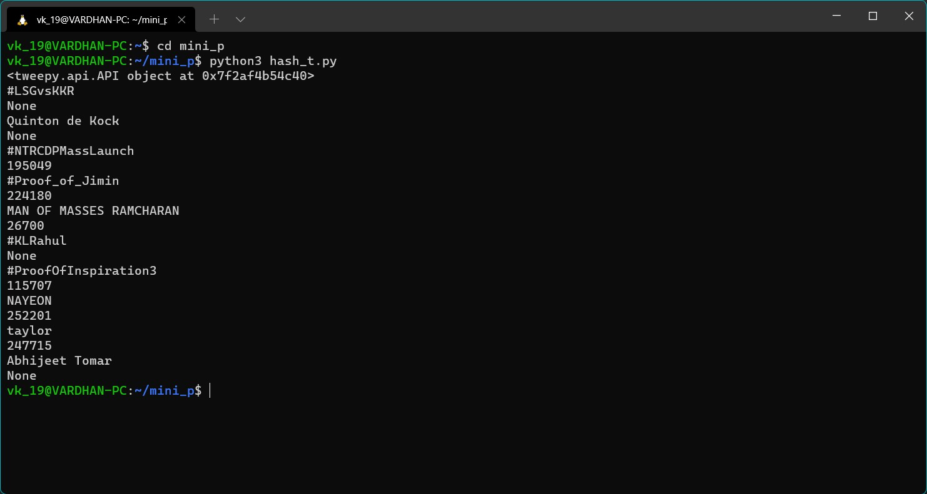

Slide 4
Result of Jaccard Similarity

Slide 5
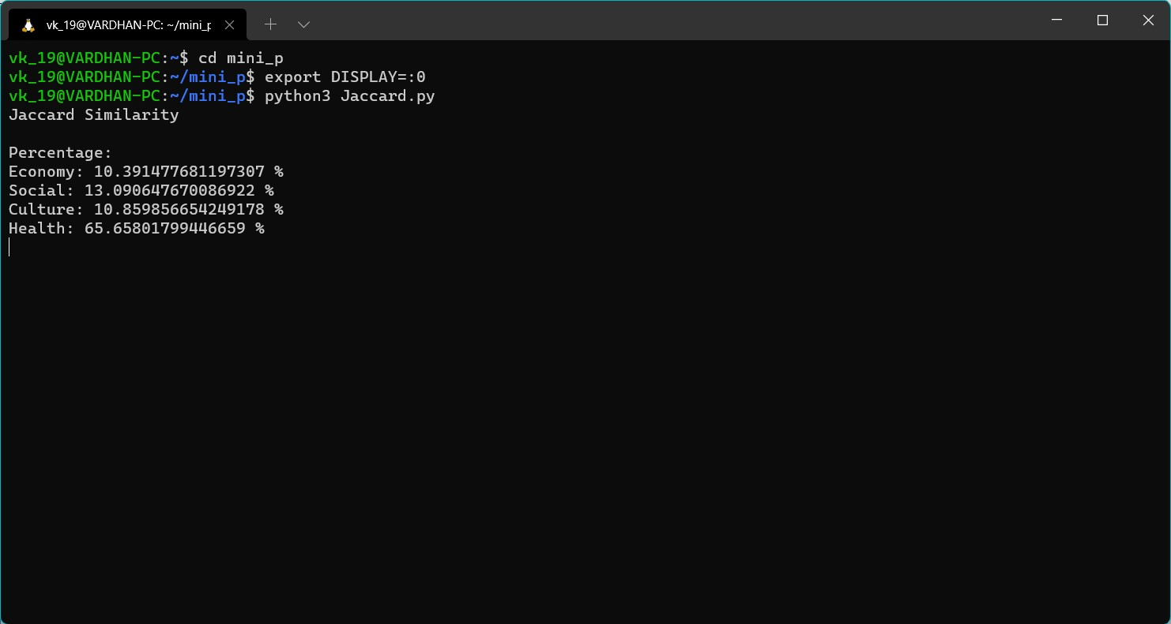

Slide 6
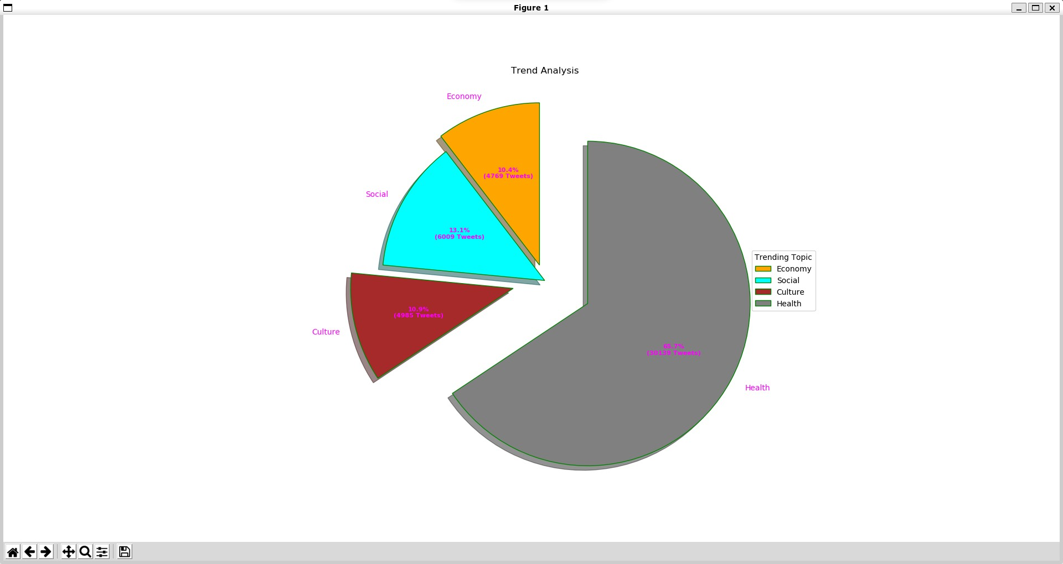

Slide 7
Result of Cosine Similarity

Slide 8
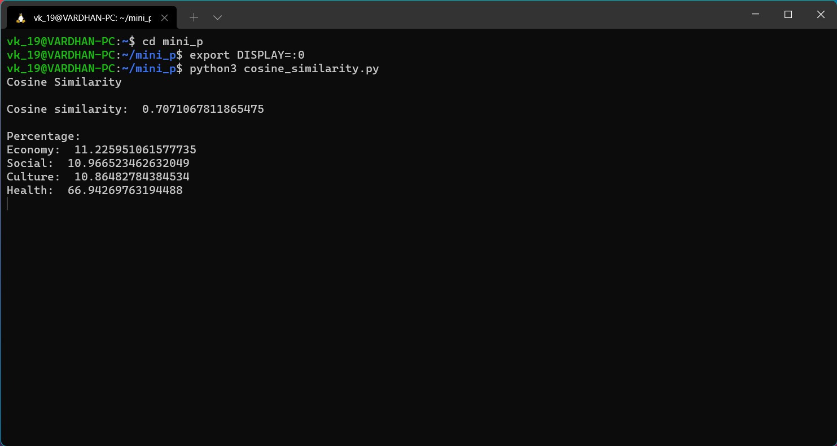

Slide 9
